Slide 1






David the Deliverer
1 SAMUEL 23-24
Linder Road Church of Christ - 4th Quarter 2024
CREDITS: This presentation template was created by Slidesgo, and includes icons by Flaticon and infographics & images by Freepik
Notes:
<In the second chapter of his book Up from Slavery, Booker T. Washington wrote, "I have learned that success is to be measured not so much by the position that one has reached in life as by the obstacles which he has overcome while trying to succeed." Measured by this standard-and it's a valid one-David was a very successful man. For ten years he was considered an outlaw, yet he fought the Lord's battles and delivered Israel from her enemies. He lived with his faithful men in the forsaken places of the land and often had to flee for his life, yet he knew that the Lord would finally deliver him and give him the promised throne. David's coronation was not only important to the people of Israel; it was important to all the people of God of every age. For out of David's family the Redeemer would ultimately come, Jesus of Nazareth, the Son of David, the Son of God.>

Slide 2



Contact Us

Slide 3

01
David delivers Keilah from the Philistines
Notes:
<Keilah was a border town in Judah, about twelve miles from the Philistine city of Gath and some ten miles west of the forest of Hereth where David and his men were camping (22:5). Situated that close to the enemy, Keilah was extremely vulnerable, especially during the harvest season when the Philistine army was searching for food. Had King Saul been concerned about defending his people instead, he would have sent a detachment of soldiers to protect Keilah, but he was obsessed with finding David and killing him.
The spies of both David and Saul were active in the land, and David's spies reported that the Philistines were attacking Keilah. David paused to determine the will of God, a practice every leader needs to imitate, for it's easy for our own personal interests to get in the way of God's will. How did David discover God's will when Abiathar the priest hadn't yet arrived in the camp? (23:6) The prophet Gad was with David (22:5), and it's likely that he prayed to the Lord for direction. Once Abiathar arrived with the ephod, David had him inquire of the Lord when there were important decisions to make (v. 9; 25:32; 26:11, 23). Footnote1
Footnote 1:David himself was called a prophet (2 Sam. 23:2; Acts 4:25), but this gift seems to have been used primarily in the writing of the Psalms, especially those that speak about the Messiah.>

Slide 4
1 Samuel 23:1-6
1 Then they told David, saying, “Behold, the Philistines are fighting against Keilah and are plundering the threshing floors.” 2 So David inquired of the Lord, saying, “Shall I go and attack these Philistines?” And the Lord said to David, “Go and attack the Philistines and deliver Keilah.” 3 But David’s men said to him, “Behold, we are afraid here in Judah. How much more then if we go to Keilah against the ranks of the Philistines?” 4 Then David inquired of the Lord once more. And the Lord answered him and said, “Arise, go down to Keilah, for I will give the Philistines into your hand.” 5 So David and his men went to Keilah and fought with the Philistines; and he led away their livestock and struck them with a great slaughter. Thus David delivered the inhabitants of Keilah.
6 Now it came about, when Abiathar the son of Ahimelech fled to David at Keilah, that he came down with an ephod in his hand.
1 Samuel 23:1-6 (NASB)
Notes:
ADAM
Similar motif to where we find Gideon: Threshing Wheat. Why attack Threshing Floors? Cause they are not well protected…when you wanted to protect something you put walls around it. That is the antithesis of Threshing floors. You needed wind to be able to winnow the grain (use winds to separate the chaff from the grain head.
ART
<Once David got the go-ahead signal from the Lord, he mobilized his men, but they weren't too enthusiastic about his plans. It was acceptable to fight the Philistines, Israel's long-time enemies, but they didn't want to fight their own Jewish brothers. What if Saul turned against David and his men? The band of 600 men would then be caught between two armies! Unwilling to impose his own ideas on his men, David sought the Lord's will a second time, and once again he was told to go rescue the people of Keilah. It wasn't David's unbelief that created the problem, because he had faith in the Lord, but the fear in the hearts of his men made them unprepared for battle.
God more than kept His promise because He not only helped David slaughter the invading Philistines but also take a great amount of spoil from them. David moved into Keilah, which was a walled city, and it was there that Abiathar went when he fled from Nob carrying the precious ephod (22:20-23; 23:6). But Saul's spies were at work and learned that David was now in Keilah, a walled city with gates. Saul told his troops they were going to Keilah to rescue the city, but his real purpose was to capture David, and he was certain that David could not escape. Saul was not only willing to slaughter the priests of Nob, but he would have destroyed his own people in the city of Keilah just to lay hands on David. People who are controlled by malice and hatred quickly lose their perspective and begin to abuse their authority.

Slide 5


Slide 6
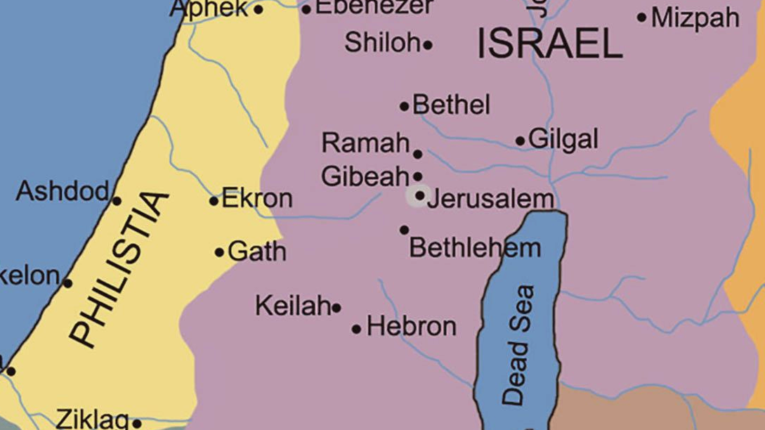
Adullam
Hereth
Notes:
Adam
Keilah is really not that far from Adullam or Hereth.

Slide 7
1 Samuel 23:1-6
1 Then they told David, saying, “Behold, the Philistines are fighting against Keilah and are plundering the threshing floors.” 2 So David inquired of the Lord, saying, “Shall I go and attack these Philistines?” And the Lord said to David, “Go and attack the Philistines and deliver Keilah.” 3 But David’s men said to him, “Behold, we are afraid here in Judah. How much more then if we go to Keilah against the ranks of the Philistines?” 4 Then David inquired of the Lord once more. And the Lord answered him and said, “Arise, go down to Keilah, for I will give the Philistines into your hand.” 5 So David and his men went to Keilah and fought with the Philistines; and he led away their livestock and struck them with a great slaughter. Thus David delivered the inhabitants of Keilah.
6 Now it came about, when Abiathar the son of Ahimelech fled to David at Keilah, that he came down with an ephod in his hand.
1 Samuel 23:1-6 (NASB)
Notes:
ADAM
The battle is the Lords to decide. God continues the pattern we’ve seen before: “I will give the X into your hands”
Where did this livestock come from? It was the beast of burden that were going to take the spoils back to Philistia.
From the previous chapter we find out that Abaithar caught up to David at Keilah.

Slide 8
02
David delivers himself and his men from Saul
Notes:
<While serving on Saul's staff, David had dodged the king's spears, thwarted an attempted kidnapping, and escaped the intended violence of three companies of soldiers and of Saul himself. Now that he was a fugitive with a price on his head and had over six hundred people to care for, David had to be very careful what he did and where he went. There might be another Doeg hiding in the shadows.>

Slide 9
1 Samuel 23:7-29
7 When it was told Saul that David had come to Keilah, Saul said, “God has delivered him into my hand, for he shut himself in by entering a city with double gates and bars.” 8 So Saul summoned all the people for war, to go down to Keilah to besiege David and his men. 9 Now David knew that Saul was plotting evil against him; so he said to Abiathar the priest, “Bring the ephod here.” 10 Then David said, “O Lord God of Israel, Your servant has heard for certain that Saul is seeking to come to Keilah to destroy the city on my account. 11 Will the men of Keilah surrender me into his hand? Will Saul come down just as Your servant has heard? O Lord God of Israel, I pray, tell Your servant.” And the Lord said, “He will come down.” 12 Then David said, “Will the men of Keilah surrender me and my men into the hand of Saul?” And the Lord said, “They will surrender you.”
1 Samuel 23:7-12 (NASB)
Notes:
ADAM
“God has delivered him into my hand…” Samuel uses the noun for “God” not “Yahweh”
“Saul summoned all the people.” Summoning the tribes for war is something he has shown an aptitude for in the previous chapters. He was a great military king. But now saul wants to “besiege” a city filled with his own citizens!
While we see David as the Hero that Killed Goliath and is the Coming King. He sees himself as a servant.
Jake Colins brought up an interesting idea around predestination with these verses. David’s choice has an impact he’s not just a puppet on the end of God’s string. He can choose to stay be and caught by Saul and flee.
ART
<From Keilah to the wilderness of Ziph (1 Sam. 23:7-18). David's spies quickly let him know that Saul was planning to come to Keilah, so with Abiathar's help, David sought the Lord's guidance. His great concern was whether the people of Keilah would turn him and his men over to Saul. Since David had rescued the city from the Philistines, you would have expected the citizens to be grateful and to protect David, but such was not the case.' The Lord warned David to get out of the city because the people were prepared to turn him over to the king. No doubt the people of Keilah were afraid that if they didn't cooperate with Saul, he would massacre them as he did the people in Nob. David recalled how pained he was because of the tragedy at Nob, and he didn't want another city wiped out because of him. He led his men out and they "kept moving from place to place" (v. 13, NIV) until they settled in the wilderness of Ziph (v. 14).

Slide 10
1 Samuel 23:7-29
13 Then David and his men, about six hundred, arose and departed from Keilah, and they went wherever they could go. When it was told Saul that David had escaped from Keilah, he gave up the pursuit. 14 David stayed in the wilderness in the strongholds, and remained in the hill country in the wilderness of Ziph. And Saul sought him every day, but God did not deliver him into his hand.
15 Now David became aware that Saul had come out to seek his life while David was in the wilderness of Ziph at Horesh. 16 And Jonathan, Saul’s son, arose and went to David at Horesh, and encouraged him in God. 17 Thus he said to him, “Do not be afraid, because the hand of Saul my father will not find you, and you will be king over Israel and I will be next to you; and Saul my father knows that also.” 18 So the two of them made a covenant before the Lord; and David stayed at Horesh while Jonathan went to his house.
1 Samuel 23:13-18 (NASB)
Notes:
ADAM
We’ve been talking about giving people into other people’s hands.
But “God did not deliver him into his hand”. This is an act of God.
ART
<From Keilah to the wilderness of Ziph (1 Sam. 23:7-18). (cont.) When Saul got the word that David had left Keilah, he called off the attack, but he still sought him day after day and neglected the important affairs of the kingdom. However, the Lord was on David's side and made sure that Saul was never successful in his quest. Ziph was a town fifteen miles southeast of Keilah in "the wilderness of Ziph" which was part of "the wilderness of Judah." This is a destitute area adjacent to the Dead Sea where David's faith and courage were greatly tested. When visitors to the Holy Land see this wilderness area, they often express amazement that David could ever survive living there.
David's beloved friend Jonathan risked his life to visit David in the wilderness and "helped him find strength in God" (v. 16, NIV). This was their last recorded meeting. Jonathan isn't mentioned again in 1 Samuel until 31:2 where we're told he died on the battlefield. Jonathan had no idea that he would be slain before David became king, because he talked with David about their future coregency and renewed with him the covenant they had made (18:8; 20:31). He assured David that God would surely make him king in His good time, and that David would always be delivered from Saul's schemes to capture him. Jonathan admitted that his father knew all these plans.>

Slide 11
Adullam
Hereth
Ziph
Notes:
Adam
Keilah is really not that far from Adullam or Hereth.

Slide 12
1 Samuel 23:7-29
19 Then Ziphites came up to Saul at Gibeah, saying, “Is David not hiding with us in the strongholds at Horesh, on the hill of Hachilah, which is on the south of Jeshimon? 20 Now then, O king, come down according to all the desire of your soul to do so; and our part shall be to surrender him into the king’s hand.” 21 Saul said, “May you be blessed of the Lord, for you have had compassion on me. 22 Go now, make more sure, and investigate and see his place where his haunt is, and who has seen him there; for I am told that he is very cunning. 23 So look, and learn about all the hiding places where he hides himself and return to me with certainty, and I will go with you; and if he is in the land, I will search him out among all the thousands of Judah.”
1 Samuel 23:19-23 (NASB)
Notes:
ADAM
What Saul credits as Cunningness we credit as righteousness and serving the Lord.
HAC-KI-LA
ART From Ziph to the wilderness of Maon (1 Sam. 23:19-28). The Ziphites weren't interested in following God's plan; their great concern was to protect themselves from the rage of King Saul. They knew where David was hiding so they conveyed this important information to Saul, carefully addressing him as "king." This was their way of assuring him that they were loyal to him and not to David. Saul was still manipulating people by making them feel sorry for him (v. 21; 22:8), and this combination of building personal pity and wielding ruthless power seemed to be working. But Saul's character was deteriorating very quickly, while the Lord was molding David into a courageous man of God.
Saul was a good enough warrior to know that he couldn't find David in the wilderness of Judah without some specific directions, so he asked the Ziphites to send him exact details. He wanted to know the hiding places in the rocks and caves that David frequented and the hidden paths that he took. Once he had the map, Saul could search out the area and quickly find his enemy. But David also had his spies working and knew what Saul was doing, and the Lord was watching over the future king. David moved out of the area of Ziph and three miles south into the wilderness of Maon.

Slide 13
1 Samuel 23:7-29
24 So they set out and went to Ziph ahead of Saul. Now David and his men were in the Desert of Maon, in the Arabah south of Jeshimon. 25 Saul and his men began the search, and when David was told about it, he went down to the rock and stayed in the Desert of Maon. When Saul heard this, he went into the Desert of Maon in pursuit of David.
26 Saul was going along one side of the mountain, and David and his men were on the other side, hurrying to get away from Saul. As Saul and his forces were closing in on David and his men to capture them, 27 a messenger came to Saul, saying, “Come quickly! The Philistines are raiding the land.” 28 Then Saul broke off his pursuit of David and went to meet the Philistines. That is why they call this place Sela Hammahlekoth. 29 And David went up from there and lived in the strongholds of En Gedi.
1 Samuel 23:24-29 (NASB)
Notes:
ADAM
What Saul credits as Cunningness we credit as righteousness and serving the Lord.
HAC-KI-LA
ART From Ziph to the wilderness of Maon (1 Sam. 23:19-28). (cont.) But Saul wasn't about to give up, so he followed David into the wilderness of Maon, and the two armies met at "the rock," a well known mountain in the area. Saul divided his army and sent half around one side of the mountain and half around the other side, a pincers movement that would have meant total defeat for David and his 600 soldiers. But the Lord was in control and brought the Philistines to attack somewhere in Judah, and Saul and his men had to abandon the attack. It was a close call for David, but God kept His promises. To commemorate this great escape, the Jews called the place "Sela Hammahlekoth," which means "the rock of parting." The Hebrew carries the idea of "a smooth rock" and therefore "a slippery rock," in other words, "the rock of slipping away." David quickly moved from Maon to Engedi, next to the Dead Sea, a place of safety with an ample water supply.
David wrote Psalm 54 on this occasion and in it prayed for salvation and vindication from the Lord. David knew that the flatterers in Saul's official circle, people like Doeg, were telling lies about him and making it look as though David wanted to kill the king. These fawning toadies were hoping to be rewarded by Saul, but they only went down in defeat because they gave allegiance to the wrong king. Leaders who enjoy flattery and praise, and who encourage and reward associates who seek only to gratify their leader's ego, can never build other leaders or accomplish the will of God to the glory of God. David developed officers who were "mighty men" (1 Chron. 21; 2 Sam. 24), but Saul attracted officers who were moral weaklings. "Therefore by their fruits you will know them" (Matt. 7:20).

Slide 14
03
David delivers Saul from Death
Notes:
<David had prayed in Psalm 54 that the Lord would vindicate him and give him opportunity to prove to Saul that he wasn't an outlaw who was trying to kill him and seize the throne. After all, Saul was not only David's king, but he was also his commander and his father-in-law, and regardless of Saul's evil attitude, David never considered Saul to be his enemy. Footnote 3. (See the inscription of Ps.18.) God answered David's prayer when Saul and his troops came to find him at Engedi.>

Slide 15
1 Samuel 24:1-22
1 Now when Saul returned from pursuing the Philistines, he was told, saying, “Behold, David is in the wilderness of Engedi.” 2 Then Saul took three thousand chosen men from all Israel and went to seek David and his men in front of the Rocks of the Wild Goats. 3 He came to the sheepfolds on the way, where there was a cave; and Saul went in to relieve himself. Now David and his men were sitting in the inner recesses of the cave. 4 The men of David said to him, “Behold, this is the day of which the Lord said to you, ‘Behold; I am about to give your enemy into your hand, and you shall do to him as it seems good to you.’” Then David arose and cut off the edge of Saul’s robe secretly. 5 It came about afterward that David’s conscience bothered him because he had cut off the edge of Saul’s robe.
1 Samuel 24:1-5 (NASB)
Notes:
5 times Davids force 3000 vs 600

Slide 16
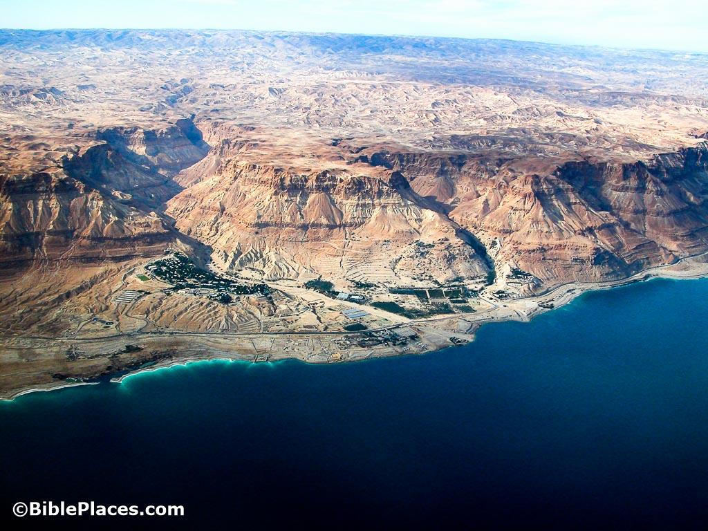
En Gedi
En Gedi is the largest oasis along the western shore of the Dead Sea. The springs here have allowed nearly continuous inhabitation of the site since 3500 BC. The area was allotted to the tribe of Judah, and was famous in the time of Solomon (Josh 15:62).

Slide 17
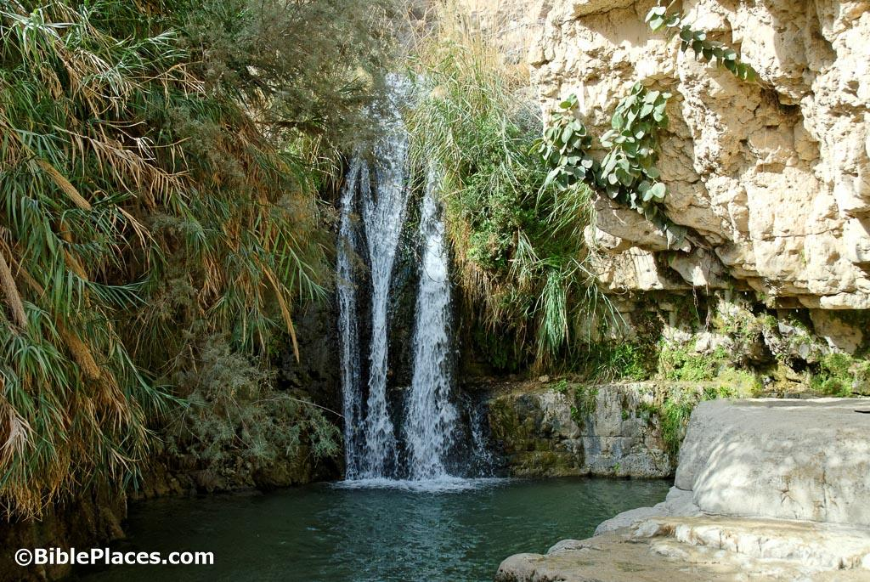
En Gedi
Even though there are many springs around the Dead Sea, most of them have a high salt content. En Gedi is one of only two freshwater springs located on the western shore of the Dead Sea and, because of the greater availability of land for agriculture at En Gedi, it is the best spring by which to settle.
Notes:
ADAM
Josephus praised En Gedi for its palm trees and balsam, and the writer of Ecclesiasticus spoke of wisdom that was exalted “like a palm tree in En Gedi” (24:14). One day, the prophet Ezekiel predicted, fishermen would line the shores of the Dead Sea by En Gedi (47:10)

Slide 18
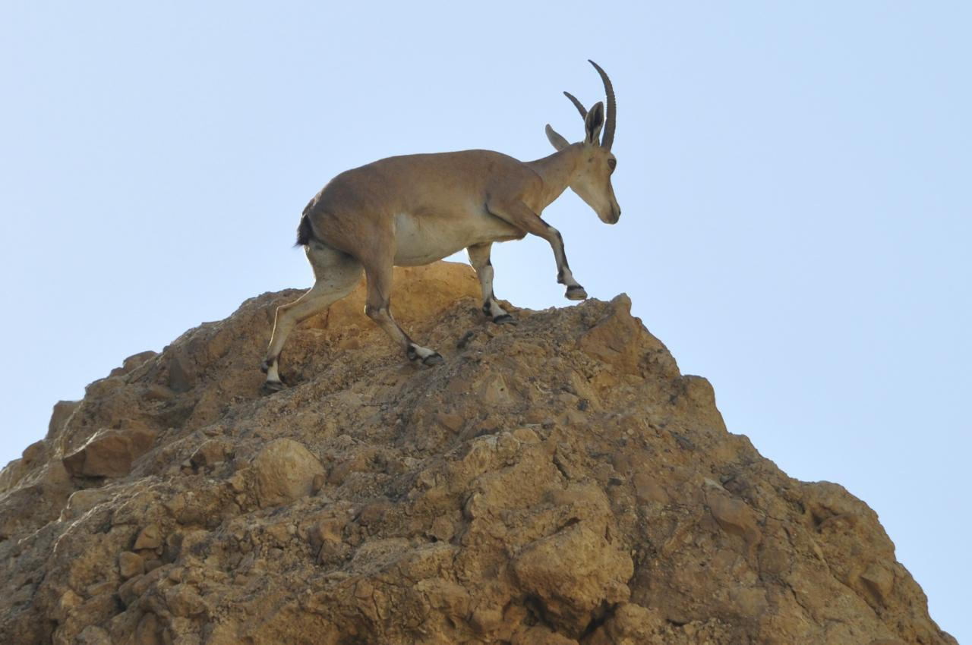
En Gedi
En Gedi means literally
“the spring of the goat.”
Evidence exists that young ibex have always lived near the springs of En Gedi.
Notes:
ADAM
Josephus praised En Gedi for its palm trees and balsam, and the writer of Ecclesiasticus spoke of wisdom that was exalted “like a palm tree in En Gedi” (24:14). One day, the prophet Ezekiel predicted, fishermen would line the shores of the Dead Sea by En Gedi (47:10)

Slide 19
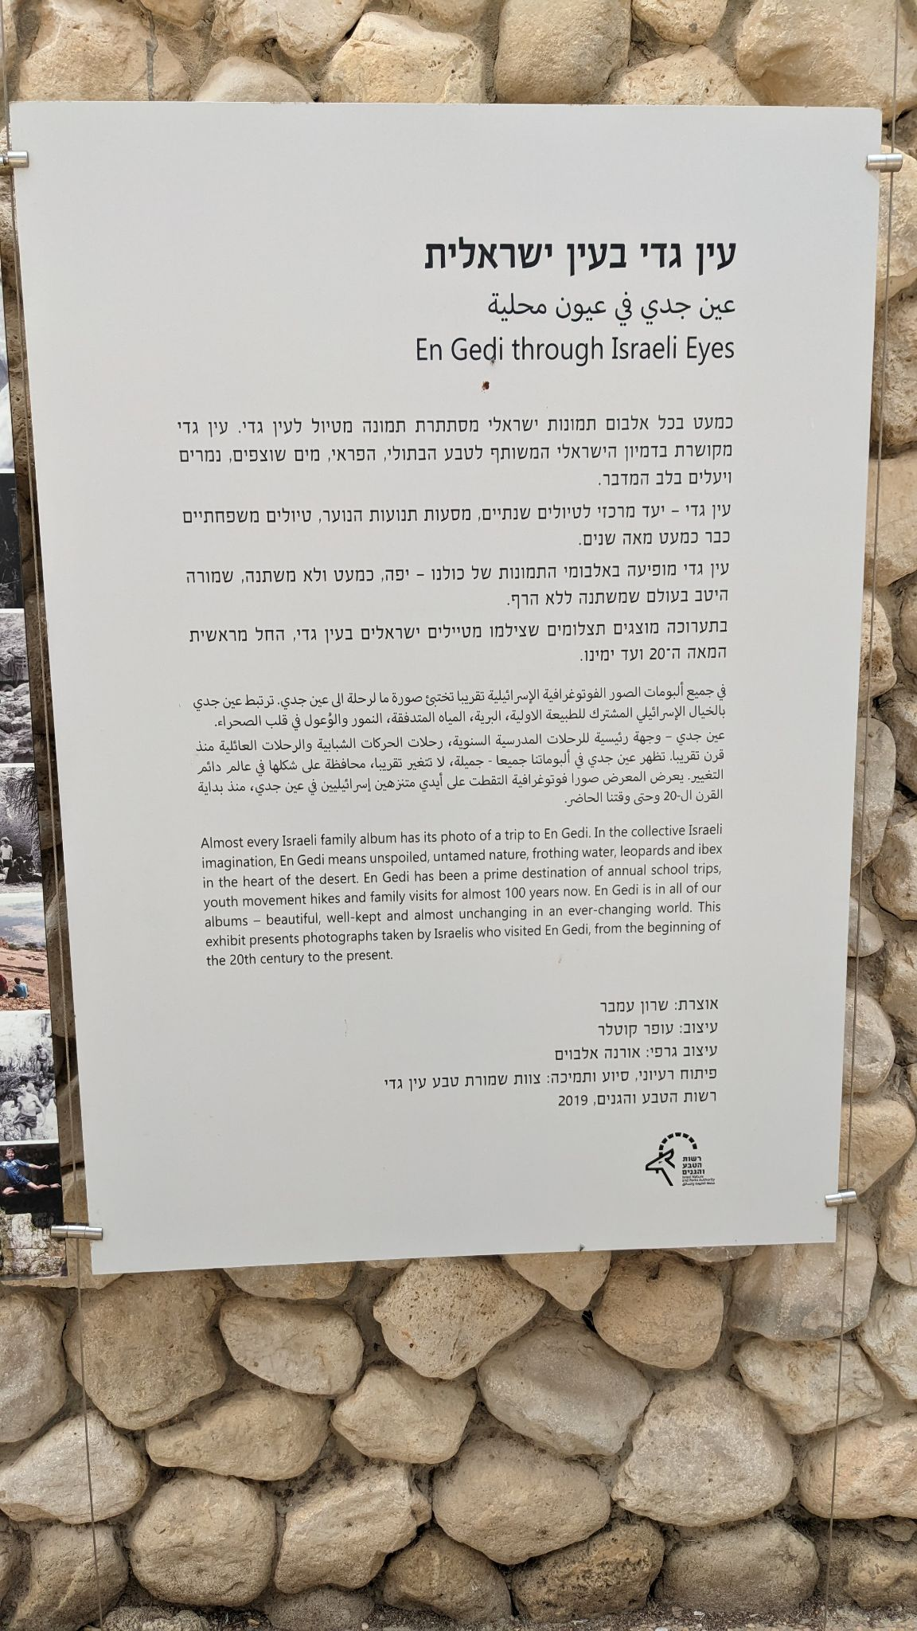
En Gedi
En Gedi means literally
“the spring of the goat.”
Evidence exists that young ibex have always lived near the springs of En Gedi.
Notes:
ART

Slide 20
En Gedi
En Gedi means literally
“the spring of the goat.”
Notes:
ART

Slide 21
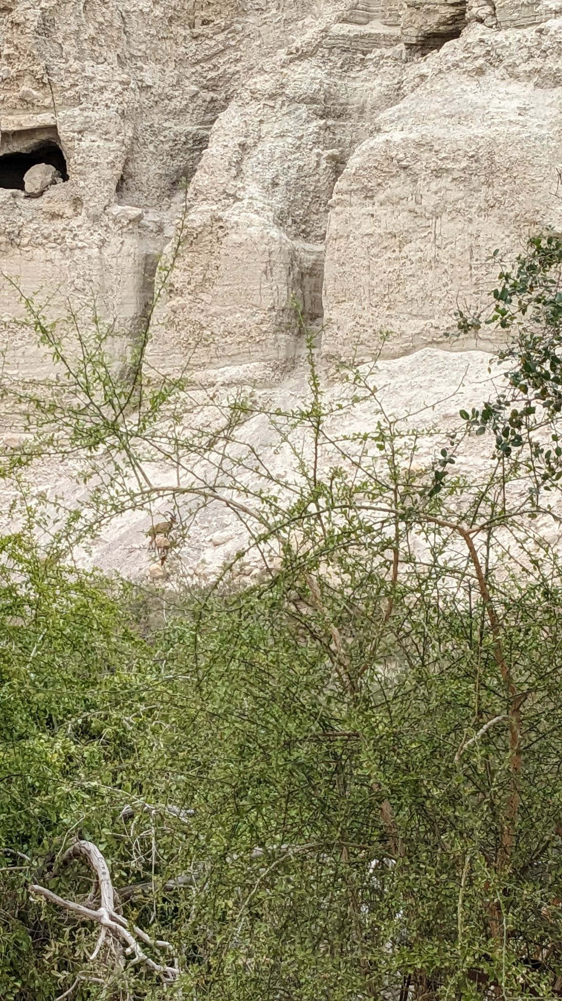
En Gedi
En Gedi means literally
“the spring of the goat.”
Evidence exists that young ibex have always lived near the springs of En Gedi.
Notes:
ADAM
Josephus praised En Gedi for its palm trees and balsam, and the writer of Ecclesiasticus spoke of wisdom that was exalted “like a palm tree in En Gedi” (24:14). One day, the prophet Ezekiel predicted, fishermen would line the shores of the Dead Sea by En Gedi (47:10)

Slide 22
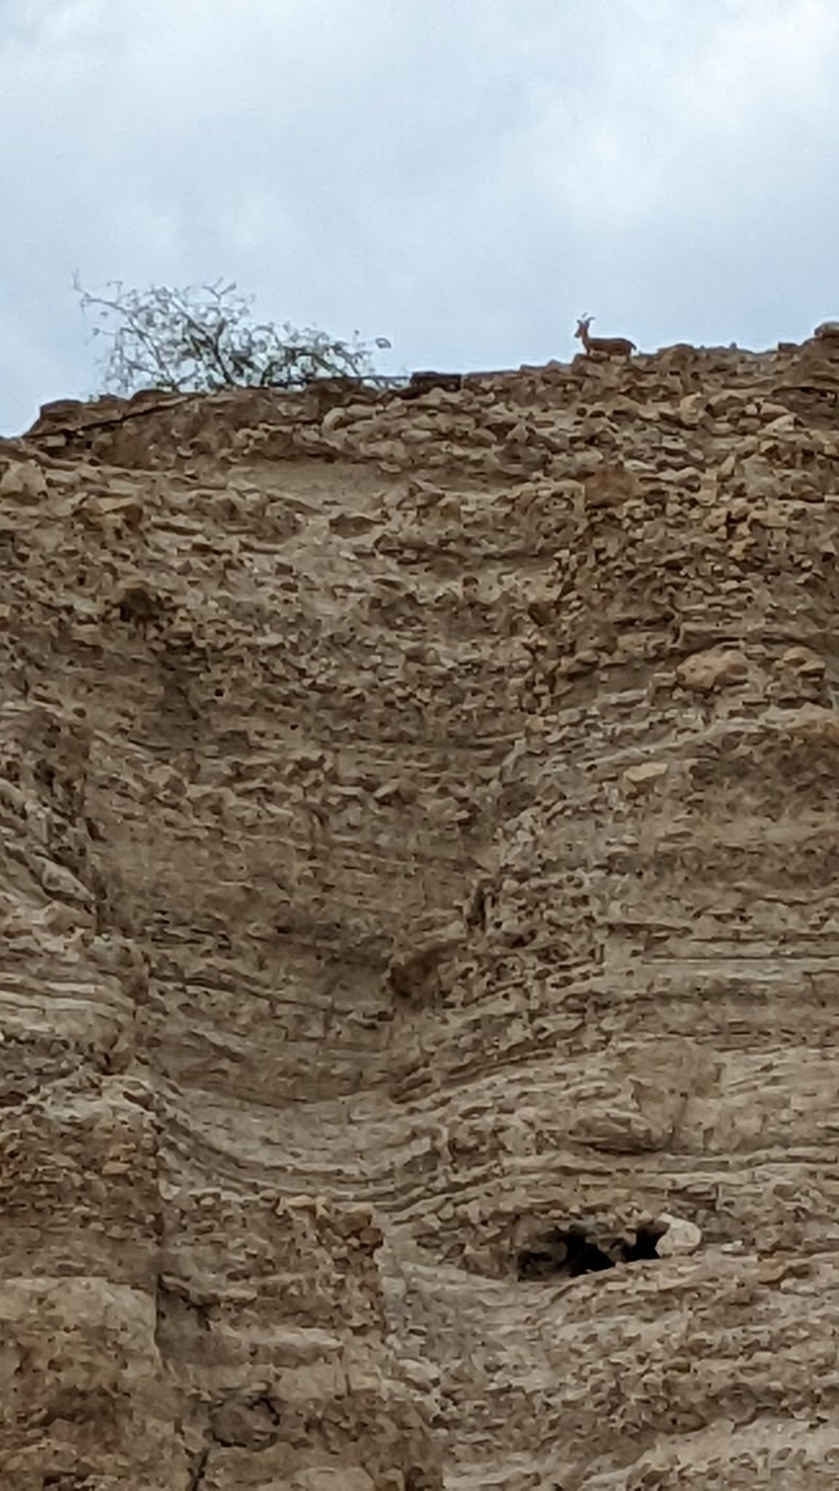
En Gedi
En Gedi means literally
“the spring of the goat.”
Evidence exists that young ibex have always lived near the springs of En Gedi.
Notes:
ADAM
Josephus praised En Gedi for its palm trees and balsam, and the writer of Ecclesiasticus spoke of wisdom that was exalted “like a palm tree in En Gedi” (24:14). One day, the prophet Ezekiel predicted, fishermen would line the shores of the Dead Sea by En Gedi (47:10)

Slide 23
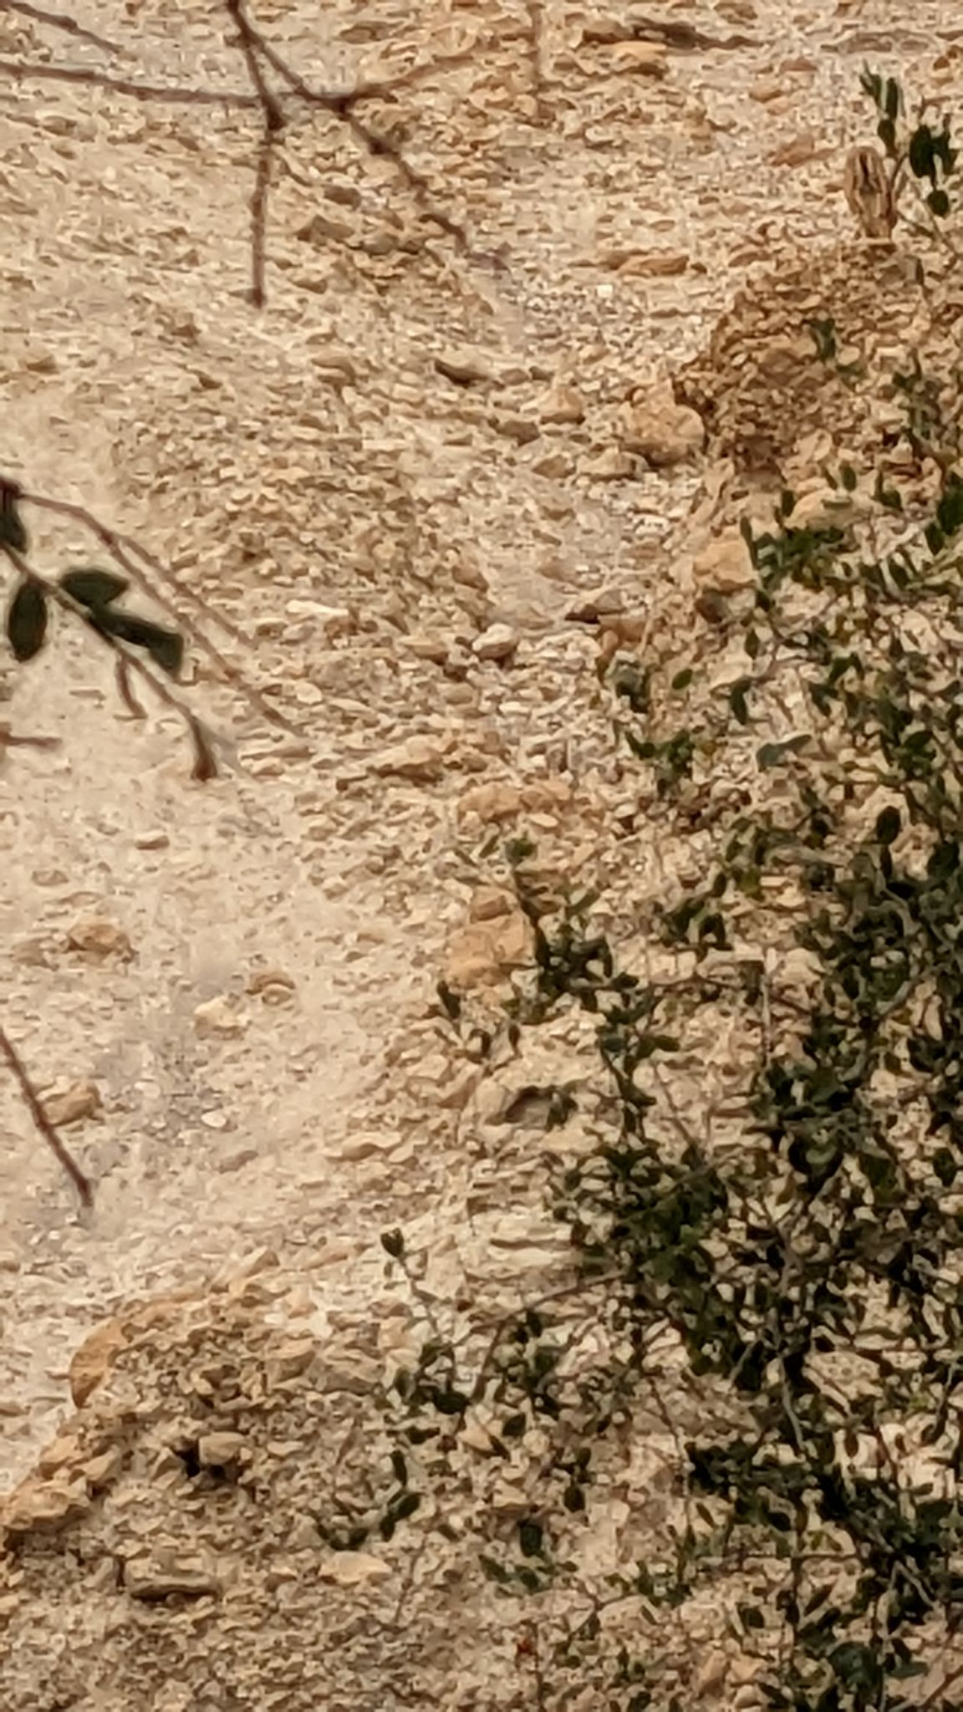
En Gedi
En Gedi means literally
“the spring of the goat.”
Evidence exists that young ibex have always lived near the springs of En Gedi.
Notes:
ADAM
Josephus praised En Gedi for its palm trees and balsam, and the writer of Ecclesiasticus spoke of wisdom that was exalted “like a palm tree in En Gedi” (24:14). One day, the prophet Ezekiel predicted, fishermen would line the shores of the Dead Sea by En Gedi (47:10)

Slide 24
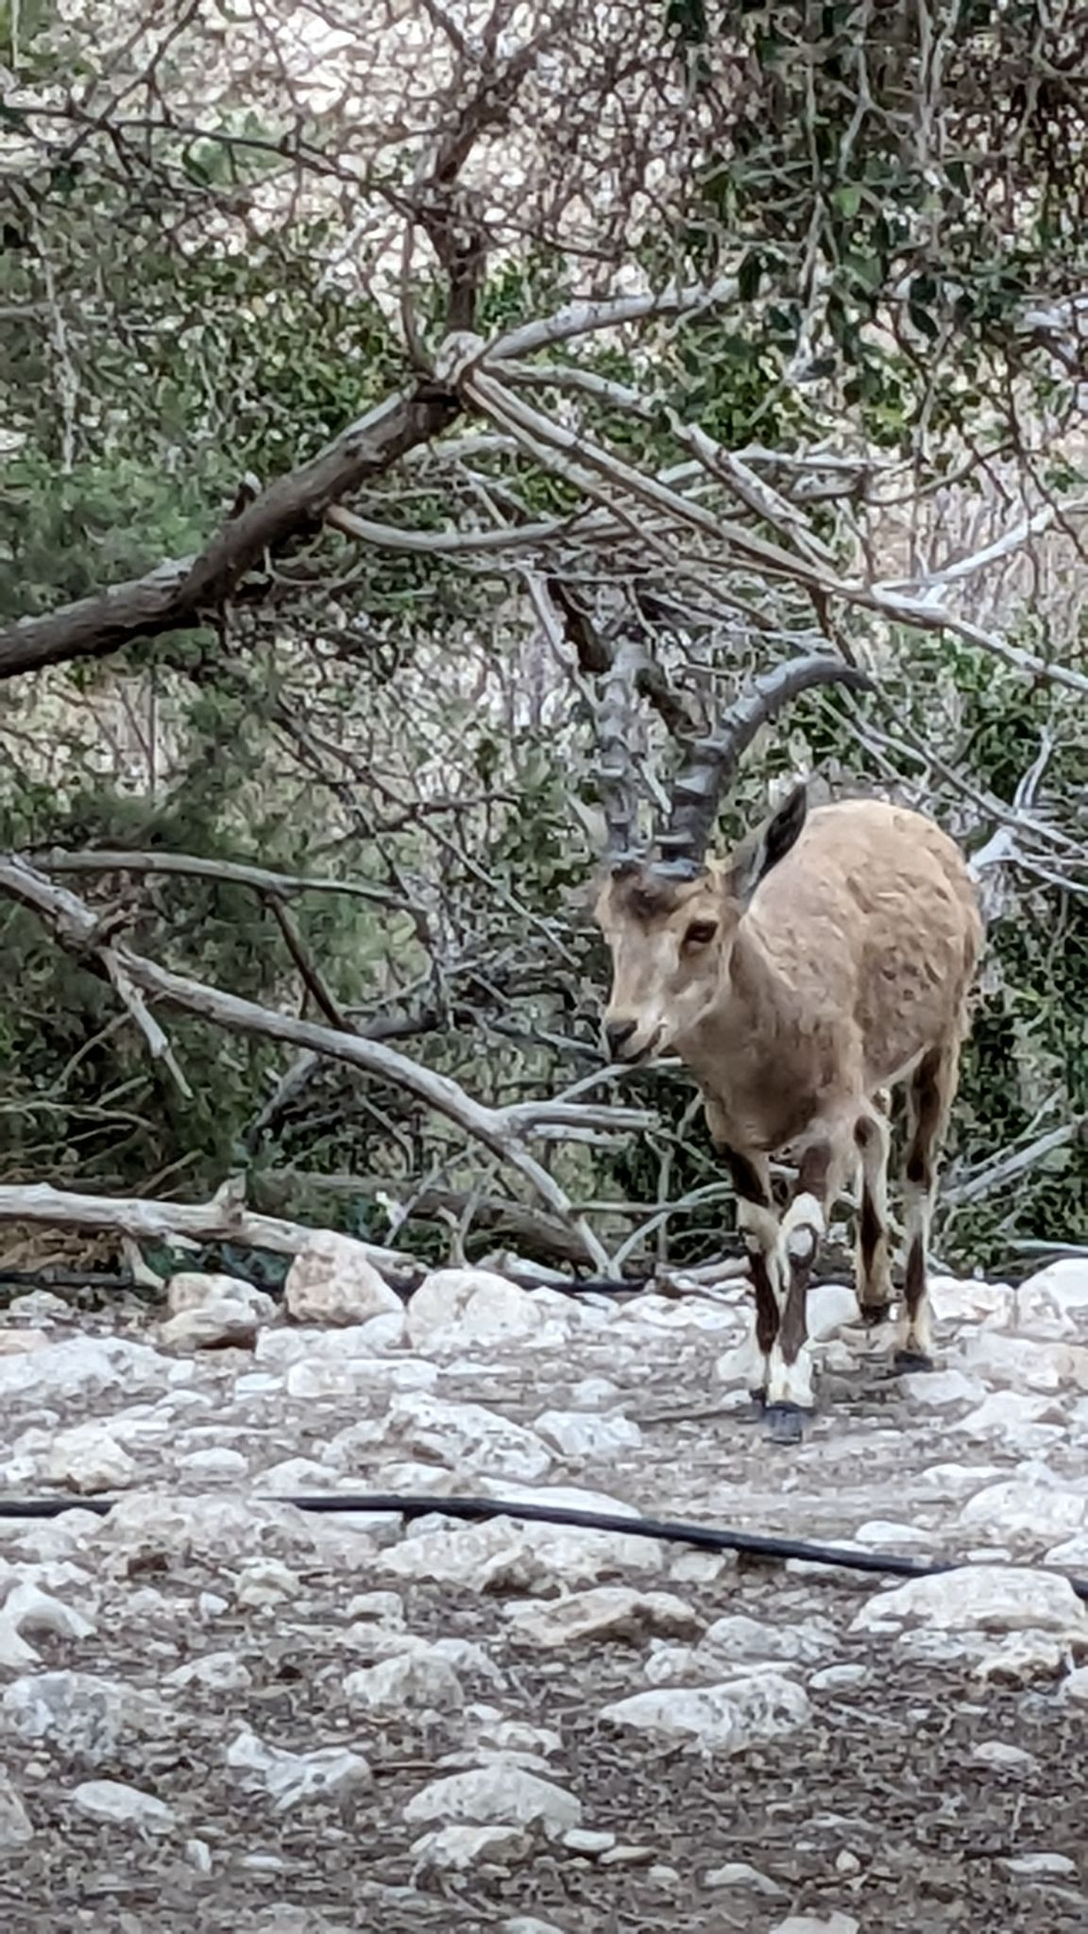
En Gedi
En Gedi means literally
“the spring of the goat.”
Evidence exists that young ibex have always lived near the springs of En Gedi.
Notes:
ADAM
Josephus praised En Gedi for its palm trees and balsam, and the writer of Ecclesiasticus spoke of wisdom that was exalted “like a palm tree in En Gedi” (24:14). One day, the prophet Ezekiel predicted, fishermen would line the shores of the Dead Sea by En Gedi (47:10)

Slide 25
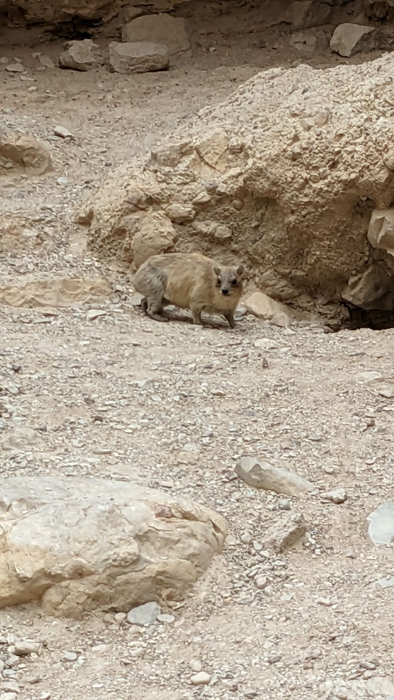
En Gedi
En Gedi means literally
“the spring of the goat.”
Another animal that lives there is the Rock Hyrax.
Notes:
ADAM
Josephus praised En Gedi for its palm trees and balsam, and the writer of Ecclesiasticus spoke of wisdom that was exalted “like a palm tree in En Gedi” (24:14). One day, the prophet Ezekiel predicted, fishermen would line the shores of the Dead Sea by En Gedi (47:10)

Slide 26
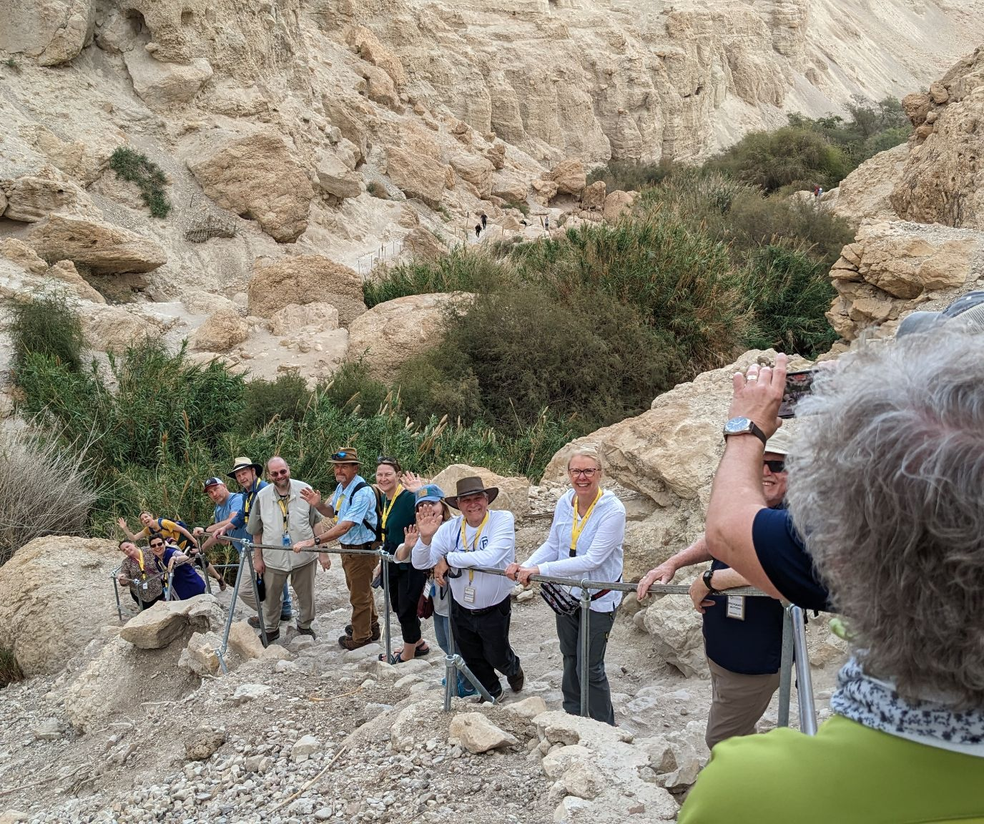
En Gedi
En Gedi means literally
“the spring of the goat.”
Another animal that lives there is the Rock Hyrax.
Notes:
ADAM
Josephus praised En Gedi for its palm trees and balsam, and the writer of Ecclesiasticus spoke of wisdom that was exalted “like a palm tree in En Gedi” (24:14). One day, the prophet Ezekiel predicted, fishermen would line the shores of the Dead Sea by En Gedi (47:10)

Slide 27
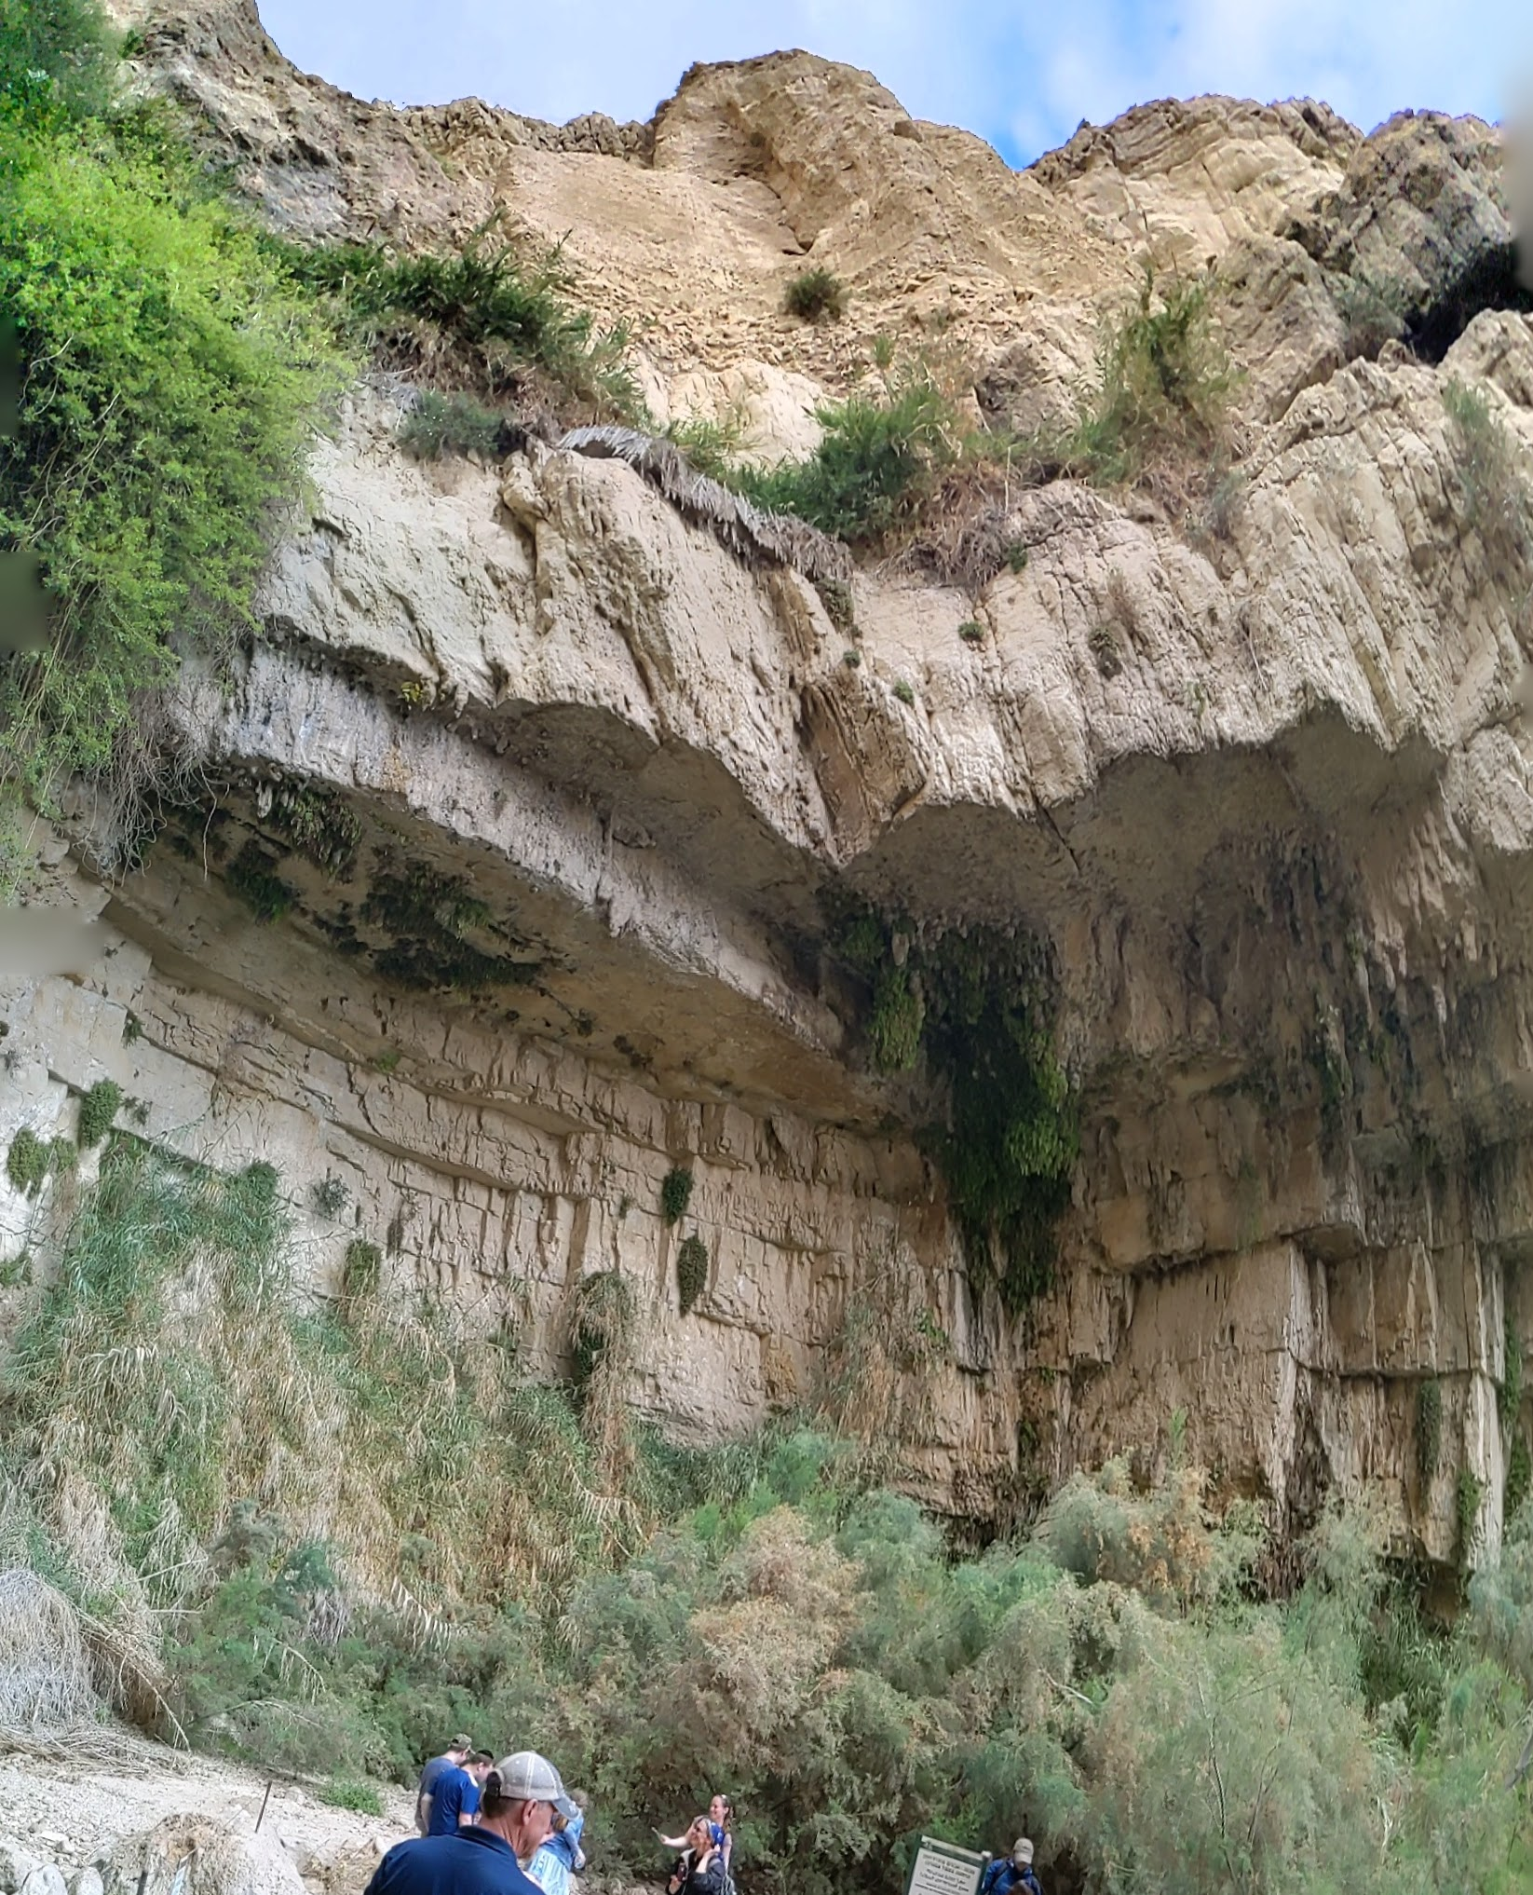
En Gedi
En Gedi means literally
“the spring of the goat.”
Another animal that lives there is the Rock Hyrax.
Notes:
ADAM
Josephus praised En Gedi for its palm trees and balsam, and the writer of Ecclesiasticus spoke of wisdom that was exalted “like a palm tree in En Gedi” (24:14). One day, the prophet Ezekiel predicted, fishermen would line the shores of the Dead Sea by En Gedi (47:10)

Slide 28
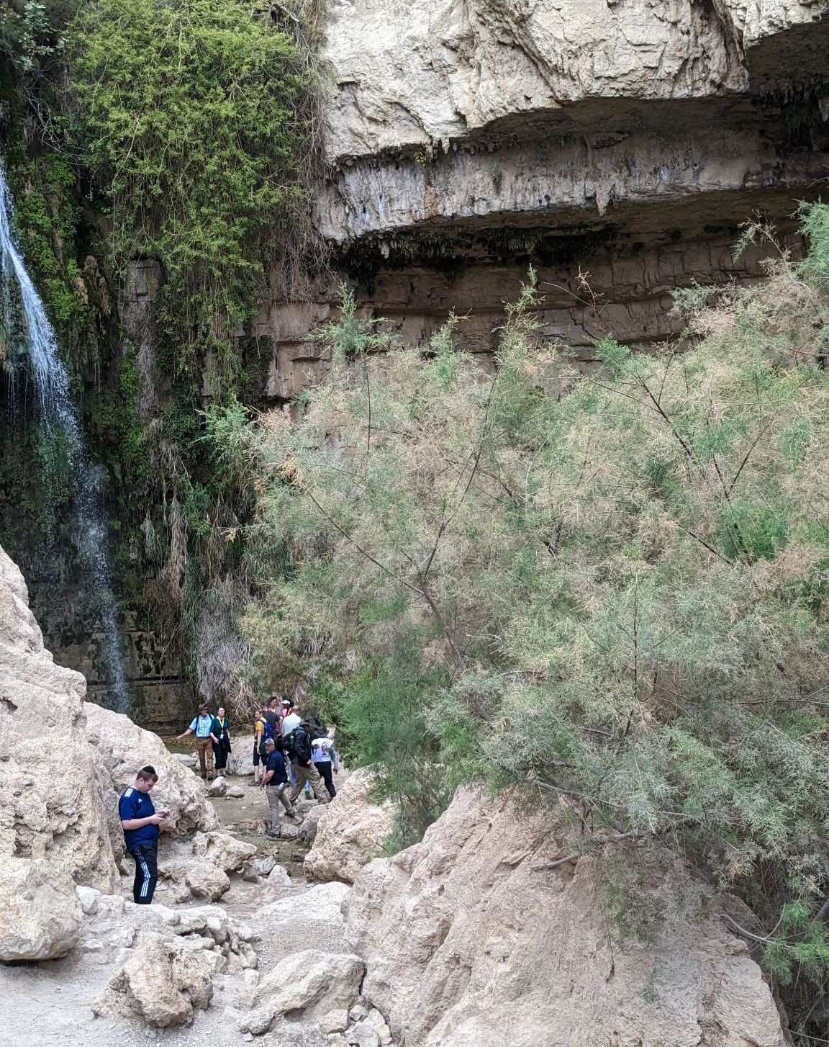
En Gedi
En Gedi means literally
“the spring of the goat.”
Another animal that lives there is the Rock Hyrax.
Notes:
ADAM
Josephus praised En Gedi for its palm trees and balsam, and the writer of Ecclesiasticus spoke of wisdom that was exalted “like a palm tree in En Gedi” (24:14). One day, the prophet Ezekiel predicted, fishermen would line the shores of the Dead Sea by En Gedi (47:10)

Slide 29


Slide 30
1 Samuel 24:1-22
1 Now when Saul returned from pursuing the Philistines, he was told, saying, “Behold, David is in the wilderness of Engedi.” 2 Then Saul took three thousand chosen men from all Israel and went to seek David and his men in front of the Rocks of the Wild Goats. 3 He came to the sheepfolds on the way, where there was a cave; and Saul went in to relieve himself. Now David and his men were sitting in the inner recesses of the cave. 4 The men of David said to him, “Behold, this is the day of which the Lord said to you, ‘Behold; I am about to give your enemy into your hand, and you shall do to him as it seems good to you.’” Then David arose and cut off the edge of Saul’s robe secretly. 5 It came about afterward that David’s conscience bothered him because he had cut off the edge of Saul’s robe.
1 Samuel 24:1-5 (NASB)
Notes:
5 times Davids force 3000 vs 600
David's temptation (1 Sam. 24: 1-4). David and his men were hiding in a large cave, of which there were many in that area, and Saul chose to use that very cave as a place where he could relieve himself. The Law of Moses was very strict when it came to matters of sanitation, especially in the army camp (Deut. 23:12-14). Each soldier was required to leave the camp to relieve himself, and he had to carry a small shovel or trowel among his weapons so he could dig a hole and cover his excrement. This meant that Saul was away from the camp and therefore quite vulnerable. He naturally wanted privacy and he felt that he was not in danger. The fact that he walked right into David's hiding place not only proved that his spies were incompetent but also that the Lord was still in control.
As David and his men pressed to the walls in the back of the cave, they quietly discussed the meaning of this remarkable occurrence. The men assured David that Saul's presence in the cave was the fulfillment of a promise God gave him that He would deliver Saul into David's hands. Footnote 4. But when did God say this? Were they referring to Samuel's words to Saul in 1 Samuel 15:26-29, or to God's message to Samuel in 16:1? Perhaps the idea came from Jonathan's words in 20:15, which some of the men might have heard personally. It's likely that the leaders of the 600 men discussed these matters among themselves, for their future was wrapped up in David's future, and obviously they came to some false conclusions. David never planned to kill Saul, for he was sure that the Lord would remove him from the scene in His own way and His own time (26:9-11).
To David's men, it seemed providential that Saul was at their mercy (24:4; Ex. 21:13), and both David and Saul agreed with them (1 Sam. 24:10, 18). But that wasn't the issue. The major question was, "How does the Lord want us to use this occasion?" David's men saw it as an opportunity for revenge, while David saw it as an opportunity to show mercy and prove that his heart was right. God was giving him an opportunity to answer his own prayer for vindication [NOT VENGEANCE] (Ps. 54:1). David stealthily crept up to the garment that Saul had laid aside, cut off a corner of the robe, and went back into the cave. Saul left the cave not realizing what had happened.

Slide 31
1 Samuel 24:1-22
1 Now when Saul returned from pursuing the Philistines, he was told, saying, “Behold, David is in the wilderness of Engedi.” 2 Then Saul took three thousand chosen men from all Israel and went to seek David and his men in front of the Rocks of the Wild Goats. 3 He came to the sheepfolds on the way, where there was a cave; and Saul went in to relieve himself. Now David and his men were sitting in the inner recesses of the cave. 4 The men of David said to him, “Behold, this is the day of which the Lord said to you, ‘Behold; I am about to give your enemy into your hand, and you shall do to him as it seems good to you.’” Then David arose and cut off the edge of Saul’s robe secretly. 5 It came about afterward that David’s conscience bothered him because he had cut off the edge of Saul’s robe.
1 Samuel 24:1-5 (NASB)
Notes:
ADAM
5 times Davids force 3000 vs 600
Saul relieving himself has the same setup as Ehud killing Eglon. Here David has another opportunity to become a hero.
The cutting the garment echos 1Sam 15:27 where saul tore samuel’s robe. The tearing was interpreted as a portent that the kingdom would be torn from saul.
GEN 3:1-2
3 Now the serpent was more crafty than any beast of the field which the Lord God had made. And he said to the woman, “Indeed, has God said, ‘You shall not eat from any tree of the garden’?” 2 The woman said to the serpent, “From the fruit of the trees of the garden we may eat;

Slide 32
1 Samuel 24:1-22
6 So he said to his men, “Far be it from me because of the Lord that I should do this thing to my lord, the Lord’s anointed, to stretch out my hand against him, since he is the Lord’s anointed.” 7 David persuaded his men with these words and did not allow them to rise up against Saul. And Saul arose, left the cave, and went on his way.
8 Now afterward David arose and went out of the cave and called after Saul, saying, “My lord the king!” And when Saul looked behind him, David bowed with his face to the ground and prostrated himself. 9 David said to Saul, “Why do you listen to the words of men, saying, ‘Behold, David seeks to harm you’? 10 Behold, this day your eyes have seen that the Lord had given you today into my hand in the cave, and some said to kill you, but my eye had pity on you; and I said, ‘I will not stretch out my hand against my lord, for he is the Lord’s anointed.’
1 Samuel 24:6-10 (NASB)
Notes:
David continues to defer to others.
“Why do you listen to the words of men, saying, ‘Behond, David seeks to harm you’?
Doeg
Abner?
Advisors
<David's conviction (1 Sam. 24:5-7) David was too wise in the truth of God's word to interpret this event as a signal for him to kill Saul, for the law says, "You shall not murder" (Ex. 20:13, NIV). Slaying an enemy on the battlefield or an attacker in self-defense was one thing, but to assassinate an unsuspecting king was quite something else. David reminded his men that Saul was the anointed of the Lord, and that no Jew had the right to attack him. The Jews were not even to curse their rulers, let alone kill them, for cursing a ruler was in the same category as blaspheming the name of the Lord (22:28).
However, David's conscience bothered him because he had cut off the corner of Saul's robe. His action sent out three messages. First, it was an insolent act of disrespect that humiliated Saul, but it was also a symbolic gesture not unlike what Saul did to Samuel's robe after the Amalekite fiasco (1 Sam. 15:27-28). By cutting off a part of the royal robe, David was declaring that the kingdom had been transferred to him. Finally, the piece of cloth was proof that David did not intend to kill the king and that the flatterers in the court were all liars. David's men would have killed Saul in a moment, but their wise captain restrained them. Leaders must know how to interpret events and respond in the right way. >

Slide 33
1 Samuel 24:1-22
11 Now, my father, see! Indeed, see the edge of your robe in my hand! For in that I cut off the edge of your robe and did not kill you, know and perceive that there is no evil or rebellion in my hands, and I have not sinned against you, though you are lying in wait for my life to take it. 12 May the Lord judge between you and me, and may the Lord avenge me on you; but my hand shall not be against you. 13 As the proverb of the ancients says, ‘Out of the wicked comes forth wickedness’; but my hand shall not be against you. 14 After whom has the king of Israel come out? Whom are you pursuing? A dead dog, a single flea? 15 The Lord therefore be judge and decide between you and me; and may He see and plead my cause and deliver me from your hand.”
1 Samuel 24:11-15 (NASB)
Notes:
Adam
Is a single flea on a dead dog really worth all the trouble for the king of israel?
ART
<David's vindication (1 Sam. 24: 8-15). When Saul was far enough away from the cave that it was safe, David left the cave and called to him. By using the title "my lord the king" and bowing to the earth, David emphasized what he had said to his men and let Saul know that he was not a rebel. Even if you can't respect the man or woman in office, you must show respect to the office (Rom. 13:1-7; 1 Peter 2:13-17). David showed his respect by calling Saul "my master" (1 Sam. 24:6), "the Lord's anointed" (vv. 6, 10), "my lord" (vv. 8, 10), "the king" (vv. 8, 14) and "my father" (v. 14). David's bold public appearance also let Saul and his army know that their official spy system was most ineffective.
Using the piece of Saul's robe as evidence, David opened his defense by exposing the deception of the courtiers who slandered David to Saul. The logic was irrefutable: David had an opportunity to kill Saul and refused to do so. David even admitted that some of his men urged him to slay the king, but he rebuked them. David was not guilty of any evil against Saul or any transgression against the Lord, but Saul was guilty of trying to kill David. "The Lord will judge between us," said David, "and prove that your officers are liars, but I will not lift my hand against you." Saul had hoped that the hand of the Philistines (18:17) or the hands of David's soldiers (19:20-21) would kill David, but they failed. Ultimately, Saul died by his own hand on the battlefield (31:1-6).
David quoted a familiar proverb (Footnote 5) to prove his point: "Wickedness proceeds from the wicked" (24:13, NKJV), which simply means that character is revealed by conduct. The fact that David did not slay the king indicated that David did not have the character of a rebel or a murderer. But at the same time, David was strongly suggesting that Saul's character was questionable because he wanted to kill his son-in-law! But what was the king really doing as he pursued David? Only chasing a dead dog and a flea that was jumping from one place to another! (Fleas and dogs go together.) The phrase "dead dog" was a humiliating term of reproach in those days (17:43; 2 Sam. 3:8; 9:8; 16:9), so David was humbling himself before the Lord and the king. David closed his defense by asserting a second time (1 Sam. 24:12, 15) that the Lord was the righteous judge and would plead the cause of His faithful servant (Pss. 35:1; 43:1; see 1 Peter 2:23).>

Slide 34
1 Samuel 24:1-22
16 When David had finished speaking these words to Saul, Saul said, “Is this your voice, my son David?” Then Saul lifted up his voice and wept. 17 He said to David, “You are more righteous than I; for you have dealt well with me, while I have dealt wickedly with you. 18 You have declared today that you have done good to me, that the Lord delivered me into your hand and yet you did not kill me. 19 For if a man finds his enemy, will he let him go away safely? May the Lord therefore reward you with good in return for what you have done to me this day. 20 Now, behold, I know that you will surely be king, and that the kingdom of Israel will be established in your hand. 21 So now swear to me by the Lord that you will not cut off my descendants after me and that you will not destroy my name from my father’s household.” 22 David swore to Saul. And Saul went to his home, but David and his men went up to the stronghold.
1 Samuel 24:16-22 (NASB)
Notes:
Adam
Saul recognizes that David is more righteous.
Saul aske and David promised to not wipe out ALL of Saul’s descendants. David fulfilled this promise by bringing Mephibosheth (Jonathan’s Son) under roal protection. (2 Sam 9)
ART
David's affirmation (1 Sam. 24:16-22). King Saul once again revealed his confused mental state by lifting up his voice and calling to David, who had certainly spoken long enough for Saul to discern that it was indeed his son-in-law." As for Saul's weeping, he had manifested temporary emotional reactions like that before, but they never brought about repentance or a change of heart.
Saul described three possible levels of life: the divine level, where we return good for evil; the human level, where we return good for good and evil for evil; and the demonic level, where we return evil for good. Saul admitted that David was a godly man who, by not slaying him, returned good for evil. But Saul was possessed by demonic forces and did evil to the one man who could have destroyed him. Now Saul openly confessed that he knew David would be the next king (23:17) and would consolidate the nation of Israel that Saul had torn apart. Even then, Saul's major concern was his own name and descendants, not the spiritual welfare of the people; he made David swear that he wouldn't wipe out his family when he became king. David had made a similar covenant with Jonathan (20:14-17, 42) and he was willing to make the same promise to Saul. How tragic that Saul's own sins destroyed his family, all but Jonathan's crippled son, Mephibosheth, whom David adopted (2 Sam. 9).
Because David knew God's calling and believed God's promise, he was able to be so bold before Saul and his army. It was indeed a holy boldness that came from a heart that was right with God. The day would come when David and his cause would be vindicated and the Lord would judge those who had opposed him. Saul went back home to Gibeah, but in spite of his tears and emotional speech, he took up his pursuit of David again (1 Sam. 26:2, 21).
David had won many battles, but one of his greatest victories occurred in that cave when he restrained himself and his men from killing Saul. "He who is slow to anger is better than the mighty, and he who rules his spirit than he who takes a city" (Prov. 16:32, NKJV). This is a good example for all of us to follow, but especially those to whom the Lord has entrusted leadership.

