Slide 1






David in Exile 1 SAMUEL 20-22
Linder Road Church of Christ - 4th Quarter 2024
CREDITS: This presentation template was created by Slidesgo, and includes icons by Flaticon and infographics & images by Freepik
Notes:
ADAM
Set the stage. Saul told J and all the servants to put david to death. David flees to Ramah and consults Samuel and they stay in Naioth (school of prophets?).
Saul sends messengers 3 times to Saul. All 3 times they ‘Prophesied”. Saul goes and also prophesied but also lay down naked all day and night.
ART
<Weirsbe>
<David has been criticized and called impulsive because he left Ramah and his friend Samuel and fled to Gibeah to confer with Jonathan. But David knew that Saul's ecstatic experience would soon end and would leave his heart unchanged. Saul had promised Jonathan that he wouldn't kill David (19:6), but he had already broken that promise four times (vv. 20-24), so the wisest course for David was to get away from Saul and go into hiding. For David to remain at Gibeah wasn't an exercise of faith; it was an act of presumption and he was only tempting God. The drama in these three chapters involves four persons: Jonathan, Saul, David, and Doeg.>

Slide 2



Contact Us

Slide 3

01
Jonathan A Faithful Friend
Notes:
ART
<In all literature, David and Jonathan stand out as examples of devoted friends. Jonathan had the more difficult situation because he wanted to be loyal to his father while at the same time being a friend to the next king of Israel. Conflict of loyalties, especially in the family, is one of the most painful difficulties we face in the life of faith (Matt. 10:34-39), but Christ calls for supreme devotion to Him and His will for our lives.>

Slide 4
1 Samuel 20:1-23
1 Then David fled from Naioth in Ramah, and came and said to Jonathan, “What have I done? What is my iniquity? And what is my sin before your father, that he is seeking my life?” 2 He said to him, “Far from it, you shall not die. Behold, my father does nothing either great or small without disclosing it to me. So why should my father hide this thing from me? It is not so!” 3 Yet David vowed again, saying, “Your father knows well that I have found favor in your sight, and he has said, ‘Do not let Jonathan know this, or he will be grieved.’ But truly as the Lord lives and as your soul lives, there is hardly a step between me and death.” 4 Then Jonathan said to David, “Whatever you say, I will do for you.” 5 So David said to Jonathan, “Behold, tomorrow is the new moon, and I ought to sit down to eat with the king. But let me go, that I may hide myself in the field until the third evening.
1 Samuel 20:1-5 (NASB)
Notes:
ADAM
A Conversation between David and Jonathan. Difficult to understand some times. It’s not written in the way we expect to see conversation in other english writings. Adam as David & Art as Jonathan
David: What have I done?
Jonathan: My father tells me everything. He doesnt want you dead
David: You father knows we’re friends. He’s not telling you cause he doesnt want you to be upset. I’m am at deaths doorstep
Jonathan: What can I do to help?
David: I’m supposed to have dinner with your father tomorrow. But let me go and hide.
ART
<Conferring (1 Sam. 20:1-10, 18-23). David met Jonathan somewhere near Gibeah and wasted no time confronting his beloved friend with the key question: "What have I done that is so evil that your father wants to kill me?" David hadn't disobeyed any royal commands, incited any rebellion against the throne, or broken God's law, yet Saul was bent on destroying him.' David knew that Saul was an envious man who wanted to keep the throne for himself and hand it on to his descendants, but David had faith that the Lord would remove Saul from the scene in His good time and in His own way (26:7-11). David dearly loved Jonathan and didn't want to hurt him by criticizing his father, but now it was a matter of life or death.
Jonathan's reply sounds rather naïve, especially in the light of Saul's statement in 19:1 and his behavior at Ramah. Saul had thrown his spear at David at least three times (10-11; 19:9-10), and he had sent three groups of soldiers to capture him, and Saul finally went to Ramah himself to do the job (vv. 20-24). How much evidence did Jonathan need that his father was a disturbed man out to destroy God's anointed king? Jonathan mistakenly thought that his own relationship to his father was closer than it really was and that Saul would confide in him, but subsequent events proved him wrong, for Saul would even try to kill Jonathan!
David refuted Jonathan's argument by stating that the logical thing for Saul to do was to keep his eldest son in the dark. Saul knew that David and Jonathan were devoted friends and that Jonathan would be pained if he knew Saul's real intentions. The matter was so serious that David couldn't put his faith in what Saul told Jonathan. "There is but a step between me and death" (20:3). This was true both metaphorically and literally, for three times David had dodged the king's spear.>

Slide 5
1 Samuel 20:1-23
6 If your father misses me at all, then say, ‘David earnestly asked leave of me to run to Bethlehem his city, because it is the yearly sacrifice there for the whole family.’ 7 If he says, ‘It is good,’ your servant will be safe; but if he is very angry, know that he has decided on evil. 8 Therefore deal kindly with your servant, for you have brought your servant into a covenant of the Lord with you. But if there is iniquity in me, put me to death yourself; for why then should you bring me to your father?” 9 Jonathan said, “Far be it from you! For if I should indeed learn that evil has been decided by my father to come upon you, then would I not tell you about it?” 10 Then David said to Jonathan, “Who will tell me if your father answers you harshly?” 11 Jonathan said to David, “Come, and let us go out into the field.” So both of them went out to the field.
1 Samuel 20:6-11 (NASB)
Notes:
ADAM
David: If you father misses me. Tell him I’m with family celebrating. If he’s ok with that. Then he doesnt want to kill me. If he’s explodes in anger. We’ll know he wants to do me harm.
If I have done something wrong. You should kill me not your father.
Jonathan: Whoa slow down. If I ever learn my father has something evil planned for you; I’d tell you in a heart beat.
David: So…How will you tell me how your father reacts?
Jonathan: Let’s go into the field and talk.
ART
<Conferring (1 Sam. 20:1-10, 18-23) (cont.). Jonathan offered to help in any way his friend suggested, and David proposed a simple test of Saul's true feelings. It was customary for each Jewish family to hold a feast at the new moon (Num. 10:10; 28:11-15; Ps. 81:3), and Saul would expect David to attend. If Saul's son-in-law and leading military hero didn't attend the feast, it would be an insult to the king as well as the family, so David's absence would help reveal Saul's genuine attitude toward David. If Saul became angry, then David's assessment was correct, but if Saul excused David and didn't press the matter, then Jonathan was correct. The only problem with this scheme was that it required Jonathan to lie by saying that David had gone to Bethlehem to attend his own family's feast. David would be hiding in the field and waiting for Jonathan to tell him whether or not it was safe to come home.2
How would Jonathan safely get the message to David? (1 Sam. 20: 10) He couldn't trust one of the servants to carry the word, so, in spite of the danger, he would have to do it himself. He devised a simple plan involving shooting three arrows out in the field where David was hiding (v. 20). Jonathan would call to the lad who was helping him and in this way signal David and tell him what to do. Even if some of Saul's spies were present, they wouldn't understand what was going on.>

Slide 6
1 Samuel 20:1-23
12 Then Jonathan said to David, “The Lord, the God of Israel, be witness! When I have sounded out my father about this time tomorrow, or the third day, behold, if there is good feeling toward David, shall I not then send to you and make it known to you? 13 If it please my father to do you harm, may the Lord do so to Jonathan and more also, if I do not make it known to you and send you away, that you may go in safety. And may the Lord be with you as He has been with my father. 14 If I am still alive, will you not show me the lovingkindness of the Lord, that I may not die? 15 You shall not cut off your lovingkindness from my house forever, not even when the Lord cuts off every one of the enemies of David from the face of the earth.” 16 So Jonathan made a covenant with the house of David, saying, “May the Lord require it at the hands of David’s enemies.” 17 Jonathan made David vow again because of his love for him, because he loved him as he loved his own life.
1 Samuel 20:12-17 (NASB)
Notes:
ADAM
Jonathan: The Lord as my witness. By this time on the third day we’ll have an answer and you’ll be the first person I tell. If my father wants to hurt you…and I dont tell you and I dont try to help…well then… I deserve to die! But…if all this works out. And we’re both still alive. You won’t forget about me will you? You’ll still be my friend and a friend to my household? You wont consider me an enemy when God cuts down everyone who has stood against you?
David: I promise.
ART
<Covenanting (1 Sam. 20:11-17). From verse 11 to verse 23, David is silent while Jonathan reviews the covenant they had made with each other (18:1-4). Jonathan even took an oath and promised to give David the correct message on the third day of the feast, so he would know whether the king was friendly or angry.3 Jonathan went beyond the immediate crisis to deal with future events. He knew that David would one day become king, and he prayed that the Lord would bless his reign. In their covenant, they agreed that Jonathan would serve next to David as second in command (23:16-18), and now Jonathan asked that if anything happened to him, David would promise not to wipe out his household, and David agreed. The phrase "the kindness of the Lord" (20:14) shows up in 2 Samuel 9 where David's compassionate care of Jonathan's crippled son, Mephibosheth, is described.
Jonathan reaffirmed his oath and included the whole house of David (1 Sam. 20:16), and he asked David to repeat his covenant oath as well. There's no mention of the offering of a covenant sacrifice (Gen. 15) or the signing of a covenant document, because the love the two men had for the Lord and each other was sufficient to make the agreement binding. Jonathan had brought much joy and encouragement to David during those difficult years, but it wasn't God's will that David permanently join himself to Saul and his family, for they belonged to the wrong tribe and represented a rejected and condemned monarchy. David never had a co-regent because Jonathan was killed in battle (1 Sam. 31:1-2), and David rejected Saul's daughter Michal as his wife and she died childless (2 Sam. 6:16-23). Had she borne any children, it would have brought confusion into the royal line.>

Slide 7
1 Samuel 20:1-23
18 Then Jonathan said to him, “Tomorrow is the new moon, and you will be missed because your seat will be empty. 19 When you have stayed for three days, you shall go down quickly and come to the place where you hid yourself on that eventful day, and you shall remain by the stone Ezel. 20 I will shoot three arrows to the side, as though I shot at a target. 21 And behold, I will send the lad, saying, ‘Go, find the arrows.’ If I specifically say to the lad, ‘Behold, the arrows are on this side of you, get them,’ then come; for there is safety for you and no harm, as the Lord lives. 22 But if I say to the youth, ‘Behold, the arrows are beyond you,’ go, for the Lord has sent you away. 23 As for the agreement of which you and I have spoken, behold, the Lord is between you and me forever.”
1 Samuel 20:18-23 (NASB)
Notes:
ADAM
Jonathan: Awesome. Tomorrow is the new moon festival. On the third day go to your hiding spot by the stone Ezel. I’ll shoot 3 arrows and send my servant to get the arrows.
If I say “The arrows are between you and me!” then everything is ok and you’re safe to come home.
If I say “The arrows are farther out…keep going!” then the Lord has sent you away.
We’ll always be friends right?
David: Always

Slide 8
02
Saul A Spiteful King
Notes:
<On the first day of the feast, David hid himself by the stone of Ezel and waited for Jonathan's signal, for it was remotely possible that the king might be favorably inclined and welcome him back into the official circle.>

Slide 9
1 Samuel 20:24-42
24 So David hid in the field; and when the new moon came, the king sat down to eat food. 25 The king sat on his seat as usual, the seat by the wall; then Jonathan rose up and Abner sat down by Saul’s side, but David’s place was empty. 26 Nevertheless Saul did not speak anything that day, for he thought, “It is an accident, he is not clean, surely he is not clean.” 27 It came about the next day, the second day of the new moon, that David’s place was empty; so Saul said to Jonathan his son, “Why has the son of Jesse not come to the meal, either yesterday or today?” 28 Jonathan then answered Saul, “David earnestly asked leave of me to go to Bethlehem, 29 for he said, ‘Please let me go, since our family has a sacrifice in the city, and my brother has commanded me to attend. And now, if I have found favor in your sight, please let me get away that I may see my brothers.’ For this reason he has not come to the king’s table
1 Samuel 20:24-29 (NASB)
Notes:
ADAM
“Son of Jesse” used by Saul in an almost derogatory fashion. He doesn’t use David’s name. Jonathan does however.
ART
<David's absence (1 Sam. 20:24-29). Constantly afraid of personal attack, Saul sat with his back to the wall, his commander Abner next to him, and Jonathan across from his father. David's place next to Jonathan was empty, but the king said nothing about it, convinced that David was ceremonially unclean and therefore unable to eat a holy feast that day. The feast consisted primarily of meat from the new moon fellowship offerings, and anyone ceremonially unclean was prohibited from participating (Lev. 7:20-21). Perhaps David had touched something unclean, or he may have had intercourse with his wife (15:16-18). If so, all he had to do was separate himself from other people for that day, bathe his body, and change clothes, and he could come back into society the next day.
But when the men met for their meal the second day, again David was missing, which suggested to Saul that his son-in-law's absence was caused by something more serious than simple ritual defilement. An unclean person could remove the defilement in a day, but David had been missing for two days. Suspicious of anything out of the ordinary in his official staff, Saul asked Jonathan why David was absent, disdainfully calling him "the son of Jesse" rather than by his given name that was now so famous. Later, Saul would try to humiliate the high priest Ahimelech by calling him "the son of Ahitub" (1 Sam. 22:11-12).
At this point Jonathan dropped his lie into the conversation and nothing went right after that. Jonathan didn't say that David's father Jesse had summoned him home but that one of his brothers had commanded him to attend the family feast. Perhaps Jonathan hoped his father would assume that the invitation came from one of David's three brothers serving in Saul's army (17:13), which might make the matter easier for Saul to accept. Jonathan also used a verb that means "to get away, to make a quick visit" so that Saul wouldn't suspect David of going home for a long visit and rallying his own troops so he could seize the throne.>

Slide 10
1 Samuel 20:24-42
30 Then Saul’s anger burned against Jonathan and he said to him, “You son of a perverse, rebellious woman! Do I not know that you are choosing the son of Jesse to your own shame and to the shame of your mother’s nakedness? 31 For as long as the son of Jesse lives on the earth, neither you nor your kingdom will be established. Therefore now, send and bring him to me, for he must surely die.” 32 But Jonathan answered Saul his father and said to him, “Why should he be put to death? What has he done?” 33 Then Saul hurled his spear at him to strike him down; so Jonathan knew that his father had decided to put David to death. 34 Then Jonathan arose from the table in fierce anger, and did not eat food on the second day of the new moon, for he was grieved over David because his father had dishonored him.
1 Samuel 20:30-34 (NASB)
Notes:
ADAM
Saul insults Jonathan with the same sin that Saul has been condemned for by Samuel. Rebellion.
What is the importance of your ‘mother’s nakedness’? Leviticus 18:7
7 “You shall not uncover the nakedness of your father, that is, the nakedness of your mother. She is your mother; you are not to uncover her nakedness.”
I think saul is saying: “You’ve shamed yourself and you’ve shamed me”. If mother’s nakedness and father’s nakedness are equivalent.
ART
<Saul's anger (1 Sam. 20:30-34). When hateful feelings are in the heart, it doesn't take much for angry words to come out of the mouth (Matt. 12:34-35). Saul had probably been brooding over how David had insulted him by refusing to attend the feast, and the longer to brooded, the more the fire raged within. But instead of attacking David, King Saul attacked his own son! Had the Lord not intervened back in Ramah, Saul would have killed David in the very presence of the Prophet Samuel (1 Sam. 19:22-24), and now he reviled his own son while eating a holy feast!
The king's tirade seems to disparage his own wife, but rightly understood, his words describe his son as the lowest of the low. According to Saul, Jonathan's treachery in befriending David indicated that he was not Saul's son at all but the son of some other man, for a son of Saul would never betray his father. Therefore, Jonathan was slandering his own mother and saying she was a common prostitute, a rebel against the Law of Moses, and a woman who practiced perversion. Because Jonathan helped David and didn't protect his father's throne, he had shamed his mother as much as if he had exposed her nakedness. She bore him to be the successor to his father, and now Jonathan had refused the crown in favor of the son of Jesse. The king was shouting, "You are no son of mine! You must be illegitimate!"
Saul's great concern was the preservation of the kingdom that the Lord had already taken from him. God had made it very clear that none of Saul's sons would ever inherit the throne and David was the king of God's choice, so Saul was fighting the will of God and asking Jonathan to do the same thing. Saul was aware that his son knew where David was hiding and commanded Jonathan to find David and bring him in to be slain. When Jonathan remonstrated with his father and refused to obey the royal command, Saul threw his spear at his own son! Jonathan left the table in great anger and spent the rest of the day fasting.>

Slide 11
1 Samuel 20:24-42
35 Now it came about in the morning that Jonathan went out into the field for the appointment with David, and a little lad was with him. 36 He said to his lad, “Run, find now the arrows which I am about to shoot.” As the lad was running, he shot an arrow past him. 37 When the lad reached the place of the arrow which Jonathan had shot, Jonathan called after the lad and said, “Is not the arrow beyond you?” 38 And Jonathan called after the lad, “Hurry, be quick, do not stay!” And Jonathan’s lad picked up the arrow and came to his master. 39 But the lad was not aware of anything; only Jonathan and David knew about the matter.40 Then Jonathan gave his weapons to his lad and said to him, “Go, bring them to the city.”
1 Samuel 20:35-40 (NASB)
Notes:
ADAM
Since the reaction was so harsh…Jonathan uses stealth to report.
ART
<Jonathan's alarm (1 Ssam. 20:35-42). Jonathan waited until the next day and then went out into the field with one of his young attendants as though he were going to practice shooting arrows. As he promised David, he shot three arrows (v. 20), one of which was sent far beyond the boy, making it necessary for Jonathan to shout to the lad. But his words were meant for David's ears: "Hurry! Go quickly! Don't linger!" When the boy came back with the arrows, Jonathan gave him the bow and sent him back to the city, and then he ran out to meet David.
This was not their last meeting (23:16-18), but it was certainly a profoundly emotional farewell. They both wept, but David wept the most. He didn't know how many years of exile lay before him, and perhaps he might never see his beloved friend again. Eastern peoples aren't ashamed to weep, embrace, and kiss one another when they meet or when they part (Gen. 31:55; Acts 20:37). Jonathan's, "Go in peace" must have encouraged David. Both men reaffirmed their covenant, knowing that the Lord heard their words and saw their hearts. David left and traveled three miles to the priestly city of Nob, and Jonathan returned to Gibeah and continued to be an officer in his father's army.
Ten years later, the Philistines would kill Saul, Jonathan, and his brothers on the battlefield (1 Sam. 31:1-6).>

Slide 12
1 Samuel 20:24-42
41 When the lad was gone, David rose from the south side and fell on his face to the ground, and bowed three times. And they kissed each other and wept together, but David wept the more. 42 Jonathan said to David, “Go in safety, inasmuch as we have sworn to each other in the name of the Lord, saying, ‘The Lord will be between me and you, and between my descendants and your descendants forever.’” Then he rose and departed, while Jonathan went into the city.
1 Samuel 20:41-42 (NASB)
Notes:
ADAM
Yahweh was to protect not only the 2 men. We’ll see his protection extend to the descendants of both. The word “forever” means what it seems to mean.
ART (REPEAT)
<Jonathan's alarm (1 Ssam. 20:35-42). Jonathan waited until the next day and then went out into the field with one of his young attendants as though he were going to practice shooting arrows. As he promised David, he shot three arrows (v. 20), one of which was sent far beyond the boy, making it necessary for Jonathan to shout to the lad. But his words were meant for David's ears: "Hurry! Go quickly! Don't linger!" When the boy came back with the arrows, Jonathan gave him the bow and sent him back to the city, and then he ran out to meet David.
This was not their last meeting (23:16-18), but it was certainly a profoundly emotional farewell. They both wept, but David wept the most. He didn't know how many years of exile lay before him, and perhaps he might never see his beloved friend again. Eastern peoples aren't ashamed to weep, embrace, and kiss one another when they meet or when they part (Gen. 31:55; Acts 20:37). Jonathan's, "Go in peace" must have encouraged David. Both men reaffirmed their covenant, knowing that the Lord heard their words and saw their hearts. David left and traveled three miles to the priestly city of Nob, and Jonathan returned to Gibeah and continued to be an officer in his father's army.
Ten years later, the Philistines would kill Saul, Jonathan, and his brothers on the battlefield (1 Sam. 31:1-6).>

Slide 13
03
David
A Hopeful Exile
Notes:
ART
<When David fled to Nob, it marked the beginning of an exile that lasted about ten years (21:1-29:11). Not all of David's wilderness experiences are recorded, but enough history has been given to show us that he was a man of faith and courage. While it's difficult to determine the background of every psalm, it's likely that David's fugitive years are reflected in Psalms 7, 11-13, 16-17, 22, 25, 31, 34-35, 52-54, 56-59, 63-64, 142-143. Psalm 18 is his song of praise when God gave him triumph over his enemies. It's wonderful that David wrote so many encouraging psalms during this period of great suffering, and from them God's people today can find strength and courage in their own times of testing. Our Lord quoted Psalm 22:1 and 31:5 when on the cross>
Footnote 5 <Biblical Scholars don’t agree on the authenticity of all the historical inscriptions to the psalms, but the psalms that have no inscriptions present an even greater mystery. In this book, I assume that the inscriptions are accurate.>

Slide 14
1 Samuel 21:1-22:5
1 Then David came to Nob to Ahimelech the priest; and Ahimelech came trembling to meet David and said to him, “Why are you alone and no one with you?” 2 David said to Ahimelech the priest, “The king has commissioned me with a matter and has said to me, ‘Let no one know anything about the matter on which I am sending you and with which I have commissioned you; and I have directed the young men to a certain place.’ 3 Now therefore, what do you have on hand? Give me five loaves of bread, or whatever can be found.” 4 The priest answered David and said, “There is no ordinary bread on hand, but there is consecrated bread; if only the young men have kept themselves from women.”
1 Samuel 21:1-4 (NASB)
Notes:
ADAM
We saw this scene played out on the Chosen Season 2 Episode 6. The scene is slightly different from the books. But still educational and informational.
ART
<David goes to Nob (1 Sam. 21:1-9). This was a priestly town three miles south of Gibeah where the tabernacle was located. (The ark was still in the house of Abinadab in Kiriath Jearim; 7:1.) Because of his friendship with Samuel, David knew he would find refuge and help among the priests there; and he had a strong personal devotion to the sanctuary of the Lord (Ps. 27:4-6). The fact that David arrived alone frightened Ahimelech, the high priest, who was a great-grandson of Eli and was also known as Ahijah (1 Sam. 14:3). He knew David's reputation and position and wondered that he was traveling without a royal entourage.
If "the king" in 21:2 refers to the Lord Jehovah (see 20:42), then David isn't lying, for David certainly was doing the Lord's business and would be for the rest of his life. But if this statement was a deliberate lie, then David was scheming instead of trusting. His motive was probably to protect the high priest from Saul's future investigations, but the plan failed; for Saul killed Ahimelech and all the priests except Abiathar, because they conspired with his enemy. However, it is possible that David had asked some of his men to rendezvous with him at the cave of Adullam (see 22:2). David's reference to the ritual purity of his men suggests this.>

Slide 15
1 Samuel 21:1-22:5
5 David answered the priest and said to him, “Surely women have been kept from us as previously when I set out and the vessels of the young men were holy, though it was an ordinary journey; how much more then today will their vessels be holy?” 6 So the priest gave him consecrated bread; for there was no bread there but the bread of the Presence which was removed from before the Lord, in order to put hot bread in its place when it was taken away.
7 Now one of the servants of Saul was there that day, detained before the Lord; and his name was Doeg the Edomite, the chief of Saul’s shepherds.
1 Samuel 21:5-7 (NASB)
Notes:
ART
<David goes to Nob (1 Sam. 21:1-9). (cont.)
David needed food, so Ahimelech gave him the sacred loaves from the tabernacle, food that was reserved only for the priests (Lev. 24:5-9). If the people had been bringing their tithes to the tabernacle as the law commanded, there would have been more food available, but it was a time of spiritual decline in the land. Jesus used this incident to teach a lesson on true obedience and spiritual discernment (Matt. 12:1-8; Mark 2:23-28; Luke 6:1-5). Ahimelech wanted to be sure that David's soldiers were ritually clean, and David assured him that neither the men nor their equipment had been defiled (Lev. 15:16-18). David also asked for Goliath's sword, which for some reason was kept in the tabernacle alongside the ephod (Ex. 28:4-13). David could now proceed on his journey with food to strengthen himself and a sword for protection.
Doeg's presence at the tabernacle is a mystery. He was an Edomite and therefore not born a child of the covenant, but he was "detained before the Lord" at the sanctuary (1 Sam. 21:7). Perhaps he had become a Jewish proselyte and was following the Hebrew faith in order to hold his job. As Saul's chief shepherd, Doeg could easily have become defiled so that he had to bring a sacrifice to the Lord. David knew that Doeg would report to Saul what he had seen at Nob and that this would mean trouble (22:9ff).
Footnote 6 The fact that Jesus mentioned Abiathar and not Ahimelech may come from the fact that Abiathar was the only priest who survived the slaughter that Saul commanded. >

Slide 16
1 Samuel 21:1-22:5
8 David said to Ahimelech, “Now is there not a spear or a sword on hand? For I brought neither my sword nor my weapons with me, because the king’s matter was urgent.” 9 Then the priest said, “The sword of Goliath the Philistine, whom you killed in the valley of Elah, behold, it is wrapped in a cloth behind the ephod; if you would take it for yourself, take it. For there is no other except it here.” And David said, “There is none like it; give it to me.”
1 Samuel 21:8-9 (NASB)

Slide 17
1 Samuel 21:1-22:5
10 Then David arose and fled that day from Saul, and went to Achish king of Gath. 11 But the servants of Achish said to him, “Is this not David the king of the land? Did they not sing of this one as they danced, saying,
‘Saul has slain his thousands,
And David his ten thousands’?”
12 David took these words to heart and greatly feared Achish king of Gath. 13 So he disguised his sanity before them, and acted insanely in their hands, and scribbled on the doors of the gate, and let his saliva run down into his beard. 14 Then Achish said to his servants, “Behold, you see the man behaving as a madman. Why do you bring him to me? 15 Do I lack madmen, that you have brought this one to act the madman in my presence? Shall this one come into my house?”
1 Samuel 21:12-15 (NASB)
Notes:
ADAM
Sarcasm: “This song was at the top of the ISRAEL HOT 100 chart for 13 weeks. Makes sense a Philistine king hear that snappy tune.”
Hell join up with Achish later in Chap 27 and 29
Saliva in 10:13 is the same word to describe eggs whites in Job 6:6. These are the one 2 occurrences of this noun.
ART
<From Nob to Gath (1 Sam. 21:10-15). Fear of Saul now temporarily replaced faith in the Lord, and David fled twenty-three miles to the enemy city of Gath, the home of the Philistine giant Goliath (17:4). It wasn't a safe place to go, but after seeing Doeg at Nob, David may have decided that his presence anywhere in Israel would only jeopardize the lives of his friends, so he decided to leave the land. Furthermore, the last place Saul would look for him would be in Philistia. David's reputation as a great warrior had preceded him,' and the king and his counselors didn't view his presence as a blessing. David then pretended to be mad, and this made it easy for him to escape unharmed. Had David waited on the Lord and sought His will, he might not have gotten into trouble.
Psalms 34 and 56 both came out of this bizarre experience. Psalm 56 was his prayer for God's help when the situation became dangerous, and Psalm 34 was his hymn of praise after God had delivered him, although he mentions "fear" (vv. 4, 7) and deliverance from trouble (1 Sam. 21:6, 17, 19). The emphasis in Psalm 56 is on the slander and verbal attacks of the Philistine leaders as they tried to get their king to deal with David. There's no question that David was a frightened man while he was in Gath, but he sustained his faith by remembering God's promises (vv. 10-11) and God's call upon his life (v. 12). According to Psalm 34, David did a lot of praying while in Gath (vv. 4-6, 17-22), and the Lord heard him. David learned that the fear of the Lord conquers every other fear (vv. 9-16). The Lord was indeed merciful to David to enable him to escape back to his own land. No matter how we feel or how dismal the circumstances appear, the safest place in the world is in the will of God.>

Slide 18
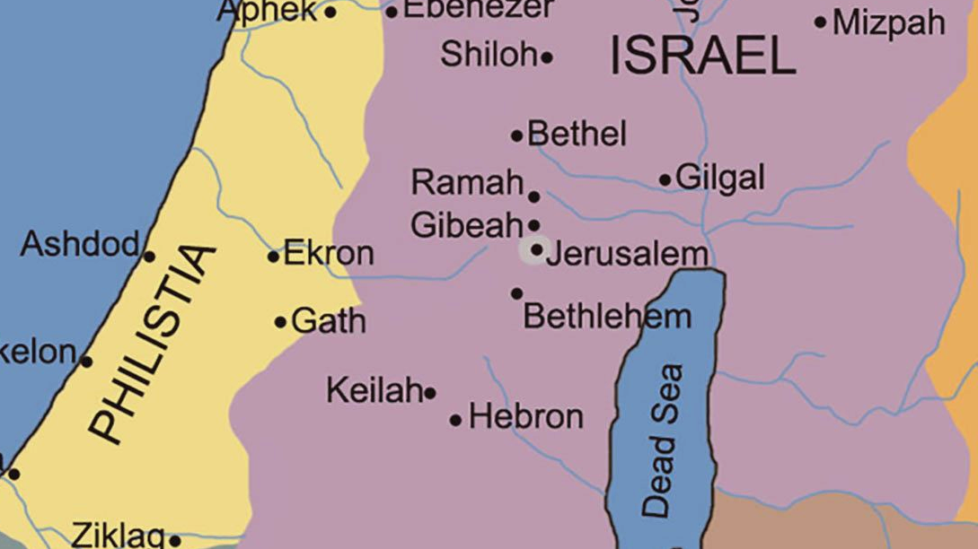
Notes:
ADAM
Chapter 19 we went from Gilgal to
Sarcasm: “This song was at the top of the ISRAEL HOT 100 chart or 13 weeks. Makes sense a Philistine king hear that snappy tune.”

Slide 19
1 Samuel 21:1-22:5
10 Then David arose and fled that day from Saul, and went to Achish king of Gath. 11 But the servants of Achish said to him, “Is this not David the king of the land? Did they not sing of this one as they danced, saying,
‘Saul has slain his thousands,
And David his ten thousands’?”
12 David took these words to heart and greatly feared Achish king of Gath. 13 So he disguised his sanity before them, and acted insanely in their hands, and scribbled on the doors of the gate, and let his saliva run down into his beard. 14 Then Achish said to his servants, “Behold, you see the man behaving as a madman. Why do you bring him to me? 15 Do I lack madmen, that you have brought this one to act the madman in my presence? Shall this one come into my house?”
1 Samuel 21:12-15 (NASB)
Notes:
ADAMSaliva in 10:13 is the same word to describe eggs whites in Job 6:6. These are the one 2 occurrences of this noun.
ART
<From Nob to Gath (1 Sam. 21:10-15). Fear of Saul now temporarily replaced faith in the Lord, and David fled twenty-three miles to the enemy city of Gath, the home of the Philistine giant Goliath (17:4). It wasn't a safe place to go, but after seeing Doeg at Nob, David may have decided that his presence anywhere in Israel would only jeopardize the lives of his friends, so he decided to leave the land. Furthermore, the last place Saul would look for him would be in Philistia. David's reputation as a great warrior had preceded him,' and the king and his counselors didn't view his presence as a blessing. David then pretended to be mad, and this made it easy for him to escape unharmed. Had David waited on the Lord and sought His will, he might not have gotten into trouble.
Psalms 34 and 56 both came out of this bizarre experience. Psalm 56 was his prayer for God's help when the situation became dangerous, and Psalm 34 was his hymn of praise after God had delivered him, although he mentions "fear" (vv. 4, 7) and deliverance from trouble (1 Sam. 21:6, 17, 19). The emphasis in Psalm 56 is on the slander and verbal attacks of the Philistine leaders as they tried to get their king to deal with David. There's no question that David was a frightened man while he was in Gath, but he sustained his faith by remembering God's promises (vv. 10-11
Sarcasm: “This song was at the top of the ISRAEL HOT 100 chart or 13 weeks. Makes sense a Philistine king hear that snappy tune.”
) and God's call upon his life (v. 12). According to Psalm 34, David did a lot of praying while in Gath (vv. 4-6, 17-22), and the Lord heard him. David learned that the fear of the Lord conquers every other fear (vv. 9-16). The Lord was indeed merciful to David to enable him to escape back to his own land. No matter how we feel or how dismal the circumstances appear, the safest place in the world is in the will of God.>

Slide 20
1 Samuel 21:1-22:5
1 So David departed from there and escaped to the cave of Adullam; and when his brothers and all his father’s household heard of it, they went down there to him. 2 Everyone who was in distress, and everyone who was in debt, and everyone who was discontented gathered to him; and he became captain over them. Now there were about four hundred men with him.
3 And David went from there to Mizpah of Moab; and he said to the king of Moab, “Please let my father and my mother come and stay with you until I know what God will do for me.” 4 Then he left them with the king of Moab; and they stayed with him all the time that David was in the stronghold. 5 The prophet Gad said to David, “Do not stay in the stronghold; depart, and go into the land of Judah.” So David departed and went into the forest of Hereth.
1 Samuel 22:1-5 (NASB)
Notes:
ART
<From Gath to the cave of Adullam (1 Sam. 22:1-2). This was a well-known place in Judah, ten miles from Gath and about fifteen miles from Bethlehem, David's hometown. David was at least in friendly territory, and the fighting men from Judah and Benjamin came to join his band (1 Chron. 12:16-18). It was here that David longed for a drink of water from the well at Bethlehem and three of his mighty men broke through enemy lines to bring it to him (2 Sam. 23:13-17). Knowing how much that drink of water cost those three men who risked their lives, David poured it out as a drink offering to the Lord. Great leaders don't take their followers for granted or treat lightly the sacrifices that they make beyond the call of duty.
All of David's family joined him at the cave, which meant that his brothers deserted Saul's army and became fugitives like David. They knew that David was God's anointed king, so they linked up with the future of the nation. Many others saw in David the only hope for a successful kingdom, so they came to him as well: those who were in distress because of Saul, those in debt, and those discontented because of the way Saul was ruining the nation (see 1 Sam. 14:29). David ended up with 400 high quality fighting men, and the number later increased to 600 (23:13; 25:13; 27:2; 30:9). Some of his mighty men and their leaders are listed in 2 Sam. 23:8-39 and 1 Chron. 11:10-41. Saul had an army of 3,000 chosen men (1 Sam. 26:2).
True leaders attract the best people who see in the leader those qualities of character that they most admire. The people around David would never have been noticed in history were it not for their association with him, just as our Lord's disciples would have died unknown had they not walked with Jesus. God usually doesn't call the great and the powerful to be His servants, but those who have a heart for Him and an eagerness to obey His will (1 Cor. 1:26-31). David's little band of rejects represented the future of the nation, and God's blessing was with them. History reveals that it is the devoted remnant, small as it might be, that holds the key to the future of God's work on this earth.
Psalms 57 and 142 are associated with David's stay in the cave of Adullam, and both of them emphasize David's faith that God was his refuge. As David prayed, the cave became a holy tabernacle where by faith he could find shelter under the wings of the cherubim in the Holy of Holies (57:1). What looked like a cave to others was to David a divine sanctuary, for the Lord was his portion and his refuge (142:5). To David, the fugitive life was like being in prison (v. 7), but he trusted the Lord to see him through. He knew that God would keep his promises and give him the throne and the kingdom.>

Slide 21
Adullam
Notes:
ADAM
Chapter 19 we went from Gilgal to
Sarcasm: “This song was at the top of the ISRAEL HOT 100 chart or 13 weeks. Makes sense a Philistine king hear that snappy tune.”

Slide 22
1 Samuel 21:1-22:5
1 So David departed from there and escaped to the cave of Adullam; and when his brothers and all his father’s household heard of it, they went down there to him. 2 Everyone who was in distress, and everyone who was in debt, and everyone who was discontented gathered to him; and he became captain over them. Now there were about four hundred men with him.
3 And David went from there to Mizpah of Moab; and he said to the king of Moab, “Please let my father and my mother come and stay with you until I know what God will do for me.” 4 Then he left them with the king of Moab; and they stayed with him all the time that David was in the stronghold. 5 The prophet Gad said to David, “Do not stay in the stronghold; depart, and go into the land of Judah.” So David departed and went into the forest of Hereth.
1 Samuel 22:1-5 (NASB)
Notes:
ART
<From Adullam to Moab (1 Sam. 22:3-4a). David honored his father and mother and sought to protect them, so he asked the king of Moab to shelter them until his days of exile were over. The Moabites were the descendants of Lot from his incestuous relationship with his older daughter (Gen. 19:30-38). In the days of Moses, the Moabites were not a people favored by the Jews (Deut. 23:3-6), but David's great-grandmother Ruth came from Moab (Ruth 4:18-22), and this may have helped David to gain their support.>

Slide 23
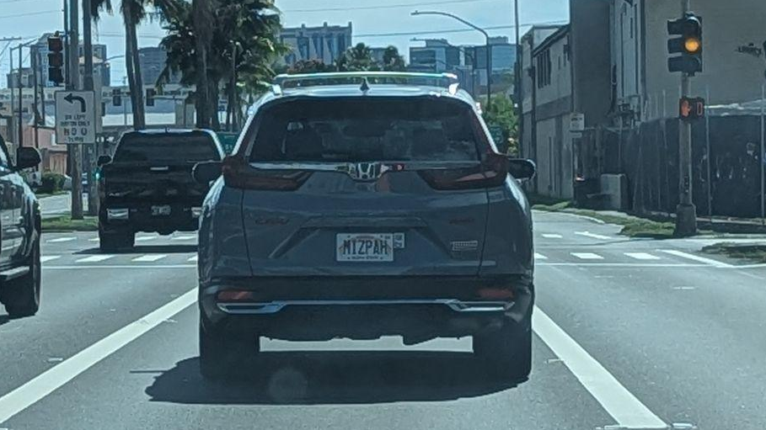

Slide 24
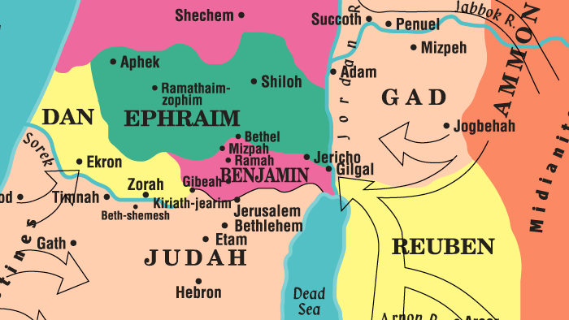
Notes:
ADAM
Chapter 19 we went from Gilgal to
Sarcasm: “This song was at the top of the ISRAEL HOT 100 chart or 13 weeks. Makes sense a Philistine king hear that snappy tune.”

Slide 25
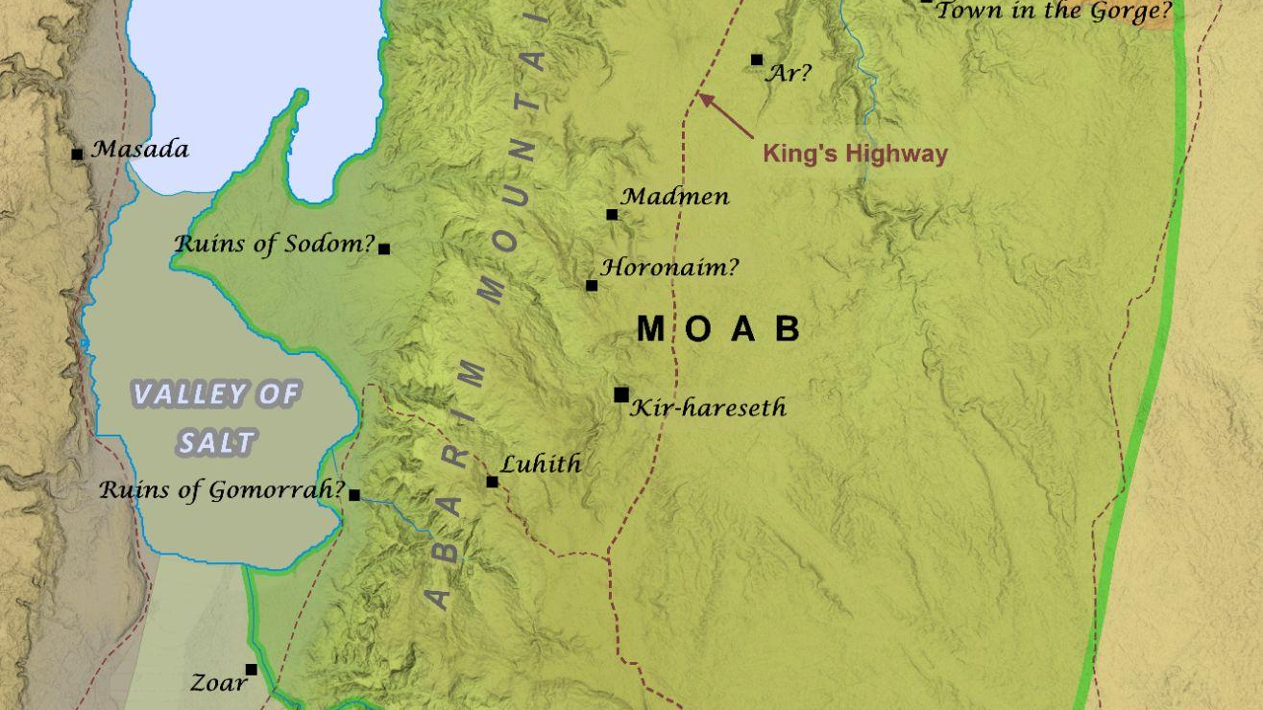

Slide 26
1 Samuel 21:1-22:5
1 So David departed from there and escaped to the cave of Adullam; and when his brothers and all his father’s household heard of it, they went down there to him. 2 Everyone who was in distress, and everyone who was in debt, and everyone who was discontented gathered to him; and he became captain over them. Now there were about four hundred men with him.
3 And David went from there to Mizpah of Moab; and he said to the king of Moab, “Please let my father and my mother come and stay with you until I know what God will do for me.” 4 Then he left them with the king of Moab; and they stayed with him all the time that David was in the stronghold. 5 The prophet Gad said to David, “Do not stay in the stronghold; depart, and go into the land of Judah.” So David departed and went into the forest of Hereth.
1 Samuel 22:1-5 (NASB)
Notes:
ART
<From Adullam to "the stronghold" (1 Sam. 22:4b). After David had secured the safety of his parents, he returned to Adullam and then moved his company to "the stronghold" or "fortress," which many students believe was at Masada by the Dead Sea, about thirty-five miles southwest of Adullam. The Hebrew word mesuda means "fortress" or "stronghold," and can refer to natural hiding places in the wilderness. David lived in different "desert strongholds" (23:14, NIV) as he tried to protect himself and his friends and outwit Saul and his spies. But the Prophet Gad warned David that the wilderness fortress wasn't safe and that he should return to the land of Judah, so he relocated in the forest of Hereth in the vicinity of the cave of Adullam. Hereth means "thicket."
The Prophet Gad will appear again in the narrative of David's life. It was he who gave David the Lord's message after David had numbered the people (2 Sam. 24:11-19; 1 Chron. 21:9-19) and assisted David in setting up the musical ministry for the sanctuary of the Lord (2 Chron. 29:25). He also wrote a book about David's reign (1 Chron. 29:29). Later, Abiathar the priest would escape Saul's slaughter of the priests at Nob and join David, so that the king would have available the ministries of both prophet and priest.>

Slide 27
Hereth
Notes:
ADAM
Chapter 19 we went from Gilgal to
Sarcasm: “This song was at the top of the ISRAEL HOT 100 chart or 13 weeks. Makes sense a Philistine king hear that snappy tune.”

Slide 28
Adullam
Notes:
ADAM
Chapter 19 we went from Gilgal to
Sarcasm: “This song was at the top of the ISRAEL HOT 100 chart or 13 weeks. Makes sense a Philistine king hear that snappy tune.”

Slide 29
Adullam
Hereth
Notes:
ADAM
Chapter 19 we went from Gilgal to
Sarcasm: “This song was at the top of the ISRAEL HOT 100 chart or 13 weeks. Makes sense a Philistine king hear that snappy tune.”

Slide 30
04
Doeg
A Deceitful Servant
Notes:
<Now we discover why the writer mentioned Doeg in verse 7, for now he steps forth as a key actor in the drama. Wherever there is a scheming leader, he will have scheming followers, for we reproduce after our own kind. These are people who will do anything to gain the leader's approval and receive his rewards, and Doeg was such a man. This was the perfect time for him to use his knowledge to please the king and raise his own stature before the other officers. The fact that he was accusing God's anointed king didn't bother him, or that he lied about what the high priest said and did. It is no wonder that David despised Doeg and express his loathing in the words of Psalm 52>

Slide 31
1 Samuel 22:6-23
6 Then Saul heard that David and the men who were with him had been discovered. Now Saul was sitting in Gibeah, under the tamarisk tree on the height with his spear in his hand, and all his servants were standing around him. 7 Saul said to his servants who stood around him, “Hear now, O Benjamites! Will the son of Jesse also give to all of you fields and vineyards? Will he make you all commanders of thousands and commanders of hundreds? 8 For all of you have conspired against me so that there is no one who discloses to me when my son makes a covenant with the son of Jesse, and there is none of you who is sorry for me or discloses to me that my son has stirred up my servant against me to lie in ambush, as it is this day.” 9 Then Doeg the Edomite, who was standing by the servants of Saul, said,
“I saw the son of Jesse coming to Nob, to Ahimelech the son of Ahitub. 10 He inquired of the Lord for him, gave him provisions, and gave him the sword of Goliath the Philistine.”
1 Samuel 22:6-10 (NASB)
Notes:
<The king's anger (1 Sam. 22:6-10). King Saul, spear in hand (18:10; 19:9; 26:7-22), was holding court under a tree on a hill 8 near Gibeah when word came to him that his spies 9 had discovered David's latest hiding place. This was probably the wilderness stronghold near the Dead Sea (1 Sam. 22:4-5), which explains why God sent the message to Gad that the company should return to Judah. Saul used this event as an occasion to berate his officers, all of whom were from his own tribe of Benjamin.10 Always suspicious of treachery in the official ranks, Saul reminded the men that he was king and therefore was the only one who could reward them for their faithful service. David attracted men who were willing to risk their lives for him, but Saul had to use bribery and fear to keep his forces together. Saul was sure that his officers were conspiring against him because they had refused to tell him that David and Jonathan had covenanted together concerning the kingdom. Jonathan was the leader of a conspiracy that included some of the very men Saul was addressing. These traitors were working for David because David had promised to reward them. Furthermore, Saul was sure that David was plotting to kill him!
Doeg told the truth when he said he saw David at Nob and that Ahimelech the high priest gave him food and the sword of Goliath. But there's no evidence that the high priest used the Urim and Thummim to determine the will of God for David (Ex. 28:30; Num. 27:21). The sword of Goliath was kept near the ephod, and Doeg (sic) may have seen the high priest with the ephod in his hand, but this wasn't evidence that Ahimelech had consulted God on behalf of David. However, the lie made Doeg look good and David look bad.>
Footnote 8 <The word “Ramah” in the KJV (v.6) means “height,” and therefore the NIV translates the text “on the hill at Gibeah.” It’s obvious that Saul and his officers couldn’t be in gibeah and Ramah at the same time, even though the cities were less than five miles apart.> NASB translates Ramah as “on the height”

Slide 32
1 Samuel 22:6-23
11 Then the king sent someone to summon Ahimelech the priest, the son of Ahitub, and all his father’s household, the priests who were in Nob; and all of them came to the king. 12 Saul said, “Listen now, son of Ahitub.” And he answered, “Here I am, my lord.” 13 Saul then said to him, “Why have you and the son of Jesse conspired against me, in that you have given him bread and a sword and have inquired of God for him, so that he would rise up against me by lying in ambush as it is this day?”
1 Samuel 22:11-13 (NASB)
Notes:
<The illegal trial (1 Sam. 22:11-15). It was but a short distance from Gibeah to Nob, so Saul immediately sent for the high priest, all his family, and the priests of Nob. Saul refused to address the high priest by his given name, but like Doeg called him "the son of Ahitub." The name Ahimelech means "brother of the king" and Saul wanted nothing to do with that, while "Ahitub" means "good brother." The king was obviously doing all he could to disgrace the high priest, when he should have been confessing his sins and seeking God's forgiveness. Saul was actually conducting an illegal trial, presenting four charges: Ahimelech gave David bread, he provided him with a weapon, he inquired of God for him, and he therefore was part of David's "conspiracy" to kill Saul so that he could become king. Never was Saul's paranoia more evident or more dangerous.>

Slide 33
1 Samuel 22:6-23
14 Then Ahimelech answered the king and said, “And who among all your servants is as faithful as David, even the king’s son-in-law, who is captain over your guard, and is honored in your house? 15 Did I just begin to inquire of God for him today? Far be it from me! Do not let the king impute anything to his servant or to any of the household of my father, for your servant knows nothing at all of this whole affair.” 16 But the king said, “You shall surely die, Ahimelech, you and all your father’s household!” 17 And the king said to the guards who were attending him, “Turn around and put the priests of the Lord to death, because their hand also is with David and because they knew that he was fleeing and did not reveal it to me.” But the servants of the king were not willing to put forth their hands to attack the priests of the Lord.
1 Samuel 22:14-17 (NASB)
Notes:
<The illegal trial (1 Sam. 22:11-15) (cont.).
When Ahimelech heard these accusations, he first defended David before giving an account of his own actions. He reminded the king that David had been a faithful servant, an argument Saul's own son Jonathan had previously used (19:4-5). The entire nation honored David as a courageous and faithful warrior. But even more, David was Saul's son-in-law, a member of the royal family, one who had always done the king's bidding. He was held in high esteem in the king's household and even served as captain of Saul's personal bodyguard (22:14, NIV). If he had wanted to kill Saul, David certainly had plenty of opportunities to do so even before he fled. Perhaps the priest's words reminded the king that it was Saul who tried to kill David, not David who tried to kill Saul.
Ahimelech denied using the ephod to determine God's will for David. In fact, he stated boldly that if he had done so, it would have been the first time, because he had never done so before." To do so would have been to forsake Saul for David! He closed his defense by stating that he and his family knew nothing about any conspiracy and therefore could in no way take part in a conspiracy.
The unjust sentence (1 Sam. 22:16-19). There was no evidence that Ahimelech had ever committed a capital crime, but Saul announced that he and his household must die. Even if the high priest had been guilty, which he was not, it was illegal to punish the whole family for the father's crime (Deut. 24:16). Their crime was knowing that David had fled and not reporting it to Saul. The things that Samuel had warned about the monarchy and even more were now taking place (1 Sam. 8:10-18). Saul had a police state in which each citizen was to spy on the others and report to the king anybody who opposed his rule. Israel had asked for a king "like the other nations," and that's what they received!
The guards nearest the king ("footmen," KJV) refused to slay the priests. (This reminds us of the time Saul commanded the people to kill Jonathan for violating the oath, and they refused to obey him (14:41-46).>

Slide 34
1 Samuel 22:6-23
18 Then the king said to Doeg, “You turn around and attack the priests.” And Doeg the Edomite turned around and attacked the priests, and he killed that day eighty-five men who wore the linen ephod. 19 And he struck Nob the city of the priests with the edge of the sword, both men and women, children and infants; also oxen, donkeys, and sheep he struck with the edge of the sword.
20 But one son of Ahimelech the son of Ahitub, named Abiathar, escaped and fled after David. 21 Abiathar told David that Saul had killed the priests of the Lord. 22 Then David said to Abiathar, “I knew on that day, when Doeg the Edomite was there, that he would surely tell Saul. I have brought about the death of every person in your father’s household. 23 Stay with me; do not be afraid, for he who seeks my life seeks your life, for you are safe with me.”
1 Samuel 22:18-23 (NASB)
Notes:
<The unjust sentence (1 Sam. 22:16-19) (cont).
Saul knew that Doeg was ready to do the evil deed, so he gave him permission to execute Ahimelech and his household, eighty-five priests of the Lord. A liar and murderer at heart (John 8:44), Doeg went beyond Saul's orders and went to Nob where he wiped out the entire population as well as the farm animals.
While this unjust trial and illegal sentence disturbs us, we must keep in mind that it was part of God's plan. This slaughter of the priests was a partial fulfillment of the ominous prophecy that had been given to unfaithful Eli (1 Sam. 2:27-36; 4:10-18), for God promised to replace the house of Eli with the house of Zadok (1 Kings 2:26-27; 4:2).
The protected priest (1 Sam. 22:20-23). The only survivor of the massacre at Nob was Abiathar, a son of Ahimelech, who then became the high priest. He knew that his only hope was to join David, so he fled to Keilah where David was now camped (23:6). When David moved from Hereth to Keilah isn't revealed in the text, but having a priest with an ephod was a tremendous help to David and his company. The 400 men had Gad the prophet, Abiathar the priest, and David the king; and they were fighting the battles of the Lord. 12 David took the blame for the slaughter of the priests, but he also took the responsibility of caring for Abiathar and making sure he was safe.
David was now officially an outlaw, but the Lord was with him and he would one day become Israel's greatest king.>
Footnote 12 Unfortunately, Abiathar sided with Adonijah In his quest for the throne, and Solomon replaced him with Azariah from the priestly family of Zadok. This was the final step in eliminating Eli’s family from the levitical priesthood.

Slide 35
Aaron
Eleazar
Ithamar
Phinehas
Eli
Hophni
Phinehas
Ahitub
Ichabod
Ahitub
Ahijah
Ahimelech
Zadok
Abiathar

Slide 36
1 Samuel 2:12-36
31 Behold, the days are coming when I will cut off your strength and the strength of your father's house, so that there will not be an old man in your house. 32 Then in distress you will look with envious eye on all the prosperity that shall be bestowed on Israel, and there shall not be an old man in your house forever. 33 The only one of you whom I shall not cut off from my altar shall be spared to weep his eyes out to grieve his heart, and all the descendants of your house shall die by the sword of men. 34 And this that shall come upon your two sons, Hophni and Phinehas, shall be the sign to you: both of them shall die on the same day. 35 And I will raise up for myself a faithful priest, who shall do according to what is in my heart and in my mind. And I will build him a sure house, and he shall go in and out before my anointed forever. 36 And everyone who is left in your house shall come to implore him for a piece of silver or a loaf of bread and shall say, “Please put me in one of the priests' places, that I may eat a morsel of bread.”’”
1 Samuel 2:31-36 (ESV)

