Slide 1






Reviewing and Rebuking 1 SAMUEL 14-15
Linder Road Church of Christ - 4th Quarter 2024
CREDITS: This presentation template was created by Slidesgo, and includes icons by Flaticon and infographics & images by Freepik
Notes:
ART (SKIP)
Wiersbe p. 59 Saul and the people rejoiced greatly over the deliverance of Jabesh Gilead from the Ammonites, and Saul was careful to give the glory to the Lord (11:13). Samuel saw the victory as a great opportunity to "renew the kingdom" (v. 14) and remind the people that Jehovah God was still their King. The fact that Saul had led the army in a great victory would tempt the Israelites to put their faith in their new king, and Samuel wanted them to know that their future success rested in trusting Jehovah alone. The king was only God's servant for the people, and both king and people had to obey God's covenant. In his farewell message, Samuel defended his own ministry (vv. 1-5), reviewed God's mercies to Israel (vv. 6-11), and admonished the people to fear the Lord and obey the covenant (vv. 12-25). Samuel mentions the Lord at least thirty times in this message, because his heart's desire was to see the people return to the Lord and honor His covenant.

Slide 2



Contact Us

Slide 3

04
An army’s insecurity
Notes:
ART
Wiersbe p67. Saul had failed miserably, but in chapter 14 we will read about Jonathan's great success as a commander. This passage (13:15-23) describes the sad condition of the army of Israel, which reveals how poor Saul's leadership was and how remarkable Jonathan's victory was. Saul walked by sight and had little faith, but Jonathan walked by faith and did exploits for the Lord.

Slide 4
1 Samuel 13:15-23
15 Then Samuel arose and went up from Gilgal to Gibeah of Benjamin. And Saul numbered the people who were present with him, about six hundred men. 16 Now Saul and his son Jonathan and the people who were present with them were staying in Geba of Benjamin while the Philistines camped at Michmash. 17 And the raiders came from the camp of the Philistines in three companies: one company turned toward Ophrah, to the land of Shual, 18 and another company turned toward Beth-horon, and another company turned toward the border which overlooks the valley of Zeboim toward the wilderness
1 Samuel 13:15-18 (NASB)
Notes:
ART A dwindling army (1 Sam. 13:15-16). Saul had mustered over 300,000 men to rescue the people of Jabesh Gilead and then had cut it down to 3,000, but now his forces numbered only 600. The Philistine army was "as the sand which is on the seashore in multitude" (v. 5), a simile also used for the army Gideon faced (Jud. 7:12) and Saul's army was twice as large as Gideon's! The difference wasn't so much the size of the army as the strength of the leader's faith. Gideon trusted God for victory and God honored him; Saul disobeyed God and God punished him. Saul had mustered that huge army by means of fear (1 Sam. 11:7), so when his men began to fear the enemy instead of the king, they began to desert the camp and go to places of safety. Jonathan knew that the Lord didn't need great numbers to accomplish His purposes (14:6), but He did honor great faith.

Slide 5
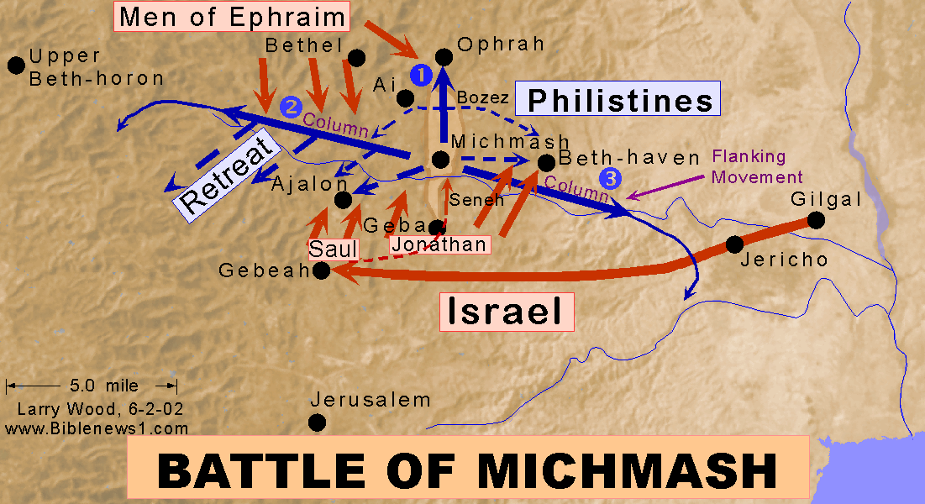

Slide 6
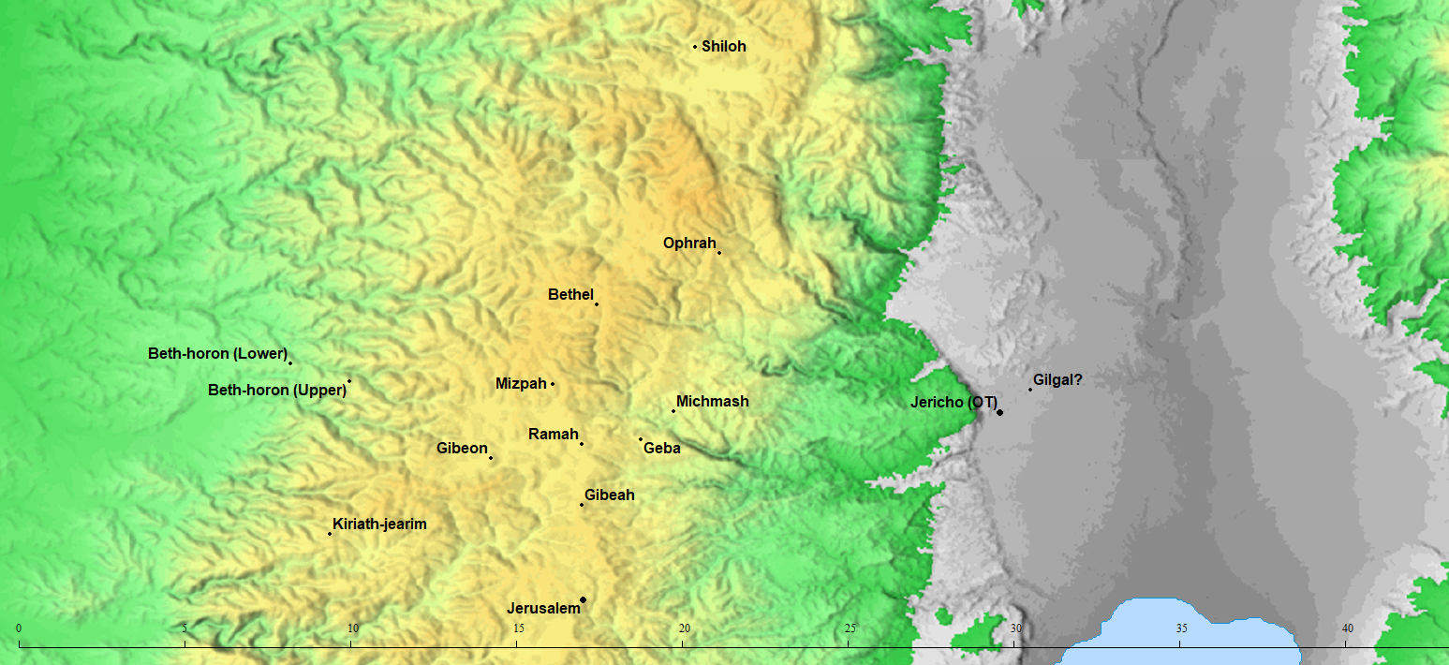

Slide 7
1 Samuel 13:15-23
15 Then Samuel arose and went up from Gilgal to Gibeah of Benjamin. And Saul numbered the people who were present with him, about six hundred men. 16 Now Saul and his son Jonathan and the people who were present with them were staying in Geba of Benjamin while the Philistines camped at Michmash. 17 And the raiders came from the camp of the Philistines in three companies: one company turned toward Ophrah, to the land of Shual, 18 and another company turned toward Beth-horon, and another company turned toward the border which overlooks the valley of Zeboim toward the wilderness
1 Samuel 13:15-18 (NASB)
Notes:
ART
Wiersbe p68 A threatened army (1 Sam. 13:17-18, 23). The Philistines repeatedly sent out "raiding parties" to protect the roads and passes that the Jews might use if they attacked, and at the same time the Philistines kept any residents from helping the Jewish army. There were three such groups: one went north toward Ophrah, a second west to Beth-horon, and the third east toward Zeboim. A fourth detachment went south toward Gibeah to prevent the Jewish army from moving up to Geba (v. 23). With all these Philistine soldiers moving about in the area, what hope was there for the Jews? No matter which way Israel turned, they would meet the enemy! And yet the Lord was going to use Jonathan and his armor-bearer to win a great victory, for with God, nothing is impossible.

Slide 8
1 Samuel 13:15-23
19 Now no blacksmith could be found in all the land of Israel, for the Philistines said, “Otherwise the Hebrews will make swords or spears.” 20 So all Israel went down to the Philistines, each to sharpen his plowshare, his mattock, his axe, and his hoe. 21 The charge was two-thirds of a shekel for the plowshares, the mattocks, the forks, and the axes, and to fix the hoes. 22 So it came about on the day of battle that neither sword nor spear was found in the hands of any of the people who were with Saul and Jonathan, but they were found with Saul and his son Jonathan. 23 And the garrison of the Philistines went out to the pass of Michmash.
1 Samuel 13:19-23 (NASB)
Notes:
ART
Wiersbe p68: A deprived army (1 Sam. 13:19-22). It was bad enough that Saul lacked men, but it was even worse that his men were not properly equipped. When the Philistines moved in and subjected the land of Israel to their rule, they deported all the ironworkers so that the Jews couldn't make weapons or even repair their farm implements. They even had to pay exorbitant prices to have their implements sharpened. The Benjamites were skilled at using slings (Jud. 20:15-16), but slings were not practical in close combat, and what about the vast number of Philistine chariots?
The Jewish army was small in number and had small supplies of weapons, but they had a great God, if only they would trust Him. All of this sets the stage for Jonathan's thrilling victory described in chapter 14, and that is contrasted with his father's sad defeat in chapter 15.
Application: Wiersbe p69 In the way it functions or doesn't function, the church today may sometimes resemble Saul's army, but if we do, it's our own fault. Through His great work on the cross, our Lord has defeated every enemy, and His power is available to His people. We have the armor and the weapons we need (Eph. 6:10ff), and His Word tells us all we need to know about the strategy of the enemy and the resources we have in Christ. All He asks is that we trust Him and obey His orders, and He will help us win the battle.
"Finally, be strong in the Lord, and in the strength of His might." (Eph. 6:10, NASB) for "the battle is the Lord's" (1 Sam. 17:47).

Slide 9
A Fooling Vow and a Lame Excuse 1 SAMUEL 14-15
Linder Road Church of Christ - 4th Quarter 2024
CREDITS: This presentation template was created by Slidesgo, and includes icons by Flaticon and infographics & images by Freepik
Notes:
Wiersbe p.71 Our task isn't an enjoyable one as we watch the character of King Saul steadily deteriorate. He has already demonstrated his unbelief and impatience (chap. 13), and now he will reveal further his disobedience and dishonesty. Saul's history will climax with the king visiting a witch and then committing suicide on the battlefield. Sir Walter Scott was right when he wrote in his poem "Marmion"
O what a tangled web we weave
When first we practice to deceive!
These chapters teach us three powerful lessons that we must heed and obey if we want the blessing of God on our lives and service.
Faith in God brings victory. 14:1-23
Foolish words bring trouble 14:24-52
Disobedience and deception bring judgment 15:1-35

Slide 10
01
Faith in God
brings victory
Notes:
Wiersbe p.71 The focus in this chapter is on Jonathan, Saul's oldest son, who had won the first major battle against the Philistines, but his father had taken the credit (13:1-7). It's a remarkable blessing of the grace of God that a man like Saul should have a son so magnificent as Jonathan. He was a courageous warrior (2 Sam. 1:22), a born leader, and a man of faith who sought to do the will of God. As the account progresses, it becomes clear that Saul is jealous of Jonathan and his popularity, and this jealousy increases when Jonathan and David became devoted friends.

Slide 11
1 Samuel 14:1-23
1 Now the day came that Jonathan, the son of Saul, said to the young man who was carrying his armor, “Come, and let’s cross over to the Philistines’ garrison that is on the other side.” But he did not tell his father. 2 Saul was staying on the outskirts of Gibeah under the pomegranate tree that is in Migron. And the people who were with him numbered about six hundred men; 3 and Ahijah, the son of Ahitub, Ichabod’s brother, the son of Phinehas, the son of Eli, the priest of the Lord at Shiloh, was wearing an ephod. And the people did not know that Jonathan had gone. 4 Now between the gorges by which Jonathan sought to cross over to the Philistines’ garrison there was a rocky crag on the one side, and a rocky crag on the other side; and the name of the one was Bozez, and the name of the other, Seneh. 5 The one crag rose on the north opposite Michmash, and the other on the south opposite Geba.
1 Samuel 14:1-5 (NASB)
Notes:
Adam
Armor-Carrier - Weapon-Bearer: More than just a caddy. He and Jonathan fought as a team. There are 9 references to him in V1-17. David was Saul’s weapon-bearer (1Sam 16). A different weapon bearer dies with Saul in 1Sam 31.
Art

Slide 13
1 Samuel 14:1-23
1 Now the day came that Jonathan, the son of Saul, said to the young man who was carrying his armor, “Come, and let’s cross over to the Philistines’ garrison that is on the other side.” But he did not tell his father. 2 Saul was staying on the outskirts of Gibeah under the pomegranate tree that is in Migron. And the people who were with him numbered about six hundred men; 3 and Ahijah, the son of Ahitub, Ichabod’s brother, the son of Phinehas, the son of Eli, the priest of the Lord at Shiloh, was wearing an ephod. And the people did not know that Jonathan had gone. 4 Now between the gorges by which Jonathan sought to cross over to the Philistines’ garrison there was a rocky crag on the one side, and a rocky crag on the other side; and the name of the one was Bozez, and the name of the other, Seneh. 5 The one crag rose on the north opposite Michmash, and the other on the south opposite Geba.
1 Samuel 14:1-5 (NASB)
Notes:
Adam
We’re introduced to a Priest in the line of Eli. God cursed his family in 1Sam 2:31-33
31 See, the days are coming when I will break your strength and the strength of your father’s family. So there will not be an old man in your family. 32 You will see the trouble of My family, even in all the good I do for Israel. And an old man will not be in your family forever. 33 But I will not destroy every man of yours from My altar. Some will be left to cry and be filled with sorrow. But all the children of your family will die in their best years.
The writer wants up to remember who this is we’re now meeting. How do I know this? They are breaking for the regular lineage description with ‘Ichabod’ who we saw born and named 10 chapters ago in Samuel 4:21. Will God make good on his promise? OR will he wait?

Slide 14
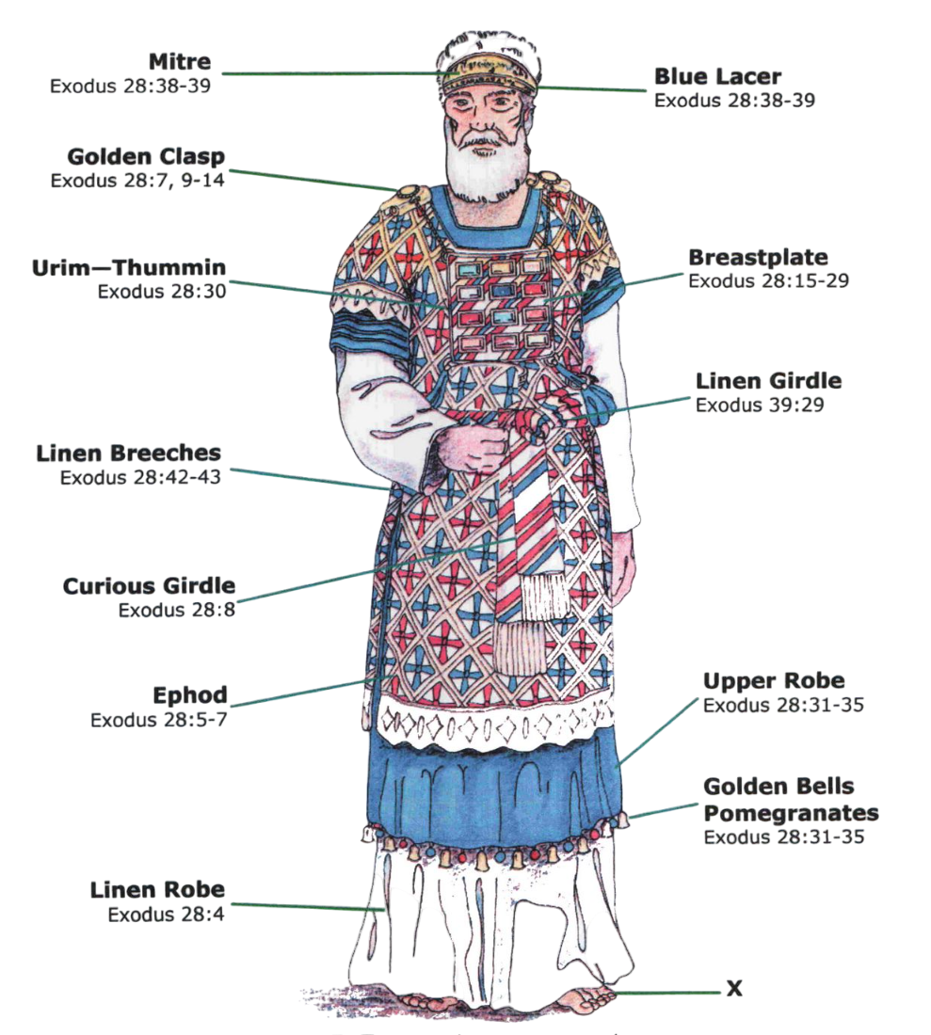
Priestly Garments
Ephod
Urim
Thummin
Breastplate

Slide 15
Aaron
Eleazar
Ithamar
Phinehas
Eli
Hophni
Phinehas
Ahitub
Ichabod
Ahitub
Ahijah
Ahimelech
Zadok
Abiathar
Notes:
ADAM
Remember: H and P are MEN abusing their position when Samuel is given to Eli by Hanna.
It’s a good educated guess that Samuel was about 10 years old when Samuel Died.
Ichabod’s wife has a child during the battle with the Philistines when the ARK of the COV is lost.
I would assume that Ahijah and Ahimelech are younger than Samuel but older than Saul.
Abiathar is a priest around during David’s death and the transition of power to Solomon. He is exiled by Solomon for supporting Adonijah for kingship after David’s death.

Slide 16
1 Samuel 14:1-23
1 Now the day came that Jonathan, the son of Saul, said to the young man who was carrying his armor, “Come, and let’s cross over to the Philistines’ garrison that is on the other side.” But he did not tell his father. 2 Saul was staying on the outskirts of Gibeah under the pomegranate tree that is in Migron. And the people who were with him numbered about six hundred men; 3 and Ahijah, the son of Ahitub, Ichabod’s brother, the son of Phinehas, the son of Eli, the priest of the Lord at Shiloh, was wearing an ephod. And the people did not know that Jonathan had gone. 4 Now between the gorges by which Jonathan sought to cross over to the Philistines’ garrison there was a rocky crag on the one side, and a rocky crag on the other side; and the name of the one was Bozez, and the name of the other, Seneh. 5 The one crag rose on the north opposite Michmash, and the other on the south opposite Geba.
1 Samuel 14:1-5 (NASB)
Notes:
ADAM
He was wearing an ephod. We might be able to assume he’s wearing priestly garments. Garments looks something like this:

Slide 17
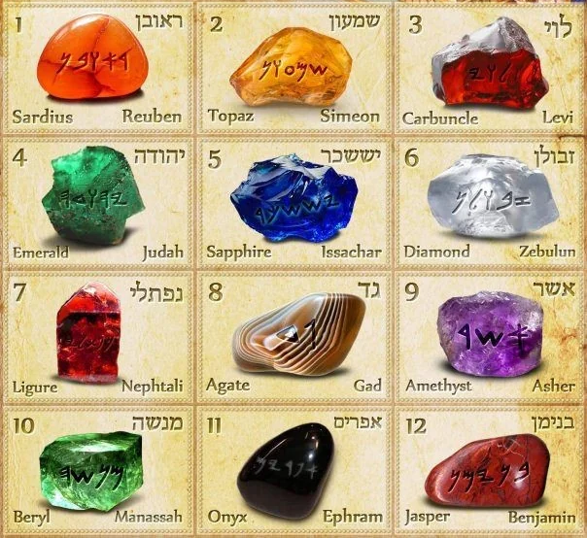
Priestly Garments
15 “You shall make a breastpiece of judgment, the work of a skillful workman; like the work of the ephod you shall make it: of gold, of blue and purple and scarlet material and fine twisted linen you shall make it. 16 It shall be square and folded double, a span in length and a span in width. 17 You shall mount on it four rows of stones; the first row shall be a row of ruby, topaz and emerald; 18 and the second row a turquoise, a sapphire and a diamond; 19 and the third row a jacinth, an agate and an amethyst; 20 and the fourth row a beryl and an onyx and a jasper; they shall be set in gold filigree. 21 The stones shall be according to the names of the sons of Israel: twelve, according to their names; they shall be like the engravings of a seal, each according to his name for the twelve tribes. Exodus 28:15-21 (NASB)
Notes:
Exodus 28:30
30 You shall put in the breastpiece of judgment the Urim and the Thummim, and they shall be over Aaron’s heart when he goes in before the Lord; and Aaron shall carry the judgment of the sons of Israel over his heart before the Lord continually.

Slide 18
1 Samuel 14:1-23
1 Now the day came that Jonathan, the son of Saul, said to the young man who was carrying his armor, “Come, and let’s cross over to the Philistines’ garrison that is on the other side.” But he did not tell his father. 2 Saul was staying on the outskirts of Gibeah under the pomegranate tree that is in Migron. And the people who were with him numbered about six hundred men; 3 and Ahijah, the son of Ahitub, Ichabod’s brother, the son of Phinehas, the son of Eli, the priest of the Lord at Shiloh, was wearing an ephod. And the people did not know that Jonathan had gone. 4 Now between the gorges by which Jonathan sought to cross over to the Philistines’ garrison there was a rocky crag on the one side, and a rocky crag on the other side; and the name of the one was Bozez, and the name of the other, Seneh. 5 The one crag rose on the north opposite Michmash, and the other on the south opposite Geba.
1 Samuel 14:1-5 (NASB)
Notes:
Adam
Not a lot of evidences for these CRAGS mentioned here. But we think the gorge is the gorge on the map
ART
Jonathan initiates the attack (1 Sam. 14:1-15). The Philistines had sent a detachment of soldiers to establish a new outpost to guard the pass at Michmash (13:23), and Jonathan saw this as an opportunity to attack and see the Lord work. Saul was hesitating in unbelief (14:2) while his son was acting by faith. God had called Saul to begin Israel's liberation from the Philistines, but most of the time he only followed up on what others started. In spite of all that the Lord had done for him and all that Samuel had taught him, Saul was not a man of faith who trusted the Lord and sought to glorify Him. Saul had a priest of the Lord attending him, a man named Ahijah from the rejected line of Eli (v. 3), but the king never waited for the Lord's counsel (vv. 18-20). Saul is a tragic example of the popular man of the world who tries to appear religious and do God's work, but who lacks a living faith in God and a heart to honor Him. Unfortunately, church history records the lives of too many gifted people who "used God" to achieve their own purposes, but in the end abandoned Him and ended life in disgrace.
Why didn't Jonathan tell his father that he had a plan to rout the enemy? Because Saul in unbelief would have vetoed such a daring venture of faith, and Jonathan had no desire to disagree with him at such a crucial time. Jonathan may have been insubordinate to his father and commander-in-chief, but his plan was still the wisest approach to take. With their false sense of security, the Philistine troops at the new outpost wouldn't be afraid of a couple of Jews who managed to cross the pass and climb the cliffs. Maybe the guards would see them as two Jewish men who wanted to desert the Hebrew army and find refuge with the enemy. Jonathan wasn't about to let the enemy attack first.

Slide 20
1 Samuel 14:1-23
6 Then Jonathan said to the young man who was carrying his armor, “Come, and let’s cross over to the garrison of these uncircumcised men; perhaps the Lord will work for us, because the Lord is not limited to saving by many or by few!” 7 His armor bearer said to him, “Do everything that is in your heart; turn yourself to it, and here I am with you, as your heart desires.” 8 Then Jonathan said, “Behold, we are going to cross over to the men and reveal ourselves to them. 9 If they say to us, ‘Wait until we come to you’; then we will stand in our place and not go up to them. 10 But if they say, ‘Come up to us,’ then we will go up, for the Lord has handed them over to us; and this shall be the sign to us.”
1 Samuel 14:6-10 (NASB)
Notes:
ADAM
It’s a slur, a mockery and an expression of the confidence of victory. Would David be quoting Jonathan in later chapters?
Speaking of Goliath: 1 Sam 17:26
26 David asked the men standing near him, “What will be done for the man who kills this Philistine and removes this disgrace from Israel? Who is this uncircumcised Philistine that he should defy the armies of the living God?”

Slide 21
1 Samuel 14:1-23
6 Then Jonathan said to the young man who was carrying his armor, “Come, and let’s cross over to the garrison of these uncircumcised men; perhaps the Lord will work for us, because the Lord is not limited to saving by many or by few!” 7 His armor bearer said to him, “Do everything that is in your heart; turn yourself to it, and here I am with you, as your heart desires.” 8 Then Jonathan said, “Behold, we are going to cross over to the men and reveal ourselves to them. 9 If they say to us, ‘Wait until we come to you’; then we will stand in our place and not go up to them. 10 But if they say, ‘Come up to us,’ then we will go up, for the Lord has handed them over to us; and this shall be the sign to us.”
1 Samuel 14:6-10 (NASB)
Notes:
ADAM
Jonathan expressed the pious hope in v6 that Yahweh would act and he protected God’s freedom with the work “perhaps”. God does act. God was with Jonathan the soldiers atest in v45 to this.
ART
Jonathan initiates the attack (1 Sam. 14:1-15). (cont.) You can't help but admire Jonathan's faith in the Lord. Perhaps as he climbed the rocks, he meditated on God's promises of victory stated in the covenant. "You will chase your enemies, and they shall fall by the sword before you. Five of you shall chase a hundred, and a hundred of you shall put ten thousand to flight; your enemies shall fall by the sword before you" (Lev. 26:7-8, NKJV; see Deut. 28:7). Action without promises is presumption, not faith, but when you have God's promises, you can go forward with confidence. Jonathan may also have been thinking of Gideon when he told his armor-bearer, "Perhaps the Lord will help us, for nothing can hinder the Lord. He can win a battle whether he has many warriors or only a few" (1 Sam. 14:6, NLT; see Jud. 6-7). "If God be for us, who can be against us?" (Rom. 8:31)

Slide 22
1 Samuel 14:1-23
6 Then Jonathan said to the young man who was carrying his armor, “Come, and let’s cross over to the garrison of these uncircumcised men; perhaps the Lord will work for us, because the Lord is not limited to saving by many or by few!” 7 His armor bearer said to him, “Do everything that is in your heart; turn yourself to it, and here I am with you, as your heart desires.” 8 Then Jonathan said, “Behold, we are going to cross over to the men and reveal ourselves to them. 9 If they say to us, ‘Wait until we come to you’; then we will stand in our place and not go up to them. 10 But if they say, ‘Come up to us,’ then we will go up, for the Lord has handed them over to us; and this shall be the sign to us.”
1 Samuel 14:6-10 (NASB)
Notes:
ADAM
This feels like the story of Gidian. Like wet and dry fleece laid out.
But to Jonathan’s credit he didn’t have to double check God’s promise.
Why the second reply being from God? Jonathans faith in God. To attack a an enemy, which occupied the superior strategic position. If Jonathan and his aid could win by crawling up on all fours against a more numerous, well-prepared and strategically well-placed enemy, then surely credit for such a victory would belong to Yahweh.
ART
Jonathan initiates the attack (1 Sam. 14:1-15). (cont.)
But Jonathan's plan of attack differed from Gideon's in at least two ways: It was not a surprise attack at night, and he and his armor-bearer deliberately let themselves be seen by the Philistine guards. It was the guards' response that would give Jonathan the guidance he needed.' Should Jonathan wait for the Philistines to come over or should he go over and meet them on their own ground? When the two men disclosed themselves to the enemy, the Philistines only laughed and mocked them. They treated them like frightened animals that had emerged from their burrows or like soldiers who were deserting the Hebrew cause and joining the Philistine army.

Slide 23
1 Samuel 14:1-23
11 When the two of them revealed themselves to the garrison of the Philistines, the Philistines said, “Behold, Hebrews are coming out of the holes where they have kept themselves hidden.” 12 So the men of the garrison responded to Jonathan and his armor bearer and said, “Come up to us and we will inform you of something.” And Jonathan said to his armor bearer, “Come up after me, for the Lord has handed them over to Israel.” 13 Then Jonathan climbed up on his hands and feet, with his armor bearer behind him; and the men fell before Jonathan, and his armor bearer put some to death after him. 14 Now that first slaughter which Jonathan and his armor bearer inflicted was about twenty men within about half a furrow in an acre of land. 15 And there was a trembling in the camp, in the field, and among all the people. Even the garrison and the raiders trembled, and the earth quaked so that it became a great trembling.
1 Samuel 14:11-15 (NASB)
Notes:
ADAM
HEBREWS is a derogatory term. It might have meant mercenaries. We’ll see more about this later.
“We will tell you something” vs “We will show you something” the hebrew is unclear here.
So Jonathan and his Armor Bearer Have killed nearly 2 footballs teams of men the space between the back of the endzone and the 5 yard line.
ART
Jonathan initiates the attack (1 Sam. 14:1-15). (cont.) But Jonathan's plan of attack differed from Gideon's in at least two ways: It was not a surprise attack at night, and he and his armor-bearer deliberately let themselves be seen by the Philistine guards. It was the guards' response that would give Jonathan the guidance he needed.' Should Jonathan wait for the Philistines to come over or should he go over and meet them on their own ground? When the two men disclosed themselves to the enemy, the Philistines only laughed and mocked them. They treated them like frightened animals that had emerged from their burrows or like soldiers who were deserting the Hebrew cause and joining the Philistine army.
This kind of arrogant self-confidence was exactly what Jonathan wanted to see, because this gave him and his armorbearer opportunity to get close to the guards before attacking. Who would fear one soldier and his armor-bearer? But these two men had Almighty God on their side! "One of you routs a thousand, because the Lord your God fights for you, just as he promised" (Josh. 23:10). The two courageous Jews quickly killed twenty men, and then the Lord honored their faith by sending an earthquake, "a very great trembling"! "But the Lord your God will deliver them over to you, throwing them into great confusion until they are destroyed" (Deut. 7:23). Terror and confusion gripped the enemy camp and prepared the way for a great victory of the army of Israel.

Slide 24
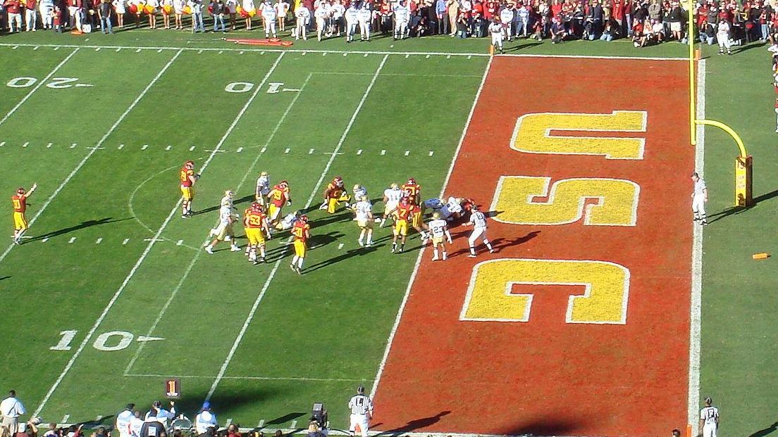
Notes:
ADAM
HEBREWS is a derogatory term. It might have meant mercenaries. We’ll see more about this later.
“We will tell you something” vs “We will show you something” the hebrew is unclear here.
So Jonathan and his Armor Bearer Have killed nearly 2 footballs teams of men the space between the back of the endzone and the 5 yard line.

Slide 25
1 Samuel 14:1-23
16 Now Saul’s watchmen in Gibeah of Benjamin looked, and behold, the multitude dissolved; they went here and there. 17 So Saul said to the people who were with him, “Look carefully now and see who has left us.” And when they had looked, behold, Jonathan and his armor bearer were not there. 18 Then Saul said to Ahijah, “Bring the ark of God here.” For at that time the ark of God was with the sons of Israel. 19 While Saul talked to the priest, the commotion in the camp of the Philistines continued and increased; so Saul said to the priest, “Withdraw your hand.”
1 Samuel 14:16-19 (NASB)
Notes:
ADAM
Saul’s piety is emphasized time and again in these chapters.
Saul is doubly impatient.
ART Wiersbe p74
Saul watches the battle (1 Sam. 14:16-19). Saul and his 600 men were back at Gibeah where Saul lived, and the watchmen on the walls could see the Philistine forces retreating and couldn't explain why. Did part of the Israeli army plan a sneak attack without Saul's permission? Who was missing? Jonathan and his armor-bearer! This was the second time that Jonathan had acted on his own (13:3), and it probably irritated Saul that his own son should be so independent. As we study the life of Saul, we will see more and more evidence that he was what some people call a "control freak." He envied other people's success, he was suspicious of any strategy he didn't originate or at least approve, and he was ruthless when it came to removing people who challenged his leadership or exposed his folly.
Saul asked the priest to bring him the ark of the Lord and probably also the ephod.' He was probably planning to take the ark to the battlefield with the army, a foolish tactic that had brought judgment in Eli's day (chap. 4); and the priest could use the ephod to determine God's will in the matter. But the priest never had a chance to determine God's will, for when Saul heard the noise of the battle increasing, he interrupted the divine proceedings and made his own decision. Once again, Saul's impatience and self confidence got the best of him and he acted without knowing God's will or receiving God's blessing (Deut. 20:4-5). He was desperately anxious to prove himself as good a soldier as Jonathan and he desperately wanted to avenge himself against his enemies (1 Sam. 14:24). It was to fulfill his own personal agenda, not to honor God, that he rushed into the battle spiritually unprepared.

Slide 26
1 Samuel 14:1-23
20 Then Saul and all the people who were with him rallied and came to the battle; and behold, every man’s sword was against his fellow Philistine, and there was very great confusion. 21 Now the Hebrews who were with the Philistines previously, who went up with them all around in the camp, even they also returned to be with the Israelites who were with Saul and Jonathan. 22 When all the men of Israel who had kept themselves hidden in the hill country of Ephraim heard that the Philistines had fled, they also closely pursued them in the battle. 23 So the Lord saved Israel that day, and the battle spread beyond Beth-aven.
1 Samuel 14:20-23 (NASB)
Notes:
ADAM
Samuel 13:5 says Beth-Aven is West of Michmash.
5 The Philistines assembled to fight Israel, with three thousand chariots, six thousand charioteers, and soldiers as numerous as the sand on the seashore. They went up and camped at Mikmash, east of Beth Aven.
Joshua 7:2 says Beth-Aven is East of Bethel
2 Now Joshua sent men from Jericho to Ai, which is near Beth Aven to the east of Bethel, and told them, “Go up and spy out the region.” So the men went up and spied out Ai.
ART Wiersbe p. 74-75
Israel enters the battle (1 Sam. 14:20-23). As Saul and his army moved toward the battlefield, they were joined by Israelites who had deserted to the enemy camp (v. 21) and by men who had fled the battle and hidden away (v. 22). We wonder what kind of soldiers these quitters turned out to be. The fact that Saul accepted these men may indicate that he was trusting his army and not trusting the Lord. Six hundred soldiers don't make a large army, so he welcomed even the weakest man to return. Yet in a few hours, Saul would be willing to kill his own son for eating some honey and breaking his father's foolish vow! Saul's emotional unbalance and contradictory thinking will show up again and again and do great damage to the kingdom. One day he will rush ahead like the horse, and the next day he will hold back like the mule (Ps. 32:9).
It was not Saul and his army who won the battle, but the Lord who used Jonathan and his armor-bearer (1 Sam. 14:23, see vv. 6, 12, and 45). The Israelite army followed the Philistines for the next fifteen miles, from Michmash to Beth Aven, and the Lord enabled them to defeat the enemy. But Saul had joined the battle so late, and his men were so weak and famished, that he couldn't achieve the kind of victory that would have been decisive (v. 30). One of the marks of a true leader is knowing when to act, and Saul had wasted time watching the battle from a distance and failing to seek the mind of the Lord.

Slide 27
Beth-aven
?

Slide 28
02
Foolish words
bring trouble
Notes:
ART
Wiersbe p75 The spiritual conditions of our hearts are revealed not only by the actions we perform but also by the words we speak. "For out of the abundance of the heart the mouth speaks" (Matt. 12:34). When you read King Saul's words recorded in Scripture, they often reveal a heart controlled by pride, foolishness, and deceit. He would say foolish things just to impress people with his "spirituality," when in reality he was walking far from the Lord.

Slide 29
1 Samuel 14:24-52
24 Now the men of Israel were hard-pressed on that day, for Saul had put the people under oath, saying, “Cursed be the man who eats food before evening, and before I have avenged myself on my enemies.” So none of the people tasted food. 25 All the people of the land entered the forest, and there was honey on the ground. 26 When the people entered the forest, behold, there was honey dripping; but no man put his hand to his mouth, because the people feared the oath. 27 However, Jonathan had not heard it when his father put the people under oath; so he put out the end of the staff that was in his hand and dipped it in the honeycomb, and put his hand to his mouth, and his eyes brightened.
1 Samuel 14:24-27 (NASB)
Notes:
ADAM
Sauls Paradoxical piety is the source of difficulty. Jonathan did not hear the oath his father laid on the people.
“His eyes brightened”
Psalms 13:3-4 3 Consider and answer me, O Lord my God;
Enlighten my eyes, or I will sleep the sleep of death,
4 And my enemy will say, “I have overcome him,”
And my adversaries will rejoice when I am shaken.
Ezra 9:8 8 But now for a brief moment grace has been shown from the Lord our God, to leave us an escaped remnant and to give us a peg in His holy place, that our God may enlighten our eyes and grant us a little reviving in our bondage.
This has echos of Judges 11. Jephthah’s vow to kill what he saw next…and they he saw his daughter.
Jud 11:30-31 Jephthah made a vow to the Lord and said, “If You will indeed give the sons of Ammon into my hand, 31 then it shall be that whatever comes out of the doors of my house to meet me when I return in peace from the sons of Ammon, it shall be the Lord’s, and I will offer it up as a burnt offering.”
Wiersbe pp75-76 A foolish vow (1 Sam. 14:24-35). Saul's heart was not right with God and he foolishly forced his army to agree to a vow of fasting until evening (v. 24). He didn't impose this fast because it was the will of God but because he wanted his soldiers to think he was a man wholly dedicated to the Lord. But this command was only more evidence of Saul's confused and superstitious faith. He thought that their fasting plus the presence of the ark would impress the Lord and He would give them victory. But Jonathan and his armor-bearer were already enjoying victory without either the ark or the fast!
No sensible commander would deprive his troops of food and energy while they were fighting the enemy. If the Lord commands it, then He would give the strength needed, but God gave Saul no such commission. Moses had fasted for forty days and nights when he was on the mountain with the Lord (Ex. 34:28), for the Lord sustained him. But Saul's soldiers were "distressed or hard-pressed" (1 Sam. 14:24), "faint or weary" (v. 28), and "very faint or very tired" (v. 31) because of this unnecessary fast. When we obey God's commands, we walk by faith, but when we obey unnatural human regulations, we only tempt the Lord. The first is confidence but the second is presumption. All of us need to heed the admonition given in Eccl. 5:2-"Do not be rash with your mouth, and let not your heart utter anything hastily before God" (NKJV).
When Jonathan and his armor-bearer joined the Israelite army in their march, they knew nothing about the king's foolish command, and Jonathan ate some honey from a honeycomb that had dropped to the ground. Then one of the soldiers told him that his father had put a curse on any soldier who ate any food that day. Why hadn't somebody warned Jonathan sooner? Perhaps they hoped that his innocent "disobedience" would open the way for all of them to eat! We wonder if Saul wasn't deliberately putting his son's life in jeopardy. However, Jonathan wasn't too worried, and he even dared to admit that his father's leadership had brought trouble to the land (v. 29).
Saul's foolish vow not only weakened the soldiers physically and hindered their ability to pursue the enemy, but it also created in the men an abnormal craving for food. When the sun set and ushered in a new day, the vow was no longer in force, and the men acted like animals as they fell on the spoils, killing the sheep and oxen and eating the meat with the blood. When Jews slaughtered their animals, they were required to drain out the blood before preparing the meat, for blood was never to be used as food (Lev. 3:17; 7:26; 17:10-14; 22:28; Deut. 12:23-24; see Gen. 9:4). A truly spiritual vow brings out the best in people, but Saul's carnal vow brought out the worst.
As he often did, the king assumed "spiritual leadership" and commanded the men to bring the animals to a great rock to be slain and the blood easily drained out. He then built an altar so that the animals could be offered as fellowship offerings (Lev. 3; 7:11-34), parts of which the people were allowed to eat in a fellowship feast. Saul was feebly trying to turn a gastronomical orgy into a worship service, but he didn't succeed too well. The men were famished and more interested in eating than in worshiping the Lord.

Slide 30
1 Samuel 14:24-52
28 Then one of the people responded and said, “Your father strictly put the people under oath, saying, ‘Cursed be the man who eats food today.’” And the people were weary. 29 Then Jonathan said, “My father has troubled the land. See now that my eyes have brightened because I tasted a little of this honey. 30 How much more, if only the people had freely eaten today of the spoils of their enemies which they found! For now the defeat among the Philistines has not been great.”
1 Samuel 14:28-30 (NASB)
Notes:
ART
Wiersbe pp75-76 A foolish vow (1 Sam. 14:24-35). Saul's heart was not right with God and he foolishly forced his army to agree to a vow of fasting until evening (v. 24). He didn't impose this fast because it was the will of God but because he wanted his soldiers to think he was a man wholly dedicated to the Lord. But this command was only more evidence of Saul's confused and superstitious faith. He thought that their fasting plus the presence of the ark would impress the Lord and He would give them victory. But Jonathan and his armor-bearer were already enjoying victory without either the ark or the fast!
No sensible commander would deprive his troops of food and energy while they were fighting the enemy. If the Lord commands it, then He would give the strength needed, but God gave Saul no such commission. Moses had fasted for forty days and nights when he was on the mountain with the Lord (Ex. 34:28), for the Lord sustained him. But Saul's soldiers were "distressed or hard-pressed" (1 Sam. 14:24), "faint or weary" (v. 28), and "very faint or very tired" (v. 31) because of this unnecessary fast. When we obey God's commands, we walk by faith, but when we obey unnatural human regulations, we only tempt the Lord. The first is confidence but the second is presumption. All of us need to heed the admonition given in Eccl. 5:2-"Do not be rash with your mouth, and let not your heart utter anything hastily before God" (NKJV).
When Jonathan and his armor-bearer joined the Israelite army in their march, they knew nothing about the king's foolish command, and Jonathan ate some honey from a honeycomb that had dropped to the ground. Then one of the soldiers told him that his father had put a curse on any soldier who ate any food that day. Why hadn't somebody warned Jonathan sooner? Perhaps they hoped that his innocent "disobedience" would open the way for all of them to eat! We wonder if Saul wasn't deliberately putting his son's life in jeopardy. However, Jonathan wasn't too worried, and he even dared to admit that his father's leadership had brought trouble to the land (v. 29).
Saul's foolish vow not only weakened the soldiers physically and hindered their ability to pursue the enemy, but it also created in the men an abnormal craving for food. When the sun set and ushered in a new day, the vow was no longer in force, and the men acted like animals as they fell on the spoils, killing the sheep and oxen and eating the meat with the blood. When Jews slaughtered their animals, they were required to drain out the blood before preparing the meat, for blood was never to be used as food (Lev. 3:17; 7:26; 17:10-14; 22:28; Deut. 12:23-24; see Gen. 9:4). A truly spiritual vow brings out the best in people, but Saul's carnal vow brought out the worst.
As he often did, the king assumed "spiritual leadership" and commanded the men to bring the animals to a great rock to be slain and the blood easily drained out. He then built an altar so that the animals could be offered as fellowship offerings (Lev. 3; 7:11-34), parts of which the people were allowed to eat in a fellowship feast. Saul was feebly trying to turn a gastronomical orgy into a worship service, but he didn't succeed too well. The men were famished and more interested in eating than in worshiping the Lord.

Slide 31
1 Samuel 14:24-52
31 They attacked the Philistines that day from Michmash to Aijalon. But the people were very tired. 32 So the people loudly rushed upon the spoils, and took sheep, oxen, and calves, and slaughtered them on the ground; and the people ate them with the blood. 33 Then observers informed Saul, saying, “Look, the people are sinning against the Lord by eating meat with the blood.” And he said, “You have acted treacherously; roll a large rock to me today.” 34 Then Saul said, “Disperse yourselves among the people and say to them, ‘Each one of you bring me his ox or his sheep, and slaughter it here and eat; and do not sin against the Lord by eating it with the blood.’” So all the people brought them that night, each one his ox with him, and they slaughtered them there. 35 And Saul built an altar to the Lord; it was the first altar that he built to the Lord.
1 Samuel 14:31-35 (NASB)
Notes:
Wiersbe pp75-76 A foolish vow (1 Sam. 14:24-35). Saul's heart was not right with God and he foolishly forced his army to agree to a vow of fasting until evening (v. 24). He didn't impose this fast because it was the will of God but because he wanted his soldiers to think he was a man wholly dedicated to the Lord. But this command was only more evidence of Saul's confused and superstitious faith. He thought that their fasting plus the presence of the ark would impress the Lord and He would give them victory. But Jonathan and his armor-bearer were already enjoying victory without either the ark or the fast!
No sensible commander would deprive his troops of food and energy while they were fighting the enemy. If the Lord commands it, then He would give the strength needed, but God gave Saul no such commission. Moses had fasted for forty days and nights when he was on the mountain with the Lord (Ex. 34:28), for the Lord sustained him. But Saul's soldiers were "distressed or hard-pressed" (1 Sam. 14:24), "faint or weary" (v. 28), and "very faint or very tired" (v. 31) because of this unnecessary fast. When we obey God's commands, we walk by faith, but when we obey unnatural human regulations, we only tempt the Lord. The first is confidence but the second is presumption. All of us need to heed the admonition given in Eccl. 5:2-"Do not be rash with your mouth, and let not your heart utter anything hastily before God" (NKJV).
When Jonathan and his armor-bearer joined the Israelite army in their march, they knew nothing about the king's foolish command, and Jonathan ate some honey from a honeycomb that had dropped to the ground. Then one of the soldiers told him that his father had put a curse on any soldier who ate any food that day. Why hadn't somebody warned Jonathan sooner? Perhaps they hoped that his innocent "disobedience" would open the way for all of them to eat! We wonder if Saul wasn't deliberately putting his son's life in jeopardy. However, Jonathan wasn't too worried, and he even dared to admit that his father's leadership had brought trouble to the land (v. 29).
Vss. 32-33 Saul's foolish vow not only weakened the soldiers physically and hindered their ability to pursue the enemy, but it also created in the men an abnormal craving for food. When the sun set and ushered in a new day, the vow was no longer in force, and the men acted like animals as they fell on the spoils, killing the sheep and oxen and eating the meat with the blood. When Jews slaughtered their animals, they were required to drain out the blood before preparing the meat, for blood was never to be used as food (Lev. 3:17; 7:26; 17:10-14; 22:28; Deut. 12:23-24; see Gen. 9:4). A truly spiritual vow brings out the best in people, but Saul's carnal vow brought out the worst.
As he often did, the king assumed "spiritual leadership" and commanded the men to bring the animals to a great rock to be slain and the blood easily drained out. He then built an altar so that the animals could be offered as fellowship offerings (Lev. 3; 7:11-34), parts of which the people were allowed to eat in a fellowship feast. Saul was feebly trying to turn a gastronomical orgy into a worship service, but he didn't succeed too well. The men were famished and more interested in eating than in worshiping the Lord.

Slide 32


Beth-aven
Aijalon

Slide 33
1 Samuel 14:24-52
31 They attacked the Philistines that day from Michmash to Aijalon. But the people were very tired. 32 So the people loudly rushed upon the spoils, and took sheep, oxen, and calves, and slaughtered them on the ground; and the people ate them with the blood. 33 Then observers informed Saul, saying, “Look, the people are sinning against the Lord by eating meat with the blood.” And he said, “You have acted treacherously; roll a large rock to me today.” 34 Then Saul said, “Disperse yourselves among the people and say to them, ‘Each one of you bring me his ox or his sheep, and slaughter it here and eat; and do not sin against the Lord by eating it with the blood.’” So all the people brought them that night, each one his ox with him, and they slaughtered them there. 35 And Saul built an altar to the Lord; it was the first altar that he built to the Lord.
1 Samuel 14:31-35 (NASB)
Notes:
ADAM
Similarities to Joshua 10:12-13
12 On the day the Lord gave the Amorites over to Israel, Joshua said to the Lord in the presence of Israel:
“Sun, stand still over Gibeon,
and you, moon, over the Valley of Aijalon.”
13 So the sun stood still,
and the moon stopped,
till the nation avenged itself on its enemies,
The sun stopped in the middle of the sky and delayed going down about a full day.
Wiersbe pp75-76 A foolish vow (1 Sam. 14:24-35). Saul's heart was not right with God and he foolishly forced his army to agree to a vow of fasting until evening (v. 24). He didn't impose this fast because it was the will of God but because he wanted his soldiers to think he was a man wholly dedicated to the Lord. But this command was only more evidence of Saul's confused and superstitious faith. He thought that their fasting plus the presence of the ark would impress the Lord and He would give them victory. But Jonathan and his armor-bearer were already enjoying victory without either the ark or the fast!
No sensible commander would deprive his troops of food and energy while they were fighting the enemy. If the Lord commands it, then He would give the strength needed, but God gave Saul no such commission. Moses had fasted for forty days and nights when he was on the mountain with the Lord (Ex. 34:28), for the Lord sustained him. But Saul's soldiers were "distressed or hard-pressed" (1 Sam. 14:24), "faint or weary" (v. 28), and "very faint or very tired" (v. 31) because of this unnecessary fast. When we obey God's commands, we walk by faith, but when we obey unnatural human regulations, we only tempt the Lord. The first is confidence but the second is presumption. All of us need to heed the admonition given in Eccl. 5:2-"Do not be rash with your mouth, and let not your heart utter anything hastily before God" (NKJV).
When Jonathan and his armor-bearer joined the Israelite army in their march, they knew nothing about the king's foolish command, and Jonathan ate some honey from a honeycomb that had dropped to the ground. Then one of the soldiers told him that his father had put a curse on any soldier who ate any food that day. Why hadn't somebody warned Jonathan sooner? Perhaps they hoped that his innocent "disobedience" would open the way for all of them to eat! We wonder if Saul wasn't deliberately putting his son's life in jeopardy. However, Jonathan wasn't too worried, and he even dared to admit that his father's leadership had brought trouble to the land (v. 29).
Vss. 32-33 Saul's foolish vow not only weakened the soldiers physically and hindered their ability to pursue the enemy, but it also created in the men an abnormal craving for food. When the sun set and ushered in a new day, the vow was no longer in force, and the men acted like animals as they fell on the spoils, killing the sheep and oxen and eating the meat with the blood. When Jews slaughtered their animals, they were required to drain out the blood before preparing the meat, for blood was never to be used as food (Lev. 3:17; 7:26; 17:10-14; 22:28; Deut. 12:23-24; see Gen. 9:4). A truly spiritual vow brings out the best in people, but Saul's carnal vow brought out the worst.
As he often did, the king assumed "spiritual leadership" and commanded the men to bring the animals to a great rock to be slain and the blood easily drained out. He then built an altar so that the animals could be offered as fellowship offerings (Lev. 3; 7:11-34), parts of which the people were allowed to eat in a fellowship feast. Saul was feebly trying to turn a gastronomical orgy into a worship service, but he didn't succeed too well. The men were famished and more interested in eating than in worshiping the Lord.

Slide 34
1 Samuel 14:24-52
36 Then Saul said, “Let’s go down after the Philistines by night and take plunder among them until the morning light, and let’s not leave a man among them alive.” And they said, “Do whatever seems good to you.” So the priest said, “Let’s approach God here.” 37 So Saul inquired of God: “Shall I go down after the Philistines? Will You hand them over to Israel?” But He did not answer him on that day. 38 Then Saul said, “Come here, all you leaders of the people, and investigate and see how this sin has happened today.
1 Samuel 14:36-38 (NASB)
Notes:
Wiersbe pp77-78 A foolish judgment (1 Sam. 14:36-52). Surely Saul realized that his delay at Gibeah and the imposing of the foolish vow had already cost the Israelites a great victory, so he tried to make amends. He decided to move the army that very night and be ready to surprise the Philistines early the next morning. The army gave no resistance, but Ahijah the priest wisely suggested that they pause long enough to seek the will of the Lord. We aren't told what method Ahijah used to ascertain God's will, but whatever it was, God didn't answer. Even though Saul was not a godly man, his oath made in the Lord's name was legitimate; and if the Lord had ignored it, He would have dishonored His own name. Furthermore, the Lord was using this event to rebuke Saul as well as to honor Jonathan. Saul would discover that his men loved Jonathan and were prepared to defend him.
Saul already knew that Jonathan had been missing from the ranks (v. 17) and therefore he assumed that his son knew nothing about the vow. But if he had learned about the vow and still violated it, that made him an even greater sinner. Either way, Jonathan would be guilty and could be slain. We get the impression that Saul was almost determined that he would demote or destroy his own son, and it's clear that Jonathan didn't agree with his father's policies and practices. Hence, Saul made another oath (v. 39), and because his heart wasn't right nor his motive holy, he was taking the Lord's name in vain (Ex. 20:7).
This time they cast lots and the lot pointed to Saul and Jonathan. The second lot fell upon Jonathan. God could have changed the results (Prov. 16:33), but He wanted to bring the whole thing out in the open and humiliate King Saul, whose pride had caused the problem to begin with. The people praised Jonathan, not Saul, as the man who had brought the great victory to Israel, and if the Lord had used Jonathan in such a wonderful way, why should he be executed? By the time this matter was settled, it was too late to follow the Philistine army, so Saul and his men retreated. The victory did send the Philistines back home for a time, but they repeatedly threatened Israel (1 Sam. 14: 52). This victory did enhance Saul's reputation and helped him consolidate his kingdom. In verses 47-48 and 52, the writer summarizes some of Saul's major victories and informs us that he drafted every good man he met.
The facts about the royal family are summarized in vv. 49-51, but when they are compared with other texts (1 Sam. 9:2; 2 Sam. 21:8;1 Chron. 8:29-33; 9:39), they reveal some problems. Saul's grandfather was Abiel and his father Kish (1 Sam. 9:1-2). Ner was his uncle and Abner ("son of Ner") was captain of the army (14:51). Only three sons are mentioned (Jonathan, Ishvi, and Malchishua), while later texts speak also of Abinadab and Esh-Baal (1 Chron. 8:33; 9:39). He had two daughters, Merab and Michel, and all of these children were by his wife Ahinoam. His concubine Rizpah bore him Armoni and Mephibosheth (2 Sam. 21:8).
Jonathan, Malchishua and Abinadab all died with their father at Gilboa (1 Sam. 31:1-2), and Abner made Ish-bosheth king (2 Sam. 2:8ff). Ish-bosheth is probably the Esh-Baal of 1 Chronicles 8:33 and 9:39, for it wasn't unusual for Jewish men to have more than one name. But what happened to Ishvi? Was this also another name for Esh-Baal (Ish-bosheth), for the two names are not found together in any text. If so, then Saul had four sons by Ahinoam-Jonathan, the eldest, and then Ishhvi/Esh-Baal/Ishbosheth, Malchi-shua, and Abinadab. Since the eldest and two youngest sons were killed in battle, this left IshBosheth/Ishvi/Esh-Baal, Saul's second-born, to claim the crown. Of course, it's possible that Ishvi had died earlier, and this would have left Esh-Baal/Ish-bosheth to reign, or if Esh-Baal died, then Ishvi/Ish-bosheth survived to rule briefly.

Slide 35
1 Samuel 14:24-52
39 For as the Lord lives, who saves Israel, even if it is in my son Jonathan, he shall assuredly die!” But not one of all the people answered him. 40 Then he said to all Israel, “You shall be on one side, and I and my son Jonathan will be on the other side.” And the people said to Saul, “Do what seems good to you.” 41 Therefore, Saul said to the Lord, the God of Israel, “Give a perfect lot.” And Jonathan and Saul were selected by lot, but the people were exonerated. 42 Then Saul said, “Cast lots between me and my son Jonathan.” And Jonathan was selected by lot.
1 Samuel 14:39-42 (NASB)
Notes:
ADAM
Jonathan is ‘his son’ before we knew he sinned…and just ‘Jonathan’ afterward
We can assume with high probability that the urim and Thummim are being used here to cast lots.
Urim begins with the first letter of the hebrew alphabet and Thummim with the last.
Wiersbe pp77-78 A foolish judgment (1 Sam. 14:36-52). Surely Saul realized that his delay at Gibeah and the imposing of the foolish vow had already cost the Israelites a great victory, so he tried to make amends. He decided to move the army that very night and be ready to surprise the Philistines early the next morning. The army gave no resistance, but Ahijah the priest wisely suggested that they pause long enough to seek the will of the Lord. We aren't told what method Ahijah used to ascertain God's will, but whatever it was, God didn't answer. Even though Saul was not a godly man, his oath made in the Lord's name was legitimate; and if the Lord had ignored it, He would have dishonored His own name. Furthermore, the Lord was using this event to rebuke Saul as well as to honor Jonathan. Saul would discover that his men loved Jonathan and were prepared to defend him.
Saul already knew that Jonathan had been missing from the ranks (v. 17) and therefore he assumed that his son knew nothing about the vow. But if he had learned about the vow and still violated it, that made him an even greater sinner. Either way, Jonathan would be guilty and could be slain. We get the impression that Saul was almost determined that he would demote or destroy his own son, and it's clear that Jonathan didn't agree with his father's policies and practices. Hence, Saul made another oath (v. 39), and because his heart wasn't right nor his motive holy, he was taking the Lord's name in vain (Ex. 20:7).
This time they cast lots and the lot pointed to Saul and Jonathan. The second lot fell upon Jonathan. God could have changed the results (Prov. 16:33), but He wanted to bring the whole thing out in the open and humiliate King Saul, whose pride had caused the problem to begin with. The people praised Jonathan, not Saul, as the man who had brought the great victory to Israel, and if the Lord had used Jonathan in such a wonderful way, why should he be executed? By the time this matter was settled, it was too late to follow the Philistine army, so Saul and his men retreated. The victory did send the Philistines back home for a time, but they repeatedly threatened Israel (1 Sam. 14: 52). This victory did enhance Saul's reputation and helped him consolidate his kingdom. In verses 47-48 and 52, the writer summarizes some of Saul's major victories and informs us that he drafted every good man he met.
The facts about the royal family are summarized in vv. 49-51, but when they are compared with other texts (1 Sam. 9:2; 2 Sam. 21:8;1 Chron. 8:29-33; 9:39), they reveal some problems. Saul's grandfather was Abiel and his father Kish (1 Sam. 9:1-2). Ner was his uncle and Abner ("son of Ner") was captain of the army (14:51). Only three sons are mentioned (Jonathan, Ishvi, and Malchishua), while later texts speak also of Abinadab and Esh-Baal (1 Chron. 8:33; 9:39). He had two daughters, Merab and Michel, and all of these children were by his wife Ahinoam. His concubine Rizpah bore him Armoni and Mephibosheth (2 Sam. 21:8).
Jonathan, Malchishua and Abinadab all died with their father at Gilboa (1 Sam. 31:1-2), and Abner made Ish-bosheth king (2 Sam. 2:8ff). Ish-bosheth is probably the Esh-Baal of 1 Chronicles 8:33 and 9:39, for it wasn't unusual for Jewish men to have more than one name. But what happened to Ishvi? Was this also another name for Esh-Baal (Ish-bosheth), for the two names are not found together in any text. If so, then Saul had four sons by Ahinoam-Jonathan, the eldest, and then Ishhvi/Esh-Baal/Ishbosheth, Malchi-shua, and Abinadab. Since the eldest and two youngest sons were killed in battle, this left IshBosheth/Ishvi/Esh-Baal, Saul's second-born, to claim the crown. Of course, it's possible that Ishvi had died earlier, and this would have left Esh-Baal/Ish-bosheth to reign, or if Esh-Baal died, then Ishvi/Ish-bosheth survived to rule briefly.

Slide 36
Priestly Garments
Ephod
Urim
Thummin
Breastplate

Slide 37
1 Samuel 14:24-52
43 So Saul said to Jonathan, “Tell me what you have done.” And Jonathan told him, and said, “I did indeed taste a little honey with the end of the staff that was in my hand. Here I am, I must die!” 44 And Saul said, “May God do the same to me and more also, for you shall certainly die, Jonathan!” 45 But the people said to Saul, “Must Jonathan die, he who has brought about this great victory in Israel? Far from it! As the Lord lives, not even a hair of his head shall fall to the ground, because he has worked with God this day.” So the people rescued Jonathan and he did not die. 46 Then Saul went up from pursuing the Philistines, and the Philistines went to their own place.
1 Samuel 14:43-46 (NASB)
Notes:
ADAM
Jonathan accepts his fate like Jephthahs daughter did:
Jud 11:34-37 34 When Jephthah came to his house at Mizpah, behold, his daughter was coming out to meet him with tambourines and with dancing. Now she was his one and only child; besides her he had no son or daughter. 35 When he saw her, he tore his clothes and said, “Alas, my daughter! You have brought me very low, and you are among those who trouble me; for I have given my word to the Lord, and I cannot take it back.” 36 So she said to him, “My father, you have given your word to the Lord; do to me as you have said, since the Lord has avenged you of your enemies, the sons of Ammon.” 37 She said to her father, “Let this thing be done for me; let me alone two months, that I may go to the mountains and weep because of my virginity, I and my companions.” 38 Then he said, “Go.”
“So the people rescued” - ESV ransomed - Other Versioned - Delivered. So something or someone was sacrificed in his place.
ART
Wiersbe pp77-78 A foolish judgment (1 Sam. 14:36-52). Surely Saul realized that his delay at Gibeah and the imposing of the foolish vow had already cost the Israelites a great victory, so he tried to make amends. He decided to move the army that very night and be ready to surprise the Philistines early the next morning. The army gave no resistance, but Ahijah the priest wisely suggested that they pause long enough to seek the will of the Lord. We aren't told what method Ahijah used to ascertain God's will, but whatever it was, God didn't answer. Even though Saul was not a godly man, his oath made in the Lord's name was legitimate; and if the Lord had ignored it, He would have dishonored His own name. Furthermore, the Lord was using this event to rebuke Saul as well as to honor Jonathan. Saul would discover that his men loved Jonathan and were prepared to defend him.
Saul already knew that Jonathan had been missing from the ranks (v. 17) and therefore he assumed that his son knew nothing about the vow. But if he had learned about the vow and still violated it, that made him an even greater sinner. Either way, Jonathan would be guilty and could be slain. We get the impression that Saul was almost determined that he would demote or destroy his own son, and it's clear that Jonathan didn't agree with his father's policies and practices. Hence, Saul made another oath (v. 39), and because his heart wasn't right nor his motive holy, he was taking the Lord's name in vain (Ex. 20:7).
This time they cast lots and the lot pointed to Saul and Jonathan. The second lot fell upon Jonathan. God could have changed the results (Prov. 16:33), but He wanted to bring the whole thing out in the open and humiliate King Saul, whose pride had caused the problem to begin with. The people praised Jonathan, not Saul, as the man who had brought the great victory to Israel, and if the Lord had used Jonathan in such a wonderful way, why should he be executed? By the time this matter was settled, it was too late to follow the Philistine army, so Saul and his men retreated. The victory did send the Philistines back home for a time, but they repeatedly threatened Israel (1 Sam. 14: 52). This victory did enhance Saul's reputation and helped him consolidate his kingdom. In verses 47-48 and 52, the writer summarizes some of Saul's major victories and informs us that he drafted every good man he met.
The facts about the royal family are summarized in vv. 49-51, but when they are compared with other texts (1 Sam. 9:2; 2 Sam. 21:8;1 Chron. 8:29-33; 9:39), they reveal some problems. Saul's grandfather was Abiel and his father Kish (1 Sam. 9:1-2). Ner was his uncle and Abner ("son of Ner") was captain of the army (14:51). Only three sons are mentioned (Jonathan, Ishvi, and Malchishua), while later texts speak also of Abinadab and Esh-Baal (1 Chron. 8:33; 9:39). He had two daughters, Merab and Michel, and all of these children were by his wife Ahinoam. His concubine Rizpah bore him Armoni and Mephibosheth (2 Sam. 21:8).
Jonathan, Malchishua and Abinadab all died with their father at Gilboa (1 Sam. 31:1-2), and Abner made Ish-bosheth king (2 Sam. 2:8ff). Ish-bosheth is probably the Esh-Baal of 1 Chronicles 8:33 and 9:39, for it wasn't unusual for Jewish men to have more than one name. But what happened to Ishvi? Was this also another name for Esh-Baal (Ish-bosheth), for the two names are not found together in any text. If so, then Saul had four sons by Ahinoam-Jonathan, the eldest, and then Ishhvi/Esh-Baal/Ishbosheth, Malchi-shua, and Abinadab. Since the eldest and two youngest sons were killed in battle, this left IshBosheth/Ishvi/Esh-Baal, Saul's second-born, to claim the crown. Of course, it's possible that Ishvi had died earlier, and this would have left Esh-Baal/Ish-bosheth to reign, or if Esh-Baal died, then Ishvi/Ish-bosheth survived to rule briefly.

Slide 38
1 Samuel 14:24-52
47 Now when Saul had taken control of the kingdom over Israel, he fought against all his enemies on every side, against Moab, the sons of Ammon, Edom, the kings of Zobah, and the Philistines; and wherever he turned, he inflicted punishment. 48 And he acted valiantly and defeated the Amalekites, and saved Israel from the hands of those who plundered them.
1 Samuel 14:47-48 (NASB)
Notes:
Adam Narrative Shift
Wiersbe pp77-78 A foolish judgment (1 Sam. 14:36-52). Surely Saul realized that his delay at Gibeah and the imposing of the foolish vow had already cost the Israelites a great victory, so he tried to make amends. He decided to move the army that very night and be ready to surprise the Philistines early the next morning. The army gave no resistance, but Ahijah the priest wisely suggested that they pause long enough to seek the will of the Lord. We aren't told what method Ahijah used to ascertain God's will, but whatever it was, God didn't answer. Even though Saul was not a godly man, his oath made in the Lord's name was legitimate; and if the Lord had ignored it, He would have dishonored His own name. Furthermore, the Lord was using this event to rebuke Saul as well as to honor Jonathan. Saul would discover that his men loved Jonathan and were prepared to defend him.
Saul already knew that Jonathan had been missing from the ranks (v. 17) and therefore he assumed that his son knew nothing about the vow. But if he had learned about the vow and still violated it, that made him an even greater sinner. Either way, Jonathan would be guilty and could be slain. We get the impression that Saul was almost determined that he would demote or destroy his own son, and it's clear that Jonathan didn't agree with his father's policies and practices. Hence, Saul made another oath (v. 39), and because his heart wasn't right nor his motive holy, he was taking the Lord's name in vain (Ex. 20:7).
This time they cast lots and the lot pointed to Saul and Jonathan. The second lot fell upon Jonathan. God could have changed the results (Prov. 16:33), but He wanted to bring the whole thing out in the open and humiliate King Saul, whose pride had caused the problem to begin with. The people praised Jonathan, not Saul, as the man who had brought the great victory to Israel, and if the Lord had used Jonathan in such a wonderful way, why should he be executed? By the time this matter was settled, it was too late to follow the Philistine army, so Saul and his men retreated. The victory did send the Philistines back home for a time, but they repeatedly threatened Israel (1 Sam. 14: 52). This victory did enhance Saul's reputation and helped him consolidate his kingdom. In verses 47-48 and 52, the writer summarizes some of Saul's major victories and informs us that he drafted every good man he met.
The facts about the royal family are summarized in vv. 49-51, but when they are compared with other texts (1 Sam. 9:2; 2 Sam. 21:8;1 Chron. 8:29-33; 9:39), they reveal some problems. Saul's grandfather was Abiel and his father Kish (1 Sam. 9:1-2). Ner was his uncle and Abner ("son of Ner") was captain of the army (14:51). Only three sons are mentioned (Jonathan, Ishvi, and Malchishua), while later texts speak also of Abinadab and Esh-Baal (1 Chron. 8:33; 9:39). He had two daughters, Merab and Michel, and all of these children were by his wife Ahinoam. His concubine Rizpah bore him Armoni and Mephibosheth (2 Sam. 21:8).
Jonathan, Malchishua and Abinadab all died with their father at Gilboa (1 Sam. 31:1-2), and Abner made Ish-bosheth king (2 Sam. 2:8ff). Ish-bosheth is probably the Esh-Baal of 1 Chronicles 8:33 and 9:39, for it wasn't unusual for Jewish men to have more than one name. But what happened to Ishvi? Was this also another name for Esh-Baal (Ish-bosheth), for the two names are not found together in any text. If so, then Saul had four sons by Ahinoam-Jonathan, the eldest, and then Ishhvi/Esh-Baal/Ishbosheth, Malchi-shua, and Abinadab. Since the eldest and two youngest sons were killed in battle, this left IshBosheth/Ishvi/Esh-Baal, Saul's second-born, to claim the crown. Of course, it's possible that Ishvi had died earlier, and this would have left Esh-Baal/Ish-bosheth to reign, or if Esh-Baal died, then Ishvi/Ish-bosheth survived to rule briefly.

Slide 39
1 Samuel 14:24-52
49 Now the sons of Saul were Jonathan, Ishvi, and Malchi-shua; and the names of his two daughters were these: the name of the firstborn was Merab, and the name of the younger, Michal. 50 And the name of Saul’s wife was Ahinoam the daughter of Ahimaaz. And the name of the commander of his army was Abner the son of Ner, Saul’s uncle. 51 Kish was the father of Saul, and Ner the father of Abner was the son of Abiel.
52 Now the war against the Philistines was severe all the days of Saul; and when Saul saw any warrior or any valiant man, he attached him to his staff.
1 Samuel 14:49-52 (NASB)
Notes:
Adam NO MORE SLICING THINGS UP AND SEND THEM TO THE TRIBES. Saul starts to keep valiant men in his staff. Starts to build armies.
Wiersbe pp77-78 A foolish judgment (1 Sam. 14:36-52). (cont.) This time they cast lots and the lot pointed to Saul and Jonathan. The second lot fell upon Jonathan. God could have changed the results (Prov. 16:33), but He wanted to bring the whole thing out in the open and humiliate King Saul, whose pride had caused the problem to begin with. The people praised Jonathan, not Saul, as the man who had brought the great victory to Israel, and if the Lord had used Jonathan in such a wonderful way, why should he be executed? By the time this matter was settled, it was too late to follow the Philistine army, so Saul and his men retreated. The victory did send the Philistines back home for a time, but they repeatedly threatened Israel (1 Sam. 14: 52). This victory did enhance Saul's reputation and helped him consolidate his kingdom. In verses 47-48 and 52, the writer summarizes some of Saul's major victories and informs us that he drafted every good man he met.
The facts about the royal family are summarized in vv. 49-51, but when they are compared with other texts (1 Sam. 9:2; 2 Sam. 21:8;1 Chron. 8:29-33; 9:39), they reveal some problems. Saul's grandfather was Abiel and his father Kish (1 Sam. 9:1-2). Ner was his uncle and Abner ("son of Ner") was captain of the army (14:51). Only three sons are mentioned (Jonathan, Ishvi, and Malchishua), while later texts speak also of Abinadab and Esh-Baal (1 Chron. 8:33; 9:39). He had two daughters, Merab and Michel, and all of these children were by his wife Ahinoam. His concubine Rizpah bore him Armoni and Mephibosheth (2 Sam. 21:8).
Jonathan, Malchishua and Abinadab all died with their father at Gilboa (1 Sam. 31:1-2), and Abner made Ish-bosheth king (2 Sam. 2:8ff). Ish-bosheth is probably the Esh-Baal of 1 Chronicles 8:33 and 9:39, for it wasn't unusual for Jewish men to have more than one name. But what happened to Ishvi? Was this also another name for Esh-Baal (Ish-bosheth), for the two names are not found together in any text. If so, then Saul had four sons by Ahinoam-Jonathan, the eldest, and then Ishhvi/Esh-Baal/Ishbosheth, Malchi-shua, and Abinadab. Since the eldest and two youngest sons were killed in battle, this left IshBosheth/Ishvi/Esh-Baal, Saul's second-born, to claim the crown. Of course, it's possible that Ishvi had died earlier, and this would have left Esh-Baal/Ish-bosheth to reign, or if Esh-Baal died, then Ishvi/Ish-bosheth survived to rule briefly.

Slide 40
03
Disobedience and deception bring judgement
Notes:
Wiersbe pp 78-79
This is a pivotal chapter in the story of Saul. The Lord gave him another opportunity to prove himself, but he failed again, lied about it, and was judged. Saul had a habit of substituting saying for doing and of making excuses instead of confessing his sins. No matter what happened, it was always somebody else's fault. He was more concerned about looking good before the people than being good before God. Consider the stages in this event that cost Saul the kingdom and eventually his life.

Slide 41
1 Samuel 15:1-35
1 Then Samuel said to Saul, “The Lord sent me to anoint you as king over His people, over Israel; now therefore, listen to the words of the Lord. 2 This is what the Lord of armies says: ‘I will punish Amalek for what he did to Israel, in that he obstructed him on the way while he was coming up from Egypt. 3 Now go and strike Amalek and completely destroy everything that he has, and do not spare him; but put to death both man and woman, child and infant, ox and sheep, camel and donkey.’”
1 Samuel 15:1-3 (NASB)
Notes:
ART
Disobeying God (1 Sam. 15:1-11). The Amalekites descended from Esau, the unbelieving brother of Jacob (Gen. 36:12, 15-16; Heb. 12:14-17) and the enemy of the Jewish people. The army of Amalek attacked the Jews shortly after Israel left Egypt, and they were defeated because God heard Moses' prayers and helped Joshua's army. At that time, the Lord declared perpetual war against Amalek (Ex. 17:8-16) and Balaam prophesied Amalek's ultimate defeat (Num. 24:20). See also Deuteronmy 25:17-19.
Some people find it difficult to believe that the Lord would command an entire nation to be destroyed just because of what their ancestors had done centuries before. Some of these critics may depend more on sentiment than on spiritual truth, not realizing how long-suffering the Lord had been with these nations and how unspeakably wicked they were (see 1 Sam. 15:18, 33; Gen. 15:16). God's covenant with the Jewish nation includes the promise, "I will curse him who curses you" (12:3), and God always keeps His Word. Nations like the Amalekites who wanted to exterminate the Jews weren't just waging war on Israel; they were opposing Almighty God and His great plan of redemption for the whole world. People are either for the Lord or against Him, and if they are against Him, they must suffer the consequences. Knowing God's covenant with Abraham, Saul allowed the Kenites to escape (1 Sam. 15:6) because they had befriended Israel. They were descendants of the Midianites, and Moses married a Midianite woman (Ex. 2:16, 21-22; see Jud. 4:11). History shows that nations that have persecuted Israel have been severely judged.

Slide 42
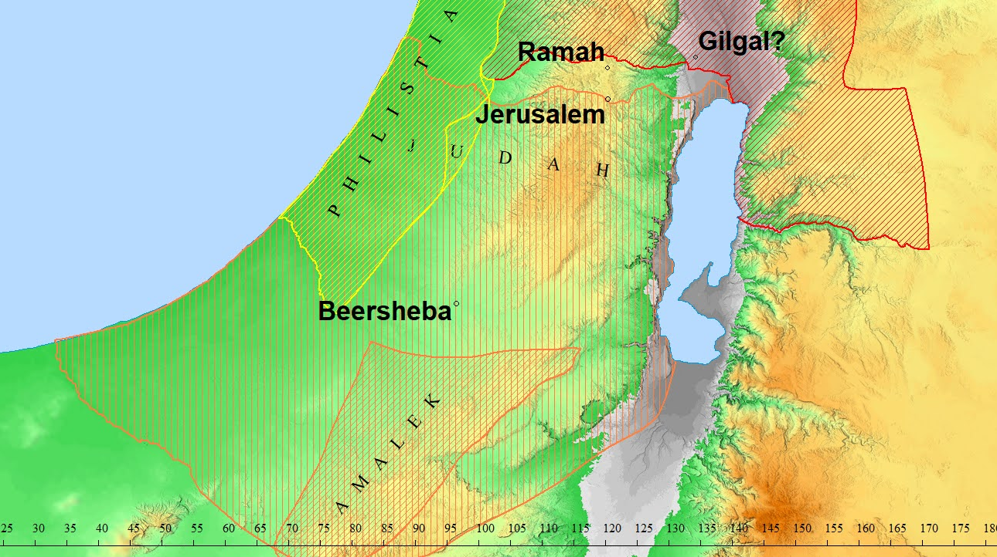

Slide 43
1 Samuel 15:1-35
4 Then Saul summoned the people and counted them in Telaim: two hundred thousand foot soldiers and ten thousand men of Judah. 5 And Saul came to the city of Amalek and set an ambush in the wadi. 6 But Saul said to the Kenites, “Go, get away, go down from among the Amalekites, so that I do not destroy you along with them; for you showed kindness to all the sons of Israel when they went up from Egypt.” So the Kenites got away from among the Amalekites. 7 Then Saul defeated the Amalekites, from Havilah going toward Shur, which is east of Egypt. 8 He captured Agag the king of the Amalekites alive, and completely destroyed all the people with the edge of the sword. 9 But Saul and the people spared Agag and the best of the sheep, the oxen, the more valuable animals, the lambs, and everything that was good, and were unwilling to destroy them completely; but everything despicable and weak, that they completely destroyed.
1 Samuel 15:4-9 (NASB)
Notes:
City of Amalek OR the City where Amaleks descendants resides?
Tried finding Telaim for about 15 minutes. Cannot find it on a map.
Disobeying God (1 Sam. 15:1-11).
We admire Saul for being careful to protect the Kenites, but he wasn't careful to obey God's will. Everything that was vile and worthless he destroyed, but he permitted King Agag to live, and he allowed the Israelite soldiers to save "the best" of the flocks and herds. But if the Lord says something is condemned, how can we say it's "the best"? "Woe to those who call evil good and good evil" (Isa. 5:20, NKJV). Saul certainly had sufficient men to get the job done right, but he decided to do it his own way. The prophet Samuel knew about Saul's disobedience before the army returned from the battle and it grieved him. The Hebrew word means "to burn" and suggests a righteous indignation, a holy anger. For the remainder of his life, Samuel mourned over Saul (1 Sam. 16:1) and cried out to God (15:11).
Serving God acceptably involves doing the will of God in the right way, at the right time, and for the right motive. God had given Saul another chance and he had failed miserably. No wonder his mentor Samuel was angry and brokenhearted. Saul was God's choice for king and Samuel wanted him to succeed. In the end, Saul's failure to exterminate all the Amalekites resulted in his own death (2 Sam. 1:1-10).

Slide 44
1 Samuel 15:1-35
10 Then the word of the Lord came to Samuel, saying,
11 “I regret that I have made Saul king, because he has turned back from following Me and has not carried out My commands.” And Samuel was furious and cried out to the Lord all night. 1 Samuel 15:10-12 (NASB)
Notes:
Wiersbe p80 Disobeying God (1 Sam. 15:1-11). In the matter of God's "repenting" (1 Sam. 15:11), there is no contradiction between this statement and verse 29. (See endnote 4.)
Wiersbe p175 NOTE 4. When the Bible speaks about the Lord “changing His mind” or “repenting” it is using human language to describe divine truth. God knows the future, including our responses to His commands,and God is never at a loss to know what to do. He does change His actions in response to what people do, but this has nothing to do with His changeless nature or attributes. Jonah announced that Nineveh would be destroyed, but the city repented and the Lord withdrew the judgment. From the human point of view,God seemed to change His mind, but not from the divine point of view. God is always true to His nature and consistent with His attributes and plans.Nothing catches Him by surprise.

Slide 45
1 Samuel 15:1-35
12 Samuel got up early in the morning to meet Saul; and it was reported to Samuel, saying, “Saul came to Carmel, and behold, he set up a monument for himself, then turned and proceeded on down to Gilgal.” 13 So Samuel came to Saul, and Saul said to him, “Blessed are you of the Lord! I have carried out the command of the Lord.” 14 But Samuel said, “What then is this bleating of the sheep in my ears, and the bellowing of the oxen which I hear?” 15 Saul said, “They have brought them from the Amalekites, for the people spared the best of the sheep and oxen to sacrifice to the Lord your God; but the rest we have completely destroyed.” 1 Samuel 15:12-15 (NASB)
Notes:
Saul lies to Samuel (1 Sam. 15:12-15). In the eyes of the soldiers and the Jewish people, Saul had won a great victory over a long-time enemy, but in God's eyes he was a failure. Yet the king was so impressed with himself that he went to Carmel and erected a stone monument in his honor and then went to Gilgal, where he had previously failed the Lord and Samuel (13:4ff). Was he trying to avoid meeting Samuel? Perhaps, but his efforts were futile. It was fifteen miles from Samuel's home in Ramah to Gilgal, perhaps a day's journey for the old prophet.
Saul's greeting was sheer hypocrisy. He had no blessing to give Samuel and he had not performed the will of the Lord. First he lied to himself in thinking he could get away with the deception, and then he lied to Samuel who already knew the truth. He even tried to lie to God by saying he would use the spared animals for sacrifices! (See 1 John 1:5-10.) Saul blamed the soldiers for sparing the spoils, but surely as their commander-in-chief, he could have controlled them. "They" spared the best, but "we" utterly destroyed the rest! With Saul, it was always somebody else's fault.

Slide 46
1 Samuel 15:1-35
16 Then Samuel said to Saul, “Stop, and let me inform you of what the Lord said to me last night.” And he said to him, “Speak!”
17 So Samuel said, “Is it not true, though you were insignificant in your own eyes, that you became the head of the tribes of Israel? For the Lord anointed you as king over Israel. 18 And the Lord sent you on a mission, and said, ‘Go and completely destroy the sinners, the Amalekites, and fight against them until they are eliminated.’ 19 Why then did you not obey the voice of the Lord? Instead, you loudly rushed upon the spoils and did what was evil in the sight of the Lord!”
1 Samuel 15:16-19 (NASB)
Notes:
Wiersbe pp82-83 Saul argues with Samuel (1 Sam. 15:16-23). Does Samuel's emphatic "Stop!" suggest that Saul was turning away, or does it mean "Stop telling lies"? Perhaps both are true, for Saul had no great desire to discuss his affairs with Samuel. But Samuel had a message from the Lord, and Saul knew he had better listen. The day would come when Saul would give anything to hear a word from the Lord (28:4-6).
Saul had once been a modest young man (9:21), but now for the second time he had willfully disobeyed the Lord's will and even erected a monument in honor of the event. He was to annihilate a nation that for centuries had done evil, but he ended up doing evil himself. Confronted with this accusation, Saul began to argue with God's servant and deny that he had done wrong. For the second time he lied when he said, "I have obeyed" (15:13, 20); for the second time he blamed his army (vv. 15, 21); and for the second time he used the feeble excuse of dedicating the spared animals as sacrifices for the Lord (vv. 15, 21).
The prophet rejected all three lies and explained why God couldn't accept the animals as legitimate sacrifices: the Lord wants living obedience from the heart, not dead animals on the altar. God doesn't need any donations from us (Ps. 50:7-15), and the sacrifice He desires is a broken and contrite heart (51:16-17). Sacrifice without obedience is only hypocrisy and empty religious ritual (Isa. 1:11-17; Jer. 7:21-26; Ps. 40:6-8). "For I desire mercy, and not sacrifice, and the knowledge of God more than burnt offerings" (Hosea 6:6, KJV). The religious leaders in Jesus' day didn't understand this truth (Matt. 9:9-13; 12:1-8), although occasionally somebody in the crowd would see the light (Mark 12:28-34).
Samuel was a Levite and a prophet, so he certainly wasn't criticizing the Jewish sacrificial system. The Lord through Moses had established Jewish worship and it was right for the people to bring their sacrifices to the Lord. This was His appointed way of worship. But the worshipers had to come to the Lord with submissive hearts and genuine faith, or their sacrifices were in vain.
When David was in the wilderness and away from the priests and the sanctuary of God, he knew that God would accept worship from his heart. "Let my prayer be set before you as incense, the lifting up of my hands as the evening sacrifice" (Ps. 141:2, NKJV). Christian worship today must be more than simply going through a liturgy; we must worship God "in spirit and in truth" (John 4:24), "singing with grace in your hearts to the Lord" (Col. 3:16, NKJV).
But the prophet went on to reveal that the sins of rebellion and stubbornness (arrogance) controlled Saul's heart, and in God's sight, they were as evil as witchcraft and idolatry. (Later, Saul would actually resort to witchcraft.) Both sins were evidences of a heart that had rejected the Word of the Lord. To know God's will and deliberately disobey it is to put ourselves above God and therefore become our own god. This is the vilest form of idolatry.

Slide 47
1 Samuel 15:1-35
20 Then Saul said to Samuel, “I did obey the voice of the Lord, for I went on the mission on which the Lord sent me; and I have brought Agag the king of Amalek, and have completely destroyed the Amalekites. 21 But the people took some of the spoils, sheep and oxen, the choicest of the things designated for destruction, to sacrifice to the Lord your God at Gilgal.”
1 Samuel 15:20-21 (NASB)
Notes:
Wiersbe pp82-83 Saul argues with Samuel (1 Sam. 15:16-23). Does Samuel's emphatic "Stop!" suggest that Saul was turning away, or does it mean "Stop telling lies"? Perhaps both are true, for Saul had no great desire to discuss his affairs with Samuel. But Samuel had a message from the Lord, and Saul knew he had better listen. The day would come when Saul would give anything to hear a word from the Lord (28:4-6).
Saul had once been a modest young man (9:21), but now for the second time he had willfully disobeyed the Lord's will and even erected a monument in honor of the event. He was to annihilate a nation that for centuries had done evil, but he ended up doing evil himself. Confronted with this accusation, Saul began to argue with God's servant and deny that he had done wrong. For the second time he lied when he said, "I have obeyed" (15:13, 20); for the second time he blamed his army (vv. 15, 21); and for the second time he used the feeble excuse of dedicating the spared animals as sacrifices for the Lord (vv. 15, 21).
The prophet rejected all three lies and explained why God couldn't accept the animals as legitimate sacrifices: the Lord wants living obedience from the heart, not dead animals on the altar. God doesn't need any donations from us (Ps. 50:7-15), and the sacrifice He desires is a broken and contrite heart (51:16-17). Sacrifice without obedience is only hypocrisy and empty religious ritual (Isa. 1:11-17; Jer. 7:21-26; Ps. 40:6-8). "For I desire mercy, and not sacrifice, and the knowledge of God more than burnt offerings" (Hosea 6:6, KJV). The religious leaders in Jesus' day didn't understand this truth (Matt. 9:9-13; 12:1-8), although occasionally somebody in the crowd would see the light (Mark 12:28-34).
Samuel was a Levite and a prophet, so he certainly wasn't criticizing the Jewish sacrificial system. The Lord through Moses had established Jewish worship and it was right for the people to bring their sacrifices to the Lord. This was His appointed way of worship. But the worshipers had to come to the Lord with submissive hearts and genuine faith, or their sacrifices were in vain.
When David was in the wilderness and away from the priests and the sanctuary of God, he knew that God would accept worship from his heart. "Let my prayer be set before you as incense, the lifting up of my hands as the evening sacrifice" (Ps. 141:2, NKJV). Christian worship today must be more than simply going through a liturgy; we must worship God "in spirit and in truth" (John 4:24), "singing with grace in your hearts to the Lord" (Col. 3:16, NKJV).
But the prophet went on to reveal that the sins of rebellion and stubbornness (arrogance) controlled Saul's heart, and in God's sight, they were as evil as witchcraft and idolatry. (Later, Saul would actually resort to witchcraft.) Both sins were evidences of a heart that had rejected the Word of the Lord. To know God's will and deliberately disobey it is to put ourselves above God and therefore become our own god. This is the vilest form of idolatry.

Slide 48
1 Samuel 15:1-35
22 Samuel said,
“Does the Lord have as much delight in burnt offerings and sacrifices
As in obeying the voice of the Lord?
Behold, to obey is better than a sacrifice,
And to pay attention is better than the fat of rams.
23 For rebellion is as reprehensible as the sin of divination,
And insubordination is as reprehensible as false religion and idolatry.
Since you have rejected the word of the Lord,
He has also rejected you from being king.”
1 Samuel 15:22-23 (NASB)
Notes:
ADAM V22-23 is hebrew poetry that has been lost in the translation. I don't have experience with this in Hebrew but I do in japanese. ONaka Peko Peko - I’m hungry
Sounds similar to what Jesus said in Matthew 15:7-9…Quoting Isaiah 29:13
7 You hypocrites! Isaiah was right when he prophesied about you:
8 “‘These people honor me with their lips,
but their hearts are far from me.
9 They worship me in vain;
their teachings are merely human rules.’”
Wiersbe pp82-83 Saul argues with Samuel (1 Sam. 15:16-23). Does Samuel's emphatic "Stop!" suggest that Saul was turning away, or does it mean "Stop telling lies"? Perhaps both are true, for Saul had no great desire to discuss his affairs with Samuel. But Samuel had a message from the Lord, and Saul knew he had better listen. The day would come when Saul would give anything to hear a word from the Lord (28:4-6).
Saul had once been a modest young man (9:21), but now for the second time he had willfully disobeyed the Lord's will and even erected a monument in honor of the event. He was to annihilate a nation that for centuries had done evil, but he ended up doing evil himself. Confronted with this accusation, Saul began to argue with God's servant and deny that he had done wrong. For the second time he lied when he said, "I have obeyed" (15:13, 20); for the second time he blamed his army (vv. 15, 21); and for the second time he used the feeble excuse of dedicating the spared animals as sacrifices for the Lord (vv. 15, 21).
The prophet rejected all three lies and explained why God couldn't accept the animals as legitimate sacrifices: the Lord wants living obedience from the heart, not dead animals on the altar. God doesn't need any donations from us (Ps. 50:7-15), and the sacrifice He desires is a broken and contrite heart (51:16-17). Sacrifice without obedience is only hypocrisy and empty religious ritual (Isa. 1:11-17; Jer. 7:21-26; Ps. 40:6-8). "For I desire mercy, and not sacrifice, and the knowledge of God more than burnt offerings" (Hosea 6:6, KJV). The religious leaders in Jesus' day didn't understand this truth (Matt. 9:9-13; 12:1-8), although occasionally somebody in the crowd would see the light (Mark 12:28-34).
Samuel was a Levite and a prophet, so he certainly wasn't criticizing the Jewish sacrificial system. The Lord through Moses had established Jewish worship and it was right for the people to bring their sacrifices to the Lord. This was His appointed way of worship. But the worshipers had to come to the Lord with submissive hearts and genuine faith, or their sacrifices were in vain.
When David was in the wilderness and away from the priests and the sanctuary of God, he knew that God would accept worship from his heart. "Let my prayer be set before you as incense, the lifting up of my hands as the evening sacrifice" (Ps. 141:2, NKJV). Christian worship today must be more than simply going through a liturgy; we must worship God "in spirit and in truth" (John 4:24), "singing with grace in your hearts to the Lord" (Col. 3:16, NKJV).
But the prophet went on to reveal that the sins of rebellion and stubbornness (arrogance) controlled Saul's heart, and in God's sight, they were as evil as witchcraft and idolatry. (Later, Saul would actually resort to witchcraft.) Both sins were evidences of a heart that had rejected the Word of the Lord. To know God's will and deliberately disobey it is to put ourselves above God and therefore become our own god. This is the vilest form of idolatry.

Slide 49
1 Samuel 15:1-35
24 Then Saul said to Samuel, “I have sinned, for I have violated the command of the Lord and your words, because I feared the people and listened to their voice. 25 Now then, please pardon my sin and return with me, so that I may worship the Lord.” 26 But Samuel said to Saul, “I will not return with you; for you have rejected the word of the Lord, and the Lord has rejected you from being king over Israel.” 27 Then Samuel turned to go, but Saul grasped the edge of his robe, and it tore off. 28 So Samuel said to him, “The Lord has torn the kingdom of Israel from you today and has given it to your neighbor, who is better than you. 29 Also the Glory of Israel will not lie nor change His mind; for He is not a man, that He would change His mind.”
1 Samuel 15:24-29 (NASB)
Notes:
ART
Wiersbe p82 Saul is rejected by God (1 Sam. 15:24-29). King Saul now moves from "I have obeyed the voice of the Lord" (v. 20) to "I have sinned." However, this was not a true expression of repentance and sorrow for sin, because when he repeated it later, he added, "Honor me now...before the elders of my people" (v. 30). He was obviously more concerned about his reputation with the people than his character before God, and that is not the attitude of a man truly broken because of sin. Saul also admitted that he spared Agag and the animals because he feared the people instead of fearing the Lord and His commandment. But this was just another indication that he was more interested in being popular with people than in pleasing God.
Samuel refused to join Saul at the altar because he knew the Lord wouldn't receive the king's worship because He had rejected him. In his previous disobedience, Saul forfeited the dynasty (13:14), but now he lost his throne. He was no longer the king of Israel because Samuel would anoint young David to be king. Saul had already been warned about this judgment and now it would be fulfilled. As Samuel turned away, Saul clutched at the tassels on the hem of his garment (Num. 15:38-39) and tore the prophet's robe (see 1 Kings 11:29-39.) Samuel used the occurrence as an object lesson and announced that God had torn the kingdom from Saul's hand. Samuel called the Lord "the Strength of Israel," a name that speaks of God's glory, eminence, and perfection. How could such a wonderful God be guilty of changing or of telling lies? The Lord had announced that Saul would lose the kingdom, and nothing could change His mind.

Slide 50
1 Samuel 15:1-35
30 Then Saul said, “I have sinned; but please honor me now before the elders of my people and before all Israel, and go back with me, so that I may worship the Lord your God.” 31 So Samuel went back following Saul, and Saul worshiped the Lord. 32 Then Samuel said, “Bring me Agag, the king of the Amalekites.” And Agag came to him cheerfully. And Agag said, “Surely the bitterness of death is gone!” 33 But Samuel said, “As your sword has made women childless, so shall your mother be childless among women.” And Samuel cut Agag to pieces before the Lord at Gilgal.
1 Samuel 15:32-33 (NASB)
Notes:
ADAM
The Audacity of this man! - Trying to save face with the people and not with GOD.
Samuel didn’t just kill Agag. He cut him to pieces.
ART Wiersbe p 83 Saul is rejected by Samuel (1 Sam. 15:30-35). The Word of God simply did not penetrate Saul's mind and heart, and he continued to worry about maintaining his reputation rather than getting right with the Lord. Why Samuel changed his mind and decided to worship with Saul is a bit of a mystery, but the prophet's actions after that left no doubt where Samuel stood with reference to the king. Samuel publicly butchered King Agag and in that way let it be known that the king had failed to fulfill his commission. Samuel returned to his home in Ramah and Saul to his home in Gibeah, and Samuel made no more trips to see the king, either publicly or privately. Saul did visit Samuel once in Ramah (19:23-24).
Our hearts go out to Samuel who certainly suffered much because of the people and the king they so desperately wanted. When the kingdom was introduced in Israel, Samuel was replaced by a leader who was inferior to him in every way. Samuel did his best to advise the king and strengthen the kingdom, but Saul insisted on having his own way. Each time Saul was assigned a task, he failed, and when he was confronted, he lied and blamed others. When Israel experienced victories, it was usually Jonathan who led the way. It was a difficult time for Samuel, but God was still on the throne and had His true king waiting to be anointed.
King Saul had lost his dynasty, his character, and his throne and crown. He had also lost a godly friend. When David appears on the scene, Saul will lose his self-control and his good sense, and eventually he will lose his last battle-and his life.

Slide 51
1 Samuel 15:1-35
34 Then Samuel went to Ramah, but Saul went up to his house at Gibeah of Saul. 35 And Samuel did not see Saul again until the day of his death, though Samuel mourned for Saul. And the Lord regretted that He had made Saul king over Israel.
1 Samuel 15:34-35 (NASB)

