Slide 1






Reviewing and Rebuking 1 SAMUEL 12-13
Linder Road Church of Christ - 4th Quarter 2024
CREDITS: This presentation template was created by Slidesgo, and includes icons by Flaticon and infographics & images by Freepik
Notes:
ART
Wiersbe p. 59 Saul and the people rejoiced greatly over the deliverance of Jabesh Gilead from the Ammonites, and Saul was careful to give the glory to the Lord (11:13). Samuel saw the victory as a great opportunity to "renew the kingdom" (v. 14) and remind the people that Jehovah God was still their King. The fact that Saul had led the army in a great victory would tempt the Israelites to put their faith in their new king, and Samuel wanted them to know that their future success rested in trusting Jehovah alone. The king was only God's servant for the people, and both king and people had to obey God's covenant. In his farewell message, Samuel defended his own ministry (vv. 1-5), reviewed God's mercies to Israel (vv. 6-11), and admonished the people to fear the Lord and obey the covenant (vv. 12-25). Samuel mentions the Lord at least thirty times in this message, because his heart's desire was to see the people return to the Lord and honor His covenant.

Slide 2



Contact Us

Slide 3

01
A leader’s integrity
Notes:
Art
Wiersbe p.60 In asking for a king, the people had rejected the kingship of Jehovah and the leadership of Samuel, the last of the judges (7:6, 15-17). It must have been painful for Samuel to conduct this last meeting as their leader and transfer the civil authority to Saul. No doubt he had hoped that one of his sons would succeed him, but they weren't even considered (8:1-3). The twelve tribes had been governed by judges for nearly 500 years, but times had changed and the people wanted a king. Before leaving office as judge, Samuel had to set the record straight and bear witness that his hands were clean and the people could find no fault in him.
To many of the people at that assembly, Samuel had "always been there." Some of them had known him when he was a child and youth at Shiloh, learning to serve as a priest, and others remembered when he had begun to proclaim the Word of the Lord (3:20). He had walked before them almost all of his life, and now he stood before them "old and gray-headed" and challenged them to accuse him of using his authority to benefit himself. "Here I am" (12:3) makes us think of Samuel's responses the night the Lord called him (3:4-6, 8, 16). In the East, it was expected that civil officials would use their offices to make money, but Samuel hadn't taken that route. He obeyed the Law of Moses and kept his hands clean (Ex. 20:17; 22:1-4, 9; 23:8; Lev. 19:13; Deut. 16:19; 24:14). With such a godly example before them, we wonder why his sons took bribes.
Like Jesus, Samuel stood before the people and asked, "Which of you convicts me of sin?" (John 8:46, NKJV). The people heard what Samuel said and bore witness that he had spoken the truth. Samuel was a man of integrity; Saul would turn out to be a man of hypocrisy and duplicity.
When the assembly gave their vote of confidence to Samuel, the prophet called the Lord and the new king to bear witness to what they had said. If the people ever changed their mind, they would have to deal with God and His appointed king!

Slide 4
1 Samuel 12:1-5
1 Then Samuel said to all Israel, “Behold, I have listened to your voice in all that you said to me and I have appointed a king over you. 2 Now, here is the king walking before you, but I am old and gray, and behold my sons are with you. And I have walked before you from my youth even to this day. 3 Here I am; bear witness against me before the Lord and His anointed. Whose ox have I taken, or whose donkey have I taken, or whom have I defrauded? Whom have I oppressed, or from whose hand have I taken a bribe to blind my eyes with it? I will restore it to you.” 4 They said, “You have not defrauded us or oppressed us or taken anything from any man’s hand.” 5 He said to them, “The Lord is witness against you, and His anointed is witness this day that you have found nothing in my hand.” And they said, “He is witness.”
1 Samuel 12:1-5 (NASB)
Notes:
ADAM
V1-5 is a legal proceeding between the people and Samuel. Confirming a job well done. The witnesses in this legal proceeding were…the LORD and Saul.
Now here is the King walking <halak - הָלַךְ>
Why use 2 different titles for the same person: ‘the king’ vs ‘his anointed’?
Application: “It's a wonderful thing to get to the closing years of life and be able to review your life and ministry and not be afraid or ashamed. May we all be able to say with our Lord, "I have glorified You on the earth. I have finished the work which You have given Me to do" (John 17:4, NKJV).”

Slide 5
1 Samuel 8:1-22
14 He will take the best of your fields and your vineyards and your olive groves and give them to his servants. 15 He will take a tenth of your seed and of your vineyards and give to his officers and to his servants. 16 He will also take your male servants and your female servants and your best young men and your donkeys and use them for his work. 17 He will take a tenth of your flocks, and you yourselves will become his servants. 18 Then you will cry out in that day because of your king whom you have chosen for yourselves, but the Lord will not answer you in that day.”
1 Samuel 8:14-18 (NASB)
Notes:
ADAM
Remember back to chapter 8. The king was going to ‘TAKE’ all of these things.
Did Samuel ever take anything? NO!

Slide 6
02
A nation’s iniquity
Notes:
ART
Wiersbe p61 Having affirmed Samuel's credibility, the people now had to accept his analysis of the situation. He reviewed Israel's history from Moses to his own day and emphasized what the Lord in His grace had done for them.

Slide 7
History repeating itself
The people sin
The people cry to Yahweh
A
C
B
D
The people are oppressed
The people are delivered by Yahweh
Notes:
ART
It's often been said that the one thing we learn from history is that we don't learn from history, and Samuel didn't want his people to make that mistake.
(vv. 9-11). Now we are in the Book of Judges with its seven cycles of disobedience, discipline, and deliverance (Jud. 2:10-23).

Slide 8
1 Samuel 12:6-25
The people sin
6 Then Samuel said to the people, “It is the Lord who appointed Moses and Aaron and who brought your fathers up from the land of Egypt. 7 So now, take your stand, that I may plead with you before the Lord concerning all the righteous acts of the Lord which He did for you and your fathers. 8 When Jacob went into Egypt and your fathers cried out to the Lord, then the Lord sent Moses and Aaron who brought your fathers out of Egypt and settled them in this place.
1 Samuel 12:6-8 (NASB)
The people are oppressed
The people cry to Yahweh
The people are delivered by Yahweh
Notes:
Describe the cycle we see described by Samuel in chapter 12

Slide 9
1 Samuel 12:6-25
The people sin
6 Then Samuel said to the people, “It is the Lord who appointed Moses and Aaron and who brought your fathers up from the land of Egypt. 7 So now, take your stand, that I may plead with you before the Lord concerning all the righteous acts of the Lord which He did for you and your fathers. 8 When Jacob went into Egypt and your fathers cried out to the Lord, then the Lord sent Moses and Aaron who brought your fathers out of Egypt and settled them in this place.
1 Samuel 12:6-8 (NASB)
The people are oppressed
The people cry to Yahweh
The people are delivered by Yahweh

Slide 10
1 Samuel 12:6-25
The people sin
6 Then Samuel said to the people, “It is the Lord who appointed Moses and Aaron and who brought your fathers up from the land of Egypt. 7 So now, take your stand, that I may plead with you before the Lord concerning all the righteous acts of the Lord which He did for you and your fathers. 8 When Jacob went into Egypt and your fathers cried out to the Lord, then the Lord sent Moses and Aaron who brought your fathers out of Egypt and settled them in this place.
1 Samuel 12:6-8 (NASB)
The people are oppressed
The people cry to Yahweh
The people are delivered by Yahweh

Slide 11
1 Samuel 12:6-25
The people sin
6 Then Samuel said to the people, “It is the Lord who appointed Moses and Aaron and who brought your fathers up from the land of Egypt. 7 So now, take your stand, that I may plead with you before the Lord concerning all the righteous acts of the Lord which He did for you and your fathers. 8 When Jacob went into Egypt and your fathers cried out to the Lord, then the Lord sent Moses and Aaron who brought your fathers out of Egypt and settled them in this place.
1 Samuel 12:6-8 (NASB)
The people are oppressed
The people cry to Yahweh
The people are delivered by Yahweh

Slide 12
1 Samuel 12:6-25
The people sin
9 But they forgot the Lord their God, so He sold them into the hand of Sisera, captain of the army of Hazor, and into the hand of the Philistines and into the hand of the king of Moab, and they fought against them. 10 They cried out to the Lord and said, ‘We have sinned because we have forsaken the Lord and have served the Baals and the Ashtaroth; but now deliver us from the hands of our enemies, and we will serve You.’ 11 Then the Lord sent Jerubbaal and Bedan and Jephthah and Samuel, and delivered you from the hands of your enemies all around, so that you lived in security.
1 Samuel 12:9-11 (NASB)
The people are oppressed
The people cry to Yahweh
The people are delivered by Yahweh
Notes:
ADAM
JUDGES 10:6-10 Parallels V10
6 Again the Israelites did evil in the eyes of the Lord. They served the Baals and the Ashtoreths, and the gods of Aram, the gods of Sidon, the gods of Moab, the gods of the Ammonites and the gods of the Philistines. And because the Israelites forsook the Lord and no longer served him, 7 he became angry with them. He sold them into the hands of the Philistines and the Ammonites, 8 who that year shattered and crushed them. For eighteen years they oppressed all the Israelites on the east side of the Jordan in Gilead, the land of the Amorites. 9 The Ammonites also crossed the Jordan to fight against Judah, Benjamin and Ephraim; Israel was in great distress. 10 Then the Israelites cried out to the Lord, “We have sinned against you, forsaking our God and serving the Baals.”

Slide 13
1 Samuel 12:6-25
The people sin
9 But they forgot the Lord their God, so He sold them into the hand of Sisera, captain of the army of Hazor, and into the hand of the Philistines and into the hand of the king of Moab, and they fought against them. 10 They cried out to the Lord and said, ‘We have sinned because we have forsaken the Lord and have served the Baals and the Ashtaroth; but now deliver us from the hands of our enemies, and we will serve You.’ 11 Then the Lord sent Jerubbaal and Bedan and Jephthah and Samuel, and delivered you from the hands of your enemies all around, so that you lived in security.
1 Samuel 12:9-11 (NASB)
The people are oppressed
The people cry to Yahweh
The people are delivered by Yahweh
Notes:
ADAM
JUDGES 10:6-10 Parallels V10
6 Again the Israelites did evil in the eyes of the Lord. They served the Baals and the Ashtoreths, and the gods of Aram, the gods of Sidon, the gods of Moab, the gods of the Ammonites and the gods of the Philistines. And because the Israelites forsook the Lord and no longer served him, 7 he became angry with them. He sold them into the hands of the Philistines and the Ammonites, 8 who that year shattered and crushed them. For eighteen years they oppressed all the Israelites on the east side of the Jordan in Gilead, the land of the Amorites. 9 The Ammonites also crossed the Jordan to fight against Judah, Benjamin and Ephraim; Israel was in great distress. 10 Then the Israelites cried out to the Lord, “We have sinned against you, forsaking our God and serving the Baals.”

Slide 14
1 Samuel 12:6-25
The people sin
9 But they forgot the Lord their God, so He sold them into the hand of Sisera, captain of the army of Hazor, and into the hand of the Philistines and into the hand of the king of Moab, and they fought against them. 10 They cried out to the Lord and said, ‘We have sinned because we have forsaken the Lord and have served the Baals and the Ashtaroth; but now deliver us from the hands of our enemies, and we will serve You.’ 11 Then the Lord sent Jerubbaal and Bedan and Jephthah and Samuel, and delivered you from the hands of your enemies all around, so that you lived in security.
1 Samuel 12:9-11 (NASB)
The people are oppressed
The people cry to Yahweh
The people are delivered by Yahweh
Notes:
ADAM
JUDGES 10:6-10 Parallels V10
6 Again the Israelites did evil in the eyes of the Lord. They served the Baals and the Ashtoreths, and the gods of Aram, the gods of Sidon, the gods of Moab, the gods of the Ammonites and the gods of the Philistines. And because the Israelites forsook the Lord and no longer served him, 7 he became angry with them. He sold them into the hands of the Philistines and the Ammonites, 8 who that year shattered and crushed them. For eighteen years they oppressed all the Israelites on the east side of the Jordan in Gilead, the land of the Amorites. 9 The Ammonites also crossed the Jordan to fight against Judah, Benjamin and Ephraim; Israel was in great distress. 10 Then the Israelites cried out to the Lord, “We have sinned against you, forsaking our God and serving the Baals.”

Slide 15
1 Samuel 12:6-25
The people sin
9 But they forgot the Lord their God, so He sold them into the hand of Sisera, captain of the army of Hazor, and into the hand of the Philistines and into the hand of the king of Moab, and they fought against them. 10 They cried out to the Lord and said, ‘We have sinned because we have forsaken the Lord and have served the Baals and the Ashtaroth; but now deliver us from the hands of our enemies, and we will serve You.’ 11 Then the Lord sent Jerubbaal and Bedan and Jephthah and Samuel, and delivered you from the hands of your enemies all around, so that you lived in security.
1 Samuel 12:9-11 (NASB)
The people are oppressed
The people cry to Yahweh
The people are delivered by Yahweh
Notes:
ADAM
JUDGES 10:6-10 Parallels V10
6 Again the Israelites did evil in the eyes of the Lord. They served the Baals and the Ashtoreths, and the gods of Aram, the gods of Sidon, the gods of Moab, the gods of the Ammonites and the gods of the Philistines. And because the Israelites forsook the Lord and no longer served him, 7 he became angry with them. He sold them into the hands of the Philistines and the Ammonites, 8 who that year shattered and crushed them. For eighteen years they oppressed all the Israelites on the east side of the Jordan in Gilead, the land of the Amorites. 9 The Ammonites also crossed the Jordan to fight against Judah, Benjamin and Ephraim; Israel was in great distress. 10 Then the Israelites cried out to the Lord, “We have sinned against you, forsaking our God and serving the Baals.”

Slide 16
1 Samuel 12:6-25
The people sin
12 When you saw that Nahash the king of the sons of Ammon came against you, you said to me, ‘No, but a king shall reign over us,’ although the Lord your God was your king.
1 Samuel 12:12 (NASB)
The people are oppressed
The people cry to Yahweh
The people are delivered by Yahweh
Notes:
Wiersbe p.62 Fear the Lord (1 Sam. 12:12-19). How should Israel have responded to this kind of national history? They should have expressed gratitude to the Lord and trusted Him for His continued care. They should have confessed their sin of unbelief and trusted Him alone. But what did they do? No sooner did the Ammonites attack than the Jews asked for a king and exchanged the rule of the Lord their King for the leadership of a mere man! God gave them what they asked for, but Israel lost something in the transaction.

Slide 17

History repeating itself
The people are oppressed
The people cry to Yahweh
B
C
A
D
The people sin
The people are delivered by Yahweh
Notes:
Adam
We’re out of order…
That’s why it’s said in Samuel 8
The pattern of response established in Egypt and in the period of the judge-deliverers has been borken in the most recent crisis with Nahash

Slide 18
1 Samuel 8:1-22
14 He will take the best of your fields and your vineyards and your olive groves and give them to his servants. 15 He will take a tenth of your seed and of your vineyards and give to his officers and to his servants. 16 He will also take your male servants and your female servants and your best young men and your donkeys and use them for his work. 17 He will take a tenth of your flocks, and you yourselves will become his servants. 18 Then you will cry out in that day because of your king whom you have chosen for yourselves, but the Lord will not answer you in that day.”
1 Samuel 8:14-18 (NASB)
Notes:
ADAM
The legal case here is that since you were oppressed and sinned there is no recourse for you.
Granted Samuel takes events out of order to make his case.

Slide 19
1 Samuel 12:6-25
13 Now therefore, here is the king whom you have chosen, whom you have asked for, and behold, the Lord has set a king over you. 14 If you will fear the Lord and serve Him, and listen to His voice and not rebel against the command of the Lord, then both you and also the king who reigns over you will follow the Lord your God. 15 If you will not listen to the voice of the Lord, but rebel against the command of the Lord, then the hand of the Lord will be against you, as it was against your fathers.
1 Samuel 12:13-15 (NASB)
Notes:
“And Behold, the Lord has set a king over you.” What do other version say?
The Message and Good New Translations choose to translate it “given you a king”

Slide 20
1 Samuel 12:6-25
16 Even now, take your stand and see this great thing which the Lord will do before your eyes. 17 Is it not the wheat harvest today? I will call to the Lord, that He may send thunder and rain. Then you will know and see that your wickedness is great which you have done in the sight of the Lord by asking for yourselves a king.” 18 So Samuel called to the Lord, and the Lord sent thunder and rain that day; and all the people greatly feared the Lord and Samuel.
1 Samuel 12:16-18 (NASB)
Notes:
ART
Wiersbe p62 However, all was not lost. God is never taken by surprise and He would not desert His people for His name's sake. If the people would fear the Lord and follow Him, He would continue to care for them and use their king to direct and protect them. Then Samuel demonstrated the awesome power of the Lord by "praying up a storm" during the dry season of wheat harvest (mid-May to mid-June). This miracle reminds us of the signs Moses and Aaron did in Egypt. Samuel was proving to the people that God could do anything for them if they trusted Him and obeyed, but that a mere king was helpless apart from the Lord. When the Jews begged Samuel for deliverance, they sounded like Pharaoh confessing his sin and begging Moses for relief (Ex, 8:8; 9:27-28; 10:16-17), and their repentance was probably just as insincere.

Slide 21
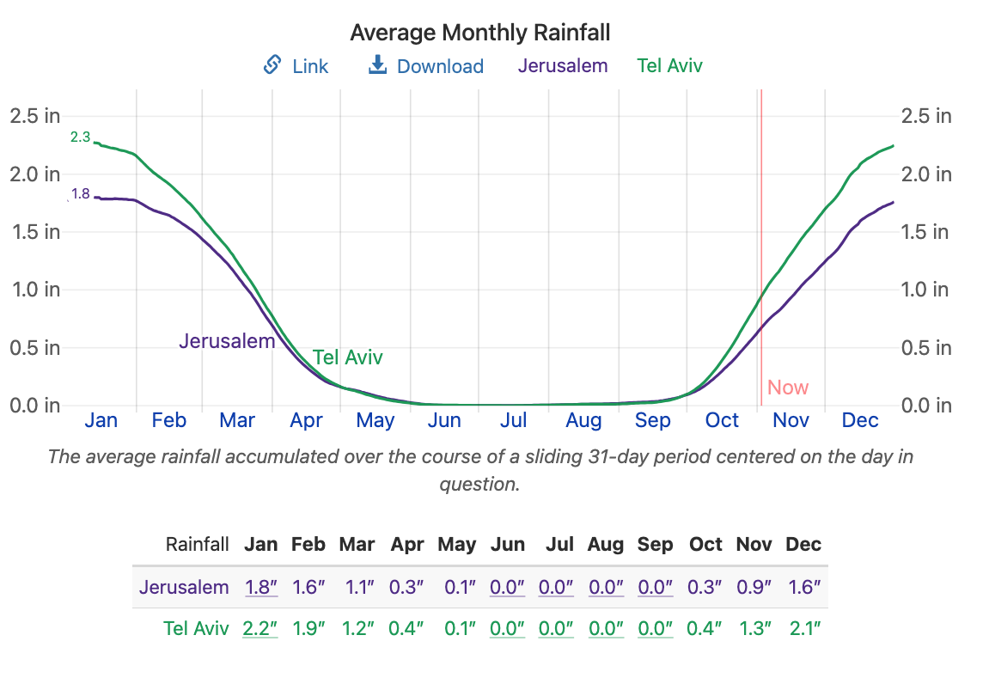
Notes:
ADAM
John calls miracles ‘signs and wonders’. This the capstone to the argument that Samuel has just made. The rain and thunder during summer harvest. Rainstorms in May-June are unknown in palestine.
Monthly data collected since 1983
Shavuot, or Shvues, is a Jewish holiday, one of the biblically ordained Three Pilgrimage Festivals. It occurs on the sixth day of the Hebrew month of Sivan; in the 21st century, it may fall anywhere between May 15 and June 14 on the Gregorian calendar. Celebrated 7 weeks after passover.
2 Loaves of bread where baked and taken to the temple as first fruits of the grain harvest.

Slide 22
1 Samuel 12:6-25
19 Then all the people said to Samuel, “Pray for your servants to the Lord your God, so that we may not die, for we have added to all our sins this evil by asking for ourselves a king.” 20 Samuel said to the people, “Do not fear. You have committed all this evil, yet do not turn aside from following the Lord, but serve the Lord with all your heart. 21 You must not turn aside, for then you would go after futile things which can not profit or deliver, because they are futile.
1 Samuel 12:19-21 (NASB)
Notes:
ART
Obey the Lord (1 Sam. 12:20-25). Samuel moved from "Fear" (v.18) to "Fear not" (v. 20) as he encouraged the people to accept the situation their unbelief created and make the most of it. How many times in our own lives do we get what we asked for and then wish we didn't have it!
The Lord would not reject or forsake His people because of His holy covenant and His great faithfulness.
God's purpose was to use Israel to bring glory to His name, and He would fulfill that purpose.
The Jewish people knew the terms of the covenant: if they obeyed, the Lord would bless them; if they disobeyed, He would chasten them.
Either way, He would be faithful to His Word; the major issue was whether Israel would be faithful.
They had made a mistake, but God would help them if they feared and obeyed Him.

Slide 23
1 Samuel 12:6-25
22 For the Lord will not abandon His people on account of His great name, because the Lord has been pleased to make you a people for Himself. 23 Moreover, as for me, far be it from me that I should sin against the Lord by ceasing to pray for you; but I will instruct you in the good and right way. 24 Only fear the Lord and serve Him in truth with all your heart; for consider what great things He has done for you. 25 But if you still do wickedly, both you and your king will be swept away.”
1 Samuel 12:22-25 (NASB)
Notes:
ART
Samuel made it clear that, no matter what they decided, he would obey the Lord. Part of his obedience would be faithfully praying for the people and teaching them the Word of God. The Word of God and prayer always go together (Acts 6:4; John 15:7; Eph. 6:17-18). Samuel's heart was broken, but as a faithful servant of the Lord, he interceded for the people and sought to lead them in the right way. For God's people not to pray is to sin against the Lord, yet if there's one thing lacking in our churches today, it is prayer, particularly prayer for those in authority (1 Tim. 2:1-4).
When we consider the great things God has done for us, how could we do other than fear Him, thank Him, and serve Him in truth all the days of our lives? God's covenant with His people Israel was still in force: if they obeyed, He would bless; if they disobeyed, He would chasten. "Yet if you persist in doing evil," warned Samuel, "both you and your king will be swept away"
Sam. 12:25). Samuel may have been referring especially to the warning given by Moses in Deut. 28:36, written into the covenant centuries before Israel had a king: "The Lord will drive you and the king you set over you to a nation unknown to you or your fathers" (NIV). Unfortunately, Israel did disobey the terms of the covenant and God had to send them in exile to Babylon.
Application: From time to time, churches and other Christian ministries face new situations and decide they must make organizational changes. Each ministry needs a Samuel to remind them of the spiritual principles that never change:
1. the character of God,
2. the Word of God,
3. the necessity of faith,
4. and the importance of obedience.
Methods are many, principles are few;
Methods always change, principles never do.

Slide 24
03
A king’s irresponsibility
Notes:
ART
Wiersbe p 64 Summary of Saul:
The narrative in chapters 13-15 focuses on Saul's early reign, especially his relationship to God and to Samuel. We see Saul making foolish and unwise decisions and trying to cover his disobedience with lies. It was the beginning of that tragic decline that ended in a witch's house and Saul's suicide on the battlefield. At chapter 16, David will come on the scene and the book will describe Saul's deepening conflict with God, himself, and David. We can trace the downward steps in his tragic failure.

Slide 25
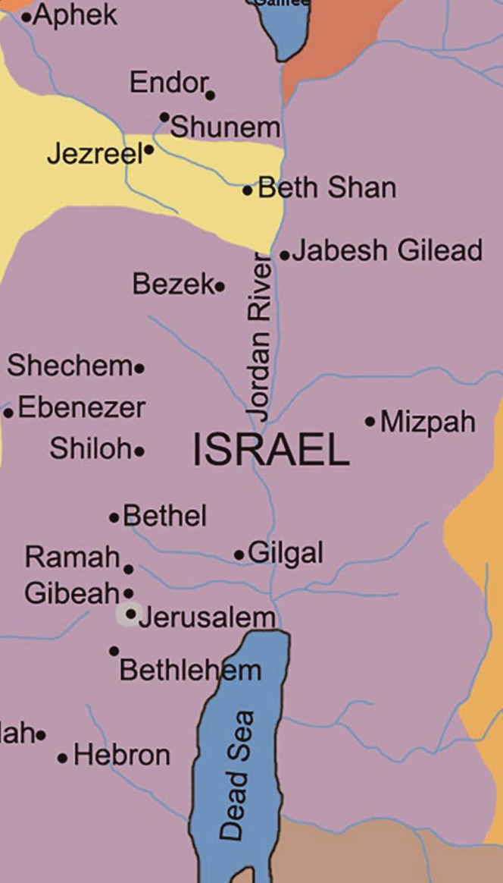
1 Samuel 13:1-14
1 Saul was thirty years old when he began to reign, and he reigned forty two years over Israel.
2 Now Saul chose for himself 3,000 men of Israel, of which 2,000 were with Saul in Michmash and in the hill country of Bethel, while 1,000 were with Jonathan at Gibeah of Benjamin. But he sent away the rest of the people, each to his tent. 3 Jonathan smote the garrison of the Philistines that was in Geba, and the Philistines heard of it. Then Saul blew the trumpet throughout the land, saying, “Let the Hebrews hear.” 4 All Israel heard the news that Saul had smitten the garrison of the Philistines, and also that Israel had become odious to the Philistines. The people were then summoned to Saul at Gilgal.
1 Samuel 13:1-4 (NASB)
Notes:
Geba - Between Gibeah and Jericho
Jonathan Smote…but Saul had smitten…who did it.
Jonathan victories are credited to the government led by his father, the king.
Who killed/took-care-of Osama-bin-laden? Obama
Wiersbe p64 I. Pride (1 Sam. 13:1-4). Saul had reigned two years when he began to establish a standing army.2 Over 300,000 men had volunteered to deliver the people of Jabesh Gilead (11:8), but Saul chose only 3,000 and divided them between himself and his son Jonathan. Saul's camp was at Michmash and Jonathan's was about fifteen miles away in Gibeah. The fact that Israel was mustering an army put the Philistines on the alert. They had garrisons in different parts of the country and monitored the situation carefully.
It is as a brave and victorious soldier that Jonathan is introduced to us. When he attacked and defeated the Philistine outpost at Geba, it was a declaration of war, and the Philistines were quick to respond. This was the beginning of Israel's war of liberation, although it wasn't finished until after David became king. But who blew the trumpet and seemed to take the credit for the victory? Saul, son of Kish! As commander-in-chief, he was calling for more men, because he knew that many battles lay ahead, but we wish he had given proper credit to his courageous son.
Why did Saul call his fellow Israelites "the Hebrews" instead of "men of Israel"? The name may have come from Abraham's ancestor Eber (Gen. 10:21), or perhaps from the word meaning "to cross over." The ancestors of Abraham were those who "crossed over the River Euphrates" (Josh. 24:2-3). Canaan was "the land of the Hebrews" (Gen. 40:15); the Egyptians would not eat with "the Hebrews" (43:32); an Egyptian "beat one of the Hebrews" (Ex. 2:11). In Scripture, the word is used primarily by foreigners speaking to or of the Jews, or by the Jews speaking to foreigners about themselves. You get the impression that the word "Hebrew" was often used as a term of contempt. Did Saul not have respect for his people? Whatever reason he had for using the word, his command was clear: gather together at Gilgal, the place that Samuel had appointed (1 Sam. 10:8ff).

Slide 26
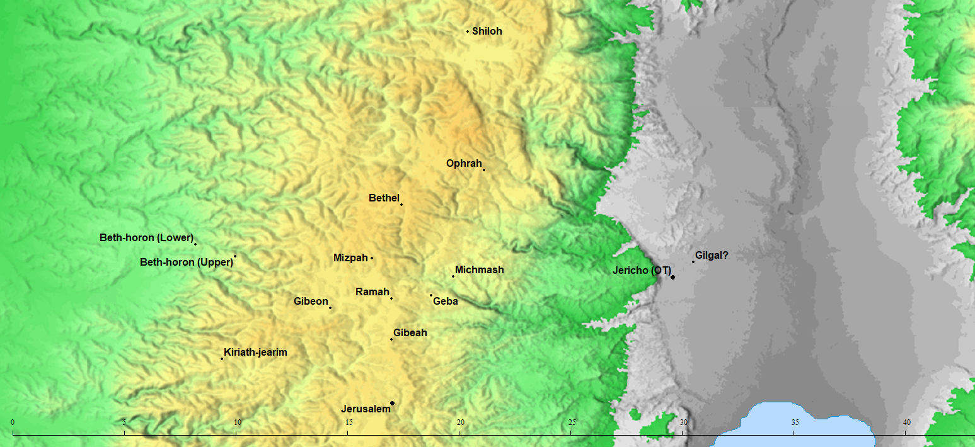

Slide 27
1 Samuel 13:1-14
5 Now the Philistines assembled to fight with Israel, 30,000 chariots and 6,000 horsemen, and people like the sand which is on the seashore in abundance; and they came up and camped in Michmash, east of Beth-aven. 6 When the men of Israel saw that they were in a strait (for the people were hard-pressed), then the people hid themselves in caves, in thickets, in cliffs, in cellars, and in pits. 7 Also some of the Hebrews crossed the Jordan into the land of Gad and Gilead. But as for Saul, he was still in Gilgal, and all the people followed him trembling. 8 Now he waited seven days, according to the appointed time set by Samuel, but Samuel did not come to Gilgal; and the people were scattering from him. 9 So Saul said, “Bring to me the burnt offering and the peace offerings.” And he offered the burnt offering.
1 Samuel 13:5-9 (NASB)
Notes:
ADAM
Pits also has can mean graves.Set the stage. Large powerful force. People trembling and what are we to do?
ART
Wiersbe p65 II. Unbelief and impatience (1 Sam. 13:5-9). The Philistine forces gathered at Michmash, less than twenty miles west of Gilgal, and it was obvious that Saul and his army were greatly outnumbered. Saul's men began to hide and even deserted the army by crossing the river, and those who remained were paralyzed with fright. As Samuel had commanded, Saul waited for seven days (10:8), and the longer he waited, the more concerned he became. His army was melting away, the enemy was mobilizing, and the situation was hopeless.
Application: Why did Samuel tarry? Was he deliberately trying to make Saul fail, or was he just reminding the new king who was still in control? Samuel had nothing to gain if Saul failed on the battlefield, and Samuel knew that God was in control, even in the appointment of the new king. Furthermore, this meeting had been planned some two years before (v. 8), and no doubt Samuel had reminded Saul of it more than once. This rendezvous was the Lord's way of testing Saul's faith and patience. Without faith and patience, we can't receive what the Lord promises (Heb. 6:12), and unbelief and impatience are marks of spiritual immaturity (James 1:1-8). Until we learn to trust God and wait on His timing, we can't learn the other lessons He wants to teach us, nor can we receive the blessings He's planned for us. Saul may have been handsome, strong, and taller than the other men, but if he didn't have a heart that was right with God, he didn't have anything. It's one thing to be victorious when you're leading an army of over 300,000 men (1 Sam. 11:8), but quite another thing when you have only 600! (v. 15) But this is where faith comes in.
Saul didn't want to go into the battle without first offering a sacrifice to the Lord, which in itself may have been a subtle form of superstition, like carrying the ark into the battle. Later Samuel would remind Saul that God seeks obedience and not sacrifice (15:22). Without waiting for God's appointed priest, Saul offered the sacrifice, and just then Samuel arrived in the camp. If Saul had waited just a few minutes more, everything would have been all right; but his impatience cost him dearly.

Slide 28
1 Samuel 13:1-14
10 As soon as he finished offering the burnt offering, behold, Samuel came; and Saul went out to meet him and to greet him. 11 But Samuel said, “What have you done?” And Saul said, “Because I saw that the people were scattering from me, and that you did not come within the appointed days, and that the Philistines were assembling at Michmash,
12 therefore I said, ‘Now the Philistines will come down against me at Gilgal, and I have not asked the favor of the Lord.’ So I forced myself and offered the burnt offering.”
1 Samuel 13:10-12 (NASB)
Notes:
ART
Wiersbe p.66 III. Deception (1 Sam. 13:10-12). As Saul decays in character, we shall see him deceiving himself and others more and more. His first deception at Gilgal occurred when he greeted Samuel cordially and expected Samuel to give him a blessing. Saul was playing the hypocrite and acting as though he had done nothing wrong. "If we say that we have fellowship with him, and walk in darkness, we lie, and do not the truth" (1 John 1:6, KJV). His second lie consisted in blaming Samuel and the soldiers and not himself. It was Samuel's fault for arriving late and the army's fault for deserting their king. His words, "I saw" indicate that Saul was walking by sight and not by faith. He lied a third time when he said that he had to force himself to offer the sacrifice. Could he not have "forced himself" to pray or to call together some of the officers to beseech the Lord for His help? The will is the servant of the mind and heart, but Saul's thinking and desiring were totally out of the will of God.
People who are good at making excuses are rarely good at anything else, and those who are quick to blame others shouldn't complain if others blame them. When God confronted our first parents with their sin, Adam blamed Eve, and Eve blamed the serpent, but neither Adam nor Eve said humbly, "I have sinned." Throughout his career, King Saul was adept at minimizing his own sins and emphasizing the faults of others, but this isn't the way a man of God leads God's people.

Slide 29
1 Samuel 13:1-14
13 Samuel said to Saul, “You have acted foolishly; you have not kept the commandment of the Lord your God, which He commanded you, for now the Lord would have established your kingdom over Israel forever. 14 But now your kingdom shall not endure. The Lord has sought out for Himself a man after His own heart, and the Lord has appointed him as ruler over His people, because you have not kept what the Lord commanded you.”
1 Samuel 13:13-14 (NASB)
Notes:
ART
Wiersbe p67 IV. Folly (1 Sam. 13:13-14). It was foolish of Saul to think that he could disobey God and get away with it, and that his disobedience could bring God's blessing on himself and his army. "Let us do evil that good may come" (Rom. 3:8) is the logic of hell, not the law of heaven. He was foolish to conclude that the sacrifice of a king at the wrong time was as good as the sacrifice of a priest at the right time. He was foolish to walk by sight and not by faith in God's promise, "for whatever is not from faith is sin" (Rom. 14:23, NASB). Saul had the same kind of superstitious faith that Eli's sons had when they carried the ark on the battlefield. He knew nothing of "the obedience of faith" (Rom. 16:26).
Saul's pride, impatience, disobedience, and deception were all seen and judged by the Lord, and Samuel announced the sentence: the crown would eventually be taken from Saul and given to another, in this case, David. Saul would continue as king, but he would not establish a lasting dynasty, and none of his sons would succeed him and rule over Israel. But even if Saul had not sinned, how could his dynasty continue "forever" (1 Sam. 13:13) when Saul was from the wrong tribe and God had already chosen David to be king of Israel? One answer is that Saul's eldest son Jonathan could have served with David, which in fact is what David and Jonathan had planned (20:31, 42; 23:16-18). Of course, the Davidic dynasty would have established the Messianic line, but someone from Saul's family would have served in court with the Davidic king.
[Mini Summary] Saul's sin at Gilgal cost him the dynasty, and his sin involving the Amalekites cost him the kingdom. He eventually lost his crown and his life (see 15:16-34, especially 23, 27-29; 16:1). God wanted a king with a heart that was right toward God, a man with a shepherd's heart, and He found that kind of heart in David (13:14; Pss. 78:72; 89:20; Acts 13:22). "This man [Saul] in his governing of Israel was a warrior and nothing more," said G. Campbell Morgan; "he was never a shepherd." But David had a shepherd's heart, because the Lord was his Shepherd (Ps. 23:1). David was under authority, so he had the right to exercise authority.
ADAM
The judges responsibilities were split between the king and the prophet. King was to lead the troops. The prophet was to communicate with Yahweh and receive authorization for war.

Slide 30
04
An army’s insecurity
Notes:
ART
Wiersbe p67. Saul had failed miserably, but in chapter 14 we will read about Jonathan's great success as a commander. This passage (13:15-23) describes the sad condition of the army of Israel, which reveals how poor Saul's leadership was and how remarkable Jonathan's victory was. Saul walked by sight and had little faith, but Jonathan walked by faith and did exploits for the Lord.

Slide 31
1 Samuel 13:15-23
15 Then Samuel arose and went up from Gilgal to Gibeah of Benjamin. And Saul numbered the people who were present with him, about six hundred men. 16 Now Saul and his son Jonathan and the people who were present with them were staying in Geba of Benjamin while the Philistines camped at Michmash. 17 And the raiders came from the camp of the Philistines in three companies: one company turned toward Ophrah, to the land of Shual, 18 and another company turned toward Beth-horon, and another company turned toward the border which overlooks the valley of Zeboim toward the wilderness
1 Samuel 13:15-18 (NASB)
Notes:
ART
A dwindling army (1 Sam. 13:15-16). Saul had mustered over 300,000 men to rescue the people of Jabesh Gilead and then had cut it down to 3,000, but now his forces numbered only 600. The Philistine army was "as the sand which is on the seashore in multitude" (v. 5), a simile also used for the army Gideon faced (Jud. 7:12) and Saul's army was twice as large as Gideon's! The difference wasn't so much the size of the army as the strength of the leader's faith. Gideon trusted God for victory and God honored him; Saul disobeyed God and God punished him. Saul had mustered that huge army by means of fear (1 Sam. 11:7), so when his men began to fear the enemy instead of the king, they began to desert the camp and go to places of safety. Jonathan knew that the Lord didn't need great numbers to accomplish His purposes (14:6), but He did honor great faith.

Slide 32
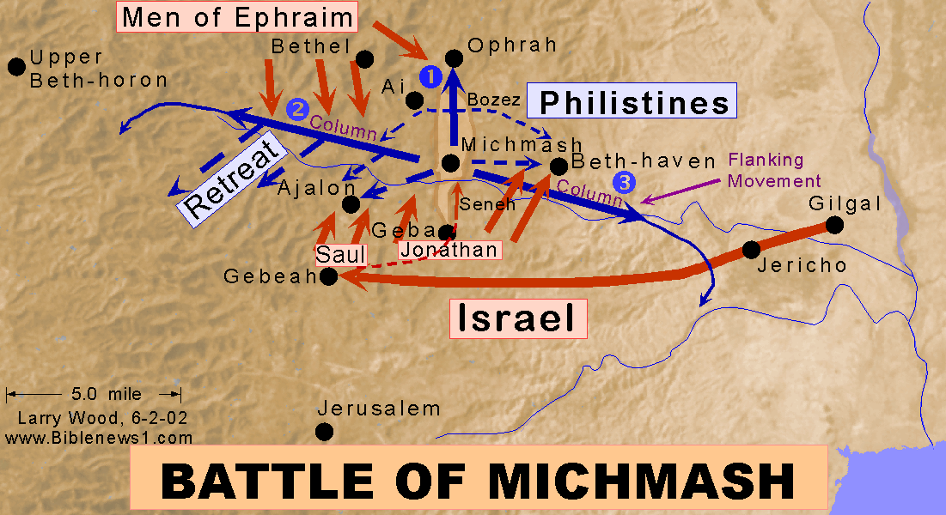

Slide 34
1 Samuel 13:15-23
15 Then Samuel arose and went up from Gilgal to Gibeah of Benjamin. And Saul numbered the people who were present with him, about six hundred men. 16 Now Saul and his son Jonathan and the people who were present with them were staying in Geba of Benjamin while the Philistines camped at Michmash. 17 And the raiders came from the camp of the Philistines in three companies: one company turned toward Ophrah, to the land of Shual, 18 and another company turned toward Beth-horon, and another company turned toward the border which overlooks the valley of Zeboim toward the wilderness
1 Samuel 13:15-18 (NASB)
Notes:
ART
Wiersbe p68 A threatened army (1 Sam. 13:17-18, 23). The Philistines repeatedly sent out "raiding parties" to protect the roads and passes that the Jews might use if they attacked, and at the same time the Philistines kept any residents from helping the Jewish army. There were three such groups: one went north toward Ophrah, a second west to Beth-horon, and the third east toward Zeboim. A fourth detachment went south toward Gibeah to prevent the Jewish army from moving up to Geba (v. 23). With all these Philistine soldiers moving about in the area, what hope was there for the Jews? No matter which way Israel turned, they would meet the enemy! And yet the Lord was going to use Jonathan and his armor-bearer to win a great victory, for with God, nothing is impossible.

Slide 35
1 Samuel 13:15-23
19 Now no blacksmith could be found in all the land of Israel, for the Philistines said, “Otherwise the Hebrews will make swords or spears.” 20 So all Israel went down to the Philistines, each to sharpen his plowshare, his mattock, his axe, and his hoe. 21 The charge was two-thirds of a shekel for the plowshares, the mattocks, the forks, and the axes, and to fix the hoes. 22 So it came about on the day of battle that neither sword nor spear was found in the hands of any of the people who were with Saul and Jonathan, but they were found with Saul and his son Jonathan. 23 And the garrison of the Philistines went out to the pass of Michmash.
1 Samuel 13:19-23 (NASB)
Notes:
ART
Wiersbe p68: A deprived army (1 Sam. 13:19-22). It was bad enough that Saul lacked men, but it was even worse that his men were not properly equipped. When the Philistines moved in and subjected the land of Israel to their rule, they deported all the ironworkers so that the Jews couldn't make weapons or even repair their farm implements. They even had to pay exorbitant prices to have their implements sharpened. The Benjamites were skilled at using slings (Jud. 20:15-16), but slings were not practical in close combat, and what about the vast number of Philistine chariots?
The Jewish army was small in number and had small supplies of weapons, but they had a great God, if only they would trust Him. All of this sets the stage for Jonathan's thrilling victory described in chapter 14, and that is contrasted with his father's sad defeat in chapter 15.
Application: Wiersbe p69 In the way it functions or doesn't function, the church today may sometimes resemble Saul's army, but if we do, it's our own fault. Through His great work on the cross, our Lord has defeated every enemy, and His power is available to His people. We have the armor and the weapons we need (Eph. 6:10ff), and His Word tells us all we need to know about the strategy of the enemy and the resources we have in Christ. All He asks is that we trust Him and obey His orders, and He will help us win the battle.
"Finally, be strong in the Lord, and in the strength of His might." (Eph. 6:10, NASB) for "the battle is the Lord's" (1 Sam. 17:47).

