Slide 1






The Call
for a King 1 SAMUEL 7-11
Linder Road Church of Christ - 4th Quarter 2024
CREDITS: This presentation template was created by Slidesgo, and includes icons by Flaticon and infographics & images by Freepik
Notes:
ART:
Wiersbe 41 The ark of the covenant was now out of enemy hands and resting in the house of Abinadab in Kiriath Jearim in the territory of Benjamin (1 Sam. 1-2; Josh. 18:28). Shiloh had been destroyed by the Philistines and was no longer the location of the sanctuary of the Lord, and many years would pass before the ark would be moved to Jerusalem by King David (1 Chron. 15). But having the ark in Jewish territory didn't automatically solve Israel's problems, for during those twenty years when the ark was in Abinidab's house, a new generation had arisen and was crying out for radical changes in Israel's government. For centuries, the people of Israel had looked to Jehovah as their King, but now they asked the Lord to give them a king just like the other nations. It was a critical time in the history of Israel, and it took the prayers and guidance of Samuel to bring them safely through this dangerous time of transition.

Slide 2



Contact Us

Slide 3

01
Seeking the Lord
Notes:
SKIP? ART: Wiersbe 41-42 1. Seeking the Lord (1 Sam. 7:3-17)
Samuel discerned that the people were restless and wanting change, and he knew that times of transition bring out either the best or the worst in people. God called Samuel to build a bridge between the turbulent age of the Judges and the new era of the monarchy, and it wasn't an easy task. There was one thing Samuel knew for certain: king or no king, the nation could never succeed if the people didn't put the Lord first and trust only in Him. That's why he called for a meeting at Mizpah, a city in Benjamin (Josh. 18:26), where he challenged God's covenant people to return to the Lord.

Slide 4
1 Samuel 7:3-17
3 Then Samuel spoke to all the house of Israel, saying, “If you return to the Lord with all your heart, remove the foreign gods and the Ashtaroth from among you and direct your hearts to the Lord and serve Him alone; and He will deliver you from the hand of the Philistines.” 4 So the sons of Israel removed the Baals and the Ashtaroth and served the Lord alone.
1 Samuel 7:3-4 (NASB)
Notes:
Adam
Baalim and Ashtaroth is a stock expression denoting israel’s sin turning away from God.
Baal was the Canaaite storm god and the central deity in most of the Ugaritic myths.
Art
Wiersbe 42 They put away their false gods (1 Sam. 7:3-4). Idolatry had been Israel's besetting sin. Jacob's family carried false gods with them (Gen. 35:2), and when the Jews were slaves in Egypt, they adopted the gods and goddesses of the Egyptians, and after the Exodus, worshiped some of these idols during the wilderness journeys (Acts 7:42-43). Moses commanded Israel to destroy every evidence of Canaanite religion, but the people eventually lapsed back into idolatry and worshiped the gods of the defeated enemy. Samuel specifically mentioned the Baals and Ashtoreths (1 Sam. 7:3-4). Baal was the Canaanite storm god to whom the Jews often turned when the land was suffering drought, and Ashtoreth was the goddess of fertility whose worship included unspeakably sensual activities. At Mount Sinai, the Jews didn't see a representation of God, but they heard His voice; and they knew that worshiping any image of their God was to practice false worship.
But putting away their false gods was only the beginning of their return to the Lord; the Jews also had to prepare their hearts for the Lord and devote themselves to the Lord alone (v. 3). This was in keeping with the first commandment, "You shall have no other gods before me" (Ex. 20:3, NIV). An idol is a substitute for God, anything that we trust and serve in place of the Lord. The Jews gave themselves to idols of wood, stone, and metal, but believers today have more subtle and attractive gods: houses and lands, wealth, automobiles, boats, position and recognition, ambition, and even other people. Anything in our lives that takes the place of God and commands the sacrifice and devotion that belong only to Him, is an idol and must be cast out. Idols in the heart are far more dangerous than idols in the temple.

Slide 5
1 Samuel 7:3-17
5 Then Samuel said, “Gather all Israel to Mizpah and I will pray to the Lord for you.” 6 They gathered to Mizpah, and drew water and poured it out before the Lord, and fasted on that day and said there, “We have sinned against the Lord.” And Samuel judged the sons of Israel at Mizpah.
1 Samuel 7:5-6 (NASB)
Notes:
We read of a command to pour out the heart like water before Yahweh as an expression of sorrow in Lam 2:19
“Arise, cry aloud in the night
At the beginning of the night watches;
Pour out your heart like water
Before the presence of the Lord;
Lift up your hands to Him
For the life of your little ones
Who are faint because of hunger
At the head of every street.”
Wiersbe 43 They confessed their sins (1 Sam. 7:5-6). Samuel planned to lead the people in a time of worship and intercession for deliverance from their enemies, but if they had iniquity in their hearts, the Lord would not hear them (Ps. 66:18). It wasn't enough just to destroy their idols; the people also had to confess their sins and surrender themselves to the Lord. Two considerations suggest that this meeting occurred during the time of the Feast of Tabernacles. First, the people poured out water before the Lord, which became a practice at the Feast of Tabernacles, commemorating the times the Lord provided water in the wilderness (John 7:37-39). Second, the people fasted, and this was required only on the annual Day of Atonement, which preceded the Feast of Tabernacles.1
The key activity that day was their confession, "We have sinned against the Lord." God's covenant promise to Israel was that He would forgive their sins if they sincerely confessed them to Him (Lev. 26:40-45), for no amount of sacrifices or rituals could wash away their sins. "The sacrifices of God are a broken spirit, a broken and a contrite heart-these, O God, you will not despise" (Ps. 51:17, NKJV). Later in Israel's history, this promise of forgiveness and blessing was reiterated by Solomon at the dedication of the temple (2 Chron. 7:14).

Slide 6
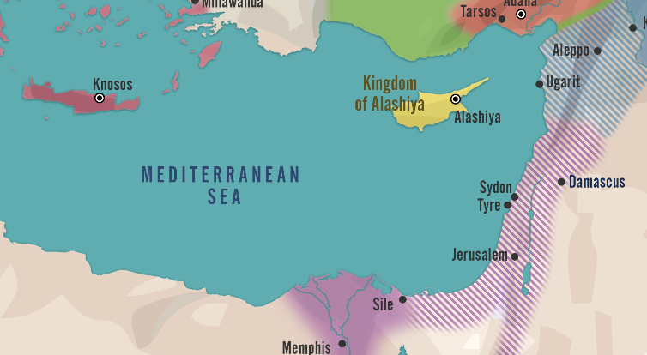
Notes:
Adam Talk about Ramses the 4th

Slide 7
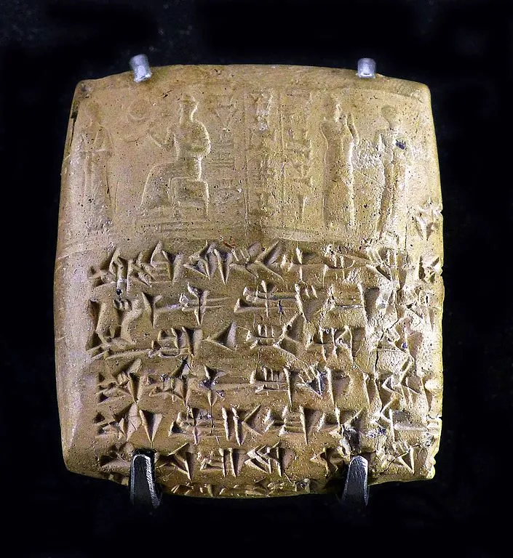
Cuneiform Tablet from Ugarit Louvre Museum.Picture Credit: Mbzt. Wikimedia Commons, Creative Commons Attribution-Share Alike 4.0 International license.
Notes:
2.5 miles from Aphek and Ebenezer
19 miles from Ebenezer to Shilo
The discovery of Ugarit has a certain fairytale typicality to it. A peasant was plowing below the tell of Ras Shamra in 1928 when he struck a solid mass, which later turned out to be a stone covering to a tomb. The French authorities—in charge of Syria at the time—were alerted, and in 1929 archaeologists from France, headed by the now-famous Claude F.A. Schaeffer, began the first season of excavation. The French have continued to dig at Ras Shamra until today, although with more involvement from the Syrians in recent years.

Slide 8
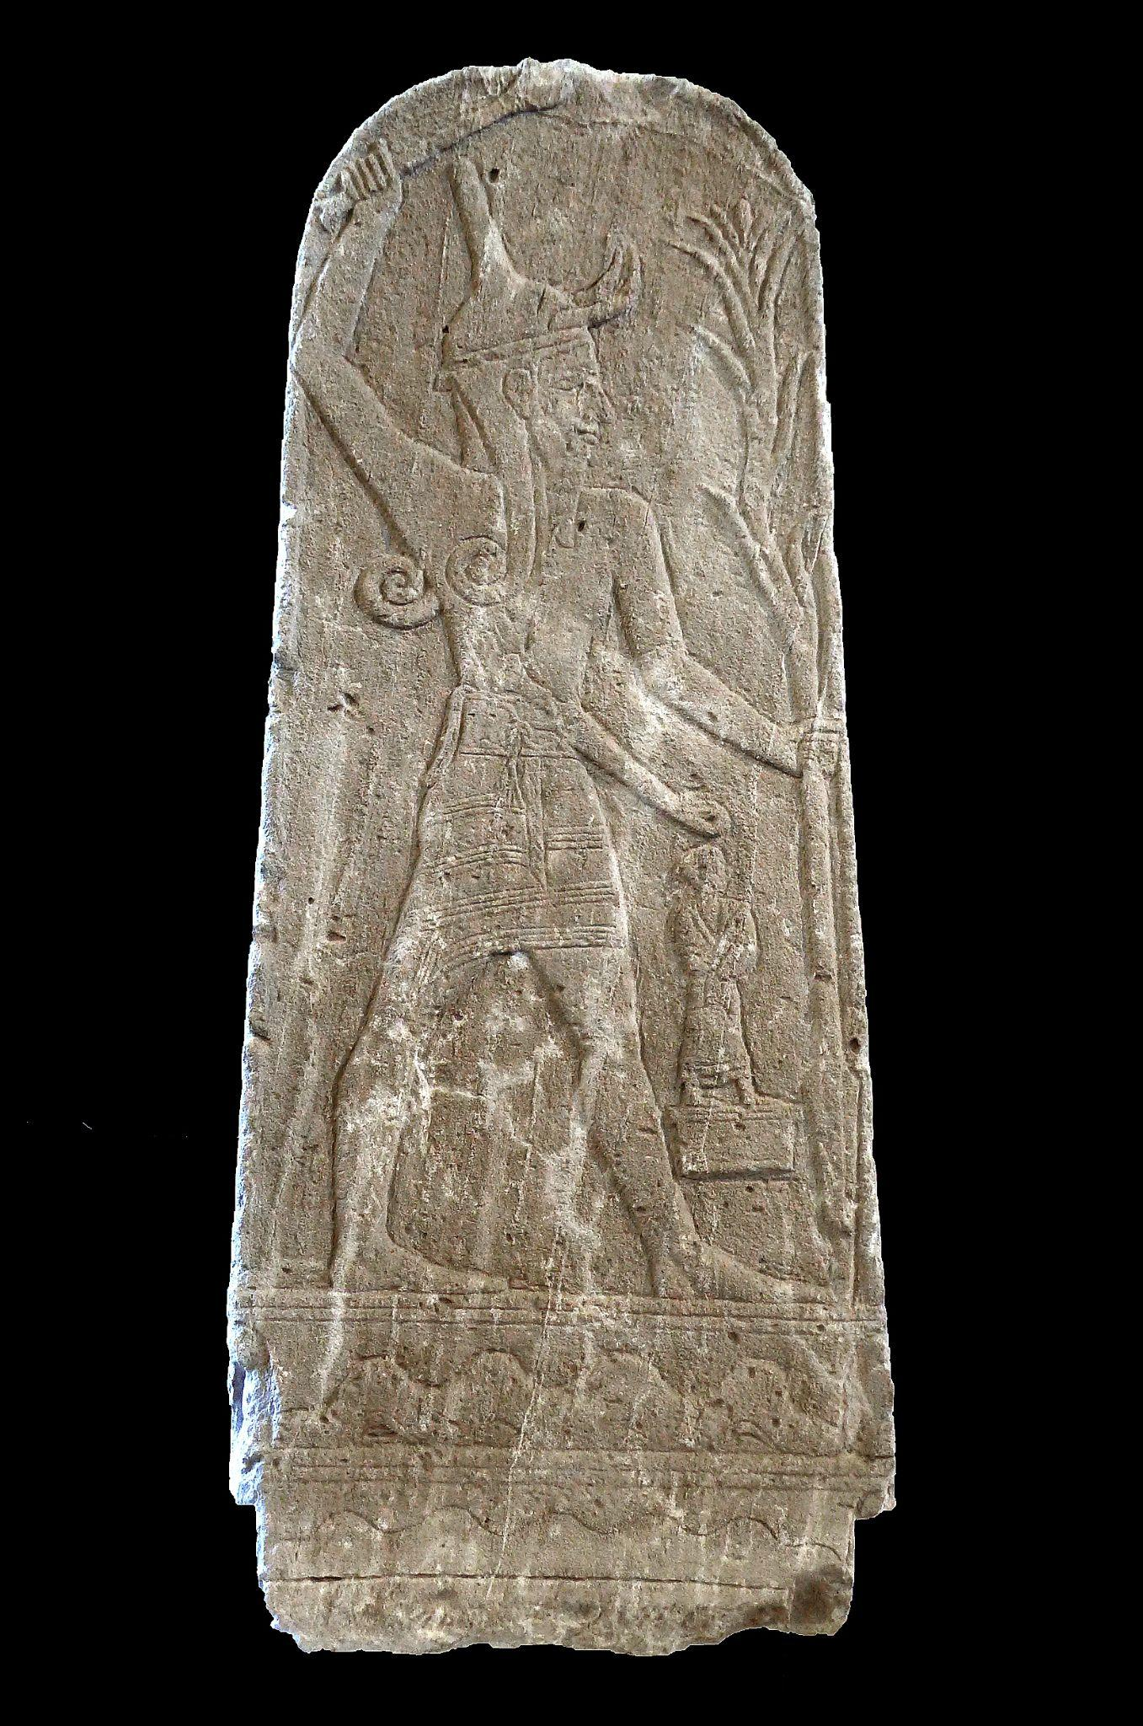
Cuneiform Tablet from Ugarit Louvre Museum.Picture Credit: Mbzt. Wikimedia Commons, Creative Commons Attribution-Share Alike 4.0 International license.
Notes:
Baal with Thunderbolt or the Baal stele is a white limestone bas-relief stele from the ancient kingdom of Ugarit in northwestern Syria. The stele was discovered in 1932, about 20 metres (66 ft) from the Temple of Baal in the acropolis of Ugarit, during excavations directed by French archaeologist Claude F. A. Schaeffer. The stele depicts Baal (or Hadad), the Aramean god of storm and rain, and is considered the most important of the Ugaritic stelae. The stele is on display at the Musée du Louvre in Paris.[1] Material Limestone
Height 142 centimetres (56 in)
Width 50 centimetres (20 in)
Depth 28 centimetres (11 in)

Slide 9
1 Samuel 7:3-17
7 Now when the Philistines heard that the sons of Israel had gathered to Mizpah, the lords of the Philistines went up against Israel. And when the sons of Israel heard it, they were afraid of the Philistines. 8 Then the sons of Israel said to Samuel, “Do not cease to cry to the Lord our God for us, that He may save us from the hand of the Philistines.” 9 Samuel took a suckling lamb and offered it for a whole burnt offering to the Lord; and Samuel cried to the Lord for Israel and the Lord answered him. 10 Now Samuel was offering up the burnt offering, and the Philistines drew near to battle against Israel. But the Lord thundered with a great thunder on that day against the Philistines and confused them, so that they were routed before Israel. 11 The men of Israel went out of Mizpah and pursued the Philistines, and struck them down as far as below Beth-car.
1 Samuel 7:7-11 (NASB)
Notes:
ADAM
Mizpah literally means “the outlook”. Today it is identified at Tell en-Nasbeh 784 meters high, 8 miles north from jerusalem. Between ramah and bethel on our map.
ART
Wiersbe 43-44 They prayed for God's help (1 Sam. 7:7-11, 13-14). When the Philistines learned about this large gathering of Jews, they became suspicious that Israel was planning to attack, so the five Philistine lords summoned their troops and prepared to invade. Israel had no standing army and no one ruler to organize one, so they felt helpless. But their greatest weapon was their faith in Jehovah God, a faith that was expressed in prayer. "Some trust in chariots, and some in horses, but we will remember the name of the Lord our God" (Ps. 20:7, KJV). As we have seen, Samuel was a man of prayer (99:6), and God answered him that day. As he sacrificed the evening burnt offering, the Lord thundered against the Philistine soldiers and so confused them that it was easy for Israel to attack and defeat them. When we remember that Baal was the Canaanite storm god, it makes the power of God's thunder even more significant.
All the days of Samuel, the Lord kept the Philistines at a distance from Israel. Because of this victory, the Jews recovered cities they had lost in battle and even gained the Amorites as allies. Whenever God's people depend on their own plans and resources, their efforts fail and bring disgrace to God's name; but when God's people trust the Lord and pray, He meets the need and receives the glory. A man or woman of prayer is more powerful than a whole army! No wonder King Jehoash called the Prophet Elisha "the chariots and horsemen of Israel" (2 Kings 13:14), a title Elisha had used for his mentor Elijah (2 Kings 2:12 and see 6:17). Do we have such men and women of prayer today?

Slide 10
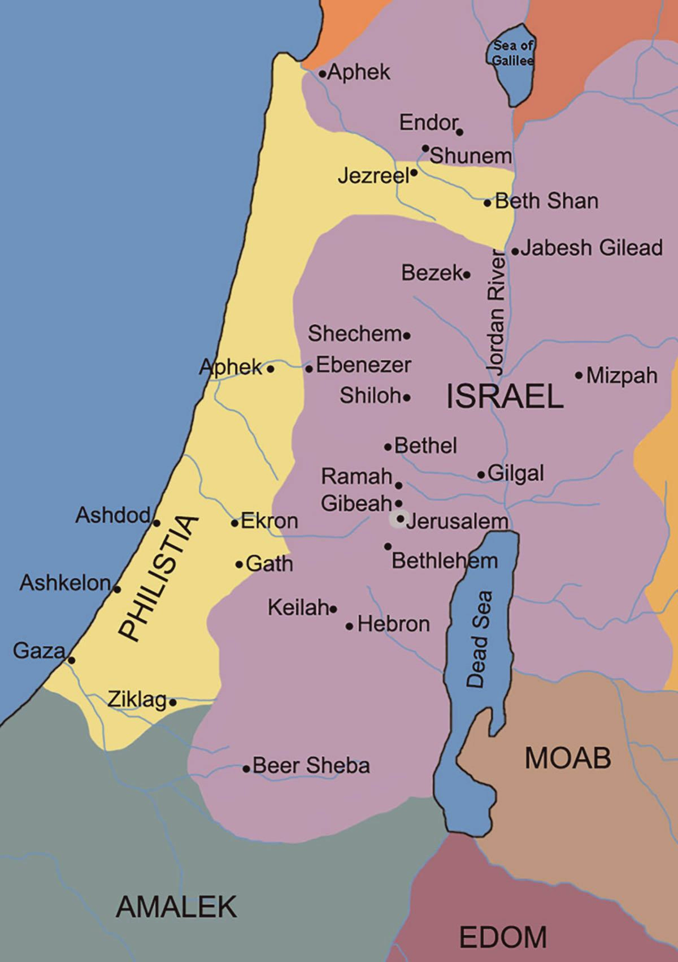
Philistine
Cities

Slide 11
1 Samuel 7:3-17
12 Then Samuel took a stone and set it between Mizpah and Shen, and named it Ebenezer, saying, “Thus far the Lord has helped us.” 13 So the Philistines were subdued and they did not come anymore within the border of Israel. And the hand of the Lord was against the Philistines all the days of Samuel. 14 The cities which the Philistines had taken from Israel were restored to Israel, from Ekron even to Gath; and Israel delivered their territory from the hand of the Philistines. So there was peace between Israel and the Amorites.
1 Samuel 7:12-14 (NASB)
Notes:
Adam
The quote “Thus far the Lord has helped us” is ambiguous in the hebrew. Is it chronological or local?
ART
Wiersbe 44 They commemorated the victory (1 Sam. 7:12). The setting up of stones to commemorate significant events has been a part of the Hebrew culture since Jacob set up a memorial at Bethel (Gen. 28:20-22; 35:14). Joshua set up twelve stones in the midst of the Jordan (Josh. 4:9) and twelve more on the western bank at Gilgal to mark the place where the waters opened and Israel crossed into the Promised Land (vv. 4:1-8, 19-21). A great heap of stones in the Achor Valley reminded the Jews of Achan's disobedience (vv. 7:24-26), and another heap marked the burial place of the king of Ai (8:29). Another heap stood at a cave at Makkedah to mark where five kings had been defeated and slain (10:25-27). Before his death, Joshua set up a "witness stone" to remind the Israelites of their vow to serve the Lord alone and obey Him (24:26-28).
ART
"Ebenezer" means "stone of help" because the monument was a reminder to the Jews that God had helped them that far and would continue to help them if they would trust Him and keep His covenant. The founder of the China Inland Mission, J. Hudson Taylor, had a plaque displayed in each of his residences that read "Ebenezer-Jehovah Jireh," Together, these Hebrew words say, "The Lord has helped us to this point, and He will see to it from now on." What an encouragement to our faith!

Slide 12
1 Samuel 7:3-17
15 Now Samuel judged Israel all the days of his life. 16 He used to go annually on circuit to Bethel and Gilgal and Mizpah, and he judged Israel in all these places. 17 Then his return was to Ramah, for his house was there, and there he judged Israel; and he built there an altar to the Lord.
1 Samuel 7:15-17 (NASB)
Notes:
Wiersbe 44-45 They respected Samuel (1 Sam. 7:15-17). It's likely that this meeting at Mizpah marked the beginning of Samuel's public ministry to the whole nation of Israel, so that from that time on he was a focal point for political unity and spiritual authority. The nation knew that Samuel was God's appointed leader (3:20-4:1), and when he died, the entire nation mourned him (28:3). He made his home in Ramah and established a circuit of ministry to teach the people the law, to hear cases, to give counsel, and to pass judgment. His two sons assisted him by serving at Beersheba (8:1-2). Israel was blessed to have a man like Samuel to guide them, but the times were changing and Israel's elders wanted the nation to change as well.

Slide 13
Philistine
Cities

Slide 14
02
Rejecting the Lord
Notes:
ART
Wiersbe 45 2. Rejecting the Lord (1 Sam. 8:1-22)
Probably twenty or twenty-five years elapsed between the events recorded in chapter 7 and those in chapter 8. Samuel now an old man, about to pass from the scene, and a new generation had emerged in Israel with new leaders who had new ideas. Life goes on, circumstances change, and God's people must have wisdom to adapt to new challenges without abandoning old convictions. Like more than one great leader, Samuel in his old age faced some painful situations and had to make some difficult decisions. He left the scene convinced that he had been rejected by the people he had served so faithfully. Samuel obeyed the Lord, but he
was a man with a broken heart.
God had chosen Moses to lead the nation of Israel and Joshua to succeed him (Deut. 31:1-15), but Joshua wasn't commanded to lay hands on any successor. He left behind elders whom he had trained to serve God, but when they died, the new generation turned away from the Lord and followed the idols of the land (Jud. 2:10-15). There was an automatic succession to the priesthood, and the Lord could call out prophets when needed, but who would lead the people and see to it that the law was obeyed? During the period of the Judges, God raised up leaders here and there and gave them great victories, but nobody was in charge of the nation as a whole. "In those days there was no king in Israel; every man did that which was right in his own eyes" (Jud. 21:25; see 17:6; 18:1; 19:1). The "nation" of Israel was a loose confederation of sovereign tribes, and each tribe was expected to seek the Lord and do His will.

Slide 15
1 Samuel 8:1-22
1 And it came about when Samuel was old that he appointed his sons judges over Israel. 2 Now the name of his firstborn was Joel, and the name of his second, Abijah; they were judging in Beersheba. 3 His sons, however, did not walk in his ways, but turned aside after dishonest gain and took bribes and perverted justice.
1 Samuel 8:1-3 (NASB)
Notes:
ADAM:
Settings the stage for the peoples request for a king…they are unhappy with the current judges.

Slide 16
1 Samuel 8:1-22
4 Then all the elders of Israel gathered together and came to Samuel at Ramah; 5 and they said to him, “Behold, you have grown old, and your sons do not walk in your ways. Now appoint a king for us to judge us like all the nations.” 6 But the thing was displeasing in the sight of Samuel when they said, “Give us a king to judge us.” And Samuel prayed to the Lord. 7 The Lord said to Samuel, “Listen to the voice of the people in regard to all that they say to you, for they have not rejected you, but they have rejected Me from being king over them. 8 Like all the deeds which they have done since the day that I brought them up from Egypt even to this day—in that they have forsaken Me and served other gods—so they are doing to you also. 9 Now then, listen to their voice; however, you shall solemnly warn them and tell them of the procedure of the king who will reign over them.”
1 Samuel 8:4-9 (NASB)
Notes:
ART:
Wiersbe 45 Asking for a king (1 Sam.8:1-9). Knowing that Israel needed a stronger central government, the elders presented their request to Samuel and backed it up with several arguments. The first two must have cut Samuel to the quick: he was now old and had no successor, and his two sons were not godly men but took bribes (1 Sam. 8:3-5). How tragic that both Eli and Samuel had sons who failed to follow the Lord. Eli was too easy on his wayward sons (2:29), and perhaps Samuel was away from home too much as he made his ministry circuit to the cities. Samuel's sons were miles away in Beersheba where their father couldn't monitor their work, but if the elders knew about their sins, surely their father must have known also.
When the elders asked to have a king "like all the nations" (8:5, 20), they were forgetting that Israel's strength was to be unlike the other nations. The Israelites were God's covenant people and He was their King. The glory of God dwelt in their midst and the law of God was their wisdom. (See Ex. 19:3-6; 33:15-16; Lev. 18:30 and 20:26; Num. 23:9.) But the elders were concerned about national security and protection from the enemies around them. The Philistines were still a powerful nation, and the Ammonites were also a threat (1 Sam. 12:12). Israel had no standing army and no king to lead it. The elders forgot that it was the Lord who was Israel's King and who gave her army the ability to defeat the enemy.

Slide 17
1 Samuel 8:1-22
10 So Samuel spoke all the words of the Lord to the people who had asked of him a king. 11 He said, “This will be the procedure of the king who will reign over you: he will take your sons and place them for himself in his chariots and among his horsemen and they will run before his chariots. 12 He will appoint for himself commanders of thousands and of fifties, and some to do his plowing and to reap his harvest and to make his weapons of war and equipment for his chariots. 13 He will also take your daughters for perfumers and cooks and bakers.
1 Samuel 8:10-13 (NASB)
Notes:
ADAM:
The stipulation here is that Samuel is talking to leaders and people of high import. Taking their sons and daughters to be commander and perfumers(concubines). There is a good chance that Saul and his family are not represented in this delegation sent to samuel.

Slide 18
1 Samuel 8:1-22
14 He will take the best of your fields and your vineyards and your olive groves and give them to his servants. 15 He will take a tenth of your seed and of your vineyards and give to his officers and to his servants. 16 He will also take your male servants and your female servants and your best young men and your donkeys and use them for his work. 17 He will take a tenth of your flocks, and you yourselves will become his servants. 18 Then you will cry out in that day because of your king whom you have chosen for yourselves, but the Lord will not answer you in that day.”
1 Samuel 8:14-18 (NASB)
Notes:
ART: Wiersbe 47 Paying for a king (1 Sam. 8:10-22). What's true of individuals is true of nations: you take what you want from life and you pay for it. Under the kingship of Jehovah God, the nation had security and sufficiency as long as they obeyed Him, and His demands were not unreasonable. To obey God's covenant meant to live a happy life as the Lord gave you all that you needed and more. But the key word in Samuel's speech is take, not give. The king and his court had to be supported, so he would take their sons and daughters, their property, their harvests, and their flocks and herds. Their choice young men would serve in the army as well as in the king's fields. Their daughters would cook and bake for the king. He would take their property and part of their harvest in order to feed the officials and servants in the royal household. While these things weren't too evident under Saul and David, they were certainly obvious under Solomon (1 Kings 4:7-28). The day came when the people cried out for relief from the heavy yoke Solomon had put on them just to maintain the glory of his kingdom (12:1-4; see Jer. 22:13-17).

Slide 19
1 Samuel 8:1-22
19 Nevertheless, the people refused to listen to the voice of Samuel, and they said, “No, but there shall be a king over us, 20 that we also may be like all the nations, that our king may judge us and go out before us and fight our battles.” 21 Now after Samuel had heard all the words of the people, he repeated them in the Lord’s hearing. 22 The Lord said to Samuel, “Listen to their voice and appoint them a king.” So Samuel said to the men of Israel, “Go every man to his city.”
1 Samuel 8:19-22 (NASB)
Notes:
ART: Wiersbe 46-48 Samuel was a man of spiritual insight and he knew that this demand for a king was evidence of spiritual decay among the leaders. They weren't rejecting him; they were rejecting God, and this grieved Samuel's heart as he prayed to the Lord for wisdom. This wasn't the first time the people had rejected their Lord. At Sinai, their request was "Make us gods!" (Ex. 32:1) and after their humiliating failure at Kadesh Barnea, they said, "Let us make a captain, and let us return into Egypt" (Num. 14:4).2 Whenever leadership in a church decays spiritually, that church becomes more like the world and uses the world's methods and resources to try to do God's work. The Jewish leaders in Samuel's day had no faith that God could defeat their enemies and protect His people, so they chose to lean on the arm of flesh.
God is never surprised by what His people do, nor is He at a loss to know what He should do. "The Lord brings the counsel of the nations to nothing; He makes the plans of the peoples of no effect. The counsel of the Lord stands forever, the plans of His heart to all generations" (Ps. 33:10-11, NKJV). There is every evidence in the Pentateuch that Israel would one day have a king. God promised Abraham, Sarah, and Jacob that kings would be among their descendants (Gen. 17:6, 16; 35:11), and Jacob had named Judah as the kingly tribe (49:10). Moses prepared the nation for a king when he spoke to the new generation preparing to enter the Promised Land (Deut. 17:14-20).
It wasn't Israel's request for a king that was their greatest sin; it was their insisting that God give them a king immediately. The Lord had a king in mind for them, David the son of Jesse, but the time wasn't ripe for him to appear. So, the Lord gave them their request by appointing Saul to be king, and He used Saul to chasten the nation and prepare them for David, the man of His choice. The fact that Saul was from the tribe of Benjamin and not from Judah is evidence enough that he was never expected to establish a dynasty in Israel. "So in my anger I gave you a king, and in my wrath I took him away" (Hosea 13:11, NIV). The greatest judgment God can give us is to let us have our own way. "And He gave them their request, but sent leanness into their soul" (Ps. 106:15, NKJV). However, the Lord wanted His people to go into this new venture with their eyes open, so He commanded Samuel to tell them what it would cost them to have a king.
In spite of these warnings, the people insisted that God give them a king. Pleasing the Lord wasn't the thing uppermost in their minds; what they wanted was guaranteed protection against their enemies. They wanted someone to judge them and fight their battles, someone they could see and follow. They found it too demanding to trust an invisible God and obey His wonderful commandments. In spite of all the Lord had done for Israel from the call of Abraham to the conquest of the Promised Land, they turned their back on Almighty God and chose to have a frail man to rule over them.

Slide 20
03
Obeying the Lord
Notes:
3. Obeying the Lord (1 Sam. 9:1-10:27)
The focus now shifts from Samuel to Saul, God's choice for Israel's king. He was from the tribe of Benjamin, which had almost been exterminated because of their rebellion against the law (Jud. 19-20). Jacob compared Benjamin to "a ravening wolf" (Gen. 49:27), and the tribe was involved in numerous battles. Benjamin's territory lay between Ephraim and Judah, so Saul's tribe was adjacent to the royal tribe of Judah. In spite of what Saul said to Samuel in 1 Samuel 9:21, he belonged to a powerful and wealthy family that owned real estate and animals and had
Servants.
Physically, Saul was tall, good-looking, and strong, the kind of king people would admire. Even Samuel, with all his spiritual perception, got carried away when he saw him (10:23-24). His weakness for admiring the physical qualities even showed up when Samuel went to anoint David (16:1-7). Saul was obedient to his father and concerned about his father's feelings (9:5), and he was persistent in wanting to obey his father's will. To invest all that time and energy looking for the lost animals suggests that he wasn't a quitter. There was a certain amount of modesty in Saul (v. 21; 10:14-16), but there was no indication of spiritual life.

Slide 21
1 Samuel 9:1-10:27
1 Now there was a man of Benjamin whose name was Kish the son of Abiel, the son of Zeror, the son of Becorath, the son of Aphiah, the son of a Benjamite, a mighty man of valor. 2 He had a son whose name was Saul, a choice and handsome man, and there was not a more handsome person than he among the sons of Israel; from his shoulders and up he was taller than any of the people.
3 Now the donkeys of Kish, Saul’s father, were lost. So Kish said to his son Saul, “Take now with you one of the servants, and arise, go search for the donkeys.” 4 He passed through the hill country of Ephraim and passed through the land of Shalishah, but they did not find them. Then they passed through the land of Shaalim, but they were not there. Then he passed through the land of the Benjamites, but they did not find them.
1 Samuel 9:1-4 (NASB)
Notes:
Wiersbe 49 Samuel meets Saul (1 Sam. 9:1-25). Saul's home was in Gibeah, which was about five miles from Ramah where Samuel lived, and yet Saul didn't even know what all Israel knew (3:20), that a man of God named Samuel lived in Ramah (9:6). How Saul could live so close to Israel's spiritual leader and not know about him is a bit of a mystery and suggests that Saul simply lived and farmed with his family at Gibeah and minded his own business. Apparently he didn't attend the annual feasts and wasn't greatly concerned about spiritual matters. Like many people today, he wasn't against religion, but he didn't make knowing the Lord a vital part of his life. It's a good thing the servant knew about Samuel and that Saul heeded his advice!
A rather insignificant event brought Saul and Samuel together; the loss of some of Kish's donkeys. The animals were valuable, of course, and later somebody found them and returned them to Kish (10:2), but who would have thought that Israel's first king would be called to the throne while searching for donkeys! David was identified with sheep (Ps. 78:70-72; 1 Sam. 17:15) and saw the people of Israel as sheep who needed protection and guidance (2 Sam. 24:17). The Lord works in unusual ways, but if Saul had not obeyed his father and listened to his servant, the story might have been different.

Slide 22
1 Samuel 9:1-10:27
5 When they came to the land of Zuph, Saul said to his servant who was with him, “Come, and let us return, or else my father will cease to be concerned about the donkeys and will become anxious for us.” 6 He said to him, “Behold now, there is a man of God in this city, and the man is held in honor; all that he says surely comes true. Now let us go there, perhaps he can tell us about our journey on which we have set out.” 7 Then Saul said to his servant, “But behold, if we go, what shall we bring the man? For the bread is gone from our sack and there is no present to bring to the man of God. What do we have?” 8 The servant answered Saul again and said, “Behold, I have in my hand a fourth of a shekel of silver; I will give it to the man of God and he will tell us our way.” 9 (Formerly in Israel, when a man went to inquire of God, he used to say, “Come, and let us go to the seer”; for he who is called a prophet now was formerly called a seer.) 10 Then Saul said to his servant, “Well said; come, let us go.” So they went to the city where the man of God was.
1 Samuel 9:5-10 (NASB)

Slide 23
1 Samuel 9:1-10:27
11 As they went up the slope to the city, they found young women going out to draw water and said to them, “Is the seer here?” 12 They answered them and said, “He is; see, he is ahead of you. Hurry now, for he has come into the city today, for the people have a sacrifice on the high place today. 13 As soon as you enter the city you will find him before he goes up to the high place to eat, for the people will not eat until he comes, because he must bless the sacrifice; afterward those who are invited will eat. Now therefore, go up for you will find him at once.” 14 So they went up to the city. As they came into the city, behold, Samuel was coming out toward them to go up to the high place.
1 Samuel 9:11-14 (NASB)
Notes:
Wiersbe 49 It was evening when the two men arrived at the gates of Ramah, because the young ladies were going out to draw water. Asking the girls if the seer was there, they were given a long detailed answer. Perhaps the Jewish maids were happy to chat with a tall, handsome stranger! Even the time of Saul's arrival at the city was providential, for Samuel appeared just as Saul and his servant entered the city. Samuel was going up to a "high place" outside the city where he would offer a sacrifice to the Lord. Since there was no central sanctuary in Israel at that time, the people brought their sacrifices to a shrine that was dedicated to the Lord and located on a hill near the city. The pagan nations worshiped their false gods at the high places and also indulged in filthy practices there, but the people of Israel were forbidden to join them (Ps. 78:58; Hosea 4:11-14; Jer. 3:2).

Slide 24
1 Samuel 9:1-10:27
15 Now a day before Saul’s coming, the Lord had revealed this to Samuel saying, 16 “About this time tomorrow I will send you a man from the land of Benjamin, and you shall anoint him to be prince over My people Israel; and he will deliver My people from the hand of the Philistines. For I have regarded My people, because their cry has come to Me.” 17 When Samuel saw Saul, the Lord said to him, “Behold, the man of whom I spoke to you! This one shall rule over My people.” 18 Then Saul approached Samuel in the gate and said, “Please tell me where the seer’s house is.”
1 Samuel 9:15-18 (NASB)
Notes:
Adam:
Wiersbe 50 The day before, the Lord had told Samuel that Saul was coming to Ramah, so he was prepared to meet him and give him God's message. Samuel couldn't say he was happy about the changes going on in Israel, but he was obedient to the Lord. The word "captain" in 1 Samuel 9:16 (KJV) simply means "leader." When Saul appeared, the Lord spoke again to Samuel and confirmed that this was indeed the man of His choice and that Samuel should anoint him as king. "God's anointed" was one of the titles for the king (12:3; 24:6; 26:9, 11, 16; Ps. 2:2, 6). The Lord would use Saul as He did Samson (Jud. 13:5), to begin to weaken the Philistines and prepare them for David's final conquest of this enemy of the Jews (1 Chron. 18:1).

Slide 25
1 Samuel 9:1-10:27
19 Samuel answered Saul and said, “I am the seer. Go up before me to the high place, for you shall eat with me today; and in the morning I will let you go, and will tell you all that is on your mind. 20 As for your donkeys which were lost three days ago, do not set your mind on them, for they have been found. And for whom is all that is desirable in Israel? Is it not for you and for all your father’s household?” 21 Saul replied, “Am I not a Benjamite, of the smallest of the tribes of Israel, and my family the least of all the families of the tribe of Benjamin? Why then do you speak to me in this way?”
1 Samuel 9:19-21 (NASB)
Notes:
ADAM: Does anyone have another translation for what is in purple?
NASB - And for whom is all that is desirable in Israel? Is it not for you and for all your father’s household?
NLT - And I am here to tell you that you and your family are the focus of all Israel’s hopes.
Wiersbe 50 Samuel's response to Saul's request must have shocked the young man. Saul discovered that he was speaking to the man he was seeking, that he would feast with him that day, that Samuel had a special message for him, and that the missing donkeys had been found and returned to his father. Furthermore, all the desire of Israel was fixed on Saul, because all Israel wanted a king. Saul didn't understand what Samuel was saying, but everything would be explained to him the next day. Samuel ignored Saul's protest that he was a nobody who belonged to an insignificant tribe, and he escorted Saul and his servant to the banquet hall at the high place where the feast would be held. Saul was given the special portion of the fellowship offering that belonged to the priest (1 Sam.9:24; Lev. 7:32-33), and the cook informed him that the portion had been set aside especially for him. Strange things were happening! After the feast, Saul returned with Samuel to his house, and there they had a long talk in which Samuel rehearsed for Saul the events that had led up to this meeting.

Slide 26
1 Samuel 9:1-10:27
22 Then Samuel took Saul and his servant and brought them into the hall and gave them a place at the head of those who were invited, who were about thirty men. 23 Samuel said to the cook, “Bring the portion that I gave you, concerning which I said to you, ‘Set it aside.’” 24 Then the cook took up the leg with what was on it and set it before Saul. And Samuel said, “Here is what has been reserved! Set it before you and eat, because it has been kept for you until the appointed time, since I said I have invited the people.” So Saul ate with Samuel that day.
1 Samuel 9:22-24 (NASB)

Slide 27
1 Samuel 9:1-10:27
25 When they came down from the high place into the city, Samuel spoke with Saul on the roof. 26 And they arose early; and at daybreak Samuel called to Saul on the roof, saying, “Get up, that I may send you away.” So Saul arose, and both he and Samuel went out into the street. 27 As they were going down to the edge of the city, Samuel said to Saul, “Say to the servant that he might go ahead of us and pass on, but you remain standing now, that I may proclaim the word of God to you.”
1 Samuel 9:25-27 (NASB)

Slide 28
1 Samuel 9:1-10:27
1 Then Samuel took the flask of oil, poured it on his head, kissed him and said, “Has not the Lord anointed you a ruler over His inheritance? 2 When you go from me today, then you will find two men close to Rachel’s tomb in the territory of Benjamin at Zelzah; and they will say to you, ‘The donkeys which you went to look for have been found. Now behold, your father has ceased to be concerned about the donkeys and is anxious for you, saying, “What shall I do about my son?”’ 3 Then you will go on further from there, and you will come as far as the oak of Tabor, and there three men going up to God at Bethel will meet you, one carrying three young goats, another carrying three loaves of bread, and another carrying a jug of wine;
1 Samuel 10:1-3 (NASB)
Notes:
ART:
Wiersbe 51 Samuel anoints Saul (1 Sam. 9:26-10:16). Early the next morning, Samuel accompanied Saul and his servant to the edge of the city, sent the servant on ahead, and then anointed Saul as the first king of Israel. From that moment on, Saul was leader over God's people ("inheritance"), but only Samuel and Saul knew it. How could young Saul be sure that God had really chosen him? Samuel gave Saul three signs, special occurrences he would encounter as he made his way home.
First, he would meet two men who would tell him that the lost animals had been found (10:2), news that Saul had already heard from Samuel. Apparently these men knew who Saul was and that he had been away from home seeking the lost property. But this was a good experience for the young king, for it assured him that God could solve his problems. One of Saul's greatest failures as a leader was his inability to take his hands off of situations and let God work. In modern language, Saul was a "control freak." Yet while Saul and his servant were dining with Samuel, God was at work saving the lost animals.

Slide 29
1 Samuel 9:1-10:27
4 and they will greet you and give you two loaves of bread, which you will accept from their hand. 5 Afterward you will come to the hill of God where the Philistine garrison is; and it shall be as soon as you have come there to the city, that you will meet a group of prophets coming down from the high place with harp, tambourine, flute, and a lyre before them, and they will be prophesying. 6 Then the Spirit of the Lord will come upon you mightily, and you shall prophesy with them and be changed into another man. 7 It shall be when these signs come to you, do for yourself what the occasion requires, for God is with you. 8 And you shall go down before me to Gilgal; and behold, I will come down to you to offer burnt offerings and sacrifice peace offerings. You shall wait seven days until I come to you and show you what you should do.”
1 Samuel 10:4-8 (NASB)
Notes:
Wiersbe 51 The second sign would take place at the oak of Tabor where he would meet three pilgrims heading for Bethel (vv. 3-4). In spite of the nation's unbelief, there were still devoted people in the land who honored the Lord and sought His face.3 There must have been a sacred place at Bethel dedicated to the Lord (Jud. 20:18, 26), and perhaps the three kids, the wine, and the three loaves of bread were gifts for the Levites serving there. Since as yet there was no central sanctuary, the three kids may have been for sacrifices. These men would greet Saul and give him two of the three loaves, and he was to receive them. God was showing Saul that not only could He solve his problems, but He could also supply his needs. As the first king of Israel, he would have to raise up an army and provide the food and equipment the men needed, and he would have to depend on the Lord.
The third sign had to do with spiritual power (1 Sam. 10:5-6). Saul would meet a band of prophets returning from worship at the high place, and they would be prophesying. The Holy Spirit of God would come upon Saul at that time and he would join the company of prophets in their ecstatic worship. In this sign, God told Saul that He could endue him with the power he needed for service. "And who is sufficient for these things?" is the question in the heart of every servant of God (2 Cor. 2:16), and the only correct answer is "our sufficiency is of God" (3:5). However, later Saul would become very self-sufficient and rebellious, and the Lord would take the Spirit from him (1 Sam. 16:14; 28:15).

Slide 30
1 Samuel 9:1-10:27
9 Then it happened when he turned his back to leave Samuel, God changed his heart; and all those signs came about on that day. 10 When they came to the hill there, behold, a group of prophets met him; and the Spirit of God came upon him mightily, so that he prophesied among them. 11 It came about, when all who knew him previously saw that he prophesied now with the prophets, that the people said to one another, “What has happened to the son of Kish? Is Saul also among the prophets?” 12 A man there said, “Now, who is their father?” Therefore it became a proverb: “Is Saul also among the prophets?” 13 When he had finished prophesying, he came to the high place.
1 Samuel 10:9-13 (NASB)
Notes:
Wiersbe 52-53 When Saul turned from Samuel to start his journey home, God gave him "another heart" (10:9, see v. 6). Don't read New Testament "regeneration" into this statement; it refers primarily to a different attitude and outlook. This young farmer would now think and act like a leader, the king of the nation, a warrior-statesman whose responsibility it was to listen to God and obey His will. The Holy Spirit would further enable him to serve God as long as he walked in obedience to His will (v. 6). Because Saul became proud and independent and rebelled against God, he lost the Spirit's power, he lost his kingdom, and he eventually lost his life.
Each of these events took place just as Samuel promised. but the only one actually described in the text is Saul's encounter with the company of prophets (vv. 10-13). In the Old Testament era, God gave His Holy Spirit to chosen people to enable them to perform special tasks, and God could take the Spirit away as well. Believers today, who are under the New Covenant, have the Holy Spirit abiding within forever (John 14:16-17) as God's seal that we are His children (Eph. 1:13-14). When David asked God not to take the Holy Spirit from him (Ps. 51:11), he was thinking especially of what the Lord did to Saul (1 Sam. 16:14; 28:15). Believers today may grieve the Spirit (Eph. 4:30) and quench the Spirit (1 Thes. 5:19), but they cannot drive Him away.
The Spirit enabled Saul (probably for the first time in his life) to have a personal experience with the Lord and to express it in praise and worship. Had Saul continued to nurture this walk with the Lord, his life would have been much different. His pride and desire for power became his besetting sin. When the news got out that Saul had prophesied with a company of prophets, some of his friends spoke about him with disdain (1 Sam. 10:11-13).
There's no evidence that he was overly wicked, but Saul was a secular person, not a spiritual person, and he was the last man his friends ever expected to have that kind of experience. The question, "Is Saul also among the prophets?" was asked of anybody who suddenly stepped out of character and did the unexpected. Since prophets often inherited their ministry from their fathers (Amos 7:14), and were even called "fathers" (2 Kings 2:12; 6:2), the second question was asked: "Who is their father?" Even after Saul was presented to the people as their king, not everybody in Israel was impressed with him (1 Sam. 10:27).

Slide 31
1 Samuel 9:1-10:27
14 Now Saul’s uncle said to him and his servant, “Where did you go?” And he said, “To look for the donkeys. When we saw that they could not be found, we went to Samuel.” 15 Saul’s uncle said, “Please tell me what Samuel said to you.” 16 So Saul said to his uncle, “He told us plainly that the donkeys had been found.” But he did not tell him about the matter of the kingdom which Samuel had mentioned.
1 Samuel 10:14-16 (NASB)
Notes:
Saul returned home and went back to work on the farm as though nothing remarkable had happened. He said nothing to his family about being anointed king, and apparently the news about his prophetic experiences hadn't reached as far as Gibeah. The experiences of the previous days should have taught him that God was with him (v. 7), and that He would take care of him and meet his needs, if only he would trust and obey. He also should have realized that he could trust Samuel to give him God's message, and that to disobey Samuel meant to disobey the Lord. One more task awaited Saul, and that was to meet Samuel at Gilgal at a time that would be shown him (v. 8). This would be a test to see if Saul was truly devoted to the Lord and willing to obey orders. Unfortunately, he failed.

Slide 32
Philistine
Cities
Notes:
Were back in Mizpah

Slide 33
1 Samuel 9:1-10:27
17 Thereafter Samuel called the people together to the Lord at Mizpah; 18 and he said to the sons of Israel, “Thus says the Lord, the God of Israel,
‘I brought Israel up from Egypt, and I delivered you from the hand of the Egyptians and from the power of all the kingdoms that were oppressing you.’ 19 But you have today rejected your God, who delivers you from all your calamities and your distresses; yet you have said, ‘No, but set a king over us!’ Now therefore, present yourselves before the Lord by your tribes and by your clans.”
1 Samuel 10:17-19 (NASB)
Notes:
Samuel presents Saul to the people (1 Sam. 10:17-27). Samuel called another convocation at Mizpah for the purpose of presenting the new king to the people. True to his prophetic calling, he first preached a sermon and reminded the people of their redemption from Egypt by God's grace and power as well as their obligation under the covenant to obey the Lord. But they had disobeyed the Lord in asking for a king! They had sinned, but the Lord would answer their request.
Only the Lord and Samuel knew that the king had already been selected and anointed, but Samuel wanted the tribes to realize that Jehovah was in charge of the selection process. He had the tribes present themselves, probably represented by their elders, and the tribe of Benjamin was selected. This may have been selection by lot (14:40-42), or one of the priests may have used the Urim and Thummim to determine the Lord's will (Ex. 28:30). The clan of Matri was selected next, and from that clan, the family of Kish and finally, the young man Saul.

Slide 34
1 Samuel 9:1-10:27
20 Thus Samuel brought all the tribes of Israel near, and the tribe of Benjamin was taken by lot. 21 Then he brought the tribe of Benjamin near by its families, and the Matrite family was taken. And Saul the son of Kish was taken; but when they looked for him, he could not be found. 22 Therefore they inquired further of the Lord, “Has the man come here yet?” So the Lord said, “Behold, he is hiding himself by the baggage.” 23 So they ran and took him from there, and when he stood among the people, he was taller than any of the people from his shoulders upward. 24 Samuel said to all the people, “Do you see him whom the Lord has chosen? Surely there is no one like him among all the people.” So all the people shouted and said, “Long live the king!”
1 Samuel 10:20-24 (NASB)
Notes:
LETS THROW SOME LOTS
Wiersbe p.54 But Saul couldn't be found! And Samuel had to inquire further of the Lord to discover that the king was hiding among the wagons and baggage, certainly not an auspicious way to begin his reign! Was he hiding out of modesty or fear? Probably the latter, because true humility accepts God's will while at the same time depending on God's strength and wisdom. As Andrew Murray said, "True humility isn't thinking meanly of one's self; it's simply not thinking of one's self at all." Had Saul been focusing on the glory of God, he would have been present in the assembly and humbly accepting God's call. Then he would have urged the people to pray for him and to follow him as he sought to do the Lord's will.
This first official act on the part of Saul suggests that there was trouble ahead. Saul was a reluctant ruler who followed his emotions instead of building his faith. He would serve as a sacrificing courageous soldier one day and become a self-centered autocrat the next day. Shunning national popularity is one thing, but shunning God-given responsibility is quite another. "If God called a man to kingship," said G. Campbell Morgan, "he has no right to hide away." Samuel did what he could to salvage an embarrassing situation. He presented Saul as God's chosen king, so the nation had to accept him, and he accented Saul's admirable physical characteristics. The people were impressed, but Samuel certainly knew that God didn't need tall, muscular men in order to get His work done. In a few years, He would use teenage David to kill a giant! (See Ps. 147:10-11.)

Slide 35
1 Samuel 9:1-10:27
25 Then Samuel told the people the ordinances of the kingdom, and wrote them in the book and placed it before the Lord. And Samuel sent all the people away, each one to his house. 26 Saul also went to his house at Gibeah; and the valiant men whose hearts God had touched went with him. 27 But certain worthless men said, “How can this one deliver us?” And they despised him and did not bring him any present. But he kept silent.
1 Samuel 10:25-27 (NASB)
Notes:
ADAM
Deut 17: 14-20
14 “When you enter the land which the Lord your God gives you, and you possess it and live in it, and you say, ‘I will set a king over me like all the nations who are around me,’ 15 you shall surely set a king over you whom the Lord your God chooses, one from among your countrymen you shall set as king over yourselves; you may not put a foreigner over yourselves who is not your countryman. 16 Moreover, he shall not multiply horses for himself, nor shall he cause the people to return to Egypt to multiply horses, since the Lord has said to you, ‘You shall never again return that way.’ 17 He shall not multiply wives for himself, or else his heart will turn away; nor shall he greatly increase silver and gold for himself.
18 “Now it shall come about when he sits on the throne of his kingdom, he shall write for himself a copy of this law on a scroll in the presence of the Levitical priests. 19 It shall be with him and he shall read it all the days of his life, that he may learn to fear the Lord his God, by carefully observing all the words of this law and these statutes, 20 that his heart may not be lifted up above his countrymen and that he may not turn aside from the commandment, to the right or the left, so that he and his sons may continue long in his kingdom in the midst of Israel.
“How can this one deliver us?” Compared to who has already delivered you Yahweh
Present - Same work to talk about bringing gifts to God.
Psalms 96:7-8 7Ascribe to the Lord, O families of the peoples,
Ascribe to the Lord glory and strength.
8 Ascribe to the Lord the glory of His name;
Bring an offering and come into His courts.
ART
Wiersbe pp54-55
The wisest thing Samuel did that day was to link the kingship with the divine covenant (1 Sam. 10:25). His first speech about the king had been negative (8:10-18), but this address and document were positive and pointed out the duties of both king and people. Samuel no doubt elaborated on Moses' words from Deuteronomy 17:14-20 and reminded the people that even the king had to submit to the Lord and His Word. There was one God, one nation, and one covenant, and the Lord was still in charge.
When the assembly was ended, everybody went back home, including the king, and there accompanied him a group of valiant men who became his officers and inner circle. They followed Saul because the Lord moved them to do so. People gave Saul gifts as tokens of their homage to the king, but one group of men despised and ridiculed him. As king, Saul could have dealt severely with them, but he held his peace. And yet later, he was willing to kill Jonathan his son just because the boy had eaten some honey! Saul's emotional instability had him weeping over David one day and trying to kill him the next.

Slide 36
04
Serving the Lord
Notes:
4. Serving the Lord (1 Sam. 11:1-15)
One of the reasons Israel asked for a king was so the nation could unite behind one leader and have a better opportunity to face their enemies. The Lord condescended to reach down to their level of unbelief, and He gave them a king who looked like a natural warrior. How sad it is that God's people trusted a man of clay whom they could admire, and yet they would not trust the Lord who throughout the nation's history had proven Himself powerful on their behalf. In His grace, God gave Saul an opportunity to prove himself and consolidate his authority.

Slide 37
1 Samuel 11:1-15
1 Now Nahash the Ammonite came up and besieged Jabesh-gilead; and all the men of Jabesh said to Nahash, “Make a covenant with us and we will serve you.” 2 But Nahash the Ammonite said to them, “I will make it with you on this condition, that I will gouge out the right eye of every one of you, thus I will make it a reproach on all Israel.” 3 The elders of Jabesh said to him, “Let us alone for seven days, that we may send messengers throughout the territory of Israel. Then, if there is no one to deliver us, we will come out to you.” 4 Then the messengers came to Gibeah of Saul and spoke these words in the hearing of the people, and all the people lifted up their voices and wept. 1 Samuel 11:1-4 (NASB)
Notes:
The challenge (1 Sam. 11:1-3). The Ammonites were descendants of Abraham's nephew Lot (Gen. 19:30-38) and therefore related to the Jewish people. The dangers posed by Nahash ("snake") and his army had helped to motivate the Jews to ask for a king, and now Nahash was encamped around Jabesh Gilead, a city about fifty miles from Saul's home. Rather than engage in a long and costly siege, Nahash offered to negotiate with the people in the city and let them live. All he demanded was that they submit to the humiliating and crippling punishment of having their right eyes gouged out. Archers and swordsmen would be handicapped in battle, and everybody would be humiliated and marked as defeated prisoners of war. Without having to kill anybody, Nahash could subdue the city, take its wealth, and enslave the people.
Wisely, the elders of the city asked for a week's delay, hoping to find somebody who could rescue them, and Nahash agreed, thinking that weak Israel couldn't muster an army. It's interesting that nobody from Jabesh Gilead responded to the call to arms when the nation had to punish the wickedness of Gilead in Benjamin (Jud. 21:8-9), but now they were asking their fellow Jews to come and rescue them!

Slide 38
1 Samuel 11:1-15
5 Now behold, Saul was coming from the field behind the oxen, and he said, “What is the matter with the people that they weep?” So they related to him the words of the men of Jabesh. 6 Then the Spirit of God came upon Saul mightily when he heard these words, and he became very angry. 7 He took a yoke of oxen and cut them in pieces, and sent them throughout the territory of Israel by the hand of messengers, saying, “Whoever does not come out after Saul and after Samuel, so shall it be done to his oxen.” Then the dread of the Lord fell on the people, and they came out as one man. 8 He numbered them in Bezek; and the sons of Israel were 300,000, and the men of Judah 30,000. 1 Samuel 11:5-8 (NASB)
Notes:
The conquest (1 Sam. 11:4-11). It's strange that the messengers from Jabesh Gilead didn't hasten to contact Samuel and Saul first of all. Samuel their prophet had prayed and God gave victory over the Philistines, and Saul their new king had the nucleus of an army. It would take time for the Jews to get accustomed to the new form of government. When the news came, Saul was plowing in the field with the oxen. The Jews were noted for their loud and passionate expressions of grief, and when Saul heard the people weeping, he asked the cause. No sooner did the king understand the situation than he experienced an endowment of the Spirit of God and his own spirit was filled with righteous indignation that such a thing should happen in Israel.
Instantly Saul moved into action and in a dramatic way sent the message to the men of Israel that they were needed for battle. (Compare the actions of the Levite in Jud. 19.) He also identified himself with Samuel when he issued the call to arms, for he and Samuel were working together. The Lord worked on Saul's behalf by putting fear in the hearts of the people so that 330,000 men gathered for battle. Saul mustered the army at Bezek, about twenty miles from Jabesh Gilead, and then sent a message to the city that help was coming the next day before midmorning. Shrewdly, the citizens told the Ammonites that they would surrender the next day, and this gave Nahash the kind of false confidence that threw the army off-guard.
Saul may have known the story of Gideon and his defeat of the Midianites, because like Gideon he divided his army into three parts and attacked at night (Jud. 7:16, 19). The morning watch was from 2 to 6 A.M., so he caught the enemy by surprise and completely routed them. Saul succeeded because he was empowered by the Spirit of God who both used Saul's natural gifts and gave him the wisdom and strength he needed. Being at the head of an inexperienced army of 330,000 men wouldn't be an easy task, but God gave the victory. The will of God will never lead us where the grace of God can't keep us and use us.

Slide 39
1 Samuel 11:1-15
9 They said to the messengers who had come, “Thus you shall say to the men of Jabesh-gilead, ‘Tomorrow, by the time the sun is hot, you will have deliverance.’” So the messengers went and told the men of Jabesh; and they were glad. 10 Then the men of Jabesh said, “Tomorrow we will come out to you, and you may do to us whatever seems good to you.” 11 The next morning Saul put the people in three companies; and they came into the midst of the camp at the morning watch and struck down the Ammonites until the heat of the day. Those who survived were scattered, so that no two of them were left together. 1 Samuel 11:9-11 (NASB)
Notes:
Do we reference Judges 21?

Slide 40
1 Samuel 11:1-15
12 Then the people said to Samuel, “Who is he that said, ‘Shall Saul reign over us?’ Bring the men, that we may put them to death.” 13 But Saul said, “Not a man shall be put to death this day, for today the Lord has accomplished deliverance in Israel.”
14 Then Samuel said to the people, “Come and let us go to Gilgal and renew the kingdom there.” 15 So all the people went to Gilgal, and there they made Saul king before the Lord in Gilgal. There they also offered sacrifices of peace offerings before the Lord; and there Saul and all the men of Israel rejoiced greatly.
1 Samuel 11:12-15 (NASB)
Notes:
When Saul was chosen king, he was given authority from God and from the nation, but when he won this great victory, he gained stature before the people. It takes both to be an effective leader. The difficulties began later when Saul's pride inflated his authority and began to destroy his character and his stature. David was humbled by his success, but Saul became more and more proud and abusive. We admire Saul for not using the victory as a means of getting rid of his enemies but for giving glory to the Lord (1 Sam. 11:13; Lev. 19:18; Rom. 12:17). Effective leaders use their authority to honor God and build up their people, but ineffective leaders use the people to build up their authority. Later on, Saul began to do that, and it led to his failure.
Vs. 11:15 Samuel seized the opportunity and called the nation together to give thanks to the Lord and to affirm the king and the kingdom. They met at Gilgal, near the Jordan River, a place that had solemn associations for the Jews (Josh. 4:19-5:11; 7:16; 10:8-15; 13:4). At the Mizpah assembly, (10:17-25) they had accepted God's king, but at Gilgal they confirmed Saul as king before the Lord (1 Sam. 12:1). Our modern word would be "coronation." The peace offerings were part of a covenant ceremony in which the people sacrificed to God and then had a meal of some of the portions of the animals they gave to God. It was clear to everybody that the king and the nation had entered into a renewed covenant relationship with the Lord and were responsible to obey Him.
Samuel had anointed Saul privately (10:1) and then presented him to the people (vv. 17-27), and now Samuel led the nation in an act of dedication to the Lord. It was a time of spiritual revival and national rejoicing. Saul had passed his first test, but it wouldn't be long before he would fail in a much simpler test and lose his kingdom. Saintly Andrew Bonar used to say, "We must be as watchful after the victory as before the battle." Saul won his first battle but he would lose the victory.

