Slide 1






Israel’s Defeat
God’s Victory 1 SAMUEL 4-6
Linder Road Church of Christ - 4th Quarter 2024
CREDITS: This presentation template was created by Slidesgo, and includes icons by Flaticon and infographics & images by Freepik
Notes:
The ark of the covenant is mentioned at least thirty-five times In these three chapters and represents Jehovah God, the central person in all of Israel's history. The ark was the most important piece of furniture in the tabernacle and resided in the Holy of Holies. In the ark were the two tables of the law, and on it was the golden "mercy seat" where God's glorious presence dwelt. This was the throne of God from which He spoke to His people (Ex. 25:10-22). To the eye of faith, God is very evident and active in all the events recorded in these chapters. None of these events happened by accident; they were all part of God's plan to chasten His people, judge sinners, and eventually establish His anointed king
The Ark of the Testimony or the Ark of the Covenant
Exodus 25: 10-16 Directions to build.
25:16 Contents: ‘And you shall put into the ark the testimony which I shall give you.”
16:34 Jar of Manna “placed before the Testimony” Heb 9:4
31:18 “the two tablets of the testimony, tablets of stone, written by the finger of God.” Deut 10:5; I Ki 8:9; 2 Chr 5:10
Nu 17:8-10 Budding rod of Aaron “placed before the Testimony” Heb. 9:4
25:21 And you shall put the Mercy Seat on top the Ark, and in the Ark you shall put the testimony which I shall give to you.” Read vs. 22
26:33-34 Ark of the testimony with the mercy seat inside the Holy of holies.
40:20-21 Read
Lev. 16:2-17 Aaron’s requirements to enter the holy of Holies 1x/yr & how to avoid death.
Nu 4:5-6 How to properly prep. the Ark of the testimony to transport it. READ
Nu 7:89; 8:1-10:10 The LORD spoke to Moses. 10:-1-10 Two trumpets!! (Read 10:9-10).

Slide 2



Contact Us

Slide 3

01
The faithful
word of God

Slide 4
1 Samuel 4:1-22
1 Thus the word of Samuel came to all Israel. Now Israel went out to meet the Philistines in battle and camped beside Ebenezer while the Philistines camped in Aphek. 2 The Philistines drew up in battle array to meet Israel. When the battle spread, Israel was defeated before the Philistines who killed about four thousand men on the battlefield. 3 When the people came into the camp, the elders of Israel said, “Why has the Lord defeated us today before the Philistines? Let us take to ourselves from Shiloh the ark of the covenant of the Lord, that it may come among us and deliver us from the power of our enemies.” 4 So the people sent to Shiloh, and from there they carried the ark of the covenant of the Lord of hosts who sits above the cherubim; and the two sons of Eli, Hophni and Phinehas, were there with the ark of the covenant of God.
1 Samuel 4:1-4 (NASB)
Notes:
Israel was defeated (1 Sam. 4:1-10). Aphek was a northern Philistine city about three miles west of the Jewish city of Ebenezer ("stone of help").' Shiloh lay about twenty miles east of Ebenezer. In their initial confrontation, the Philistines defeated Israel and killed 4,000 men, and the elders of Israel were perplexed over this defeat. Wasn't Israel God's chosen nation, and didn't He give them the land as their possession? Then why was Israel defeated by their idol-worshiping neighbors? If the elders had recalled the terms of God's covenant, they would have realized that this shameful defeat was caused by Israel's disobedience to God's law (Lev. 26:39; Deut. 28:25).
The Lord had clearly told them how to fight their wars (Deut. 20), but instead of searching their hearts and confessing their sins, the people decided to imitate Moses and Joshua and take the ark of the covenant into the battle with them. (See Num. 10:33-36; Josh. 3-4 and 6.) But this approach was merely "using God" to accomplish their own purposes. Unlike Moses and Joshua, they didn't seek the will of the Lord, they weren't walking by faith, and they certainly weren't seeking to glorify God. Even worse, the two wicked priests Hophni and Phinehas would be carrying the holy ark of God! How could God bless two sinful men whom He had already consigned to judgment? (1 Sam. 2:29, 34-4:4,17) But Israel's hope was that the presence of the ark would save the Jews from the hand of their enemies.2
Adam
The Losses were suffered ‘on the battlefield’ AKA troops held their ground and did not flee.
We know the loss is due to the judgment on the sin of Eli and his house. Though the leaders did not come to this conclusion

Slide 5
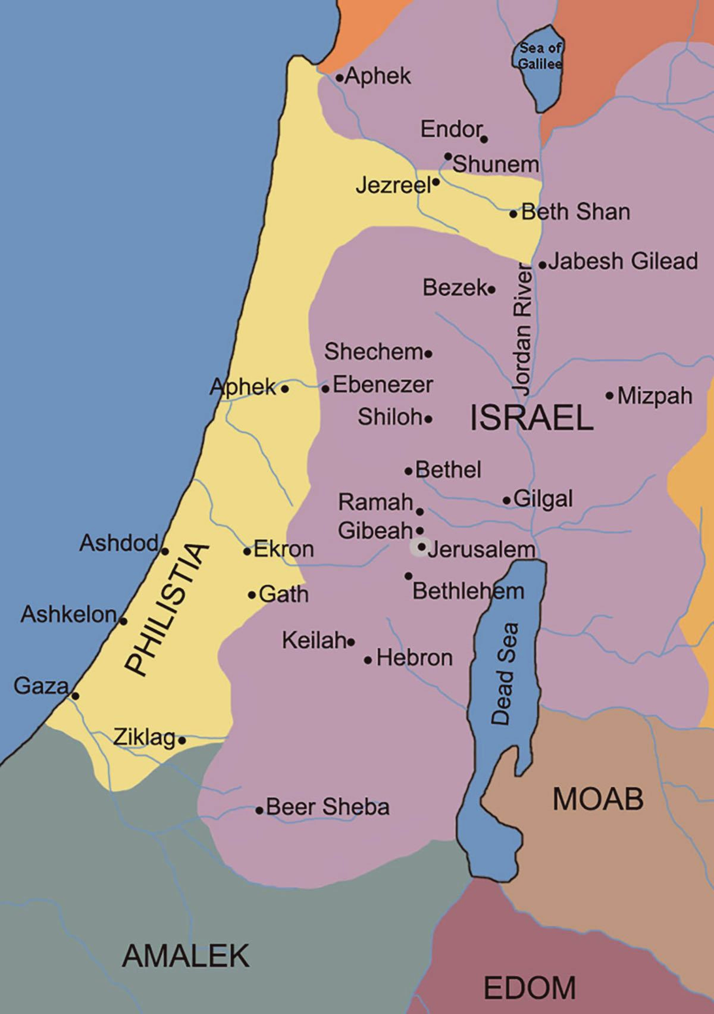
Philistine
Cities
Notes:
2.5 miles from Aphek and Ebenezer
19 miles from Ebenezer to Shilo

Slide 6

Philistine
Cities
Notes:
2.5 miles from Aphek and Ebenezer
19 miles from Ebenezer to Shiloh
The Philistines take a major role in the First Book of Samuel as the chief enemies of Israel. We see the crucial conflict that brings Israel to the point of national crisis. Out of this national calamity arose Israel’s great deliverer, King David. The book opens on a disastrous note as the Philistines capture the Ark of the Covenant. Because of the great sin into which Israel had lapsed, God permitted her to lose temporarily her most valued possession, the ark of the Covenant. The Ark was the visible representation of God’s presence among His people and was in the tabernacle in Shiloh.
Samuel advised Israel to engage the Philistines in was several years after the time of Samson. What Samuel and Israel were to learn from this crisis was that deliverance from the enemy’s oppression depended upon spiritual conversion.

Slide 7
1 Samuel 4:1-22
5 As the ark of the covenant of the Lord came into the camp, all Israel shouted with a great shout, so that the earth resounded. 6 When the Philistines heard the noise of the shout, they said, “What does the noise of this great shout in the camp of the Hebrews mean?” Then they understood that the ark of the Lord had come into the camp. 7 The Philistines were afraid, for they said, “God has come into the camp.” And they said, “Woe to us! For nothing like this has happened before. 8 Woe to us! Who shall deliver us from the hand of these mighty gods? These are the gods who smote the Egyptians with all kinds of plagues in the wilderness. 9 Take courage and be men, O Philistines, or you will become slaves to the Hebrews, as they have been slaves to you; therefore, be men and fight.”
1 Samuel 4:5-9 (NASB)
Notes:
When Hophni and Phinehas appeared in the camp carrying the ark of God, the soldiers and elders shouted enthusiastically, but their carnal self-confidence was just the prelude to another defeat. The ark may have been with them in the camp, but the Lord was against them. Their joyful shout may have bolstered their spirits, but it was no guarantee of victory. All it did was motivate the Philistine army to determine to fight harder and win the battle, which they did, killing 30,000 Jewish soldiers. God will not be "used" just to make sinful people achieve their own selfish purposes. God's promise is, "Them who honor me I will honor" (2:30).
Adam
‘Hebrews’ here is a derogatory term
‘God’ in the hebrew is the plural and in the greek septuagint it is plural. I cannot find a modern translation that keeps that plural. But considering that the greek background of the Philisties (they are poly-theists) it makes sense they would think multiple gods entered the ‘Hebrew’ camp.

Slide 8
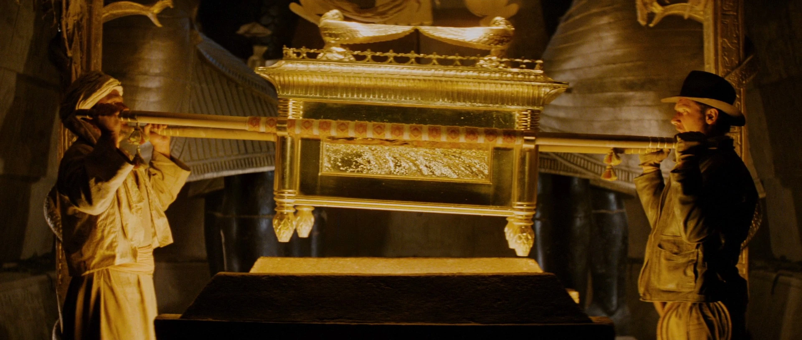
A Famous Representation

Slide 9
1 Samuel 4:1-22
10 So the Philistines fought and Israel was defeated, and every man fled to his tent; and the slaughter was very great, for there fell of Israel thirty thousand foot soldiers. 11 And the ark of God was taken; and the two sons of Eli, Hophni and Phinehas, died.
1 Samuel 4:10-11 (NASB)
Notes:
The ark was taken (1 Sam. 4:11a). Five times in verses 11-22 you find the phrase "the ark of God was [is] taken" (vv. 11, 17, 19, 21-22). Never in the history of Israel had the ark of God ever fallen into enemy hands! So holy was the ark that it was kept behind the veil in the tabernacle and seen only by the high priest on the annual Day of Atonement (Lev. 16). When the Jewish camp moved during the nation's years of wandering, the first thing the high priest did was cover the ark with the veil (Num. 4:5-6), and only then would he attend to the other pieces of furniture.
The ark of God was the throne of God (2 Sam. 6:2, NIV; also Pss. 80:1 and 99:1), but now God's throne was in enemy territory! The Jews had forgotten that the ark was God's throne in Israel only if Israel was submitted to Him and obedient to His covenant. Anything else was nothing but ignorant superstition, like people trusting good-luck charms. It wasn't a sin to take the ark into battle if the people were truly devoted to the Lord and wanted to honor Him. God put the ark into pagan hands, but Eli's two sons had lived like pagans while ministering before the ark, so what was the difference? God would use the ark to teach both the Jews and the Philistines some important lessons.
The two priests were slain (1 Sam. 4;11b). This fulfilled the Word of God spoken to Eli by the anonymous prophet (2:27-36) and to Samuel when he was called by the Lord (3:11-18). God had been long-suffering with Hophni and Phinehas as they desecrated His sacrifices and defiled His people, but now their time was up and their sins had found them out.
Adam
The words are the same here in v3 and v11. The irony that the Israelites ‘take’ the ark as easily as the Philistines ‘take’ it.
The Philistine anxiety emphasises how surprising is The defeat of israel and the ‘assumed’ defeat of its gods.

Slide 10
1 Samuel 4:1-22
12 Now a man of Benjamin ran from the battle line and came to Shiloh the same day with his clothes torn and dust on his head. 13 When he came, behold, Eli was sitting on his seat by the road eagerly watching, because his heart was trembling for the ark of God. So the man came to tell it in the city, and all the city cried out. 14 When Eli heard the noise of the outcry, he said, “What does the noise of this commotion mean?” Then the man came hurriedly and told Eli. 15 Now Eli was ninety-eight years old, and his eyes were set so that he could not see. 16 The man said to Eli, “I am the one who came from the battle line. Indeed, I escaped from the battle line today.” And he said, “How did things go, my son?” 17 Then the one who brought the news replied, “Israel has fled before the Philistines and there has also been a great slaughter among the people, and your two sons also, Hophni and Phinehas, are dead, and the ark of God has been taken.” 18 When he mentioned the ark of God, Eli fell off the seat backward beside the gate, and his neck was broken and he died, for he was old and heavy. Thus he judged Israel forty years.
1 Samuel 4:12-18 (NASB)
Notes:
The high priest died (1 Sam. 4:12-18). Eli knew that his sons had entered the Holy of Holies and taken the ark to the battlefield, but he was unable to stop them, just as he had been unable to control them in past years. He wasn't worrying about his sons as he sat in his special seat by the tabernacle; he was trembling for the safety of the ark of God. But didn't Eli realize that God was still on the heavenly throne even if His earthly throne had been cheapened and transformed into a good-luck charm? Wasn't the Lord able to protect His own furniture and His own glory?
The messenger ran first to the busiest part of Shiloh and delivered the sad news of Israel's defeat, and the people's loud lament- ing caught Eli's attention. The messenger ran to Eli to gave him the bad news: Israel was defeated, there was a great slaughter, Hophni and Phinehas were both slain and as if saving the worst news for the last-the ark of God had been taken by the Philistines. Eli must have suffered a stroke or a heart attack, for he fell back, broke his neck, and died. He was "a heavy man," probably caused by eating too much meat from the sacrifices (2:29) and leading a sedentary life. The death of Eli and his two sons was the beginning of the fulfillment of God's prophecy that Eli's branch of the priesthood would be destroyed and a new line introduced.

Slide 11
1 Samuel 4:1-22
19 Now his daughter-in-law, Phinehas’ wife, was pregnant and about to give birth; and when she heard the news that the ark of God was taken and that her father-in-law and her husband had died, she kneeled down and gave birth, for her pains came upon her. 20 And about the time of her death the women who stood by her said to her, “Do not be afraid, for you have given birth to a son.” But she did not answer or pay attention. 21 And she called the boy Ichabod, saying, “The glory has departed from Israel,” because the ark of God was taken and because of her father-in-law and her husband. 22 She said, “The glory has departed from Israel, for the ark of God was taken.”
1 Samuel 4:19-22 (NASB)
Notes:
The glory of God departed (1 Sam. 4:19-22). The wife of Phinehas had more spiritual insight than her father-in-law, her husband, and her brother-in-law. The two brothers used the ark as a good luck charm, Eli was concerned with the safety of the ark, but she was burdened for the glory of God. She named her son Ichabod "the glory is gone"-and then she died. The presence of God's glory in the camp was a special sign that the Israelites were the people of God (Ex. 40:34; Rom. 9:4), but now the glory had departed and God's special favor was gone. When King Solomon dedicated the temple, the glory of God returned (1 Kings 8:10), but before the destruction of Jerusalem, the Prophet Ezekiel saw the glory leave the temple and the city (Ezek. 8:4; 9:3; 10:4, 18; 11:22-23). Ezekiel also saw the future millennial temple and the return of the glory of God (Ezek. 43:1- 5). The glory of God didn't return to this earth until the birth of Jesus Christ, the Savior of the world (Luke 2:8-11; John 1:14). Today, God's glory dwells in His people individually (1 Cor. 6:19- 20) and in His church collectively (Eph. 2:19-22).
So significant was this tragic event that Asaph the psalmist included it in one of his psalms (Ps. 78:60-61). But he tells us that much more happened than the capture of the ark by the Philistines, for the Lord abandoned the tabernacle at Shiloh and allowed the enemy to destroy it (Jer. 7:12-14; 26:6, 9). The Philistines eventually returned the ark and it remained first in Beth-shemesh and then Kiriath-jearim (1 Sam. 6:13-21). The priests must have constructed some kind of tabernacle at Nob (1 Sam. 21:1ff), but in Solomon's day, it was at Gibeon (1 Chron. 21:29; 1 Kings 3:4). Eventually Solomon incorporated the tabernacle into the temple which he built (2 Chron. 5:5).
The wicked sons of Eli thought their scheme would save the glory of God, but it only took the glory of God away!

Slide 12
02
The Vindicating Power of God
Notes:
ADD PHILISTINE INFO.
The philistines came from ancient greece. (the Agean area)- 2019 article https://www.newscientist.com/article/2208581-ancient-dna-reveals-that-jews-biblical-rivals-were-from-greece/
2023
https://www.biblicalarchaeology.org/daily/people-cultures-in-the-bible/who-were-philistines-where-did-they-come-from/
Ramesses III’s mortuary temple at Medinet Habu. In the 12th century B.C.E., during the reign of Ramesses III, a confederation of tribes from the “islands” of the “northern countries” attacked Egypt—several times, both on sea and land
The word “Palestine” comes from the Greek word Philistia, which was used to describe the ancient state of the Philistines.
No sooner does God begin to reveal His Word to His people than the enemy shows up to attack them. The Philistines are mentioned in Scripture as early as the days of Abraham (Gen. 21:32; see 10:14), and in the Books of Samuel they're mentioned over 150 times. They were originally a seagoing people from the Aegean region who invaded the territory along the Mediterranean coast (Phoenicia) and sought to control all of the land we know as Palestine. (The name "Palestine" is a form of the word "Philistine.") The Philistines were very distressed when Israel conquered the Promised Land and many times attempted to drive them out. It's likely that this particular battle was Israel's response to one of those Philistine invasions.

Slide 13
1 Samuel 5:1-12
1 Now the Philistines took the ark of God and brought it from Ebenezer to Ashdod. 2 Then the Philistines took the ark of God and brought it to the house of Dagon and set it by Dagon. 3 When the Ashdodites arose early the next morning, behold, Dagon had fallen on his face to the ground before the ark of the Lord. So they took Dagon and set him in his place again. 4 But when they arose early the next morning, behold, Dagon had fallen on his face to the ground before the ark of the Lord. And the head of Dagon and both the palms of his hands were cut off on the threshold; only the trunk of Dagon was left to him. 5 Therefore neither the priests of Dagon nor all who enter Dagon’s house tread on the threshold of Dagon in Ashdod to this day.
1 Samuel 5:1-5 (NASB)
Notes:
The five key cities of the Philistines were Ashdod, Gaza, Ashkelon, Gath, and Ekron, and each had a ruler or "lord" (6:16- 17). The Philistines first put the ark into the temple of their god Dagon in Ashdod as evidence that Dagon was stronger and greater than Jehovah. At the beginning of the battle, the Philistines were frightened when they heard that the God of Israel was in the camp, but now they were making fun of Him and exalting their own gods. In their mythology, Dagon was the principal god of the Philistines and the father of Baal, the storm god, whose worship brought so much trouble to Israel.
The temple of Dagon at Ashdod had become the chief center of Dagon worship after Samson’s destruction of the temple at Gaza.
Dagon was the chief deity of the Philistines, and the worship of this pagan god dates back the third millennium BC. According to ancient mythology, Dagon was the father of Baal. He was the fish god (dag in Hebrew means “fish”), and he was represented as a half-man, half-fish creature. Shaped from stone, the central idol in the temple depicted a deity who was half-fish, halfman. Surviving images resemble a mermaid with a curly Sumerian-style beard.
However, Dagon didn't have a chance, for Jehovah God was and is well able to take care of Himself! The next morning, the worshipers found Dagon prostrate before the ark like one of the worshipers. Like every dead idol, Dagon had to be righted again (Ps. 115), but things were even worse the next morning. The stump of Dagon was prostrate before the ark of the covenant, but his head and hands had been cut off and placed at the threshold of the temple! But that wasn't the end, for the Lord not only humiliated the god of the Philistines, but he judged the people who worshiped that god. When the Philistines captured the ark and arrogantly treated the Lord as though He were just another god, they invited the judgment of God.

Slide 14
1 Samuel 5:1-12
6 Now the hand of the Lord was heavy on the Ashdodites, and He ravaged them and smote them with tumors, both Ashdod and its territories. 7 When the men of Ashdod saw that it was so, they said, “The ark of the God of Israel must not remain with us, for His hand is severe on us and on Dagon our god.” 8 So they sent and gathered all the lords of the Philistines to them and said, “What shall we do with the ark of the God of Israel?” And they said, “Let the ark of the God of Israel be brought around to Gath.” And they brought the ark of the God of Israel around. 9 After they had brought it around, the hand of the Lord was against the city with very great confusion; and He smote the men of the city, both young and old, so that tumors broke out on them.
1 Samuel 5:6-9 (NASB)
Notes:
When you put the evidence together, it seems that the Lord sent infected mice or rats (1 Sam. 6:4) among the people and spread a terrible plague. According to the covenant, the Lord should have sent this affliction on the unbelieving Jews (Deut. 28:58-60), but in His grace, He punished the enemy. Some students believe this was the bubonic plague and that the people experienced painful inflammatory swellings of the lymph glands, especially in the groin. Others think it was a plague of tumors, perhaps severe hemorrhoids (see 1 Sam. 5:9), although it's difficult to understand the part the rats played in this affliction. Whatever the punishment was, it pained and humiliated the Philistines who attributed their suffering to the presence of the ark.

Slide 15
1 Samuel 5:1-12
10 So they sent the ark of God to Ekron. And as the ark of God came to Ekron the Ekronites cried out, saying, “They have brought the ark of the God of Israel around to us, to kill us and our people.” 11 They sent therefore and gathered all the lords of the Philistines and said, “Send away the ark of the God of Israel, and let it return to its own place, so that it will not kill us and our people.” For there was a deadly confusion throughout the city; the hand of God was very heavy there. 12 And the men who did not die were smitten with tumors and the cry of the city went up to heaven.
1 Samuel 5:10-12 (NASB)
Notes:
But the five lords of the Philistines were anxious to preserve the glory of their victory. If they could prove that the calamity was a coincidence, they could retain the ark and continue to magnify Dagon's superiority over Jehovah. The easiest way to do this was to move the ark to another city and see what happened, so they took it to Gath-and the same thing happened! Then they carried it to Ekron, where the people protested and told them to take it elsewhere! God killed a number of citizens ("deadly destruction") and also sent a painful plague to the people of Ekron just as He had done to the inhabitants of Ashdod and Gath. God had vindicated Himself and proved that it was His hand that had destroyed the statue of Dagon and that brought affliction to the Philistine people. Nobody could call the eruption of these plagues a mere coincidence. But the lords of the Philistines still had to figure out how to get rid of the ark without humiliating themselves and perhaps bringing more judgment on their land.

Slide 16
03
The Wise
Providence
of God

Slide 17
1 Samuel 6:1-18
1 Now the ark of the Lord had been in the country of the Philistines seven months. 2 And the Philistines called for the priests and the diviners, saying, “What shall we do with the ark of the Lord? Tell us how we shall send it to its place.” 3 They said, “If you send away the ark of the God of Israel, do not send it empty; but you shall surely return to Him a guilt offering. Then you will be healed and it will be known to you why His hand is not removed from you.” 4 Then they said, “What shall be the guilt offering which we shall return to Him?” And they said, “Five golden tumors and five golden mice according to the number of the lords of the Philistines, for one plague was on all of you and on your lords. 5 So you shall make likenesses of your tumors and likenesses of your mice that ravage the land, and you shall give glory to the God of Israel; perhaps He will ease His hand from you, your gods, and your land.
1 Samuel 6:1-5 (NASB)
Notes:
The experiences described in 5:1-12 occurred during a period of seven months, at the end of which the five lords decided it was time to get rid of the ark. They wouldn't admit it, but Jehovah had vindicated Himself before the Philistines and humiliated their false god. Still wanting to save face, the lords sought some way to send the ark back to Israel without directly involving themselves or their people.

Slide 18
1 Samuel 6:1-18
6 Why then do you harden your hearts as the Egyptians and Pharaoh hardened their hearts? When He had severely dealt with them, did they not allow the people to go, and they departed? 7 Now therefore, take and prepare a new cart and two milch cows on which there has never been a yoke; and hitch the cows to the cart and take their calves home, away from them. 8 Take the ark of the Lord and place it on the cart; and put the articles of gold which you return to Him as a guilt offering in a box by its side. Then send it away that it may go. 9 Watch, if it goes up by the way of its own territory to Beth-shemesh, then He has done us this great evil. But if not, then we will know that it was not His hand that struck us; it happened to us by chance.”
1 Samuel 6:6-9 (NASB)
Notes:
Man proposes (1 Sam. 6:1-9). The Philistine wise men came up with a scheme that would test the God of Israel one more time. If Jehovah, represented by the ark, was indeed the true and living God, let Him take the ark back to where it belonged! The lords set up a plan that would absolve them of responsibility and blame. They would take two cows that had calves and separate them from the calves. They would hitch the cows to a new cart, put the ark on the cart, and turn the cows loose. If the cows didn't move at all, or if they went to their calves, it would be "proof" that the God of Israel wasn't in control and the Philistines had nothing to fear. If the cows meandered all over without any sense of direction, the lords could draw the same conclusion. The situation being what it was, the cows would probably head for their calves, because that was the natural thing to do. The cows needed to get rid of their milk and the calves needed the nourishment.
But that wasn't all. The wise men decided that the nation had to send "appeasement gifts" to Jehovah in the form of golden models of the mice and the tumors. If the cows didn't head for Israelite territory, the Philistines could always reclaim their gold. If the cows went over the border into Israel, the Lord would be appeased and wouldn't send Philistia any more plagues. This plan enabled the Lord to receive glory without the lords of the Philistines being embarrassed. When you consider that the cows were nursing their calves and lowing for them, and that the cows had never drawn a cart before, the odds were that they wouldn't go down the road that led from Ekron to Beth-Shemesh. The five lords and their wise men had it all figured out.

Slide 19
1 Samuel 6:1-18
10 Then the men did so, and took two milch cows and hitched them to the cart, and shut up their calves at home. 11 They put the ark of the Lord on the cart, and the box with the golden mice and the likenesses of their tumors. 12 And the cows took the straight way in the direction of Beth-shemesh; they went along the highway, lowing as they went, and did not turn aside to the right or to the left. And the lords of the Philistines followed them to the border of Beth-shemesh.
1 Samuel 6:10-12 (NASB)
Notes:
God disposes (1 Sam. 6:10-18). But they were wrong. The lords of the Philistines didn't know the true and living God, but the cows did, and they obeyed Him! "The ox knows its owner and the donkey its master's crib" (Isa. 1:3, NKJV). They crossed the border and came to the priestly city of Beth-Shemesh (Josh. 21:13-16) where the men were working in the fields harvesting the wheat. They joyfully welcomed the return of the ark, and the Levites took it off the cart and put it on a great stone in the field.

Slide 20
1 Samuel 6:1-18
13 Now the people of Beth-shemesh were reaping their wheat harvest in the valley, and they raised their eyes and saw the ark and were glad to see it. 14 The cart came into the field of Joshua the Beth-shemite and stood there where there was a large stone; and they split the wood of the cart and offered the cows as a burnt offering to the Lord. 15 The Levites took down the ark of the Lord and the box that was with it, in which were the articles of gold, and put them on the large stone; and the men of Beth-shemesh offered burnt offerings and sacrificed sacrifices that day to the Lord. 16 When the five lords of the Philistines saw it, they returned to Ekron that day.
1 Samuel 6:13-16 (NASB)
Notes:
Grateful that the throne of God had been restored to His people, the Levites offered the cows as burnt offerings to the Lord, and in their joy ignored the fact that only male animals could legally be offered (Lev. 1:3). Other men from the city brought additional sacrifices. They also put the golden gifts on the rock and offered them to the Lord. Since Shiloh had been destroyed and there was no sanctuary available for worship, they used the large rock as an altar, and the Lord accepted their offerings. What the Lord is looking for is a broken and contrite heart, not a slavish obedience to the letter of the law (Ps. 51:15-17). The enemy was near at hand (1 Sam. 6:16) and the Jewish men didn't dare leave the place to which God had directed the cows.

Slide 21
1 Samuel 6:1-18
17 These are the golden tumors which the Philistines returned for a guilt offering to the Lord: one for Ashdod, one for Gaza, one for Ashkelon, one for Gath, one for Ekron; 18 and the golden mice, according to the number of all the cities of the Philistines belonging to the five lords, both of fortified cities and of country villages. The large stone on which they set the ark of the Lord is a witness to this day in the field of Joshua the Beth-shemite.
1 Samuel 6:17-18 (NASB)
Notes:
God had done what Dagon could never do: He guided the cows, kept their attention on the right road, overcame their desire to go to their calves, and brought them to the priestly city of Beth-Shemesh. His providence rules over all. Alas, the priests and Levites didn't do their job well, and what should have been a great cause for joy turned out to be a cause of sorrow because of man's foolishness. Eventually the ark would be given a safe resting place until King David would move it to a specially prepared place in Jerusalem (2 Sam. 6:12ff).

Slide 22
04
The Holy
Wrath
of God
Notes:
Related scriptures to 6:19:
Lev. 16: ¹³ He shall put the incense on the fire before the Lord, that the cloud of incense may cover the mercy seat that is on the ark of the testimony, otherwise he will die.
Num. 1: ⁵⁰ But you shall appoint the Levites over the tabernacle of the testimony, and over all its furnishings and over all that belongs to it. They shall carry the tabernacle and all its furnishings, and they shall take care of it; they shall also camp around the tabernacle. ⁵¹ So when the tabernacle is to set out, the Levites shall take it down; and when the tabernacle encamps, the Levites shall set it up. But the layman who comes near shall be put to death.
Num. 4: ⁵ “When the camp sets out, Aaron and his sons shall go in and they shall take down the veil of the screen and cover the ark of the testimony with it; ⁶ and they shall lay a covering of porpoise skin on it, and shall spread over it a cloth of pure blue, and shall insert its poles. ¹⁶ “The responsibility of Eleazar the son of Aaron the priest is the oil for the light and the fragrant incense and the continual grain offering and the anointing oil—the responsibility of all the tabernacle and of all that is in it, with the sanctuary and its furnishings.” ¹⁷ Then the Lord spoke to Moses and to Aaron, saying, ¹⁸ “Do not let the tribe of the families of the Kohathites be cut off from among the Levites. ¹⁹ But do this to them that they may live and not die when they approach the most holy objects: Aaron and his sons shall go in and assign each of them to his work and to his load; ²⁰ but they shall not go in to see the holy objects even for a moment, or they will die.”

Slide 23
1 Samuel 6:19-20
19 He struck down some of the men of Beth-shemesh because they had looked into the ark of the Lord. He struck down of all the people, 50,070 men, and the people mourned because the Lord had struck the people with a great slaughter. 20 The men of Beth-shemesh said, “Who is able to stand before the Lord, this holy God? And to whom shall He go up from us?”
1 Samuel 6:19-21 (NASB)
Notes:
The men of Beth-Shemesh should have covered the ark, because it wasn't supposed to be seen by anyone except the high priest, and this mistake was costly. Some of the people became curious and looked into the ark and were slain. If the pagan Philistines were judged for the way they treated the ark, how much more responsible were the Jews who knew the law and were living in a levitical city!
Students have debated the accuracy of the number of people who were killed, because 50,000 seems too high for a town like Beth-Shemesh. Some make the number only 70 and say that the 50,000 is a scribal error, and perhaps it is. The Hebrews used letters for numbers and it would be easy for a copyist to make a mistake. Others include in the 50,000 the 4,000 plus "the great slaughter" (4:17) on the battlefield, but the text specifically says it was the irreverent people who looked into the ark who were slain. (See 1 Sam. 6:19; Lev. 16:13; Num. 1:50-51; 4:5, 16-20.) It isn't likely that 50,000 people lined up and passed by the ark, for the people queued up would have scattered when the first viewers were killed. Perhaps they were slain later. Certainly the Levites would have protected the ark from the curious, for they knew the penalties for breaking the law of God. That 70 men were judged isn't difficult to believe, but 50,000 seems extravagant although vs. 19 does say it was ‘with a great slaughter’. However, since we don't know the population of Beth- Shemesh and its environs, we can't pass judgment on the text. One day an archeologist may solve the problem for us.
While God doesn't live in our church buildings or in any of its furnishings (Acts 7:48-50), we do want to show respect for anything dedicated to the the glory of God. The awesome event described here certainly warns us against religious curiosity and lack of reverence for the Lord. "It is a terrifying thing to fall into the hands of the living God" (Heb. 10:31, NASB). In today's Western society, with its informality and lack of respect for the sacred, it's easy even for believers to get so "chummy" with the Lord that they forget He is "high and lifted up."

Slide 24
05
The Merciful
Grace
of God

Slide 25
1 Samuel 6:21 - 7:2
6:21 So they sent messengers to the inhabitants of Kiriath-jearim, saying, “The Philistines have brought back the ark of the Lord; come down and take it up to you.”
7:1 And the men of Kiriath-jearim came and took the ark of the Lord and brought it into the house of Abinadab on the hill, and consecrated Eleazar his son to keep the ark of the Lord. 2 From the day that the ark remained at Kiriath-jearim, the time was long, for it was twenty years; and all the house of Israel lamented after the Lord.
1 Samuel 6:21-7:2 (NASB)
Notes:
The Lord could have withdrawn Himself from His people, but instead, He graciously allowed the ark to be taken about ten miles to Kiriath Jearim where it remained in the home of Abinadab. The men of the city consecrated Abinadab's son Eleazar to guard the ark. This was undoubtedly a levitical family, for after what had happened to the men of Beth-Shemesh, the men weren't likely to take any more chances by breaking the law! The ark remained in Kiriath Jearim for perhaps a century, for the battle of Aphek was fought about 1104 B.C., and David brought the ark to Jerusalem in about 1003 B.C. (2 Sam. 6). The ark had been in the home of Abinadab twenty years when Samuel called an assembly of the people to turn from their sins and seek the Lord (1 Sam. 7:3).
The ark of the covenant represented the presence of the Lord with His people and the rule of the Lord over His people. The Lord had every right to abandon His sinful people, but He graciously remained with them, though not in the special tabernacle He had commanded them to build. It was a difficult time for the Jews, for they were not a united people, nor were they a godly people. Israel thought that their problems would be solved if they had a king like the other nations, but they would discover that having their own way would lead them into greater problems. God still gives His best to those who leave the choice with Him.
What the ark was to Israel, Jesus Christ is to God's people today; and when He is given His rightful place of preeminence in our lives, He will bless us and work on our behalf. "But in your hearts set apart Christ as Lord," is the way Peter explained it (1 Peter 3:15, NIV). When Jesus Christ is Lord, the future is your friend, and you can walk through each day confident of His presence and His help.

