Slide 1






The Lord of Hosts Is with Us 1 SAMUEL 1-3
Linder Road Church of Christ - 4th Quarter 2024
CREDITS: This presentation template was created by Slidesgo, and includes icons by Flaticon and infographics & images by Freepik
Notes:
Title & Intro
One of the awesome titles of our great God is "Lord of Hosts" or “Lord of the armies”
The title is used nearly 300 times in Scripture and is found for the first time in 1 Samuel 1:3. "Lord of hosts" describes God as the sovereign Lord of the host of the stars (Isa. 40:26), the angelic host (Ps. 103:20-21) and the armies of Israel (Ex. 12:41; Ps. 46:7, 11). In the Authorized Version, "hosts" is transliterated "Sabaoth" in Romans 9:29 and James 5:4. In his hymn "A Mighty Fortress Is Our God," Martin Luther rightly applied this title to Jesus Christ:
Did we in our own strength confide,
Our striving would be losing,
Were not the right Man on our side,
The Man of God's own choosing.
Dost ask who that may be?
Christ Jesus, it is He;
Lord Sabaoth His name,
From age to age the same,
And He must win the battle.

Slide 2
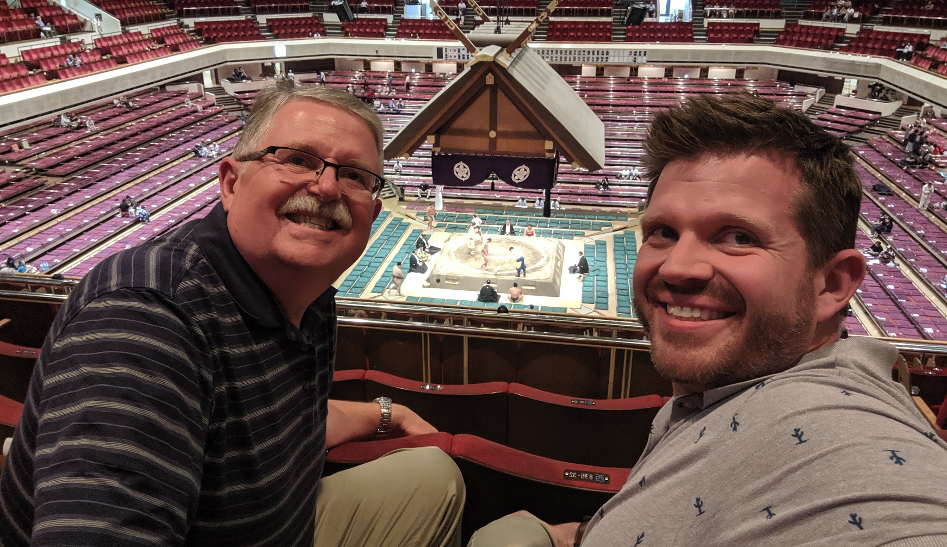
Who are we?
Arthur Clark
(Clark The Older)
Adam Clark
(Clark The Younger)

Slide 3



Contact Us

Slide 4
Where are we?
Judges
Ruth
1st Samuel
2nd Samuel
Pre-King
Pre-David
Man’s King
God’s King

Slide 5


Where are we?
Judges
Ruth
1st Samuel
2nd Samuel
Pre-King
Pre-David
Man’s King
God’s King
Notes:
The story of the people of Israel recorded in the Bible is a living demonstration of the fact that the Lord does win the battle, that He is sovereign in all things. People and events recorded in Scripture are part of what theologians call "salvation history," God's gracious plan to send the Savior into the world to die for sinners. The Book of Ruth ends with the name of David (Ruth 4:22), and 1 Samuel tells the story of David's successful preparation for reigning on the throne of Israel. It was from David's family that Jesus Christ, the "Son of David," was born. The Books of Samuel, Kings, and Chronicles record many sins and failures on the part of God's people, but they also remind us that God is on the throne, and when He isn't allowed to rule, He overrules. He is the Lord of Hosts and His purposes will be accomplished. Wiersbe p. 12
ART
Chase a rabbit
Adam
Judges is Pre-King
1st Samuel - Man’s King
2nd Samuel - God’s King

Slide 6
29 Now the acts of King David, from first to last, are written in the Chronicles of Samuel the seer, and in the Chronicles of Nathan the prophet, and in the Chronicles of Gad the seer, 30 with accounts of all his rule and his might and of the circumstances that came upon him and upon Israel and upon all the kingdoms of the countries.
1 Chronicles 29:29-30 ESV
Judges
1st Samuel
2nd Samuel
Notes:
Picture
“Chronicles of Samuel the seer” Samuel was many things: he was the last judge; he was a prophet (I Sam 3:20);
Art
1st and 2nd Samuel and Kings don’t have attributed authors.

Slide 7
Lord of hosts
Now this man used to go up year by year from his city to worship and to sacrifice to the Lord of hosts at Shiloh, where the two sons of Eli, Hophni and Phinehas, were priests of the Lord.
1 Samuel 1:3 (ESV)
Notes:
Scripture
One of the awesome titles of our great God is "Lord of Hosts" or “Lord of the armies”
The title is used nearly 300 times in Scripture and is found for the first time in 1 Samuel 1:3. "Lord of hosts" describes God as the sovereign Lord of the host of the stars (Isa. 40:26), the angelic host (Ps. 103:20-21) and the armies of Israel (Ex. 12:41; Ps. 46:7, 11). In the Authorized Version, "hosts" is transliterated "Sabaoth" in Romans 9:29 and James 5:4. In his hymn "A Mighty Fortress Is Our God," Martin Luther rightly applied this title to Jesus Christ:
Did we in our own strength confide,
Our striving would be losing,
Were not the right Man on our side,
The Man of God's own choosing.
Dost ask who that may be?
Christ Jesus, it is He;
Lord Sabaoth His name,
From age to age the same,
And He must win the battle.

Slide 8
—Martin Luther
“Did we in our own strength confide,
Our striving would be losing,
Were not the right Man on our side,
The Man of God's own choosing.
Dost ask who that may be?
Christ Jesus, it is He;
Lord Sabaoth His name,
From age to age the same,
And He must win the battle.”
Notes:
Art to lead a song
In his hymn “A Mighty Fortress Is Our God” M L applied this title to Jesus Christ.
Quote: The story of the people of Israel recorded in the Bible is a living demonstration of the fact that the Lord does win the battle,..People and events recorded in Scripture are part of what theologians call “salvation history,” God’s gracious plan to send the Savior into the world to die for sinners. The book of Ruth ends with the name of David’s successful prep. For reigning on the throne of Israel. It was from David’s family that Jesus Christ, the “Son of David,” was born. The Books of Samuel, Kings, and Chronicles record many sins and failures on the part of God’s people, but they also remind us that God is on the throne, and when He isn’t allowed to rule, He overrules. He is the Lord of Hosts And His purposes will be accomplished.

Slide 9
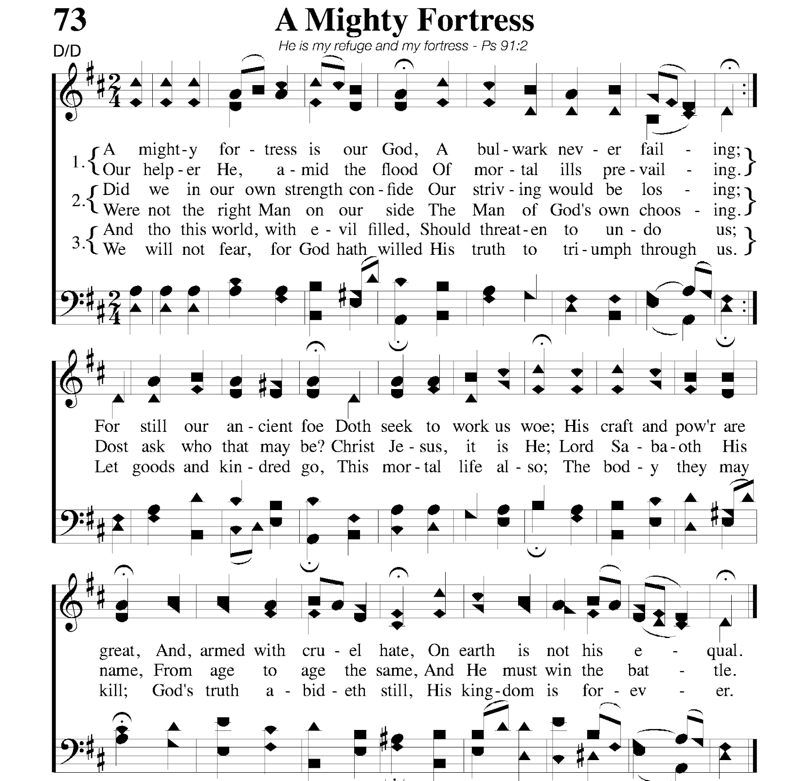

Slide 10
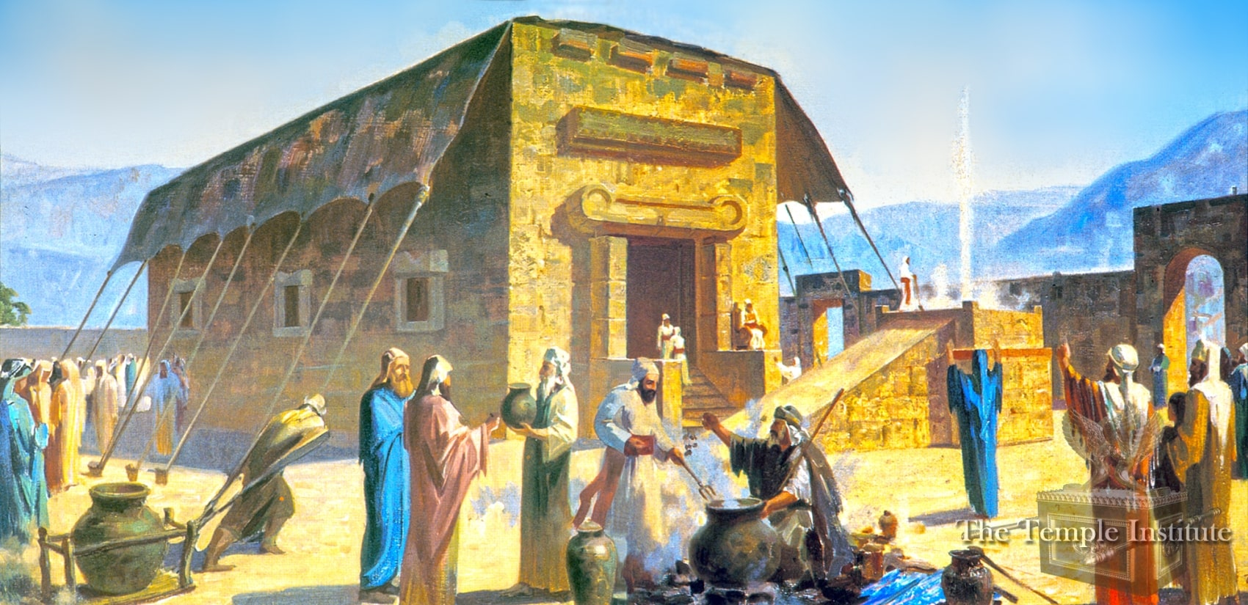
Shiloh home of the Tabernacle
Notes:
Art
Scripture
“Lord of hosts” or “Lord of the armies” 1st time of 300x in scripture. In the KJV “hosts” is transliterated “Sabaoth” here and Ro. 9:29 and James 5:4.
https://templeinstitute.org/tabernacle/
Shiloh appears 33x in the O.T. Genesis 49:10, the context is Jacob giving Judah his blessing and refers to “Until Shiloh comes” Messianic prophecy. The other 32x refer to the City in Ephraim (region of Samaria) 24 miles n of Jerusalem and 10 mi. N of Bethel. Israel’s first capital city for almost four centuries used by Joshua, Eli and Samuel.
ADAM
https://templeinstitute.org/tabernacle/
“After the Israelite tribes had entered into the land, the Tabernacle eventually made its way to Shilo, where it stood for 369 years. In Shilo the curtained walls of the tabernacle were replaced with stone, but the roof remained a covering of skins. (Zevachim 14:6)” - Temple institute -
Show MAP
Mishnah Zevachim 14:5-7
5) When the Jewish people arrived at Gilgal private altars were permitted, offerings of the most sacred order were then eaten within the curtains, and offerings of lesser sanctity were eaten anywhere.
6) When they arrived at Shiloh, private altars were prohibited. And there was no roof of wood or stone there, i.e., in the Tabernacle in Shiloh; rather there was only a building of stone below and the curtains of the roof of the Tabernacle were spread above it. And the period that the Tabernacle was in Shiloh was characterized in the Torah as “rest” in the verse: “For you have not as yet come to the rest and to the inheritance, which the Lord your God has given you” (Deuteronomy 12:9). Offerings of the most sacred order were then eaten within the curtains in the courtyard of the Tent of Meeting, and offerings of lesser sanctity and second tithe were eaten in any place that overlooks Shiloh.
7) When Shiloh was destroyed (see I Samuel 4:18), the Jewish people arrived with the Tabernacle at Nov, and later at Gibeon, and private altars were permitted. Offerings of the most sacred order were then eaten within the curtains in the courtyard of the Tent of Meeting, and offerings of lesser sanctity were eaten in all the cities of Eretz Yisrael.

Slide 11
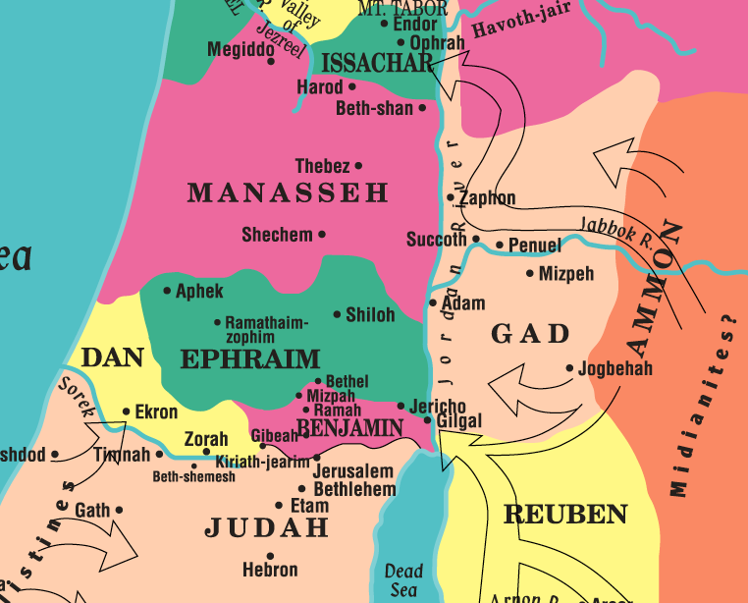
Shiloh Destroyed
Notes:
https://jbqnew.jewishbible.org/jbq-past-issues/2016/441-january-march-2016/reconstructing-destruction-tabernacle-shiloh/
ART
USE LASER POINTER, start with Ramah
Ramah - Samuel’s birthplace, Judicial home and burial place. Six miles N of Jerualem.
Bethel - Five mi. N of Ramah. Samuel’s N. office. Here 800 yrs before Jacob saw the heavenly ladder. Magnificent view as one of the four highest points in the land with Mt. Ebal, Hebron & Mizpah.
Mizpah - Three mi. W of Ramah. Samuel’s W. office where he set up the “Ebenezer” stone (7:12). On the N slope was Gibeon, where Joshua made the “sun stand still”.
Bethlehem - 12 miles S. of Ramah. Birthplace of David and Jesus.
Gibeah - Half way between Ramah and Jerusalem. Saul’s home.
Kiriath-jearim - Home of the Tabernacle after its return from the Philistines.
Ramathaim-Zophim - is NT city of Arimathea
Adam
Shi´loh - An ancient religious center of Israel. Located about ten miles north of Bethel to the east of the Jerusalem-Nablus road (Judg 21:19), it is identified with modern Khirbet Seilun. Shiloh was the administrative and religious center for the Israelite tribes during the early settlement period (twelfth century BCE). Home of the Tabernacle from Joshua to Samuel (where he ministered as a child). There the tabernacle was set up (Josh 18:1), the distribution of the land by lot took place (Josh 18; Josh 19), the Levites were assigned their cities (Judg 21), and the ten tribes gathered to consider the apostasy of the east Jordan tribes (Josh 22). Shiloh was the central sanctuary and seat of the priesthood (Eleazar, Josh 21:1-2) until the Ark was captured in the battle with the Philistines at Ebenezer (1Sam 4). The Ark was not returned to Shiloh, and the city never regained its prestige. Shiloh’s destruction by the Philistines is not related in the OT, but Jeremiah cites its fate in his prophecies (Jer 7:12-14; Jer 26:6-9). (BibleOdyssey.org)

Slide 12

01
God directs history
Notes:
We’ve seen God directing his people and their history through the book of Judges and the book of Ruth. This is particularly true of the history recorded in the Bible, for there we have the inspired account of the hand of God at work in the affairs of mankind to bring the Savior into the world.
1. God directs history
The Book of Judges is the book of "no king" and describes a nation in which anarchy was the norm. "In those days there was no king in Israel, but every man did that which was right in his own eyes" (Jud. 17:6; and see 18:1; 19:1; and 21:25). Israel wasn't a united people, as during the days of Joshua, but it was a loose confederation of tribes with God-appointed judges ruling in widely separated areas. There was no standing army nor were there permanent military leaders. Men from the different tribes volunteered to defend the land when they were summoned to battle.
But during those dark days of the Judges, a love story took place that's recorded in the Book of Ruth. Boaz married Ruth the Moabitess and from their union came Obed, the father of Jesse who became the father of David the king. There was no king in Israel, but God was already at work preparing the way for His chosen servant (Ps. 78:56-72). If Judges is the book of "no king," then 1 Samuel is the book of "man's king." The people of Israel asked for a king and God gave them Saul, from the tribe of Benjamin, who turned out to be a tragic failure. But the Lord had prepared David for the throne, and 2 Samuel is the book of "God's king."
You cannot read the records of the past without seeing the hand of "the Lord of Hosts" at work in the events of what we call history. The Lord is mentioned over sixty times in 1 Samuel 1-3, for He is the chief actor in this drama. Men and women are free to make their decisions, good or bad, but it is Jehovah, the Lord of history, who ultimately accomplishes His purposes in and through the nations (Acts 14:15-17; 17:24-26; Dan. 4:25, 32). Indeed, "history is His story," a truth that is a great encouragement to God's people who suffer for their faith. But this truth is also a warning to unbelievers who ignore or oppose the will of God, because the Lord of hosts will ultimately triumph.
Samuel was God's "bridge builder" at a critical time in Jewish history when the weak confederation of tribes desperately needed direction. He was the last of the judges (1 Sam. 7:15-17; Acts 13:20) and the first of a new line of prophets after Moses (3:24). He established a school of the prophets, and he anointed two kings-Saul who failed and David who succeeded. At a time when the ages were colliding and everything seemed to be shaking, Samuel gave spiritual leadership to the nation of Israel and helped to move them toward national unification and spiritual rededication.
In human history, it may appear to us that truth is "forever on the scaffold" and wrong is "forever on the throne," but that isn't heaven's point of view. As you study 1 Samuel, you will see clearly that God is always in control. While He is long-suffering and merciful and answers the prayers of His people, He is also holy and just and punishes sin. We live today in a time of radical worldwide change, and the church needs leaders like Samuel who will help God's people understand where they've been, who they are, and what they are called to do.

Slide 13
What is History?
“What are all histories but God manifesting Himself”
Oliver Cromwell 1599-1658
English statesman, politician, and soldier
“little more than the register of crimes, follies, and misfortunes of mankind,”
Edward Gibbon 1737-1794
English essayist, historian, and politician
“a confused heap of facts.”
Lord Chesterfield 1694-1773
British statesman, diplomat and wit of his time
“History is His story.”
Dr. A.T. Pierson 1837-1911
Preacher and missionary
Notes:
1. God directs history
"What are all histories but God manifesting Himself," said Oliver Cromwell over three centuries ago, but not everybody agrees with him. The British historian Edward Gibbon, who wrote The Decline and Fall of the Roman Empire, called history "little more than the register of crimes, follies, and misfortunes of mankind," and Lord Chesterfield, his contemporary, called history "a confused heap of facts." But Dr. A.T. Pierson, preacher and missionary statesman of the last century, said it best when he wrote, "History is His story."

Slide 14
What is History?
“What are all histories but God manifesting Himself”
Oliver Cromwell 1599-1658
English statesman, politician, and soldier
“little more than the register of crimes, follies, and misfortunes of mankind,”
Edward Gibbon 1737-1794
English essayist, historian, and politician
“a confused heap of facts.”
Lord Chesterfield 1694-1773
British statesman, diplomat and wit of his time
“History is His story.”
Dr. A.T. Pierson 1837-1911
Preacher and missionary
Notes:
1. God directs history (Cont.)
You cannot read the records of the past without seeing the hand of "the Lord of Hosts" at work in the events of what we call history. The Lord is mentioned over sixty times in 1 Samuel 1-3, for He is the chief actor in this drama. Men and women are free to make their decisions, good or bad, but it is Jehovah, the Lord of history, who ultimately accomplishes His purposes in and through the nations (Acts 14:15-17; 17:24-26; Dan. 4:25, 32). Indeed, "history is His story," a truth that is a great encouragement to God's people who suffer for their faith. But this truth is also a warning to unbelievers who ignore or oppose the will of God, because the Lord of hosts will ultimately triumph.
Samuel was God's "bridge builder" at a critical time in Jewish history when the weak confederation of tribes desperately needed direction. He was the last of the judges (1 Sam. 7:15-17; Acts 13:20) and the first of a new line of prophets after Moses (3:24). He established a school of the prophets, and he anointed two kings-Saul who failed and David who succeeded. At a time when the ages were colliding and everything seemed to be shaking, Samuel gave spiritual leadership to the nation of Israel and helped to move them toward national unification and spiritual rededication.
In human history, it may appear to us that truth is "forever on the scaffold" and wrong is "forever on the throne," but that isn't heaven's point of view. As you study 1 Samuel, you will see clearly that God is always in control. While He is long-suffering and merciful and answers the prayers of His people, He is also holy and just and punishes sin. We live today in a time of radical worldwide change, and the church needs leaders like Samuel who will help God's people understand where they've been, who they are, and what they are called to do.

Slide 15
02
God answers prayer
Notes:
2. God answers prayer (1 Sam. 1:1-28)
During the period of the judges, the Israelites were in dire straits because they lacked godly leadership. The priesthood was defiled, there was no sustained prophetic message from the Lord (3:1), and the Law of Moses was being ignored throughout the land. As He often did in Israel's history, God began to solve the problem by sending a baby. Babies are God's announcement that He knows the need, cares about His people, and is at work on their behalf. The arrival of a baby ushers in new life and a new beginning; babies are signposts to the future, and their conception and birth is a miracle that only God can do (Gen. 30:1-2). To make the event seem even greater, God sometimes selects barren women to be the mothers, as when He sent Isaac to Sarah, Jacob and Esau to Rebekah, and Joseph to Rachel.

Slide 16
1 Samuel 1:1-28
1 There was a certain man of Ramathaim-zophim of the hill country of Ephraim whose name was Elkanah the son of Jeroham, son of Elihu, son of Tohu, son of Zuph, an Ephrathite. 2 He had two wives. The name of the one was Hannah, and the name of the other, Peninnah. And Peninnah had children, but Hannah had no children.
3 Now this man used to go up year by year from his city to worship and to sacrifice to the Lord of hosts at Shiloh, where the two sons of Eli, Hophni and Phinehas, were priests of the Lord. 4 On the day when Elkanah sacrificed, he would give portions to Peninnah his wife and to all her sons and daughters. 5 But to Hannah he gave a double portion, because he loved her, though the Lord had closed her womb. 6 And her rival used to provoke her grievously to irritate her, because the Lord had closed her womb. ”
1 Samuel 1:1-6 (ESV)
Notes:
Scripture
A divided home (1 Sam. 1:1-8). Elkanah was a Levite, a Kohathite from the family of Zuph (1 Chron. 6:22-28, 34-35). The Levites were scattered throughout the land and went to Shiloh to minister at the tabernacle whenever they were needed. Elkanah lived in Ramah on the border of Ephraim and Benjamin (see Josh. 18:25). Elkanah's famous son Samuel would be born in Ramah (1 Sam. 1:19-20), live there (7:17), and be buried there when he died (25:1).
In many ways, Elkanah seems to be a good and godly man, except that he had two wives. Apparently Hannah was his first wife, and when she proved barren, he married Peninnah so he could have a family. We don't know why Elkanah didn't wait on the Lord and trust Him to work out His plan, but even Abraham married Hagar (Gen. 16) and Jacob ended up with four wives! While bigamy and divorce were not prohibited by Jewish law (Deut. 21:15-17; 24:1-4), God's original plan was that one man be married to one woman for one lifetime (Mark 10:1-9).
Each year Elkanah took his family to Shiloh to worship (Ex. 23:14-19), and together they ate a meal as a part of their worship (Deut. 12:1-7). This annual visit to the tabernacle should have been a joyful event for Hannah, but each year Peninnah used it as an opportunity to irritate her rival and make fun of her barrenness. When Elkanah distributed the meat from the sacrifice, he had to give many portions to Peninnah and her children, while Hannah received only one portion. Elkanah gave her a generous share, but his generosity certainly didn't compensate for her infertility.
The name "Hannah" means "a woman of grace," and she did manifest grace in the way she dealt with her barrenness and Peninnah's attitude and cruel words. Elkanah was able to have children by Peninnah, so Hannah knew that the problem lay with her and not with her husband. It seemed unfair that a woman with Peninnah's ugly disposition should have many children while gracious Hannah was childless. She also knew that only the Lord could do for her what he did for Sarah and Rachel, but why had God shut up her womb? Certainly this experience helped to make her into a woman of character and faith and motivated her to give her best to the Lord. She expressed her anguish only to the Lord and she didn't create problems for the family by disputing with Peninnah. In everything she said and did, Hannah sought to glorify the Lord. Indeed, she was a remarkable woman who gave birth to a remarkable son.

Slide 17
1 Samuel 1:1-28
7 So it went on year by year. As often as she went up to the house of the Lord, she used to provoke her. Therefore Hannah wept and would not eat. 8 And Elkanah, her husband, said to her, “Hannah, why do you weep? And why do you not eat? And why is your heart sad? Am I not more to you than ten sons? 9 After they had eaten and drunk in Shiloh, Hannah rose. Now Eli the priest was sitting on the seat beside the doorpost of the temple of the Lord. 10 She was deeply distressed and prayed to the Lord and wept bitterly. 11 And she vowed a vow and said, “O Lord of hosts, if you will indeed look on the affliction of your servant and remember me and not forget your servant, but will give to your servant a son, then I will give him to the Lord all the days of his life, and no razor shall touch his head.”
1 Samuel 1:7-11 (ESV)
Notes:
Scripture
A devout prayer (1 Sam. 1:9-18). During one of the festive meals at Shiloh, Hannah left the family and went to the tabernacle to pray. She had determined in her heart that the Lord wanted her to pray for a son so that she might give him back to the Lord to serve Him all his life. It's an awesome fact that, humanly speaking, the future of the nation rested with this godly woman's prayers; and yet, how much in history has depended on the prayers of suffering and sacrificing people, especially mothers.
The original tabernacle was a tent surrounded by a linen fence, but from the description in the text we learn that God's sanctuary now included some sort of wooden structure with posts (1:9) and doors (3:2, 15) and in which people could sleep (vv. 1- 3). This structure and the tabernacle together were called "the house of the Lord" (1:7), "the temple," "the tabernacle of the congregation," and God's "habitation" (2:32). It was here that aged Eli, the high priest, sat on his priestly throne to oversee the ministry, and it was there that Hannah went to pray. She wanted to ask the Lord for a son and to promise the Lord her son would serve Him all the days of his life.
What an example Hannah is in her praying! It was a prayer born out of sorrow and suffering, but in spite of her feelings, she laid bare her soul before the Lord. It was a prayer that involved submission, for she presented herself to the Lord as His handmaid, to do whatever He wanted her to do (see Luke 1:48). It was a prayer that also involved sacrifice, because she vowed to give her son back to the Lord, to be a Nazirite (Num. 6) and serve the Lord all his life. In praying like this, was Hannah "bargaining" with the Lord? I don't think so. Bearing a son would have removed her disgrace and perhaps ended her rival's persecution, but giving up the son was another matter. Perhaps it would have been easier for her to go on living in barrenness than to have a child for three years and have to give him up forever. I wonder if God had given Hannah an inner conviction that her son would play an important part in the future of the nation.

Slide 18
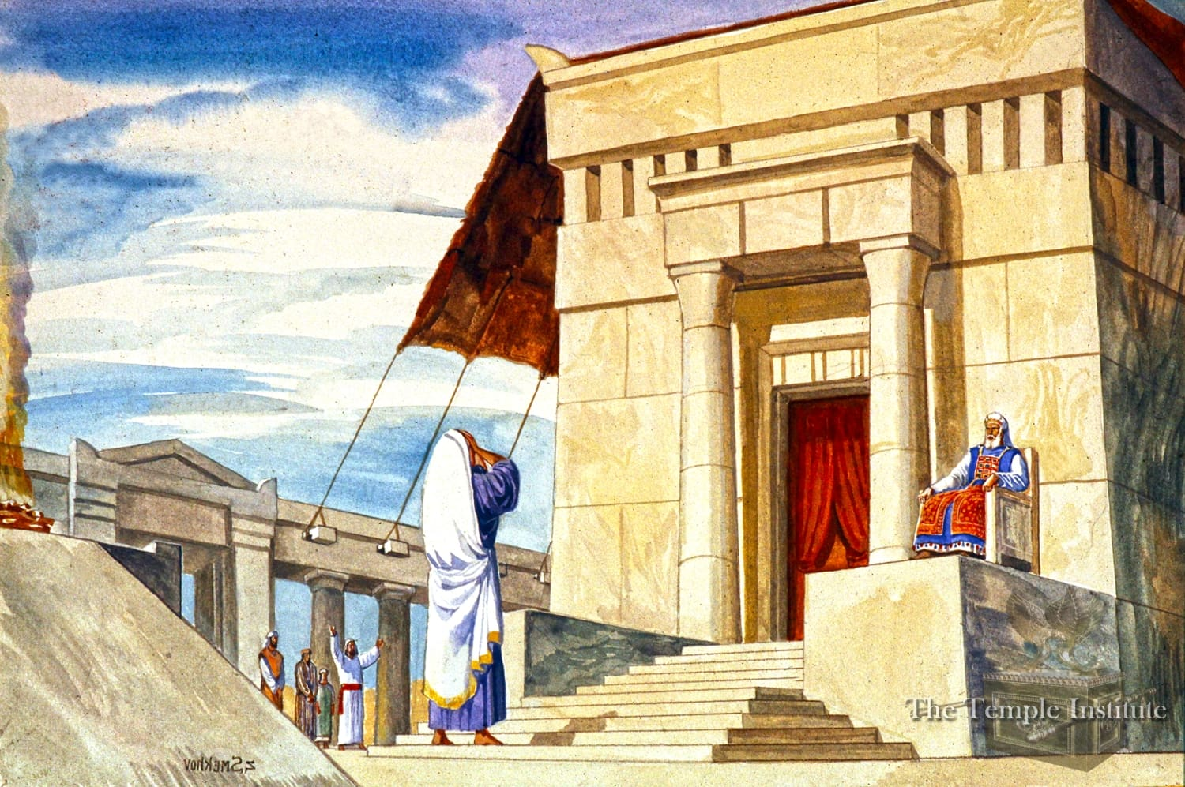
Hannah Wept Bitterly

Slide 19
1 Samuel 1:1-28
12 As she continued praying before the Lord, Eli observed her mouth. 13 Hannah was speaking in her heart; only her lips moved, and her voice was not heard. Therefore Eli took her to be a drunken woman. 14 And Eli said to her, “How long will you go on being drunk? Put your wine away from you.” 15 But Hannah answered, “No, my lord, I am a woman troubled in spirit. I have drunk neither wine nor strong drink, but I have been pouring out my soul before the Lord. 16 Do not regard your servant as a worthless woman, for all along I have been speaking out of my great anxiety and vexation.” 17 Then Eli answered, “Go in peace, and the God of Israel grant your petition that you have made to him.” 18 And she said, “Let your servant find favor in your eyes.” Then the woman went her way and ate, and her face was no longer sad.
1 Samuel 1:12-18 (ESV)
Notes:
Scripture
Hannah's faith and devotion were so strong that they rose above the misunderstanding and criticism of the nation's highest spiritual leader. When you give your best to the Lord, it's not unusual to be criticized by people who ought to encourage you. Moses was criticized by his brother and sister (Num. 12), David by his wife (2 Sam. 6:12-23), and Mary of Bethany by an apostle (John 12:1-8), yet all three were commended by the Lord. In the first four chapters of 1 Samuel, Eli comes across as a poor example of a believer, let alone a high priest. He was probably self-indulgent (4:18) and definitely tolerant of the sins of his two sons (2:22-36), and yet he was quick to judge and condemn the devotions of a godly woman. "In prayer it is better to have a heart without words, than words without a heart," said John Bunyan, and that's the way Hannah prayed.
Those who lead God's people need spiritual sensitivity so they can "rejoice with those who rejoice, and weep with those who weep" (Rom. 12:15 NKJV). Eli accused her of pouring out too much wine, when all she was doing was pouring out her soul to God in prayer (1 Sam. 1:15). Five times Hannah called herself a "handmaid," which signified her submission to the Lord and His servants. We don't read that Eli apologized to her for judging her so severely, but at least he gave her his blessing, and she returned to the feast with peace in her heart and joy on her countenance. The burden was lifted from her heart and she knew that God had answered her prayer.

Slide 20
“In prayer it is better to have a heart without words, than words without a heart.” John Bunyan
Notes:
Scripture
Hannah's faith and devotion were so strong that they rose above the misunderstanding and criticism of the nation's highest spiritual leader. When you give your best to the Lord, it's not unusual to be criticized by people who ought to encourage you. Moses was criticized by his brother and sister (Num. 12), David by his wife (2 Sam. 6:12-23), and Mary of Bethany by an apostle (John 12:1-8), yet all three were commended by the Lord. In the first four chapters of 1 Samuel, Eli comes across as a poor example of a believer, let alone a high priest. He was probably self-indulgent (4:18) and definitely tolerant of the sins of his two sons (2:22-36), and yet he was quick to judge and condemn the devotions of a godly woman. "In prayer it is better to have a heart without words, than words without a heart," said John Bunyan, and that's the way Hannah prayed.
Those who lead God's people need spiritual sensitivity so they can "rejoice with those who rejoice, and weep with those who weep" (Rom. 12:15 NKJV). Eli accused her of pouring out too much wine, when all she was doing was pouring out her soul to God in prayer (1 Sam. 1:15). Five times Hannah called herself a "handmaid," which signified her submission to the Lord and His servants. We don't read that Eli apologized to her for judging her so severely, but at least he gave her his blessing, and she returned to the feast with peace in her heart and joy on her countenance. The burden was lifted from her heart and she knew that God had answered her prayer.

Slide 21
1 Samuel 1:1-28
19 They rose early in the morning and worshiped before the Lord; then they went back to their house at Ramah. And Elkanah knew Hannah his wife, and the Lord remembered her. 20 And in due time Hannah conceived and bore a son, and she called his name Samuel, for she said, “I have asked for him from the Lord.”
21 The man Elkanah and all his house went up to offer to the Lord the yearly sacrifice and to pay his vow. 22 But Hannah did not go up, for she said to her husband, “As soon as the child is weaned, I will bring him, so that he may appear in the presence of the Lord and dwell there forever.”
1 Samuel 1:19-22 (ESV)
Notes:
COULD SKIP
Scripture
A distinguished son (1 Sam. 1:19-28). When the priests offered the burnt offering early the next morning, Elkanah and his family were there to worship God, and Hannah's soul must have been rejoicing, for she had given herself as a living sacrifice to the Lord (Rom. 12:1-2). When the family arrived home, God answered her prayers and gave her conception, and when her child was born, it was a son whom she named Samuel. The Hebrew word sa-al means "asked," and sama means "heard," and el is one of the names for God, so Samuel means "heard of God" or "asked of God." All his life, Samuel was both an answer to prayer and a great man of prayer.3
Certainly Hannah told Elkanah about her vow, because she knew that Jewish law permitted a husband to annul a wife's vow if he disagreed with it (Num. 30). Elkanah agreed with her decision and allowed her to remain at home with her son when the rest of the family went on its annual trip to Shiloh. We can't help but admire Elkanah for what he said and did, for this was his firstborn son by his beloved Hannah and father and son would be separated for the rest of their lives. A firstborn son had to be redeemed by a sacrifice (Ex. 13:11-13), but Elkanah was giving his son as a living sacrifice to the Lord. As a Levite, a Nazirite, a prophet, and a judge, Samuel would faithfully serve the Lord and Israel and help to usher in a new era in Jewish history.

Slide 22
1 Samuel 1:1-28
23 Elkanah her husband said to her, “Do what seems best to you; wait until you have weaned him; only, may the Lord establish his word.” So the woman remained and nursed her son until she weaned him. 24 And when she had weaned him, she took him up with her, along with a three-year-old bull, an ephah of flour, and a skin of wine, and she brought him to the house of the Lord at Shiloh. And the child was young. 25 Then they slaughtered the bull, and they brought the child to Eli. 26 And she said, “Oh, my lord! As you live, my lord, I am the woman who was standing here in your presence, praying to the Lord. 27 For this child I prayed, and the Lord has granted me my petition that I made to him. 28 Therefore I have lent him to the Lord. As long as he lives, he is lent to the Lord.”
1 Samuel 1:23-28 (ESV)
Notes:
COULD SKIP
Scripture
Mothers usually weaned children at the age of three, and surely during those precious years, Hannah taught her son and prepared him for serving the Lord. He did not have a personal knowledge of the Lord until later when God spoke to him (1 Sam. 3:7-10). Hannah was a woman of prayer (1:27) and taught her son to be a man of prayer. When she and Elkanah took their son to Shiloh to give him to the Lord, they brought along the necessary sacrifices so they could worship the Lord. The Authorized Version reads "three bullocks" while other translations read "a three-year-old bull" (NIV, NASB). However, the fact that the parents took a skin of wine and an ephah of meal, enough to accompany three sacrifices, suggests that three bullocks is the correct number, for three-tenths of an ephah of grain was needed for each bull sacrificed (Num. 28:12).
When Elkanah and Hannah presented their son to the Lord, Hannah reminded Eli that she was the woman who had prayed for a son three years before. Did the old man remember the occasion and did he recall how unfairly he had dealt with this sorrowing woman? If he did, there's no record of it; but he received the boy to become a servant of the Lord at the tabernacle and be trained in the law of the Lord.
Considering the low level of spiritual life in Eli and the wicked ways of his sons, it took a great deal of faith for Elkanah and Hannah to leave their innocent son in their care. But the Lord was with Samuel and would preserve him from the pollution around him. Just as God protected Joseph in Egypt, so He would protect Samuel in Shiloh, and so He can protect our children and grandchildren in this present evil world. Judgment was coming to Eli and his family, but God would have Samuel prepared to guide the nation and move them into the next stage of their development.
The story thus far makes it clear that the life and future of a nation depends on the character of the home, and the character of the home depends on the spiritual life of the parents. An African proverb says, "The ruin of a nation begins in the homes of its people," and even Confucius taught, "The strength of a nation is derived from the integrity of its homes." Eli and his sons had "religious" homes that were godless, but Elkanah and Hannah had a godly home that honored the Lord, and they gave Him their best. The future hope of the people of Israel rested with that young lad in the tabernacle learning to serve the Lord. Never underestimate the power of the home or the power of a little child dedicated to God.

Slide 23
03
God receives praise and worship
Notes:
3. God receives praise and worship (1 Sam. 2:1-11)
After Hannah left her son with Eli, she could have gone off alone and had a good cry, but instead she burst into a song of praise to the Lord. The world doesn't understand the relationship between sacrifice and song, how God's people can sing their way into sacrifice and sacrifice their way into singing. "And when the burnt offering began, the song of the Lord began also" (2 Chron. 29:27, KJV). Before He went to the garden where He would be arrested, Jesus sang a hymn with His disciples (Matt. 26:30); and Paul and Silas sang hymns to the Lord after they had been humiliated and beaten (Acts 16:20-26). Frequently in the psalms you find David praising God in the midst of difficult circumstances. After being beaten by the religious leaders in Jerusalem, the apostles "departed from the presence of the council, rejoicing that they were counted worthy to suffer shame for His name" (Acts 5:41, NKJV).
Hannah's song near the beginning of 1 Samuel should be compared with David's song found near the end of 2 Samuel (22), as well as with Mary's song in Luke 1:46-55. All three songs tell of God's grace to undeserving people, God's victory over the enemy, and the wonderful way God turns things upside down in order to accomplish His purposes. What Mary expressed in her song is especially close to what Hannah sang in her hymn of praise.

Slide 24
1 Samuel 2:1-11
1 And Hannah prayed and said,
“My heart exults in the Lord;
my horn is exalted in the Lord.
My mouth derides my enemies,
because I rejoice in your salvation.
2 “There is none holy like the Lord:
for there is none besides you;
there is no rock like our God.
3 Talk no more so very proudly,
let not arrogance come from your mouth;
for the Lord is a God of knowledge,
and by him actions are weighed.
4 The bows of the mighty are broken,
but the feeble bind on strength.
5 Those who were full have hired themselves out for bread,
but those who were hungry have ceased to hunger.
The barren has borne seven,
but she who has many children is forlorn.
6 The Lord kills and brings to life;
he brings down to Sheol and raises up.
7 The Lord makes poor and makes rich;
he brings low and he exalts.
1 Samuel 2:1-7 (ESV)
Notes:
Scripture
Chaism in the prayer for Hanna.
ADAM
[3]Hannah's Prayer (1 Sam 2:1-10)
A(2:1-2) "my horn is exalted in my God" (1S2:1)” (קרני)
B(2:3) "a God who judges deeds" (1S2:3)
C(2:4-5) Reversal
D(2:6-7) "The LORD puts to death and gives life" (1S2:6 )
C'(2:8a) Reversal
B'(2:8b-9) "He will guard the footsteps of his faithful ones, but the wicked shall perish in the darkness" (1S2:9)
A'(2:10) "exalt the horn of his anointed" (1S2:10)"
(קרן)

Slide 25
1 Samuel 2:1-11
8 He raises up the poor from the dust;
he lifts the needy from the ash heap
to make them sit with princes
and inherit a seat of honor.
For the pillars of the earth are the Lord's,
and on them he has set the world.
9 “He will guard the feet of his faithful ones,
but the wicked shall be cut off in darkness,
for not by might shall a man prevail.
10 The adversaries of the Lord shall be broken to pieces;
against them he will thunder in heaven.
The Lord will judge the ends of the earth;
he will give strength to his king
and exalt the horn of his anointed.”
11 Then Elkanah went home to Ramah. And the boy was ministering to the Lord in the presence of Eli the priest.
1 Samuel 2:8-11 (ESV)
Notes:
Scripture
This is a structured thanksgiving psalm but rather than ending with an appeal for other to worship…it ends with a prayer for the welfare of the king.

Slide 26

Why is this important at the beginning of Samuel?
The Lord kills and brings to life;
he brings down to Sheol and raises up.
The Lord makes poor and makes rich;
he brings low and he exalts.
Notes:
I Samuel 2: 6-7

Slide 27
1 Samuel 2:1-11
1 And Hannah prayed and said,
“My heart exults in the Lord;
my horn is exalted in the Lord.
My mouth derides my enemies,
because I rejoice in your salvation.
2 “There is none holy like the Lord:
for there is none besides you;
there is no rock like our God.
3 Talk no more so very proudly,
let not arrogance come from your mouth;
for the Lord is a God of knowledge,
and by him actions are weighed.
4 The bows of the mighty are broken,
but the feeble bind on strength.
5 Those who were full have hired themselves out for bread,
but those who were hungry have ceased to hunger.
The barren has borne seven,
but she who has many children is forlorn.
6 The Lord kills and brings to life;
he brings down to Sheol and raises up.
7 The Lord makes poor and makes rich;
he brings low and he exalts.
1 Samuel 2:1-7 (ESV)
Notes:
COULD SKIP
Scripture
The joy of the Lord (1 Sam. 2:1). Hannah was praying and rejoicing at the same time! She was thinking of God's blessing to the nation of Israel as well as to herself and her home. When prayer is selfish it isn't spiritual and it does not honor the Lord. Hannah knew in her heart that God was going to do great things for His people and that her son would play an important part in accomplishing God's will. Her worship came from her heart and was saturated with the joy of the Lord.
The word "horn" in verses 1 and 10 symbolizes strength or a strong person (see Pss. 75:4-5, 10; 89:17, 24; 92:10; 132:17). To have your "horn exalted" meant to receive new strength from God and be especially helped by Him at a time of crisis. An "enlarged mouth" means a mouth boasting of God's victory over His enemies. Defeated people have to keep their mouths shut, but those who share God's victory have something to talk about to the glory of God.
"I rejoice in thy salvation" suggests more than Hannah's being delivered from barrenness. Hannah sees this miracle as the beginning of new victory for Israel who time after time had been invaded, defeated, and abused by their enemies (Jud. 2:10-23). But the word "salvation" is yeshua-Joshua-one of the names of the promised Messiah. King David would be God's yeshua to deliver Israel from her enemies, and Jesus the Son of David would be God's yeshua to deliver all people from the bondage of sin and death.
The majesty of the Lord (1 Sam. 2:2-3). It's good for us to begin our praying with praising, because praise helps us focus on the glory of the Lord and not on the greatness of our needs. When we see the greatness of God, we start to see life in perspective. Hannah knew the character of God and exalted His glorious attributes. She began by affirming His holiness and uniqueness. The two go together because in both Hebrew and Greek the word "holy" means "wholly other, set apart, separated." Orthodox Jews confess daily, "Hear, O Israel: the Lord our God is one Lord" (Deut. 6:4, KJV). There is no other God, and whenever Israel turned to idols for help, they lost the blessing of the Lord.
The "Rock" is one of the repeated images of the Lord in the Scriptures. It's found in the "Song of Moses" (Deut. 32:4, 15, 18, 30-31, 37) and in David's song (2 Sam. 22:32). The rock speaks of the Lord's strength, stability, and steadfastness and magnifies the fact that He does not change. We can depend on Him, for His character is unchangeable and His promises never fail. "For I am the Lord, I change not" (Mal. 3:6 KJV).
The Lord is also "a God of knowledge" (1 Sam. 2:3), so people had better be careful what they say and how they say it. There's no place for pride and arrogance when you stand before a God who knows you through and through, everything you've thought, spoken, and done. God heard all of Peninnah's haughty words spoken against Hannah, and He also heard Hannah's prayer from her heart. God is omniscient and knows all things, and He is omnipresent and beholds all things.
Hannah rejoiced because this holy God is a just judge of the actions of His people. Unlike the people involved in human judicial proceedings, the Lord knows everything and is able to weigh us and our actions accurately. He weighed Belshazzar and found him "wanting" (Dan. 5:27). The Lord weighs our motives (Prov. 16:2) and our hearts (24:11-12), and His scales are accurate. Like Hannah, we may be misunderstood and maligned by people, but the Lord will always act justly.
The grace of the Lord (1 Sam. 2:4-8a). God is holy and just and is always true to His Word and His character. But He is also merciful and gracious and often does things that catch us by surprise. Hannah described some of His acts and affirmed that the Lord turned everything upside down! The "Song of Mary" (The Magnificat) in Luke 1:46-55 expresses some of these same truths.
The mighty warriors fail while the stumbling weaklings win the battle (1 Sam. 2:4; see Ecc. 9:11). The rich people with plenty of food are looking for something to eat and are willing to labor for it, while the poor hungry people have more than they need (1 Sam. 2:5a). The barren woman gives birth to seven children, while the woman with many children is exhausted and feeble and can't even enjoy her family (v. 5b). The truth in this statement is reflected in the fact that Hannah bore five more children (v. 21).
Because He is sovereign, the Lord is in charge of life and death and everything in between (v. 6). He can rescue us from the grave or permit us to die. If He allows us to live, He can make us rich or poor, exalted or abased, for He knows what's best. This doesn't suggest that people should meekly comply with difficult circumstances and do nothing about them, but that we can't change these circumstances without the Lord's help (Deut. 8:18). In His grace, God can choose the poor and raise them up to sit among the princes (see Ps. 113:7-8 and Luke 1:52). He takes them from the dust and the garbage heap and puts them on glorious thrones! But isn't that what God did for Jesus (Phil. 2:1-10) and what Jesus did for us when He saved us? (Eph. 2:1-10) Indeed, because of the cross, the Lord has "turned the world upside down" (Acts 17:6), and the only people who have clear vision and true values are those who have trusted Jesus.

Slide 28
1 Samuel 2:1-11
8 He raises up the poor from the dust;
he lifts the needy from the ash heap
to make them sit with princes
and inherit a seat of honor.
For the pillars of the earth are the Lord's,
and on them he has set the world.
9 “He will guard the feet of his faithful ones,
but the wicked shall be cut off in darkness,
for not by might shall a man prevail.
10 The adversaries of the Lord shall be broken to pieces;
against them he will thunder in heaven.
The Lord will judge the ends of the earth;
he will give strength to his king
and exalt the horn of his anointed.”
11 Then Elkanah went home to Ramah. And the boy was ministering to the Lord in the presence of Eli the priest.
1 Samuel 2:8-11 (ESV)
Notes:
COULD SKIP
Scripture
This is a structured thanksgiving psalm but rather than ending with an appeal for other to worship…it ends with a prayer for the welfare of the king.
The protection of the Lord (1 Sam. 2:8b-10a). God has established the world so that it can't be moved, and what happens on our planet is under His watchful care." We may think that God has abandoned the earth to Satan and his demonic powers, but this is still our Father's world (Ps. 24:1-2), and He has set His King on heaven's throne (Ps. 2:7-9). As God's people walk on this earth and walk in the light, the Lord will guard and guide their steps, but the wicked will walk in spiritual darkness because they depend on their own wisdom and strength. It may seem that the wicked "have it made," but one day the storm of God's wrath will burst upon them in fierce judgment. God is long-suffering with those who resist Him, but their day is coming.
The reign of the Lord (1 Sam. 2:10b). This is a remarkable statement that the Lord will give an anointed king to Israel and strengthen him to serve Him and the nation. Hannah certainly knew the Law of Moses because in them she found the promises of a future king. God told Abraham and Sarah that kings would come from them (Gen. 17:6, 16), and He repeated this promise to Jacob (35:11). In his last words to his sons, Jacob announced that Judah would be the royal tribe (49:10); and in Deuteronomy 17:14-20, Moses gave instructions concerning a future king. When Israel asked for a king, God was prepared to grant their request. In many respects, King David fulfilled this prophecy; but the ultimate fulfillment is in Jesus the Christ ("Anointed One") who will one day sit on David's throne and rule over His glorious kingdom (Luke 1:32-33, 69-75).
Hannah and Elkanah left their son in Shiloh and returned to Ramah with joyful hearts and great expectation to see what the Lord would do. What a wonderful thing it is when a husband and wife are dedicated to the Lord, worship Him together, pray together, and trust His Word. Hannah went to the place of worship with a broken heart, but the Lord gave her peace because she prayed and submitted to His will.

Slide 29
04
God judges sin
Notes:
4. God judges sin (1 Sam. 2:12-36)
Up to this point, the focus has been on Elkanah and his family (1:1-2:11), but now it will shift to Eli and his family (2:12-3:21). Throughout this section, you will see a deliberate contrast between Samuel and the two sons of Eli, Hophni and Phinehas. Eli's sons "abhorred the offering of the Lord" (2:17), but "Samuel ministered before the Lord" (v. 18). The two brothers committed evil deeds at the tabernacle and invited God's judgment, but Samuel served at the tabernacle and grew in God's favor (v. 26). The priestly line would end in Eli's family, but Samuel would be called of God to carry on a holy priesthood (2:34-3:1). From the human viewpoint, it looked as though Eli's evil sons were getting away with their disobedience, but God was preparing judgment for them while He was equipping His servant Samuel to continue His work.

Slide 30
1 Samuel 2:12-36
12 Now the sons of Eli were worthless men. They did not know the Lord. 13 The custom of the priests with the people was that when any man offered sacrifice, the priest's servant would come, while the meat was boiling, with a three-pronged fork in his hand, 14 and he would thrust it into the pan or kettle or cauldron or pot. All that the fork brought up the priest would take for himself. This is what they did at Shiloh to all the Israelites who came there. 15 Moreover, before the fat was burned, the priest's servant would come and say to the man who was sacrificing, “Give meat for the priest to roast, for he will not accept boiled meat from you but only raw.” 16 And if the man said to him, “Let them burn the fat first, and then take as much as you wish,” he would say, “No, you must give it now, and if not, I will take it by force.” 17 Thus the sin of the young men was very great in the sight of the Lord, for the men treated the offering of the Lord with contempt.
1 Samuel 2:12-17 (ESV)
Notes:
ADAM
Worthless Men vs Worthless Hannah
Acts of Change in determining God’s will
Joshua 14:2
These are the inheritances that the people of Israel received in the land of Canaan, which Eleazar the priest and Joshua the son of Nun and the heads of the fathers' houses of the tribes of the people of Israel gave them to inherit. 2 Their inheritance was by lot, just as the Lord had commanded by the hand of Moses for the nine and one-half tribes.
Jonah 1:7
And they said to one another, “Come, let us cast lots, that we may know on whose account this evil has come upon us.” So they cast lots, and the lot fell on Jonah.
Scripture
God's judgment deserved (1 Sam. 2:12-21). Since Eli was an old man with failing vision (4:15), he left the work of the tabernacle to his two sons, and they took advantage of their father by doing what they pleased. Hophni and Phinehas did not personally know the Lord but were "sons of Belial," a Hebrew term that described worthless people who openly practiced lawlessness (Deut. 13:13; Jud. 19:22; 1 Sam. 25:25; Prov. 16:27). In 2 Corinthians 6:15, Paul uses Belial as a synonym for Satan. The law stated precisely what portions of the sacrifices belonged to the priests (Lev. 7:28- 36; 10:12-15; Deut. 18:1-5), but the two brothers took the meat that they wanted and also took the fat parts that belonged to the Lord. They even took raw meat so they could roast it and not have to eat boiled meat. They "abhorred the offering of the Lord" (1 Sam. 2:17) and "trampled on" (scorned) the Lord's sacrifices (v. 29).
Hophni and Phinehas not only showed disrespect for the sacrifices on the altar, but they also had no regard for the women who served at the door of the tabernacle (v. 22; Ex. 38:8). Instead of encouraging them in their spiritual walk, the two brothers seduced them. These women were not official servants appointed by the law but were volunteers who assisted the priests and Levites. Perhaps they helped care for the little children who came with the adult worshipers, or they may have been there just to be close to the presence of the Lord. Ministerial immorality is in the news today, and it's a tragic thing, but it's really nothing new.

Slide 31
1 Samuel 2:12-36
18 Samuel was ministering before the Lord, a boy clothed with a linen ephod. 19 And his mother used to make for him a little robe and take it to him each year when she went up with her husband to offer the yearly sacrifice. 20 Then Eli would bless Elkanah and his wife, and say, “May the Lord give you children by this woman for the petition she asked of the Lord.” So then they would return to their home.
21 Indeed the Lord visited Hannah, and she conceived and bore three sons and two daughters. And the boy Samuel grew in the presence of the Lord.
1 Samuel 2:18-21 (ESV)
Notes:
Scripture
In contrast to the wickedness of Eli's sons is the faithfulness of Samuel (1 Sam. 2:18-21). He was somewhat of an apprentice priest, learning the work of the sanctuary, and even wore a linen robe with an ephod (vest) over it, just as the adult priests and Levites did. Each year when his parents came to Shiloh, his mother would bring a new set of garments for the growing lad. In Scripture, garments often speak of the spiritual life (Isa. 61:10; Zech. 3:1-5; Eph. 4:22-32; Col. 3:8-17; 1 Peter 5:5), and a change of clothing symbolizes a new beginning (Gen. 35:2; 41:14; 45:22; Ex. 19:10; Rev. 3:18). Each year's new garments spoke not only of a boy growing physically but also spiritually (1 Sam. 2:21), and this reminds us of our Lord who "increased in wisdom and stature, and in favor with God and men" (Luke 2:52, NKJV).
God was about to bring judgment to the house of Eli, but the Lord blessed Elkanah and Hannah and their house, for He gave her five more children (1 Sam. 2:21; see Ps. 113:9). This was the gracious gift of God and an answer to the prayer of Eli (1 Sam. 2:20) who was pleased with Samuel and grateful for his ministry. Hannah gave one child to the Lord and the Lord gave back five!

Slide 32
1 Samuel 2:12-36
22 Now Eli was very old, and he kept hearing all that his sons were doing to all Israel, and how they lay with the women who were serving at the entrance to the tent of meeting. 23 And he said to them, “Why do you do such things? For I hear of your evil dealings from all these people. 24 No, my sons; it is no good report that I hear the people of the Lord spreading abroad. 25 If someone sins against a man, God will mediate for him, but if someone sins against the Lord, who can intercede for him?” But they would not listen to the voice of their father, for it was the will of the Lord to put them to death.
26 Now the boy Samuel continued to grow both in stature and in favor with the Lord and also with man.
1 Samuel 2:22-26 (ESV)
Notes:
Scripture
ART Talk about the sins of the brothers
God's judgment disregarded (1 Sam. 2:22-26). Hophni and Phinehas not only showed disrespect for the sacrifices on the altar, but they also had no regard for the women who served at the door of the tabernacle (v. 22; Ex. 38:8). Instead of encouraging them in their spiritual walk, the two brothers seduced them. These women were not official servants appointed by the law but were volunteers who assisted the priests and Levites. Perhaps they helped care for the little children who came with the adult worshipers, or they may have been there just to be close to the presence of the Lord. Ministerial immorality is in the news today, and it's a tragic thing, but it's really nothing new.
Godly people told Eli about his sons' sins, and he spoke to them about their conduct, but it did no good. He wasn't much of a godly father or spiritual leader, and his sons disregarded his warnings. It's tragic when a father-and a spiritual leader at that-loses his influence over his own family and can only wait for God's hand of judgment to fall. Lot lost his influence with his family (Gen. 19:12- 14), and after David sinned with Bathsheba, his influence over his sons was greatly weakened. Hophni and Phinehas had no respect for the Lord or for the office of their father the high priest, so all God could do was judge them and replace them with faithful servants.
ADAM
Call attention to ‘If someone sins against the Lord who can intercede for him”

Slide 33
1 Samuel 2:12-36
27 And there came a man of God to Eli and said to him, “Thus says the Lord, ‘Did I indeed reveal myself to the house of your father when they were in Egypt subject to the house of Pharaoh? 28 Did I choose him out of all the tribes of Israel to be my priest, to go up to my altar, to burn incense, to wear an ephod before me? I gave to the house of your father all my offerings by fire from the people of Israel. 29 Why then do you scorn my sacrifices and my offerings that I commanded for my dwelling, and honor your sons above me by fattening yourselves on the choicest parts of every offering of my people Israel?’ 30 Therefore the Lord, the God of Israel, declares: ‘I promised that your house and the house of your father should go in and out before me forever,’ but now the Lord declares: ‘Far be it from me, for those who honor me I will honor, and those who despise me shall be lightly esteemed.
1 Samuel 2:27-30 (ESV)
Notes:
Scripture
God's judgment declared (1 Sam. 2:27-36). An anonymous "man of God'' appeared at Shiloh to declare the terms of God's judgment on Eli and his family. The title "man of God'' is used some seventy times in the Old Testament and usually refers to a prophet sent by the Lord. First, the prophet dealt with the past (vv. 27-28) and reminded Eli that his position as high priest was a gift of God's grace. The Lord had chosen Aaron to be the first high priest and given him the privilege of passing this honor on to his eldest son (Ex. 4:14-16; 28:1-4). It was a privilege for the high priest and his sons to offer sacrifices on the brazen altar, burn incense on the golden altar, wear the sacred garments, and eat of the holy offerings. Then the messenger focused on the present (1 Sam. 2:29) and accused Eli of putting his sons ahead of the Lord and sharing in their sins. (The "you" at the beginning of v. 29 is plural and includes Eli with his sons.) To tolerate sin and not deal with it severely is to participate in that sin. As high priest, Eli had the authority to discipline his sons, but he refused to do so. "Do not share in the sins of others" (1 Tim. 5:22 NIV). If Eli had been a man of God, concerned for the glory of God, he would have remonstrated with his sons and called them to repent; and if they refused, he would have replaced them.

Slide 34
1 Samuel 2:12-36
31 Behold, the days are coming when I will cut off your strength and the strength of your father's house, so that there will not be an old man in your house. 32 Then in distress you will look with envious eye on all the prosperity that shall be bestowed on Israel, and there shall not be an old man in your house forever. 33 The only one of you whom I shall not cut off from my altar shall be spared to weep his eyes out to grieve his heart, and all the descendants of your house shall die by the sword of men. 34 And this that shall come upon your two sons, Hophni and Phinehas, shall be the sign to you: both of them shall die on the same day. 35 And I will raise up for myself a faithful priest, who shall do according to what is in my heart and in my mind. And I will build him a sure house, and he shall go in and out before my anointed forever. 36 And everyone who is left in your house shall come to implore him for a piece of silver or a loaf of bread and shall say, “Please put me in one of the priests' places, that I may eat a morsel of bread.”’”
1 Samuel 2:31-36 (ESV)
Notes:
Scripture
But the burden of the prophet's message was centered on the future (1 Sam. 2:30-36). God had given the priesthood to Aaron and his descendants forever, and nobody could take this honor (Ex. 29:9; 40:15; Num. 18:7; Deut. 18:5). However, God's servants can't live any way they please and expect the Lord to honor them; for "them who honor me I will honor" (1 Sam. 2:30). The privilege of the priesthood would remain with the tribe of Levi and the house of Aaron, but God would take it away from Eli's branch of the family. Eli's descendants would become weak and die off and there would be no more old men like Eli in the family. They would have to beg for their food and would plead for an opportunity to serve (v. 36). In David's day the descendants of Eleazar outnumbered those of Ithamar at least two to one Chron. 24:1-5), so Eli's family did slowly die out. But even worse, very soon Eli's two pampered sons would die on the same day. Even the tabernacle would experience distress (1 Sam. 2:32, NIV), which turned out to include the capture of the ark and ultimately the moving of the tabernacle from Shiloh to Nob (21:1- 6; Jer. 7:14). However, at Nob many of the priests were slain by Doeg, which was a partial fulfillment of this prophecy.
Eli descended from Aaron through Ithamar, Aaron's fourth son, but God would abandon that line and turn to the sons of Eleazar, Aaron's third son and successor in the high priesthood." Under David, both Zadok and Abiathar served as high priests (2 Sam. 8:17), but when Solomon became king, he removed Eli's great-great grandson Abiathar from the high priesthood because he had cooperated with David's son Adonijah in his attempt to seize the throne. Solomon appointed Zadok to serve as high priest, and he was of the house of Eleazar. (See 1 Kings 2:26-27, 35.) In the list of Jewish high priests in 1 Chronicles 6:3-15, the names from Eli to Abiathar are missing. By confirming Zadok as high priest, Solomon fulfilled the prophecy given by the man of God nearly a century and a half before."
But the future wasn't all bleak, for the man of God announced that God would raise up a faithful priest who would please God's heart and do God's will (1 Sam. 2:35). The immediate reference is to Zadok, but ultimately it points to Jesus Christ who alone could have a "sure house" and be God's anointed priest "forever." Our Lord came from the tribe of Judah, so He had no connection with the house of Aaron, but was made a high priest after the order of Melchizedek (Heb. 7-8).

Slide 35
Aaron
Eleazar
Ithamar
Phinehas
Eli
Hophni
Phinehas
Ahitub
Ichabod
Ahitub
Ahijah
Ahimelech
Zadok
Abiathar
Notes:
https://www.jesuswalk.com/david/genealogy_of_the_priesthood_in_davids_time.htm
Ithamar: 1 Chronicles 24:1-6
The divisions of the sons of Aaron were these. The sons of Aaron: Nadab, Abihu, Eleazar, and Ithamar. 2 But Nadab and Abihu died before their father and had no children, so Eleazar and Ithamar became the priests.
Icabod: 1 Samuel 4:21
And she named the child Ichabod, saying, “The glory has departed from Israel!” because the ark of God had been captured and because of her father-in-law and her husband.
Ahitub the Younger: 1 Chronicles 6:4-8
Eleazar fathered Phinehas, Phinehas fathered Abishua, 5 Abishua fathered Bukki, Bukki fathered Uzzi, 6 Uzzi fathered Zerahiah, Zerahiah fathered Meraioth, 7 Meraioth fathered Amariah, Amariah fathered Ahitub, 8 Ahitub fathered Zadok
Ahijah: 1 Sam 14: 1-3
One day Jonathan the son of Saul said to the young man who carried his armor, “Come, let us go over to the Philistine garrison on the other side.” But he did not tell his father. 2 Saul was staying in the outskirts of Gibeah in the pomegranate cave at Migron. The people who were with him were about six hundred men, 3 including Ahijah the son of Ahitub, Ichabod's brother, son of Phinehas, son of Eli, the priest of the Lord in Shiloh, wearing an ephod.
Ahimelech: 1 Sam 22:11
Then the king sent to summon Ahimelech the priest, the son of Ahitub, and all his father's house

Slide 36
05
God rewards faithfulness
Notes:
5. God rewards faithfulness (1 Sam. 3:1-21)
Once again we see the contrast between the wickedness of Eli's family and the faithfulness of the boy Samuel (v. 1). He ministered before the Lord under the guidance of Eli at a time when God wasn't speaking to His people very often. The spiritual leaders were corrupt, and God's people weren't obeying His law anyway, so why should God say anything new to them? It was a tragic day in the nation of Israel when the living God no longer sent His people signs and prophetic messages (Ps. 74:9; Ezek. 7:26; Amos 8:11-12; Micah 3:6). The silence of God was the judgment of God.
But God was about to change the situation and speak His precious Word to a young boy who would listen and obey.

Slide 37
1 Samuel 3:1-21
1 Now the boy Samuel was ministering to the Lord in the presence of Eli. And the word of the Lord was rare in those days; there was no frequent vision.
2 At that time Eli, whose eyesight had begun to grow dim so that he could not see, was lying down in his own place. 3 The lamp of God had not yet gone out, and Samuel was lying down in the temple of the Lord, where the ark of God was.
4 Then the Lord called Samuel, and he said, “Here I am!” 5 and ran to Eli and said, “Here I am, for you called me.” But he said, “I did not call; lie down again.” So he went and lay down.
1 Samuel 3:1-5 (ESV)
Notes:
An attentive ear (1 Sam. 3:1-9). Samuel was probably twelve years old when the Lord spoke to him one night as he lay in the tabernacle "annex" where Eli was also sleeping. The "lamp of God" was the seven-branched golden candlestick that stood in the holy place before the veil, to the left of the golden altar of incense (Ex. 25:31-40; 27:20-21; 37:17-24). It was the only source of light in the holy place, and the priests were ordered to keep it burning always (27:20) and to trim the wicks when they offered the incense each morning and evening (30:7-8). The lamp was a symbol of the light of God's truth given to the world through His people Israel. Alas, the light of God's Word was burning dimly in those days, and God's high priest was barely able to see! The ark was there, containing the law of God (25:10-22; 37:1-9; Heb. 9:1-5), but the law was not honored by God's people.
Adam
The first mention of the ark in I Samuel. I find it interesting that Samuel doesn't know the Lord and doesn’t equate the Lord and his presence with the Ark. As we’ll see in the following chapters when the israelites lose the Ark in battle.

Slide 38
1 Samuel 3:1-21
6 And the Lord called again, “Samuel!” and Samuel arose and went to Eli and said, “Here I am, for you called me.” But he said, “I did not call, my son; lie down again.” 7 Now Samuel did not yet know the Lord, and the word of the Lord had not yet been revealed to him.
8 And the Lord called Samuel again the third time. And he arose and went to Eli and said, “Here I am, for you called me.” Then Eli perceived that the Lord was calling the boy. 9 Therefore Eli said to Samuel, “Go, lie down, and if he calls you, you shall say, ‘Speak, Lord, for your servant hears.’” So Samuel went and lay down in his place.
1 Samuel 3:6-9 (ESV)
Notes:
The Lord spoke to Samuel four times (1 Sam. 3:4, 6, 8, 10), and the first three times, Samuel thought it was Eli calling him. One of the marks of a faithful servant is an attentive ear and an immediate response. But Samuel had never heard God's voice, so he didn't know who was calling to him. Like Saul of Tarsus, Samuel's call and conversion occurred at the same time, except that Samuel's experience was at night while Saul saw a blazing light when he heard God's voice (Acts 9:1-9). Eli was discerning enough to realize that God was speaking to the boy, so he told him how to respond.

Slide 39
1 Samuel 3:1-21
10 And the Lord came and stood, calling as at other times, “Samuel! Samuel!” And Samuel said, “Speak, for your servant hears.” 11 Then the Lord said to Samuel, “Behold, I am about to do a thing in Israel at which the two ears of everyone who hears it will tingle. 12 On that day I will fulfill against Eli all that I have spoken concerning his house, from beginning to end. 13 And I declare to him that I am about to punish his house forever, for the iniquity that he knew, because his sons were blaspheming God, and he did not restrain them. 14 Therefore I swear to the house of Eli that the iniquity of Eli's house shall not be atoned for by sacrifice or offering forever.”
1 Samuel 3:10-14 (ESV)
Notes:
An obedient will (1 Sam. 3:10-14). Samuel obeyed Eli, went back to his sleeping place, and waited for the voice to come again. This time God spoke the boy's name twice, for the Shepherd calls His sheep by name and gets their attention (John 10:3, 14). Not only that, the Lord came and stood near Samuel as He spoke to him. This experience wasn't a dream or a vision but a manifestation of the presence of the Lord. Samuel's response was, "Speak, for your servant is listening" (1 Sam. 3:10, NIV), and he left out the word, "Lord" (see v. 9). Why? Samuel didn't yet have a personal knowledge of the Lord (v. 7), so he couldn't know whose voice it was that had spoken to him. Perhaps he was being careful not to accept it as the voice of Jehovah when he had no way to be sure.
Because Samuel was obedient to God and to Eli, he heard the message from the Lord and learned what God planned to do. This was certainly a weighty message to give to a young boy, but in so doing, perhaps God was rebuking the spiritual lethargy of the adults, for to which of them could God give this message? When God can't find an obedient adult, He sometimes calls a child. "And I will make mere lads their princes" (Isa. 3:4, NASB).
Samuel didn't know the message the unknown prophet had delivered to Eli, but the message God gave him confirmed it. The Lord would judge the house of Eli because Eli's two sons "made themselves vile [contemptible]" and Eli did nothing to restrain them. Though Eli and his sons were priests, they could offer no sacrifice that would atone for their sins! Their sins were deliberate and defiant, and for such sins no sacrifice could be offered (Num. 15:30). Not only had they defiled themselves, but they had also defiled the priesthood. The Lord had been long-suffering toward the house of Eli, but they hadn't repented and turned from their sins;now it was too late.
TINGLE
2 Kings 21:12
therefore thus says the Lord, the God of Israel: Behold, I am bringing upon Jerusalem and Judah such disaster that the ears of everyone who hears of it will tingle.

Slide 40
Aaron
Eleazar
Ithamar
Phinehas
Eli
Hophni
Phinehas
Ahitub
Ichabod
Ahitub
Ahijah
Ahimelech
Zadok
Abiathar
Notes:
https://www.jesuswalk.com/david/genealogy_of_the_priesthood_in_davids_time.htm
Ithamar: 1 Chronicles 24:1-6
The divisions of the sons of Aaron were these. The sons of Aaron: Nadab, Abihu, Eleazar, and Ithamar. 2 But Nadab and Abihu died before their father and had no children, so Eleazar and Ithamar became the priests.
Icabod: 1 Samuel 4:21
And she named the child Ichabod, saying, “The glory has departed from Israel!” because the ark of God had been captured and because of her father-in-law and her husband.
Ahitub the Younger: 1 Chronicles 6:4-8
Eleazar fathered Phinehas, Phinehas fathered Abishua, 5 Abishua fathered Bukki, Bukki fathered Uzzi, 6 Uzzi fathered Zerahiah, Zerahiah fathered Meraioth, 7 Meraioth fathered Amariah, Amariah fathered Ahitub, 8 Ahitub fathered Zadok
Ahijah: 1 Sam 14: 1-3
One day Jonathan the son of Saul said to the young man who carried his armor, “Come, let us go over to the Philistine garrison on the other side.” But he did not tell his father. 2 Saul was staying in the outskirts of Gibeah in the pomegranate cave at Migron. The people who were with him were about six hundred men, 3 including Ahijah the son of Ahitub, Ichabod's brother, son of Phinehas, son of Eli, the priest of the Lord in Shiloh, wearing an ephod.
Ahimelech: 1 Sam 22:11
Then the king sent to summon Ahimelech the priest, the son of Ahitub, and all his father's house

Slide 41
1 Samuel 3:1-21
15 Samuel lay until morning; then he opened the doors of the house of the Lord. And Samuel was afraid to tell the vision to Eli. 16 But Eli called Samuel and said, “Samuel, my son.” And he said, “Here I am.” 17 And Eli said, “What was it that he told you? Do not hide it from me. May God do so to you and more also if you hide anything from me of all that he told you.” 18 So Samuel told him everything and hid nothing from him. And he said, “It is the Lord. Let him do what seems good to him.”
1 Samuel 3:15-18 (ESV)
Notes:
A humble heart (1 Sam. 3:15-18). Samuel had heard the voice of God and received the message of God, but he still got up early and went back to his old tasks. He opened the doors of the sanctuary so the people could come to sacrifice,' and he said nothing to Eli about what God had told him. This shows remarkable maturity on the part of a young boy. Most youths would have been proud of their experience with the Lord, rushed around delivering the message, and would not have stooped to open doors. It was only when Eli commanded him that Samuel related the message of judgment that God had given to him.
Was Eli's response to the message active submission or passive resignation to something that couldn't be changed? I vote for resignation, the same attitude that Hezekiah displayed when Isaiah told him his foolish actions would one day bring ruin to the kingdom of Judah (Isa. 39). Eli was an old man who had not been a good father or a faithful priest, and he had already been warned that judgment was coming. His two sons would perish in one day and his family would lose the privilege of the priesthood, so what was there to live for? God had chosen Samuel to be judge, priest, and prophet, so the light of truth would keep burning in Israel. All the old man could do was to wait patiently for the sword to fall.
Eli had his faults as we all do, and we must appreciate his positive attitude toward young Samuel, his successor as the spiritual leader in Israel. It isn't every veteran servant who can graciously lay down his tools and let the young apprentice take over. Until the very end of his life, Eli at least had a concern for the ark of God and the future of the nation; and the news of Israel's defeat and the capture of the ark caused his death. If Eli had shown some of this concern when his sons were young like Samuel, things would have been different.
Adam
Eli is the same man who said
“1Sam 2:25 “If someone sins against a man, God will mediate for him, but if someone sins against the Lord, who can intercede for him?””
David has similar sentiment:
2 Sam 15:24-26
24 And Abiathar came up, and behold, Zadok came also with all the Levites, bearing the ark of the covenant of God. And they set down the ark of God until the people had all passed out of the city. 25 Then the king said to Zadok, “Carry the ark of God back into the city. If I find favor in the eyes of the Lord, he will bring me back and let me see both it and his dwelling place. 26 But if he says, ‘I have no pleasure in you,’ behold, here I am, let him do to me what seems good to him.”

Slide 42
1 Samuel 3:1-21
19 And Samuel grew, and the Lord was with him and let none of his words fall to the ground. 20 And all Israel from Dan to Beersheba knew that Samuel was established as a prophet of the Lord. 21 And the Lord appeared again at Shiloh, for the Lord revealed Himself to Samuel at Shiloh by the word of the Lord.
1 Samuel 3:19-21 (ESV)
Notes:
A godly walk (1 Sam. 3:19-21). For the second time we're told that Samuel grew (2:21; 3:19), but the affirmation is added, "the Lord was with him." This statement will also be made about youthful David (16:18; 18:12, 14). The Lord was against Eli and his sons, but His blessing was upon Samuel and his ministry. Unlike the other judges, Samuel's words and influence would reach the entire nation. The people recognized that God had called Samuel to be a prophet and declare the Word of God and the will of God. Once again, the Lord appeared from time to time at Shiloh and revealed Himself to His prophet. Israel was about to experience a new beginning that would lead to new challenges and dangers as well as new blessings and victories.

